Slide 1
An Undergraduate Curriculum Infused with Parallelism
Vijay Pai (PI), Deborah Bennett, Cordelia Brown, Yung Lu, Sam Midkiff
smidkiff@purdue.edu

Slide 2
Let’s start off pessimistically
I’ve been involved in two or three of these workshops, and the comment I’ve heard from industrial participants is
I don’t care if your students know how to do parallel programming – we can teach them that – what I care about is that they can think critically and come up with solutions. And they often cannot.
The bad news that we should all keep in mind is that critical thinking and creativity, including thinking outside the box, examining programs for the possibility of the unexpected, are largely dependent on critical thinking.

Slide 3
A contrary opinion
Can we follow the National Labs & Fortran model, or what appears to be the Google model
  The labs assume you don’t know Fortran when they hire you, and teach it
  Google seems to assume that if you are a smart hardworking you will be a good Googlean
Use the parallelism time to practice and “teach” critical thinking – senior design courses in engineering
I believe concurrency and parallelism are more fundamental than, e.g., programming language choice, but I’m biased. However, reality exists outside of my biases, so I may be right and biased.

Slide 4
The challenge in an CE Curriculum
We teach C as the intro course for good reasons
The student have very few “easy” classes
  Schedule is full
  Few courses that are not hardcore EE or CE
  Average graduation time is > 8 semesters
Many EE classes are first class citizens in the curriculum, and are mandated by ABET
  Also 15 – 18 hours of math
  Curriculum changes go through the department
  This is often good, about ½ of our graduates design and program microcontrollers and small systems interacting w/hardware
  Need to be at least tolerable ECEs at the end of four years

Slide 5
How did we tackle the problem?
Iteratively
  Considered what we needed to teach
  Looked at courses we could teach them in
  Look at what was undone, or was crucial enough to be repeated in other courses
  Goto 2
Because of the parallel nature of systems, increased emphasis is sometimes adequate
Implementation is a work in progress

Slide 6
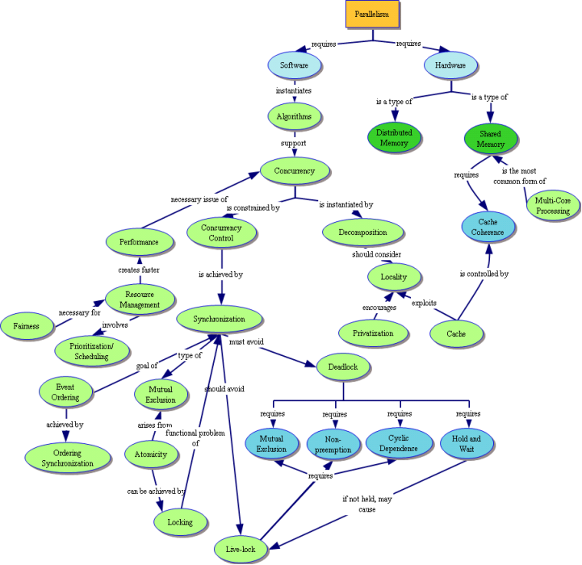
Concept Inventory Map
[Yale, et al, HICE 2009]

Slide 7
First Year Engineering / CS 159 ©, ECE 495K, 1st year Calculus, etc.
201 Linear Circuits I
207 El Meas tech.
200 Soph.
Seminar
270 Intr Dig. Sys. Design
264 Adv C Pgm
264 (Honors) Lab
202 Linear Circuit 2
255 Linear Circuit 2
208 Dev Design Lab
362 Micro Systems
337 ASIC Design Lab
364 Software Eng Tool
301 Signal & Systems
302 Prob. Method
369 Discrete Math
477 Senior
Design
437 Comp Arch
368 Data Struct.
CmpE Electives to 49 (typically one of these)
Computer Networks; Introduction to Computer Security; Software Engineering; Object Oriented Programming Using C++ and Java; Introduction to Computer communication Networks; Introduction to Artificial Intelligence; Fundamentals of Computer Graphics; Software for Embedded Systems; Introduction to Data Management; Programming Parallel Machines; Embedded Systems; Artificial Intelligence; Computer Network Systems; Visualization Techniques
400 Senior
Seminar
468 Compilers or
469 Operating Systems
+ 60 or so hours of other stuff (math, breadth, English, etc.)

Slide 8
Evaluation of what we’ve done
A test was developed to measure students grasp of the content
Test is given early and late in the semester
Challenges
  Phrasing of questions is difficult because of wide range of students taking the test (freshman to seniors)
  Motivating students to take the test is difficult, since not on the syllabus cannot make it worth too many points
  Distribution of results tends to be bi-modal, with a trend towards being more knowledgeable as they take more classes.

Slide 9
Conclusions
Emphasis on parallelism in existing systems concepts an important tool to squeeze in parallelism and concurrency concepts
ABET and breadth requirements (both within science/math and outside) reduce flexibility
Even though we know this is extremely important, other parties consider other topics to be equally or more important
  Other topics may be as important
  Must be a part of an overall curriculum reform

Slide 10
A brief announcement
Workshop on Integrating Parallelism Throughout the Undergraduate Curriculum to be help in conjunction with the ACM Symposium on the Principles and Practice of Parallel Programming (PPOPP 2011)
Saturday, February 12, San Antonio, TX
Send abstracts to smidkiff@purdue.edu by Dec. 15
Significant travel support should be available

