Slide 1
Lecture 34: working with web pages
CS 51P December 3, 2018

Slide 2
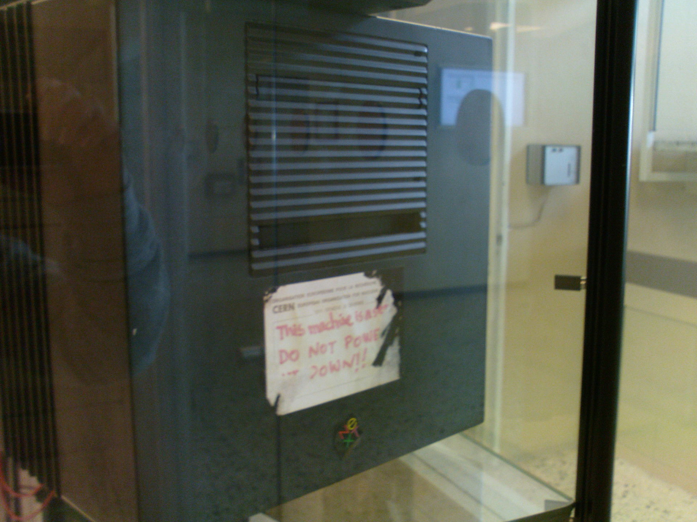
client-server model
client
server
terminology:
client
server
port
protocol
socket
http://www.kecksci.claremont.edu:80/faculty/
https://commons.wikimedia.org/wiki/File:HP_2133_Mini-Note_PC_(front_view_compare_with_pencil).jpg
https://upload.wikimedia.org/wikipedia/commons/2/2c/First-server-cern-computer-center.jpg

Slide 3
in python
import requests url = "http://www.kecksci.claremont.edu/faculty/" res = requests.get(url)
if (res.status_code == requests.codes.ok):
print(res.text[:500])
<!DOCTYPE html PUBLIC "-//W3C//DTD XHTML 1.0 Strict//EN" "http://www.w3.org/TR/xhtml1/DTD/xhtml1-strict.dtd">
<html xmlns="http://www.w3.org/1999/xhtml">
<head>
<meta http-equiv="Content-Type" content="text/html; charset=utf-8" />
<title>Keck Science :: People : Faculty Staff Listing</title>
<link href="../styles/default.css" title="JSD" rel="stylesheet" type="text/css" />
<link href="../styles/clickbanner.css" rel="stylesheet" type="text/css" />
<script type="text/javascript" src

Slide 4
(side note)
url = "http://www.kecksci.claremont.edu/faculty/" res = requests.get(url)
if (res.status_code == requests.codes.ok):
print(res.text[:500])
else: print("problem loading " + url)
try: res.raise_for_status() print(res.text[:500]) except: print("problem loading " + url)
try: res.raise_for_status() print(res.text[:500]) except requests.exceptions.HTTPError: print("problem loading " + url)

Slide 5
import requests url = "http://www.kecksci.claremont.edu/faculty/" res = requests.get(url)
if (res.status_code == requests.codes.ok):
print(res.text[:500])

Slide 6
<!DOCTYPE html PUBLIC "-//W3C//DTD XHTML 1.0 Strict//EN" "http://www.w3.org/TR/xhtml1/DTD/xhtml1-strict.dtd">
<html xmlns="http://www.w3.org/1999/xhtml">
<head>
<meta http-equiv="Content-Type" content="text/html; charset=utf-8" />
<title>Keck Science :: People : Faculty Staff Listing</title>
<link href="../styles/default.css" title="JSD" rel="stylesheet" type="text/css" />
<link href="../styles/clickbanner.css" rel="stylesheet" type="text/css" />
<script type="text/javascript" src="../js/jquery-1.4.2.min.js"></script>
<!-- Special IE 6 fixes -->
<!--[if IE 6]>
<link href="../styles/ie6-compat.css" rel="stylesheet" type="text/css" />
<script type="text/javascript" src="../js/jquery.pngFix.js"></script>
<script type="text/javascript">
$(document).ready(function(){
$(document).pngFix();
});
</script>
<![endif]-->
</head>
<body class="col2">
<div id="website">
<div id="header">
<div id="logo">Keck Science Department - <a
href="http://www.claremontmckenna.edu/" id="logo_cmc_link">Claremont
McKenna College</a> | <a href="http://www.pitzer.edu/"
id="logo_pitzer_link">Pitzer College</a> | <a
href="http://www.scrippscollege.edu/" id="logo_scripps_link">Scripps
College</a></div>
<a href="../prospectives" id="prospectivebtn">Prospective Students - Learn about our program</a>
</div>
<div id="menu_main">
<ul>
<li id="menu_home"><a href="../default.asp">Home</a></li>
<li id="menu_academics"><a href="../majors/">Academics</a></li>
<li id="menu_thesis"><a href="../thesis">Thesis</a></li>
<li id="menu_research"><a href="../research">Research</a></li>

Slide 7
<html> <head> <title>Title for Webpage</title> </head> <body> <h1> Section 1 header </h1>
word in <b>bold</b>
<a href="http://www.pomona.edu"> a link </a> </body> </html>
<html><head><title>Title for Webpage</title></head> <body> <h1> Section 1
header </h1>
word in <b>bold</b><a href="http://www.pomona.edu"> a link </a> </body> </html>

Slide 8
html basics
tags
elements
attributes
<html> <head> <title>Title for Webpage</title> </head> <body> <h1> Section 1 header </h1>
word in <b>bold</b>
<a href="http://www.pomona.edu">
a link
</a> </body> </html>

Slide 9
excerpt from https://websitesetup.org/HTML5-cheat-sheet.pdf

Slide 10
<!DOCTYPE html PUBLIC "-//W3C//DTD XHTML 1.0 Strict//EN" "http://www.w3.org/TR/xhtml1/DTD/xhtml1-strict.dtd">
<html xmlns="http://www.w3.org/1999/xhtml">
<head>
<meta http-equiv="Content-Type" content="text/html; charset=utf-8" />
<title>Keck Science :: People : Faculty Staff Listing</title>
<link href="../styles/default.css" title="JSD" rel="stylesheet" type="text/css" />
<link href="../styles/clickbanner.css" rel="stylesheet" type="text/css" />
<script type="text/javascript" src="../js/jquery-1.4.2.min.js"></script>
<!-- Special IE 6 fixes -->
<!--[if IE 6]>
<link href="../styles/ie6-compat.css" rel="stylesheet" type="text/css" />
<script type="text/javascript" src="../js/jquery.pngFix.js"></script>
<script type="text/javascript">
$(document).ready(function(){
$(document).pngFix();
});
</script>
<![endif]-->
</head>
<body class="col2">
<div id="website">
<div id="header">
<div id="logo">Keck Science Department - <a
href="http://www.claremontmckenna.edu/" id="logo_cmc_link">Claremont
McKenna College</a> | <a href="http://www.pitzer.edu/"
id="logo_pitzer_link">Pitzer College</a> | <a
href="http://www.scrippscollege.edu/" id="logo_scripps_link">Scripps
College</a></div>
<a href="../prospectives" id="prospectivebtn">Prospective Students - Learn about our program</a>
</div>
<div id="menu_main">
<ul>
<li id="menu_home"><a href="../default.asp">Home</a></li>
<li id="menu_academics"><a href="../majors/">Academics</a></li>
<li id="menu_thesis"><a href="../thesis">Thesis</a></li>
<li id="menu_research"><a href="../research">Research</a></li>

Slide 11
<tr bgcolor="#EEEEEE">
<td><Font size="-1">1</font></td>
<td height="40"> <font size="-1"><a href="profile.asp?FacultyID=267"> Maria Alfaro</a>
</font></td>
<td> <font size="-1"><a href="mailto:malfaro@kecksci.claremont.edu">malfaro@kecksci.claremont.edu</a></font></td>
<td width="8%"> <div align="left"><font size="-1">KSC 110
</font></div></td>
<td width="11%"> <font size="-1">
909-607-7014</font></td>
<td align="center"> <font size="-1">
Keck Science
</font></td>
<td width="8%" align="center"> <font size="-1">Staff
</font></td>
<td> <font size="-1">
</font></td>
</tr>
<tr bgcolor="#CCCCCC">
<td><Font size="-1">2</font></td>
<td height="40"> <font size="-1"><a href="profile.asp?FacultyID=35"> Jennifer A Armstrong</a>
</font></td>
<td> <font size="-1"><a href="mailto:jarmstrong@kecksci.claremont.edu">jarmstrong@kecksci.claremont.edu</a></font></td>
<td width="8%"> <div align="left"><font size="-1">BL 134
</font></div></td>
<td width="11%"> <font size="-1">
909-607-9716</font></td>
<td align="center"> <font size="-1">
Biology
</font></td>
<td width="8%" align="center"> <font size="-1">Professor
</font></td>
<td> <font size="-1">Mondays and Thursdays 8:30-9:30 and by appointment
</font></td>
</tr>

Slide 12
Given an object soup . . .
first element with tag name t
soup.t
soup.find('t')
returns object of type Tag
value of individual attribute attr
soup.find('t').get('attr')
returns object of type str
displayed content of a tag
soup.find('t').string
returns object of type str
<html> <head> <title>Title for Webpage</title> </head> <body> <h1> Section 1 header </h1>
word in <b>bold</b>
<a href="http://www.pomona.edu"> a link </a> </body> </html>

Slide 13
import requests
from bs4 import BeautifulSoup url = "http://www.kecksci.claremont.edu/faculty/" res = requests.get(url)
if (res.status_code == requests.codes.ok):
soup = BeautifulSoup(res.text, "html.parser")
print(soup.title)
print(soup.find("a"))
print(soup.a.string)
print(soup.a.get('href'))
print(soup.a['href']))
<title>Keck Science :: People : Faculty Staff Listing</title>
<a href="http://www.claremontmckenna.edu/" id="logo_cmc_link">Claremont
McKenna College</a>
Claremont
McKenna College
http://www.claremontmckenna.edu/
http://www.claremontmckenna.edu/

