Slide 1
Lecture 24: Security and Privacy
CS 51P December 9, 2019

Slide 2
Computer Science

Slide 3
Computer Security

Slide 4
Computer Security
Security is about making sure that computers behave correctly
A secure system should:
  Do what it is supposed to do
  Not do anything else

Slide 5
What might go wrong
class ObjectStore:
def __init__(self, len):
self.objects = [None]*len
def read(i):
return self.objects[i]
def store(i, o):
self.objects[i]= o

Slide 6
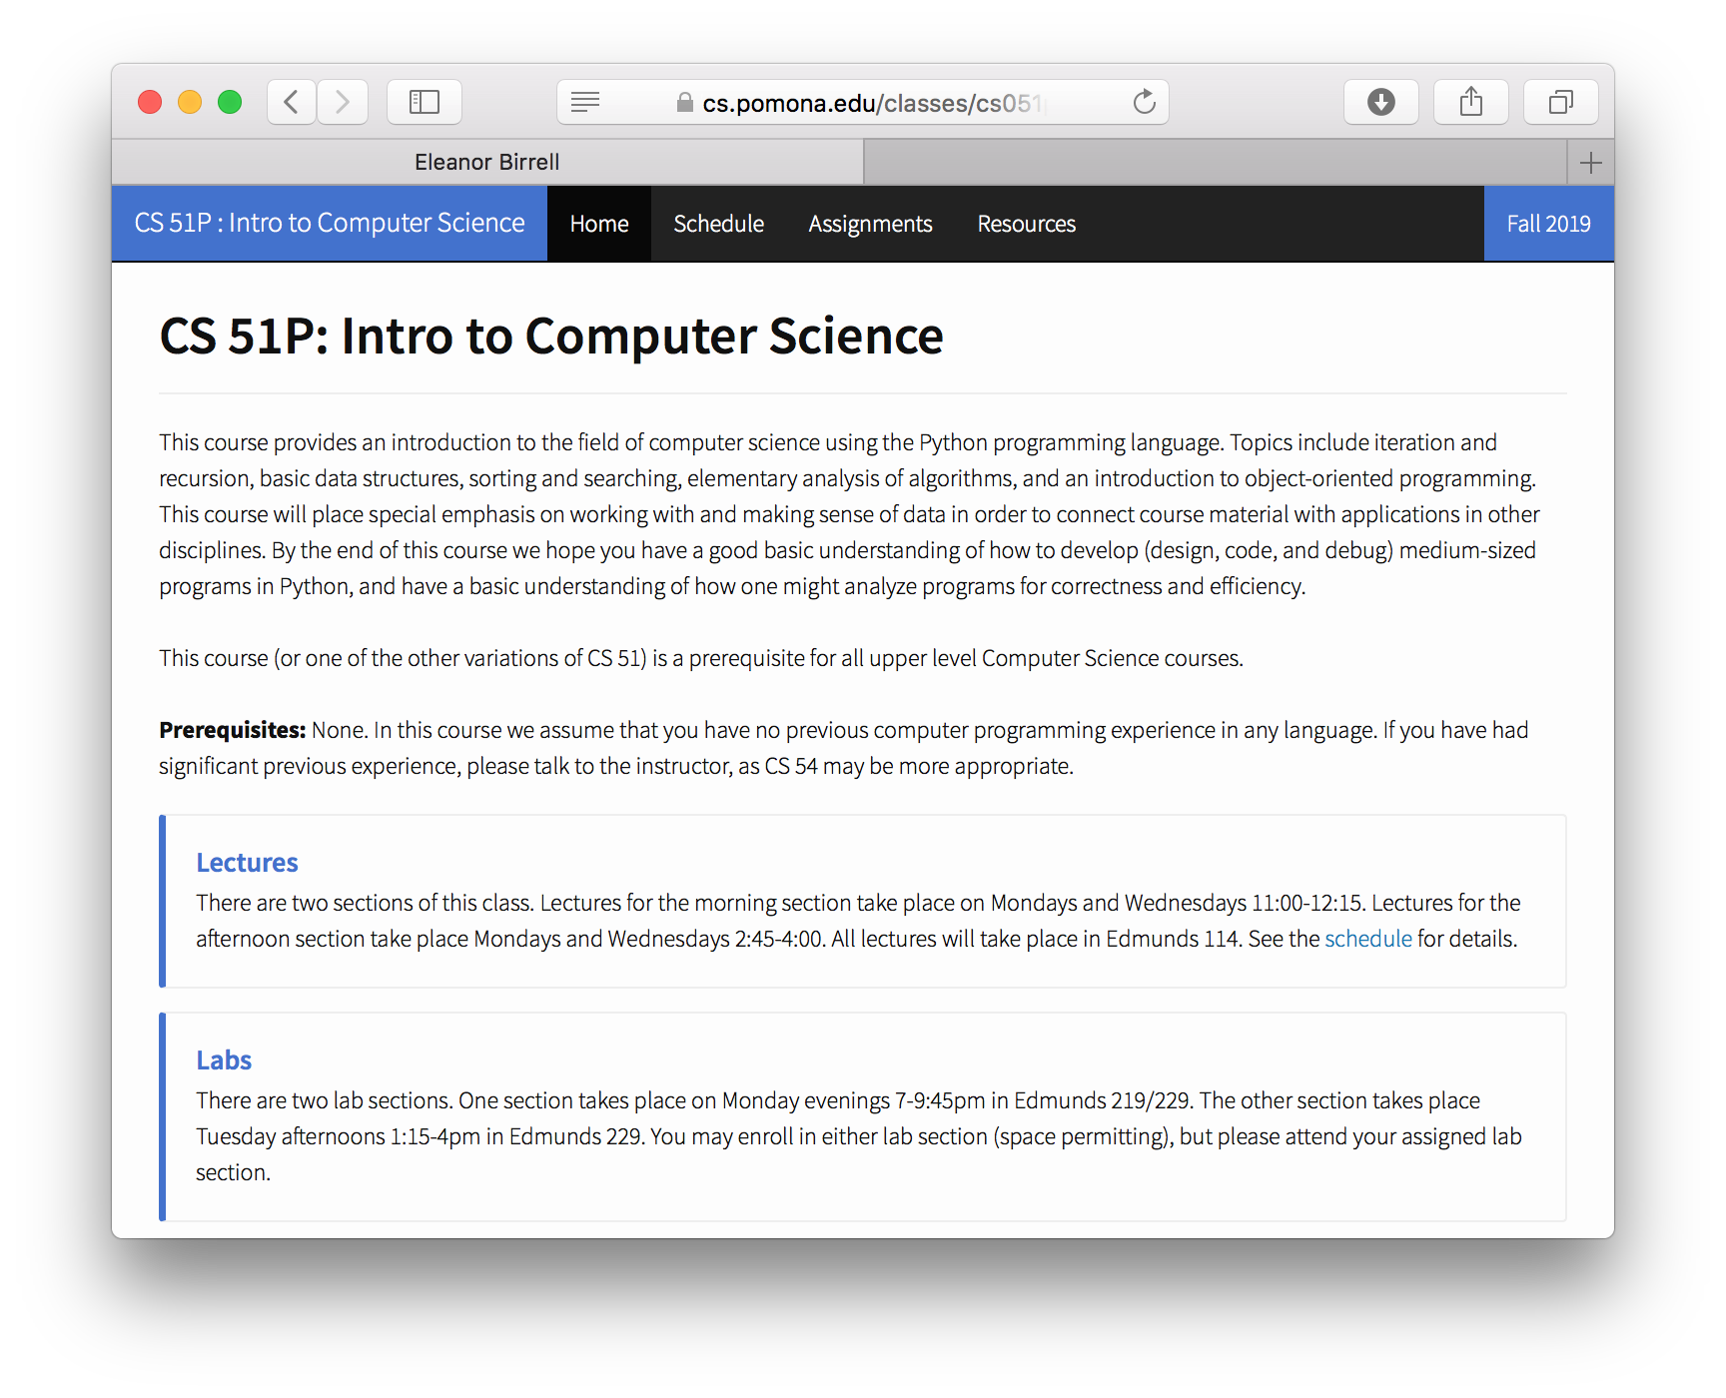

OpenSSL
struct {
HeartbeatMessageType type;
uint16 payload_length;
opaque payload[HeartbeatMessage.payload_length];
opaque padding[padding_length];
} HeartbeatMessage;

Slide 7

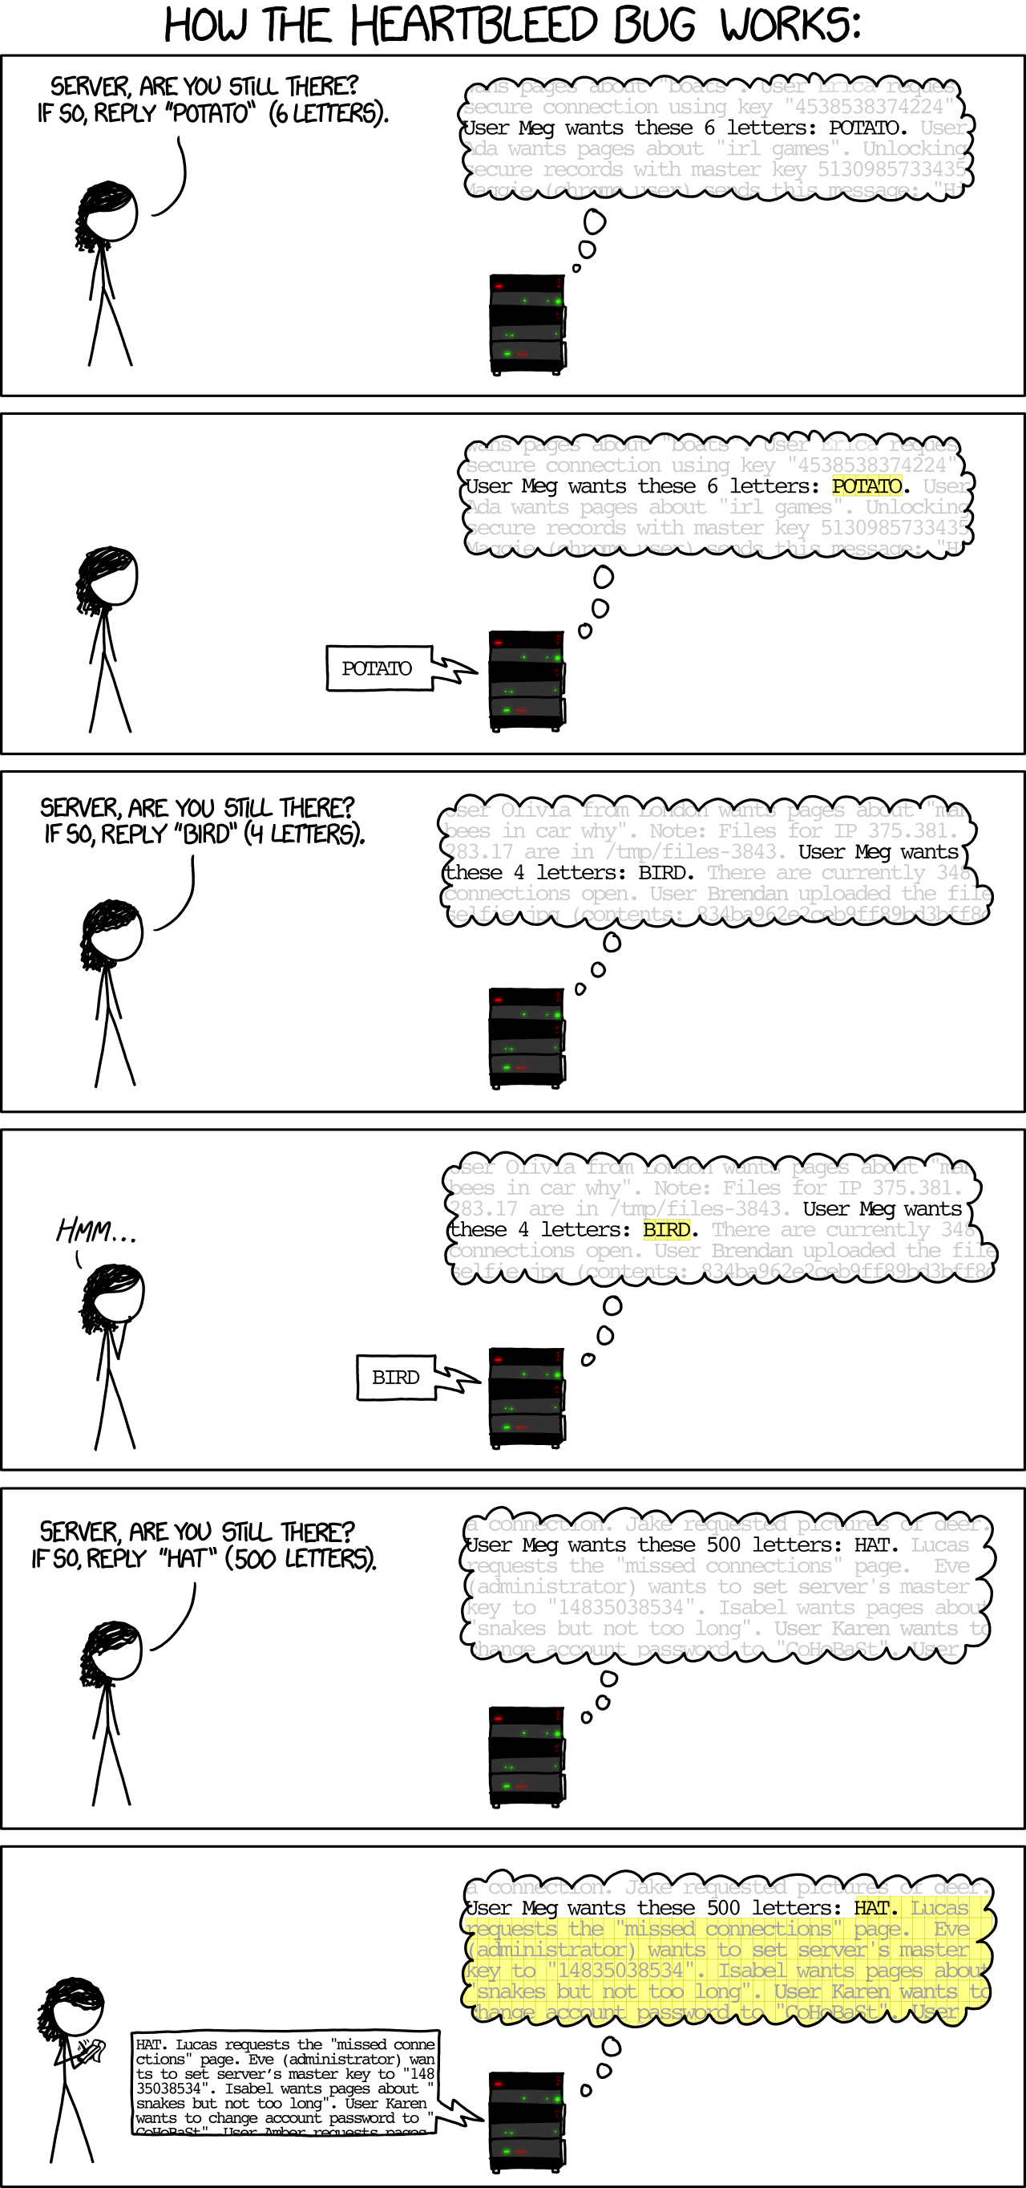
Heartbleed

Slide 8
What might go wrong
class ObjectStore:
def __init__(self, len):
self.objects = [None]*len
def read(i):
return self.objects[i]
def store(i, o):
self.objects[i]= o

Slide 9
Memory
Stack
def f1(o):
os = ObjectStore(10)
...
os.store(12, o);
...
Return ptr
&exploit_code
47
o
os
None
def main():
f1(47)
print("done")
def exploit_code():
# do evil stuff
….
Heap
Statics
Code
0x00000000

Slide 10

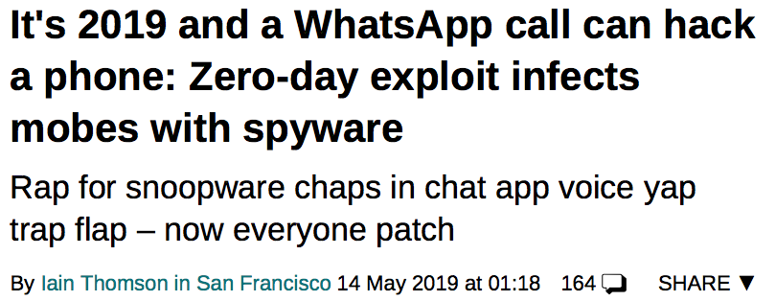
WhatsApp Vulnerability
Notes:
May 2019
triggered by manipulating packets at beginning of VOIP call; allowed remote code execution
https://www.theregister.co.uk/2019/05/14/whatsapp_zero_day/

Slide 11
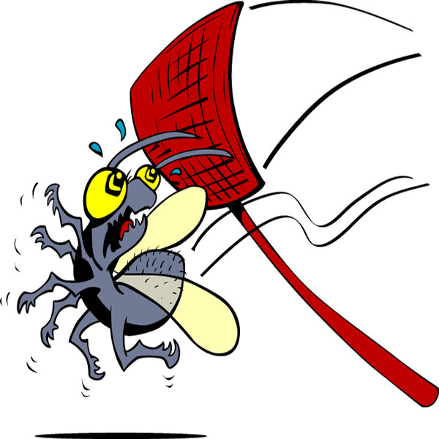
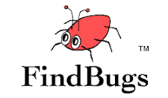

So how do we fix this?
Testing
Bug finding tools
Provably correct code
White-hat hacking

Slide 12
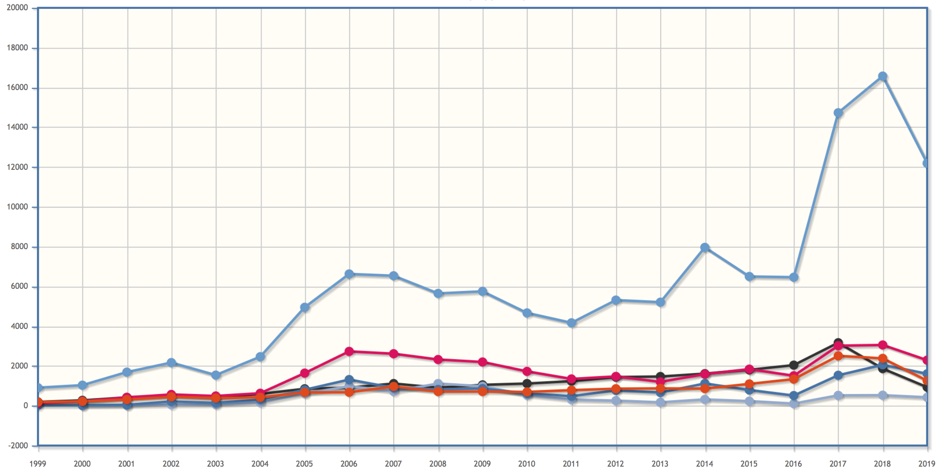
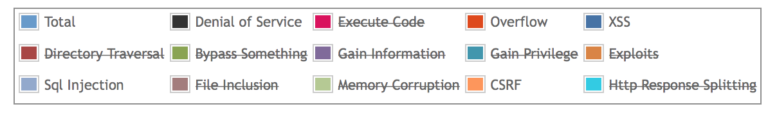
Vulnerabilities by Year
Notes:
https://www.cvedetails.com/vulnerabilities-by-types.php

Slide 13
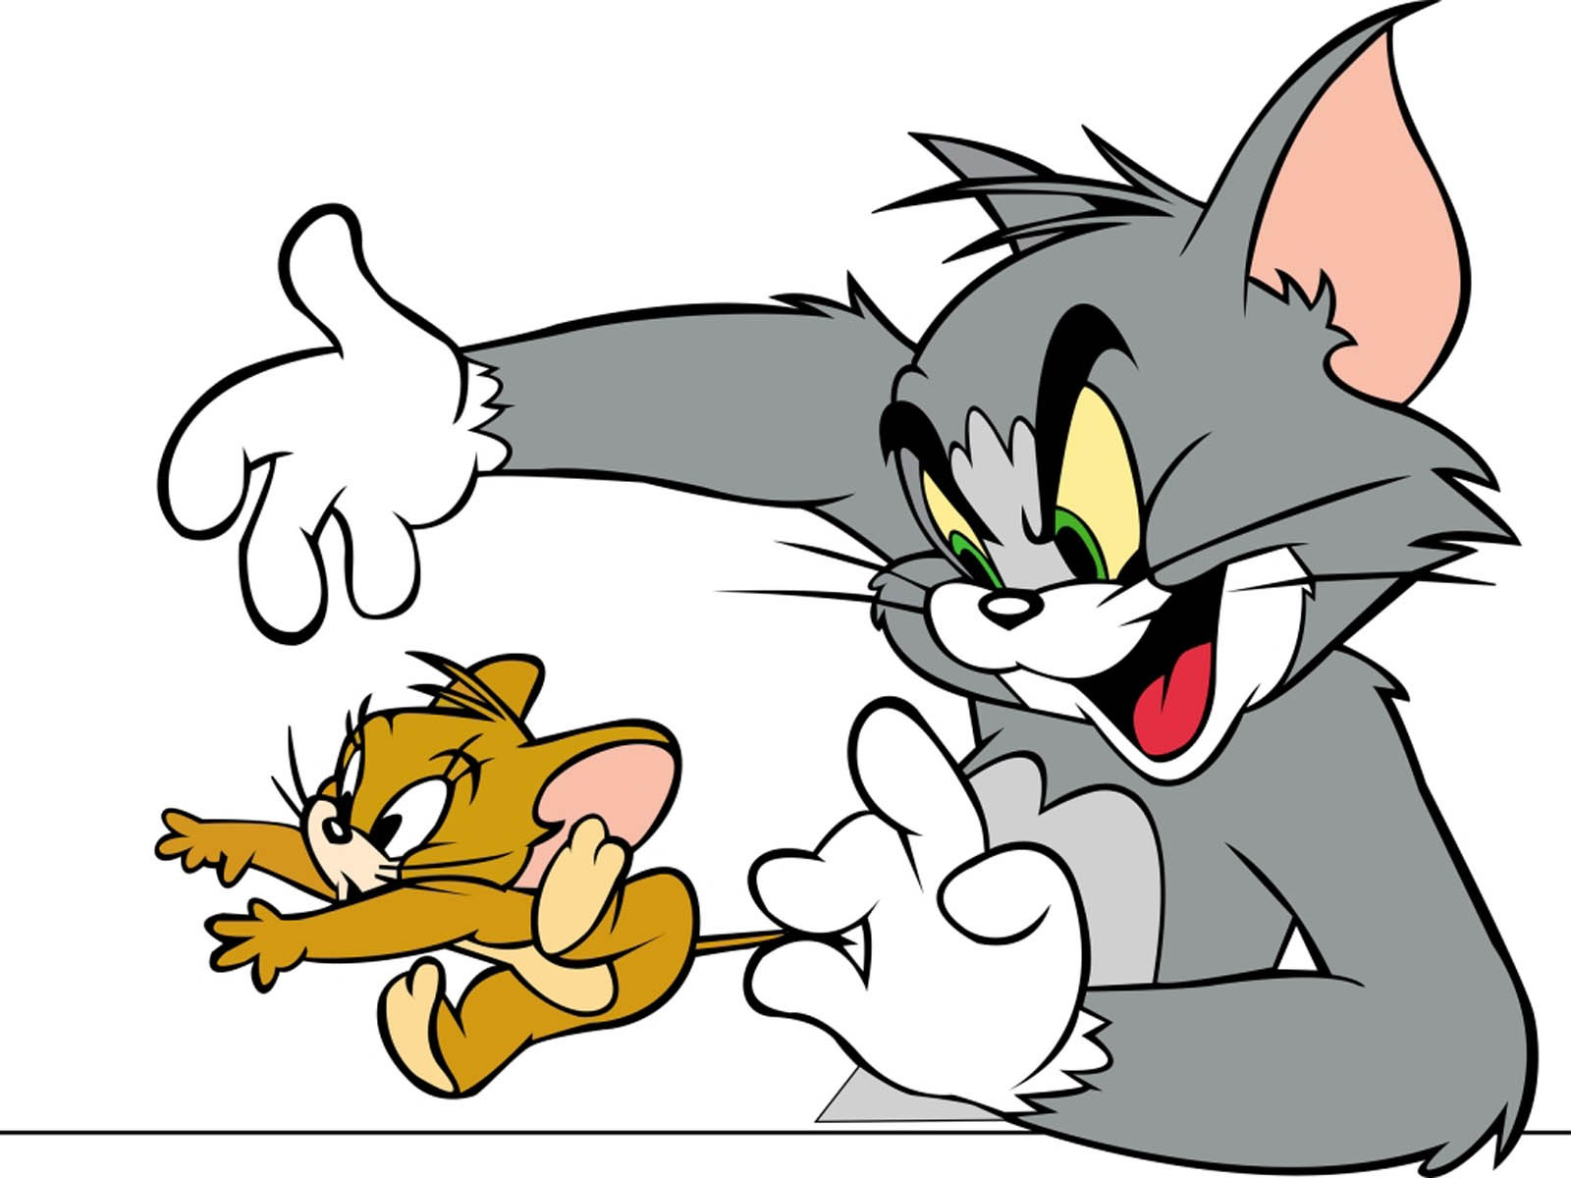

Slide 14

So how do we fix this?

Slide 15
Security by Design
Build secure, trustworthy computer systems/applications/etc.
Define what the system is supposed to do
Make sure it does that (and only that)

Slide 16
Engineering Security
Attacks
are perpetrated by
threats
that cause
incorrect behavior
by exploiting
vulnerabilities
which are controlled by
countermeasures.

Slide 17
What are the threats?

Slide 18
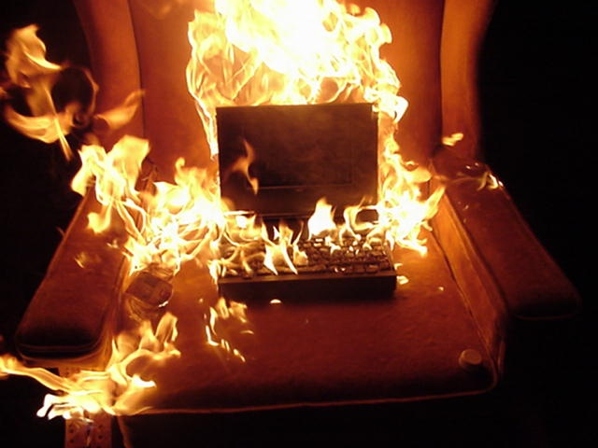
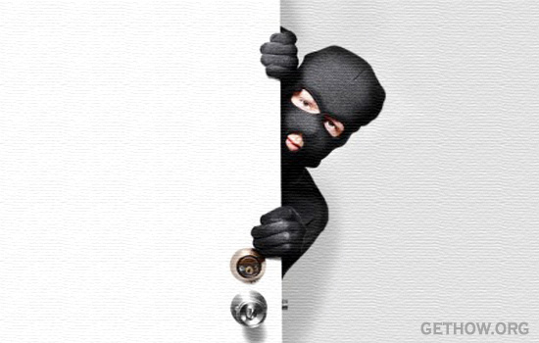
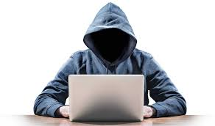
Threat Models
Capabilities, Resources, Motivation

Slide 19
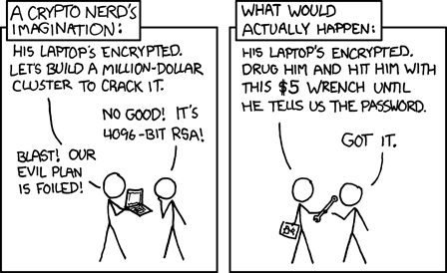
Threat Models

Slide 20
Engineering Security
Attacks
are perpetrated by
threats
that cause
incorrect behavior
by exploiting
vulnerabilities
which are controlled by
countermeasures.

Slide 21
Security Goals
"The system shall prevent/detect action on/to/with asset."
  e.g., "The system shall prevent theft of money"
  e.g., "The system shall prevent erasure of account balances"
Poor goals:
  "the system shall use encryption to prevent reading of messages"
  "the system shall use authentication to verify user identities"
  "the system shall resist attacks"
Security goals should specify what not how

Slide 22
C I A

Slide 23
C I A
Confidentiality
Integrity
Availability

Slide 24
Confidentiality Goals
Protection of assets from unauthorized disclosure
i.e., which principals are allowed to learn what
Examples:
  Keep contents of a file from being read (access control: more later)
  Keep information secret (information flow: more later)
  value of variable secret
  behavior of system
  information about individual
Notes:
Examples of iflow:
pub :=0; if (sec=1) { pub := 1; }
system load goes up when processing secret information
power consumed when processing secret information (DPA)
Database linking: Gender, DOB, ZIP uniquely identify about 99% of people in Cambridge, MA

Slide 25
Integrity Goals
Protection of assets from unauthorized modification
i.e., what changes are allowed to system and its environment, including inputs and outputs
Examples:
Output is correct according to (mathematical) specification
No exceptions thrown
Only certain principals may write to a file (access control)
Data are not corrupted or tainted by downloaded programs (information flow)

Slide 26
Availability Goals
Protection of assets from loss of use
i.e., what has to happen when/where
Examples:
Operating system must accept inputs periodically
Program must produce output by specified time
Requests must be processed fairly (order, priority, etc.)
Denial of service (DoS) attacks compromise availability

Slide 27
Aspects of security
Confidentiality: protection of assets from unauthorized disclosure
Integrity: protection of assets from unauthorized modification
Availability: protection of assets from loss of use
Notes:
This course will mostly focus on C and I, not A

Slide 28
Exercise
Attack: John copies Mary's homework
What is a security goal this attack would violate?
Which aspect of security does that policy address?
Notes:
Even if there aren't right answers, some are better than others---simpler, more clear cut, easier to argue, etc.

Slide 29
Exercise
Attack: Paul causes Linda's system to freeze
Goal?
Aspect?

Slide 30

Exercise: Stork Baby Delivery
The stork baby delivery system allows an autonomous aircraft (a stork) to deliver a payload (a baby) to a geographic location prespecified by some higher authority (providence). Prior to take-off, providence programs a stork with the geographic location describing where the baby should be delivered. Throughout the mission, the stork transmits back to providence a video of the landscape (labeled with geographic location coordinates) that the stork flies over. While a stork is in flight, providence may issue commands to that stork and change the location for the delivery, alter the path being followed to that location, or abort the mission.
Threat model: The adversary desires to prevent baby deliveries. The adversary has access to radio equipment that transmits and receives on the same frequencies that providence uses for communication with a stork. The adversary also controls weapons systems that can destroy a stork in flight.

Slide 31
How do we design countermeasures

Slide 32

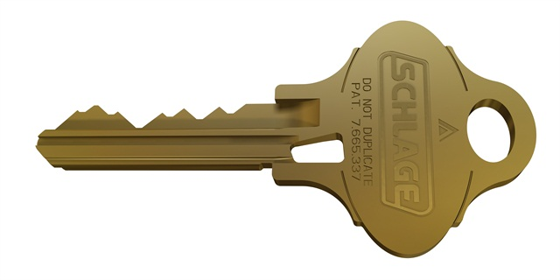
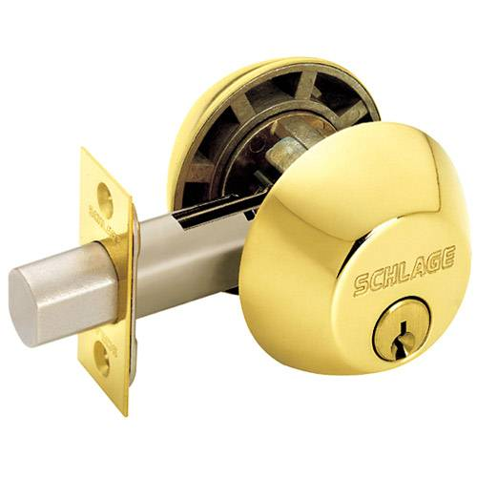
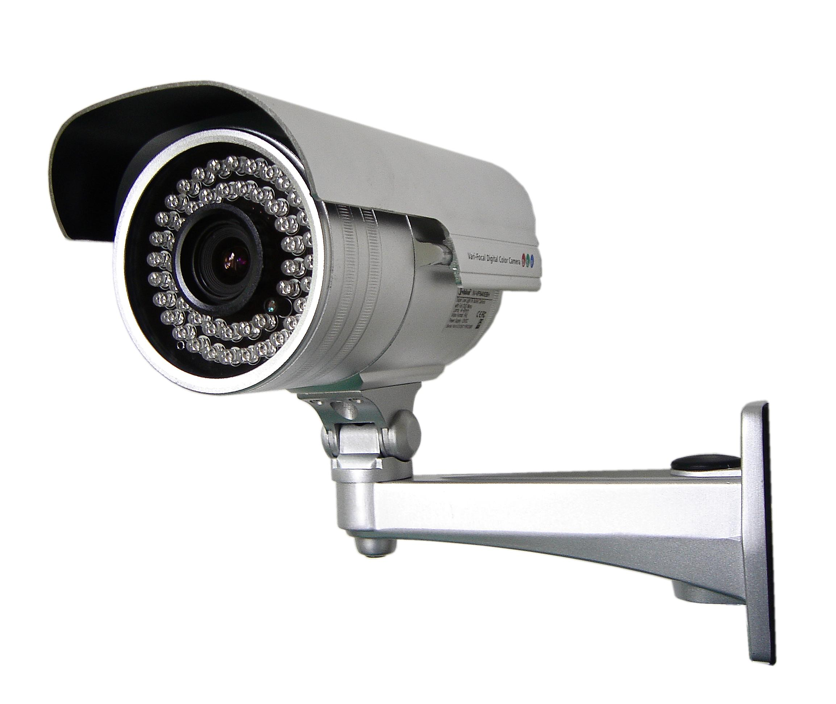
Classes of Countermeaures
thentication: mechanisms that bind
principals to actions
thorization: mechanisms that govern
whether actions are permitted
dit: mechanisms that record and
review actions

Slide 33
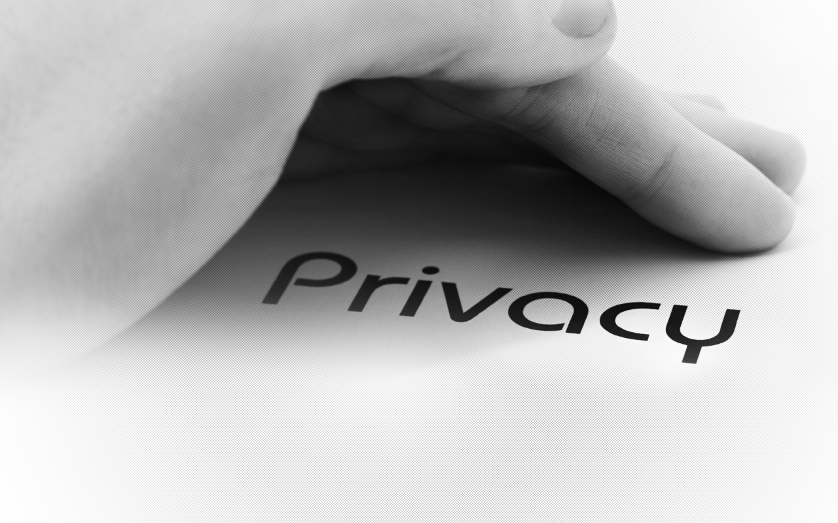
What is Privacy?
Notes:
discuss
Warren/Brandeis (right to be left alone)
Privacy as confidentiality
Nissenbaum (contextual integrity)

Slide 34
What is a privacy violation?
Police read papers stored in your home
Police read papers you threw in the trash
Police read your medical records
Your parents read your medical records
Pomona uses your medical records in a research study
Police read your texts/Facebook messages
Police read your Facebook posts
Police read your emails
Google employee reads your emails
Google uses your emails to target personalized ads
Someone tracks your location for months (using phone)
Notes:
Assume all actions occur without your consent and without a warrant

Slide 35
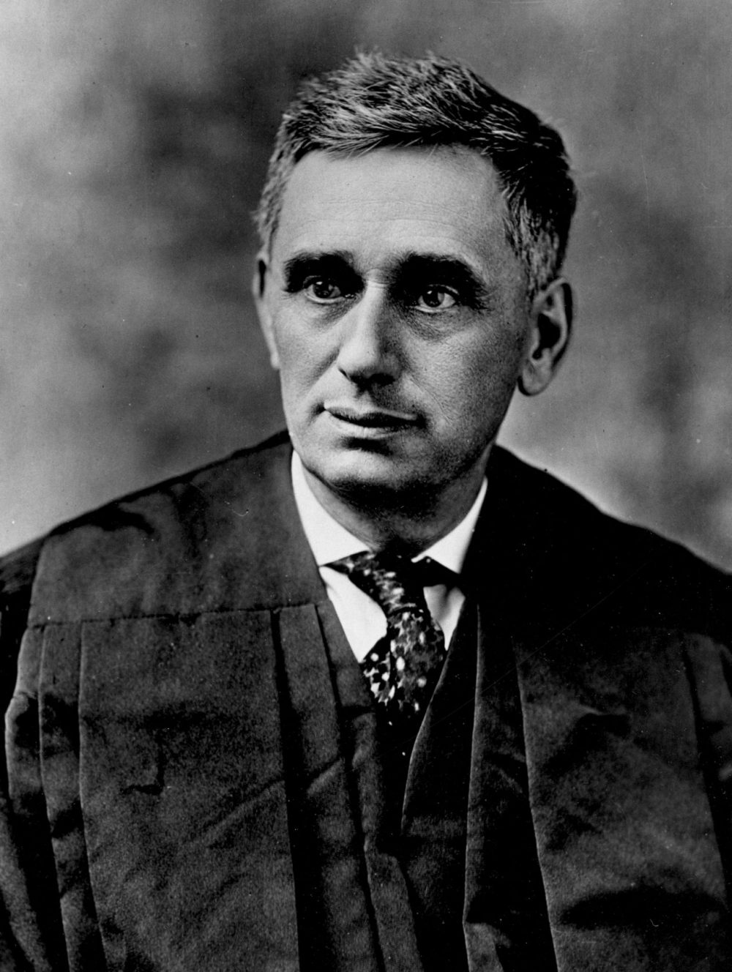
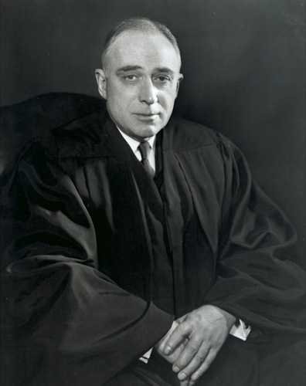
Privacy in American Law
Notes:
Louis Brandeis was an American lawyer and Supreme Court justice, also a leader of the progressive party
With his law partner Samual Warren, influential early writer on privacy law, including "The Right to Privacy" [Harvard Law Review, 1890], which developed the idea of a right to be left alone, and a right to control private data.
John Harlan (supreme court justice) outlined a two-prong test for a "reasonable expectation of privacy" in his concurrence to Katz v. United States (1967) to identify when laws or behaviors violated fourth amendment protections.
Update: Carpenter v. United States http://www.scotusblog.com/2018/06/opinion-analysis-court-holds-that-police-will-generally-need-a-warrant-for-cellphone-location-information/

Slide 36
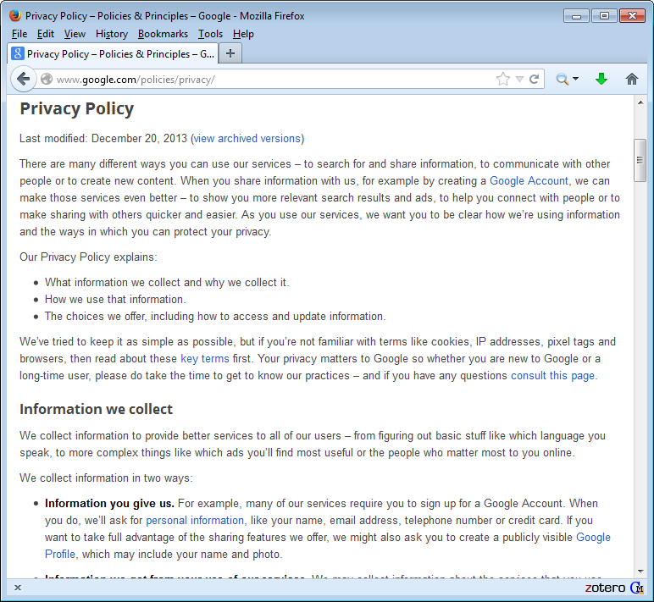
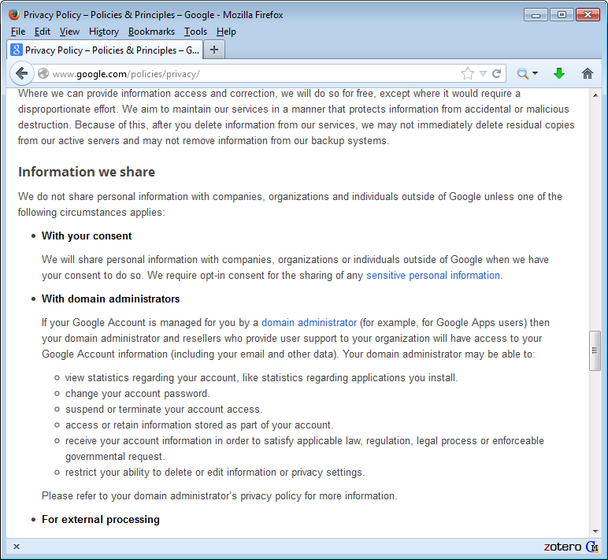
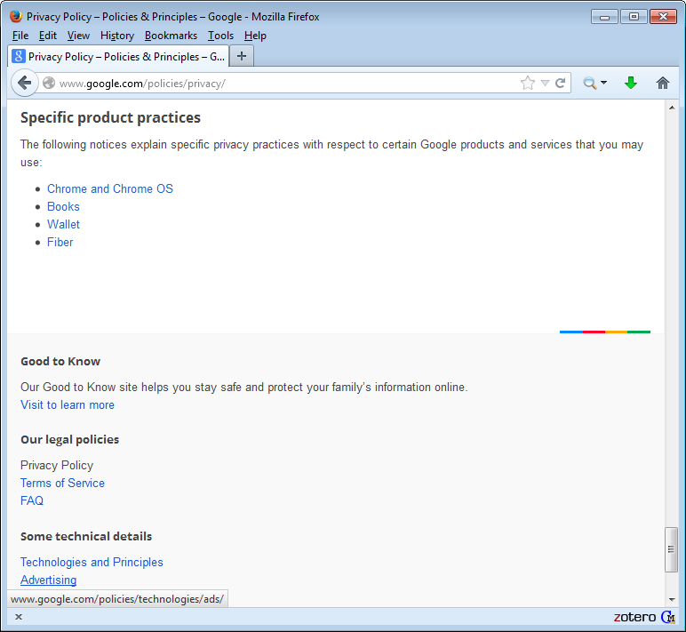
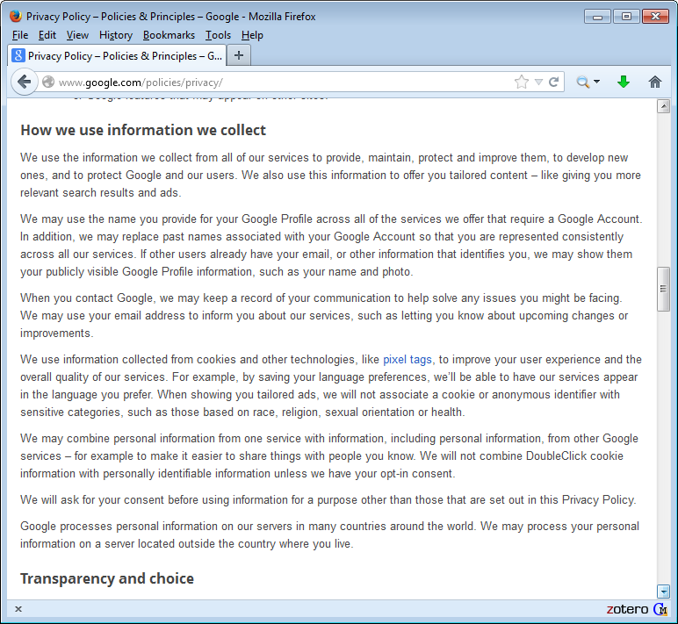
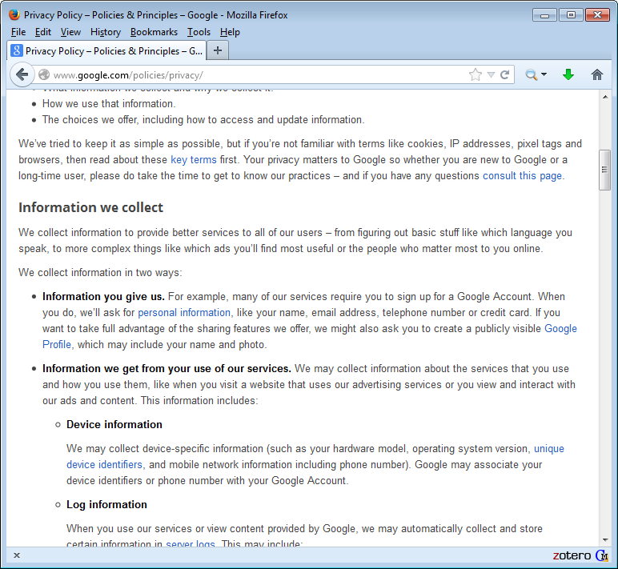
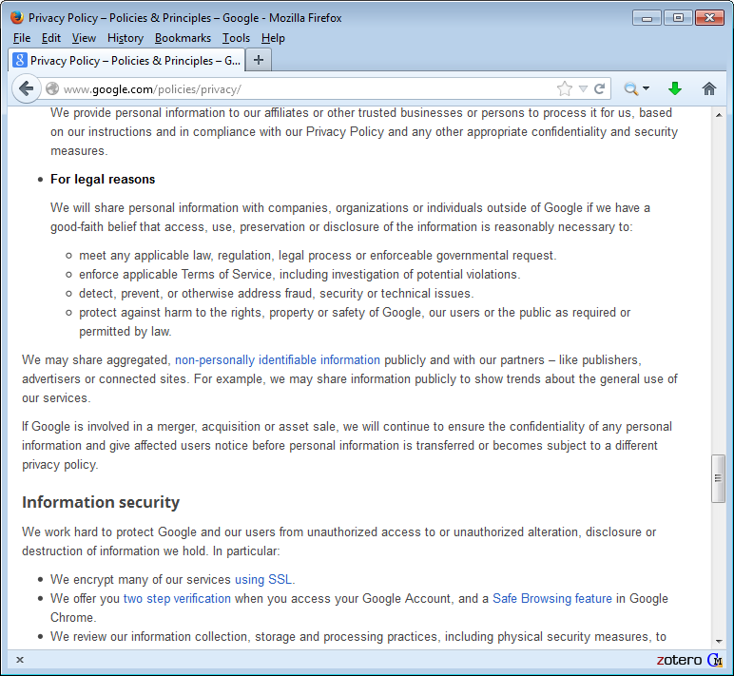
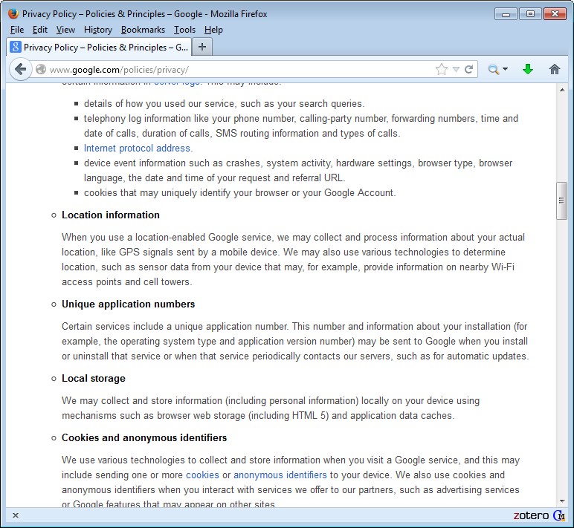
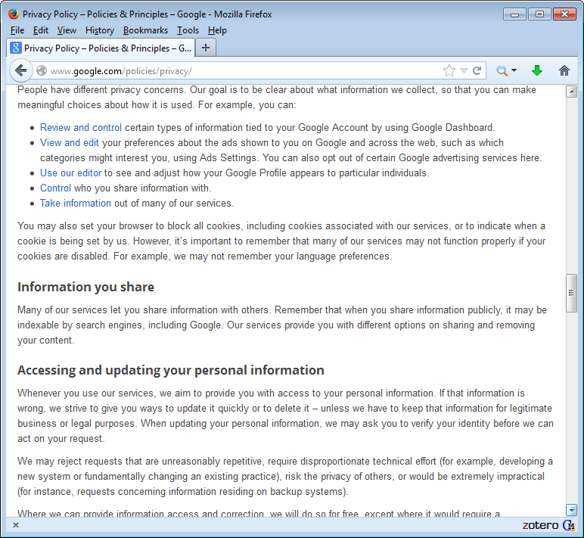
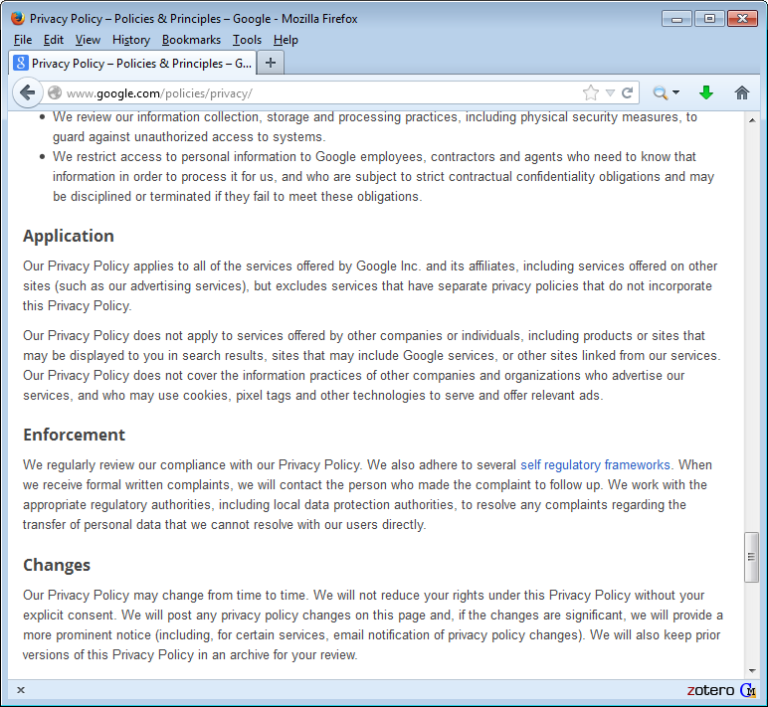
Notice & Consent

Slide 37
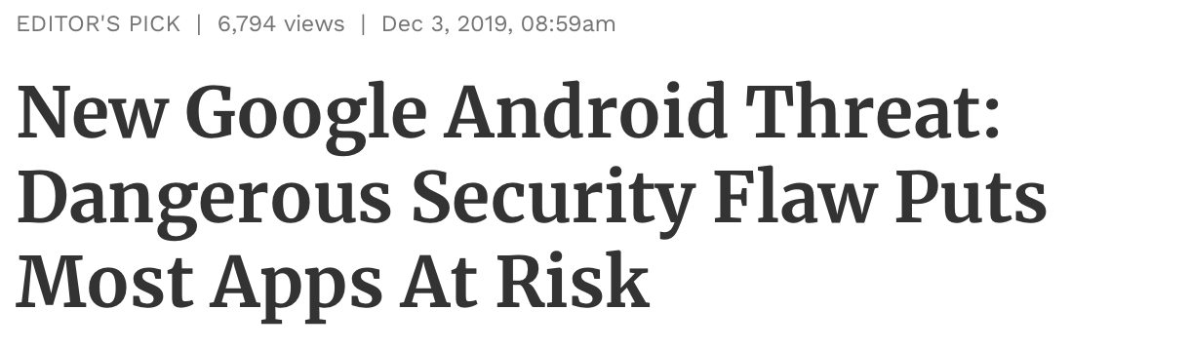
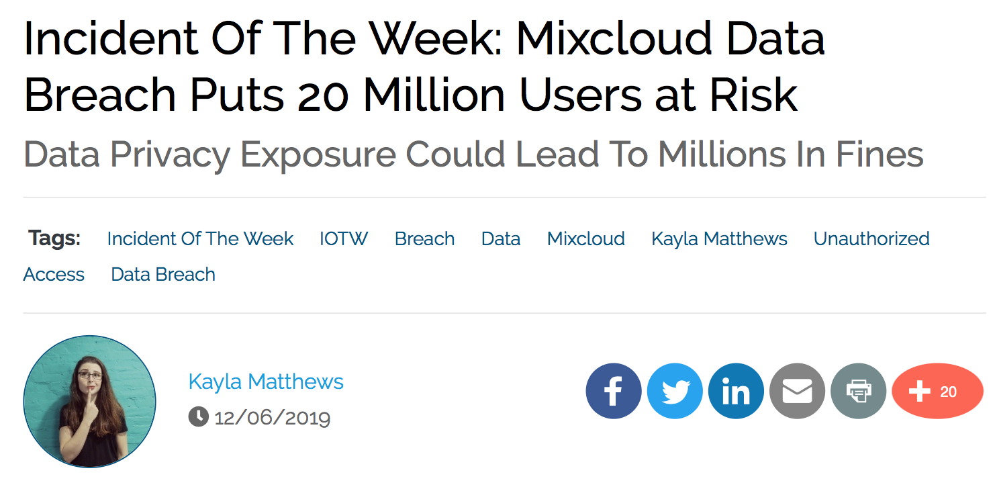
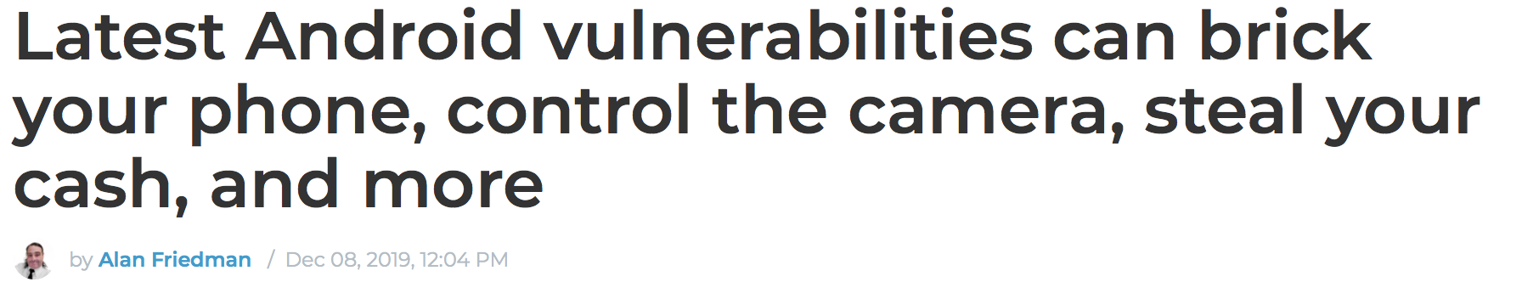
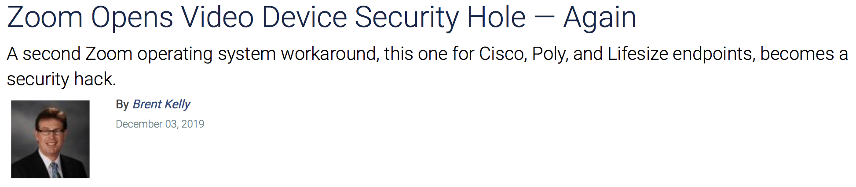
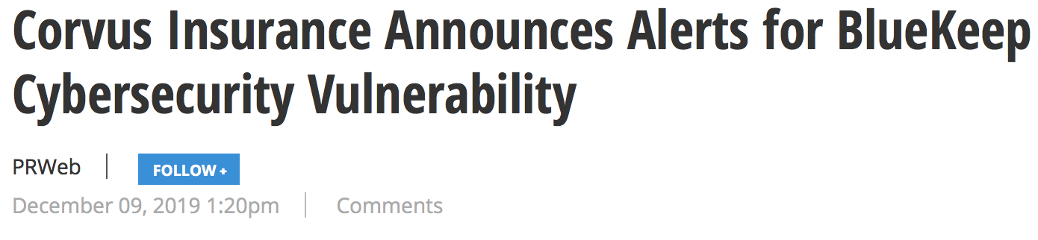
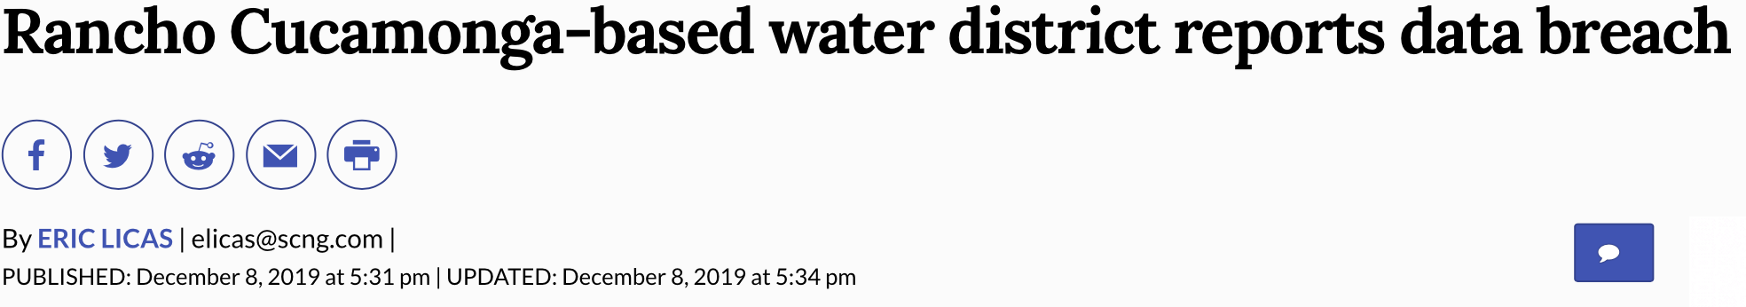
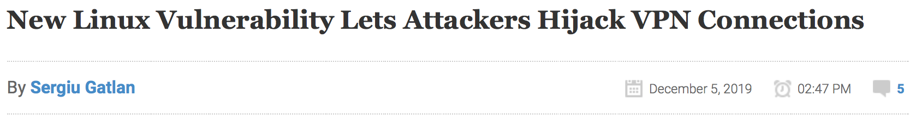
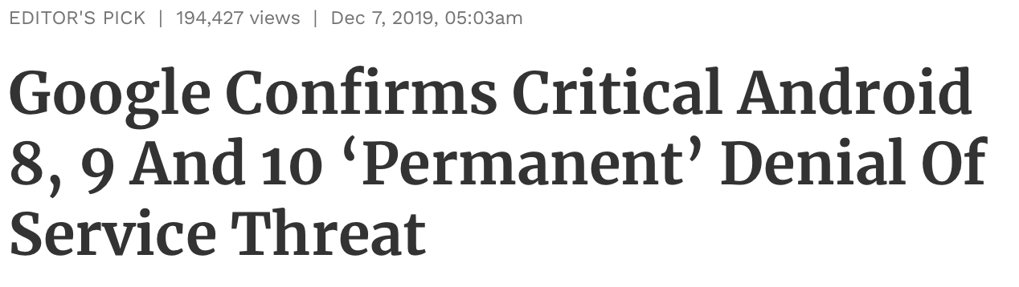
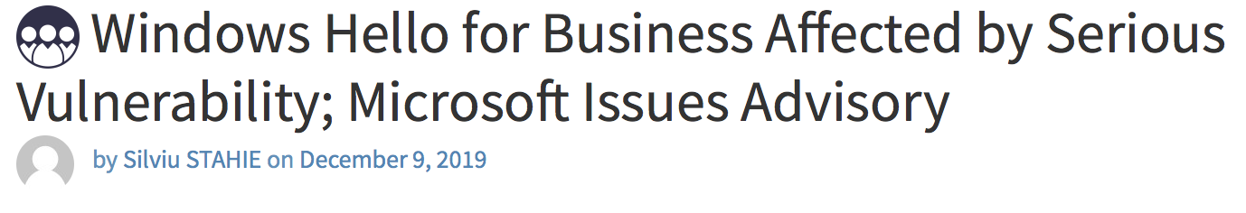
Today

