Slide 1
Lecture 21: AI and Machine Learning
CS 51P November 25, 2019
Notes:
Based on Dave Kauchak's materials from 51a (Lecture 17 & Lecture 18, Spring 2019)

Slide 2
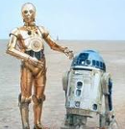
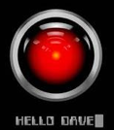

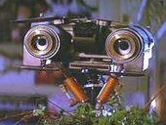
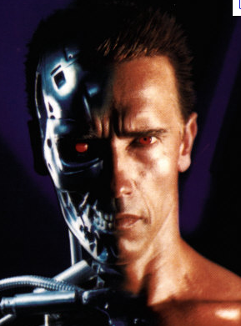

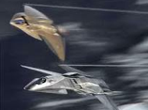
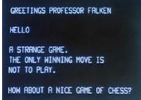
What is Artificial Intelligence?

Slide 3
What is Artificial Intelligence?
One definition: “Building programs that enable computers to do what humans can do.”
For example:
read,
walk around,
drive,
play games,
solve problems,
learn,
have conversations…

Slide 4
A broader definition
“Building programs that enable computers to do do intelligent things”
human vs. rational
Think like a human Cognitive Modeling | Think rationally Logic-based Systems
Act like a human Turing Test | Act rationally Rational Agents
thinking
vs.
acting

Slide 5

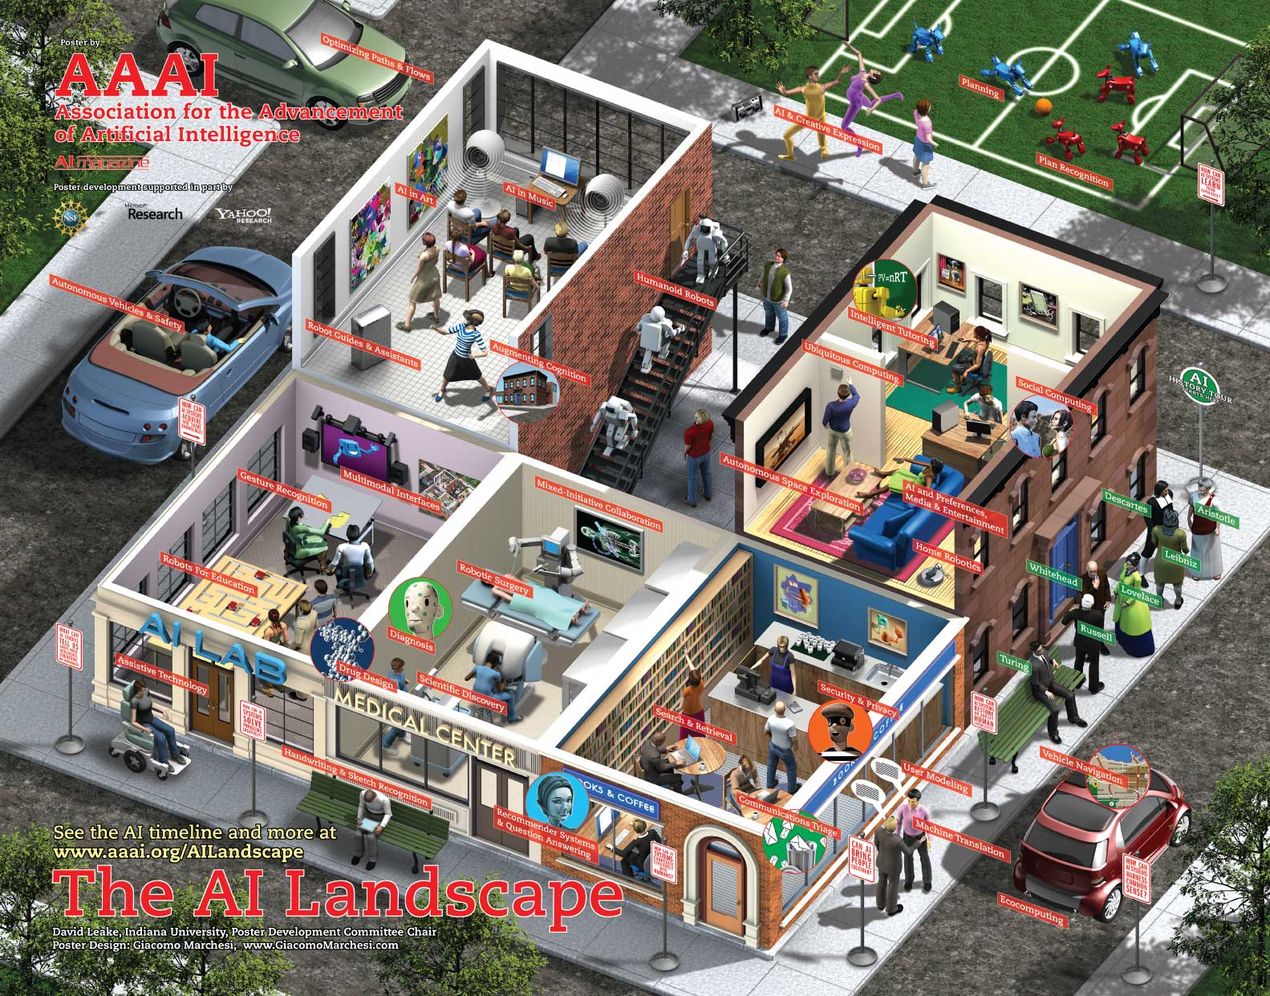
What challenges are there?

Slide 6
What challenges are there?
Perception
  perceive the environment via sensors
Computer vision (perception via images/video)
  process visual information
  object identification, face recognition, motion tracking
Natural language processing and generation
  speech recognition, language understanding
  language translation, speech generation, summarization

Slide 7
What challenges are there?
Knowledge representation
  encode known information
  water is wet, the sun is hot, professors are people, …
Learning
  learn from environment
  What type of feedback? (supervised vs. unsupervised vs. reinforcement vs …)
Reasoning/problem solving
  achieve goals, solve problems
  planning
  How do you make an omelet? I’m carrying an umbrella and it’s raining… will I get wet?
Robotics
  How can computers interact with the physical world?

Slide 8
Machine Learning is…
Machine learning is about predicting the future based on the past.
-- Hal Daume III
past
future
predict
learn
Training
Data
model/
predictor
Testing
Data
model/
predictor

Slide 9
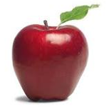
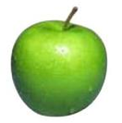
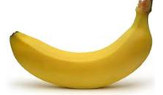
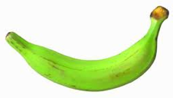
Data
examples
Data

Slide 10

Data
examples
Data

Slide 11

Data
examples
Data

Slide 12
Supervised learning
examples
label
label₁
label₃
labeled examples
label₄
label₅

Slide 13
Supervised learning
label
label₁
model/
predictor
label₃
label₄
label₅

Slide 14
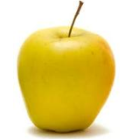
Supervised learning
model/
predictor
predicted label

Slide 15
Supervised learning: classification
label
apple
apple
banana
banana
Classification: a finite set of labels

Slide 16
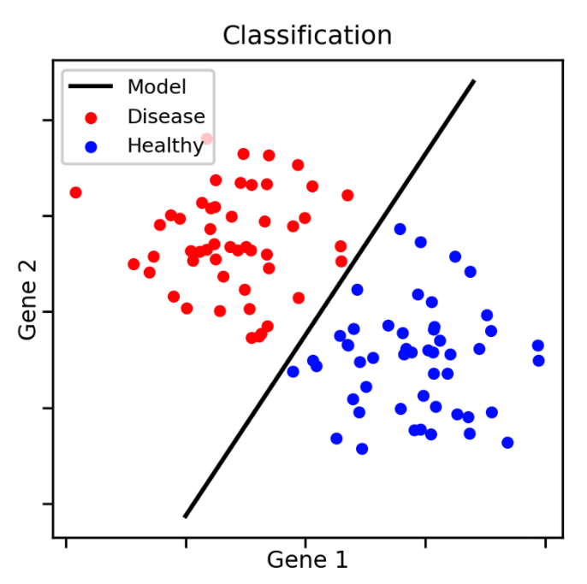
Classification Example

Slide 17
Classification Applications
Face recognition
Character recognition
Spam detection
Medical diagnosis: From symptoms to illnesses
Biometrics: Recognition/authentication using physical and/or behavioral characteristics: Face, iris, signature, etc
...

Slide 18
Supervised learning: regression
label
-4.5
10.1
3.2
4.3
Regression: label is real-valued

Slide 19
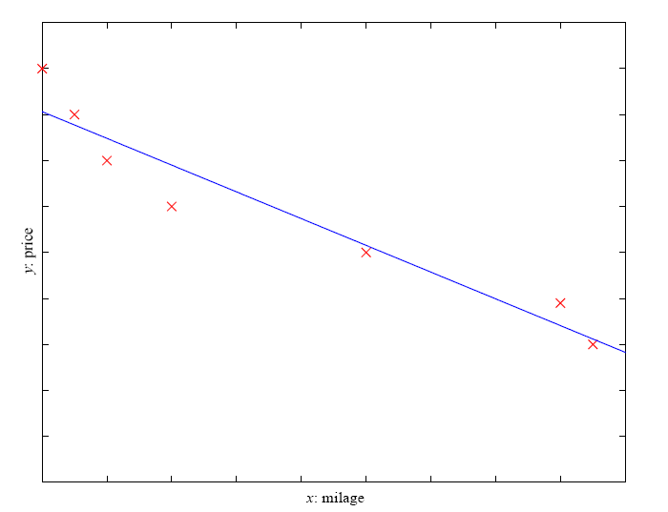
Regression Example
Price of a used car
x : car attributes
(e.g. mileage)
y : price

Slide 20
Regression Applications
Economics/Finance: predict the value of a stock
Epidemiology
Car/plane navigation: angle of the steering wheel, acceleration, …
Temporal trends: weather over time
…

Slide 21
Supervised learning: ranking
label
1
4
2
3
Ranking: label is a ranking

Slide 22
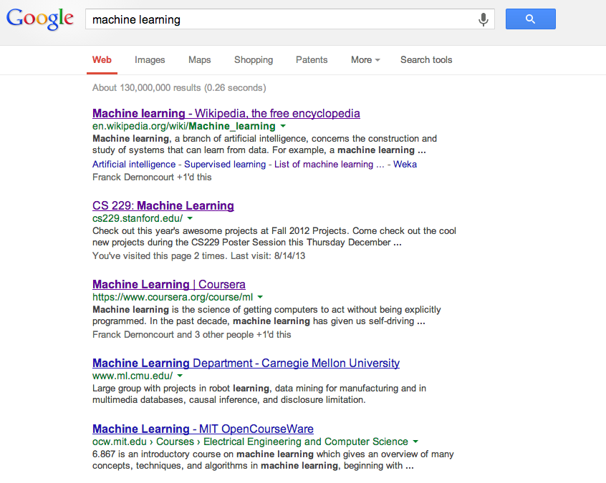
Ranking example
Given a query and
a set of web pages,
rank them according
to relevance

Slide 23
Ranking Applications
User preference, e.g. Netflix “My List” -- movie queue ranking
iTunes
search
…

Slide 24
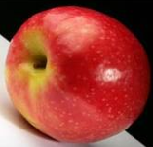
Unsupervised learning
Unsupervised learning: given data, i.e. examples, but no labels

Slide 25
Learn clusters/groups
customer segmentation (i.e. grouping)
image compression
bioinformatics: learn motifs
…

Slide 26
Reinforcement learning
left, right, straight, left, left, left, straight
GOOD
left, straight, straight, left, right, straight, straight
BAD
left, right, straight, left, left, left, straight
18.5
left, straight, straight, left, right, straight, straight
-3
Given a sequence of examples/states and a reward after completing that sequence, learn to predict the action to take in for an individual example/state

Slide 27
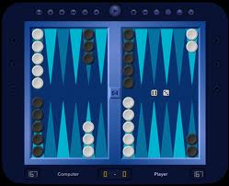
Reinforcement learning example
Backgammon
…
WIN!
…
LOSE!
Given sequences of moves and whether or not the player won at the end, learn to make good moves

Slide 28
Other learning variations
What data is available:
    Supervised, unsupervised, reinforcement learning
    semi-supervised, active learning, …
How are we getting the data:
    online vs. offline learning
Type of model:
    generative vs. discriminative
    parametric vs. non-parametric

Slide 29
Representing examples
examples
What is an example?
How is it represented?

Slide 30
Features
examples
features
How our algorithms actually “view” the data
Features are the questions we can ask about the examples
f₁, f₂, f₃, …, f_{n}
f₁, f₂, f₃, …, f_{n}
f₁, f₂, f₃, …, f_{n}
f₁, f₂, f₃, …, f_{n}

Slide 31
Features
examples
features
How our algorithms actually “view” the data
Features are the questions we can ask about the examples
red, round, leaf, 3oz, …
green, round, no leaf, 4oz, …
yellow, curved, no leaf, 8oz, …
green, curved, no leaf, 7oz, …

Slide 32
Classification revisited
examples
label
red, round, leaf, 3oz, …
apple
learn
green, round, no leaf, 4oz, …
apple
model/
classifier
yellow, curved, no leaf, 8oz, …
banana
green, curved, no leaf, 7oz, …
banana
During learning/training/induction, learn a model of what distinguishes apples and bananas based on the features
Notes:
This is the problem we’ll focus on for this class

Slide 33
Classification revisited
predict
Apple or banana?
model/
classifier
red, round, no leaf, 4oz, …
The model can then classify a new example based on the features

Slide 34
Classification revisited
predict
model/
classifier
Apple
red, round, no leaf, 4oz, …
Why?
The model can then classify a new example based on the features

Slide 35
Classification revisited
Training data
Test set
examples
label
red, round, leaf, 3oz, …
apple
?
green, round, no leaf, 4oz, …
apple
red, round, no leaf, 4oz, …
yellow, curved, no leaf, 4oz, …
banana
green, curved, no leaf, 5oz, …
banana

Slide 36
Classification revisited
Training data
Test set
examples
label
red, round, leaf, 3oz, …
apple
?
green, round, no leaf, 4oz, …
apple
red, round, no leaf, 4oz, …
yellow, curved, no leaf, 4oz, …
banana
Learning is about generalizing from the training data
green, curved, no leaf, 5oz, …
banana

Slide 37
models
model/
classifier
We have many, many different options for the model
They have different characteristics and perform differently (accuracy, speed, etc.)

Slide 38
Probabilistic modeling
train
probabilistic model:
p(example)
Model the data with a probabilistic model which tells us how likely a given data example is
training data

Slide 39
Probabilistic models
Example to label
probabilistic model:
p(example)
apple
or
banana
yellow, curved, no leaf, 6oz
features

Slide 40
Probabilistic models
For each label, ask for the probability
yellow, curved, no leaf, 6oz, banana
probabilistic model:
p(example)
yellow, curved, no leaf, 6oz, apple
features
label

Slide 41
Probabilistic models
Pick the label with the highest probability
yellow, curved, no leaf, 6oz, banana
probabilistic model:
p(example)
0.004
yellow, curved, no leaf, 6oz, apple
0.00002
features
label

Slide 42
What can we currently do?

Slide 43
What can we currently do?
Understand spoken language?
speech recognition is really good, if:
  restricted vocabulary
  specific speaker with training
Gotten quite good in the last few years and shows up in lots of places:
  Mobile: Siri, Ok Google, etc.
  Home assistants: Alexa, Google Home
What does the spoken language actually mean (language understanding)?
  much harder problem!
  many advances in NLP in small things, but still far away from a general solution

Slide 44
What can we currently do?
Speak?
  Understandable, but you wouldn’t confuse it for a person
  Can do accents, intonations, etc.
  Better with restricted vocabulary
  Loquendo
    https://www.nuance.com/omni-channel-customer-engagement/voice-and-ivr/text-to-speech.html
    Dealing with facial expression is challenging

Slide 45
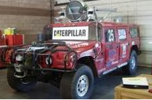
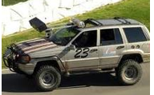
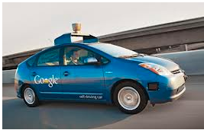
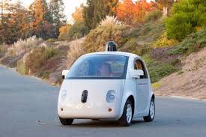
What can we currently do?
Drive a car?
  Freeway driving is relatively straightforward
  Off-road a bit harder
    see DARPA grand challenges (2004, 2005)
  And urban driving is even trickier
    See DARPA urban challenge (2007)
    Google’s autonomous vehicle
Notes:
https://www.google.com/selfdrivingcar/
https://www.tesla.com/autopilot
Uber

Slide 46
What can we currently do?
Drive a car?
Many driver assist technologies:
Automatic breaking
Automatic pedestrian detection
Lane drift avoidance
”smart” cruise control
Blind spot warning
…

Slide 47
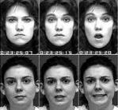
What can we currently do?
Identify emotion?
Some success in text
  movie reviews (assignment 7!)
  blogs
  twitter
  dealing with sarcasm is hard
Some success with faces
  strongly biased by training data
  works best when exaggerated

Slide 48
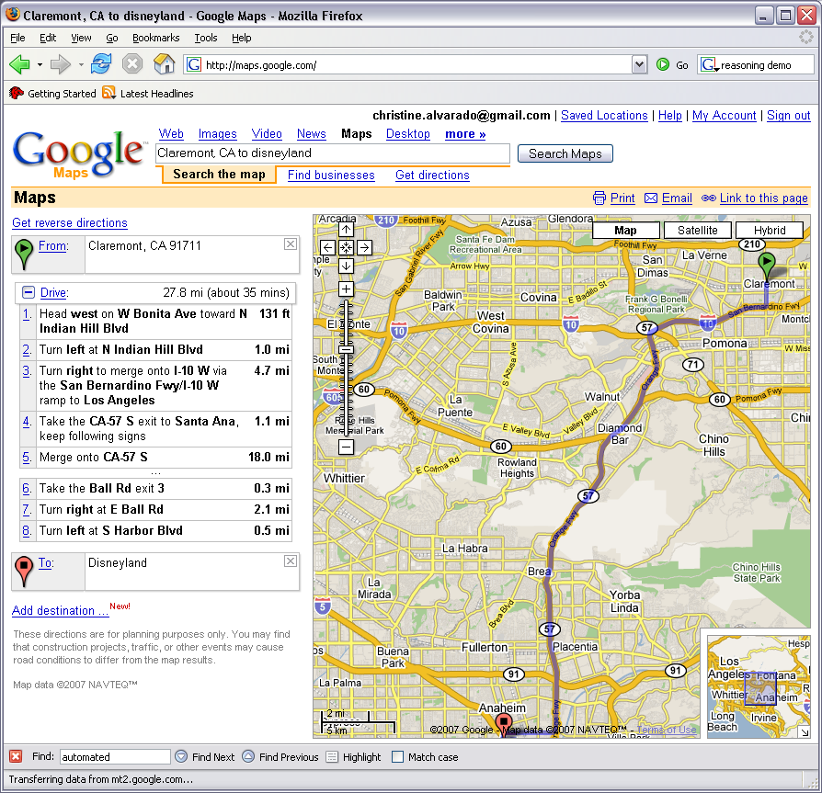
What can we currently do?
Reasoning?
  Success on small sub-problems
  General purpose reasoning is harder
    Wolfram Alpha
    OpenCyc

Slide 49
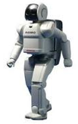
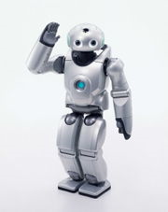
What can we currently do?
Walk?
  Robots have had a variety of locomotion methods
  Walking with legs, is challenging
    Differing terrains, stairs, running, ramps, etc.
  Recently, a number of successes
    Honda’s Asimo
      https://www.youtube.com/watch?v=SARB9Ol_Wz4
    Sony QRIO
      http://www.youtube.com/watch?v=9vwZ5FQEUFg
    Boston Dynamic’s Atlas
      https://www.youtube.com/watch?v=hSjKoEva5bg

Slide 50
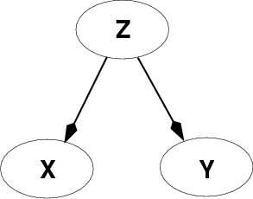
Fundamental problem of AI
Reasoning with knowledge
and uncertainty
Search
Many different ways of making an agent intelligent
Learning
Reasoning with
Utility

Slide 51
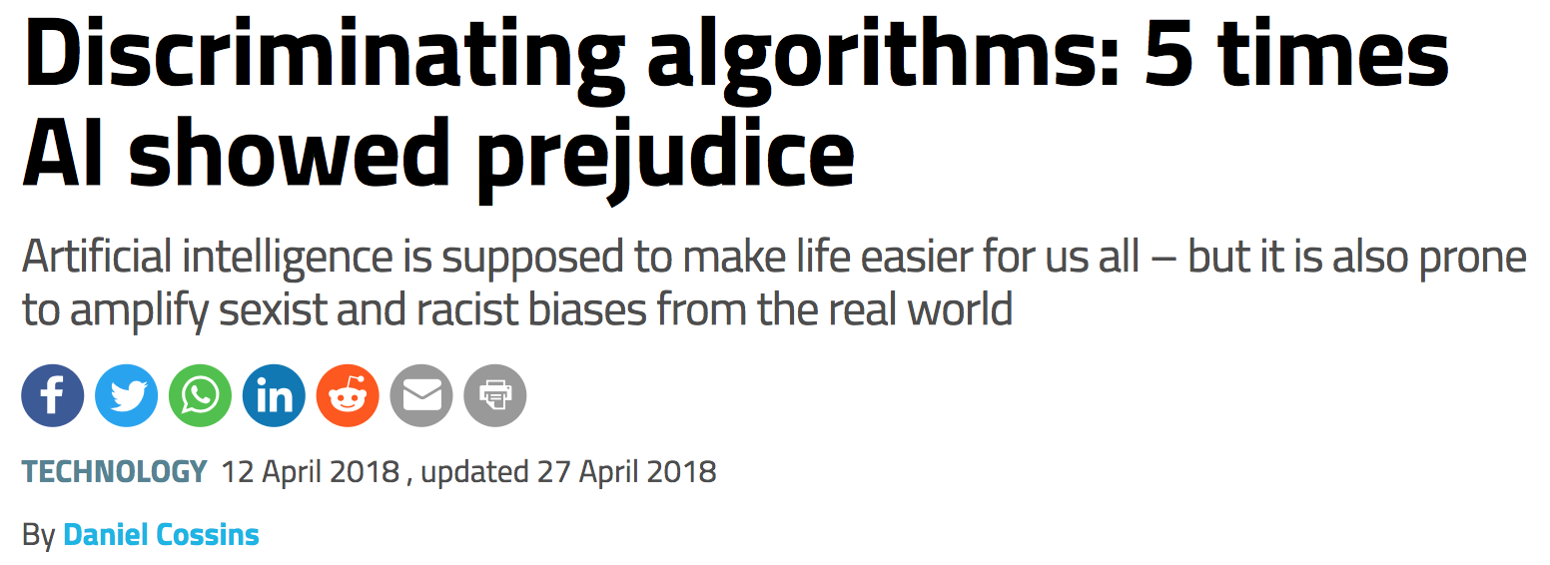
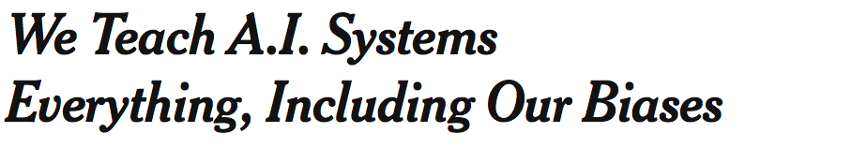

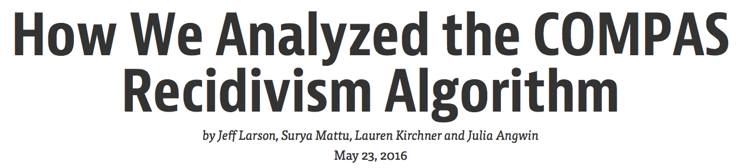
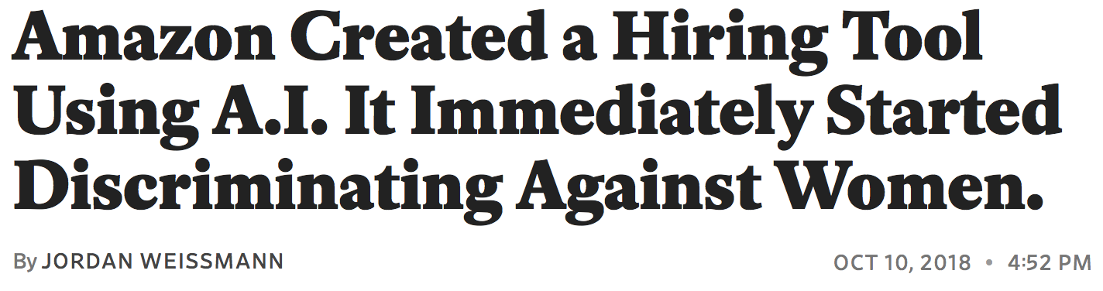
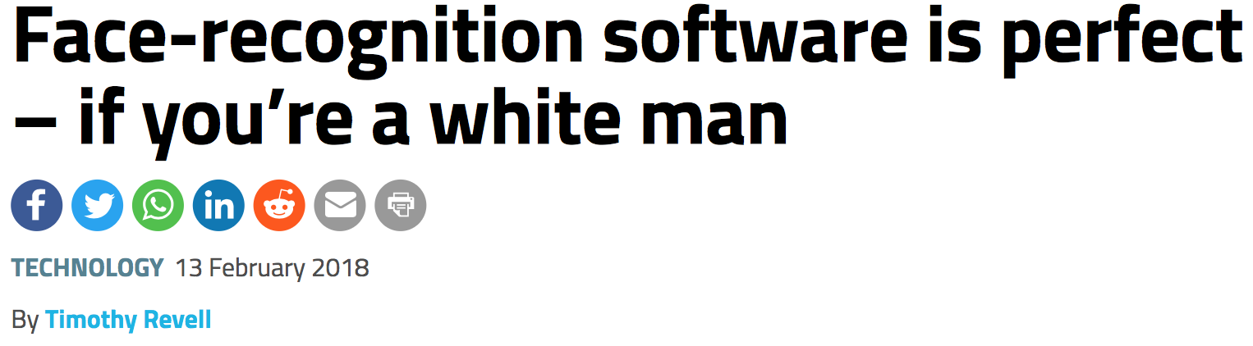
AI and Ethics

