Slide 1
Lecture 19: Plotting
CS 51P November 18, 2019

Slide 2
Last Week: Dictionaries
a data structure that stores key:value pairs
d = {'apple': .99, 'banana': .19, 'cantelope': 2.99}
restriction:
key must be immutable

Slide 3
Last Week: Dictionary Operations
other
adding to a dictionary
a_dict[key] = value
a_dict.update(b_dict)
removing from a dictionary
del (a_dict[key])
a_dict.pop(key)
returns a_dict[key]
len(a_dict)
a_dict.keys()
returns list
a_dict.values()
returns list
a_dict.items()
returns list of tuples
b_dict = a_dict.copy()
shallow copy!

Slide 4
Last Week: Lists vs. dictionaries
Both data structures.
Why would you choose one over the other?
a data structure is something that holds a collection of data and that supports certain operations for working with that data
Lists: sequential access
Dictionaries: fast lookup

Slide 5
def mystery(my_dict): d = {} for i in my_dict.keys(): if my_dict[i] in d: d[my_dict[i]].append(i) else: d[my_dict[i]] = [i] return d def main(): d = {"a":1, "b":2, "c":1, "d":0, "e":2} print(mystery(d))
main()

Slide 6
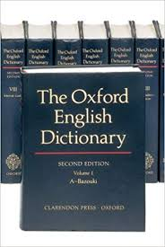
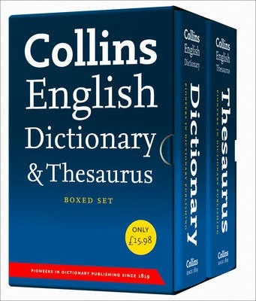
Exercise
The function merge(d1,d2) merges two dictionaries and returns a single dictionary containing all the key:value pairs from both input dictionaries. If both dictionaries contain the same key, the new dictionary should contain the smaller of the two values.

Slide 7
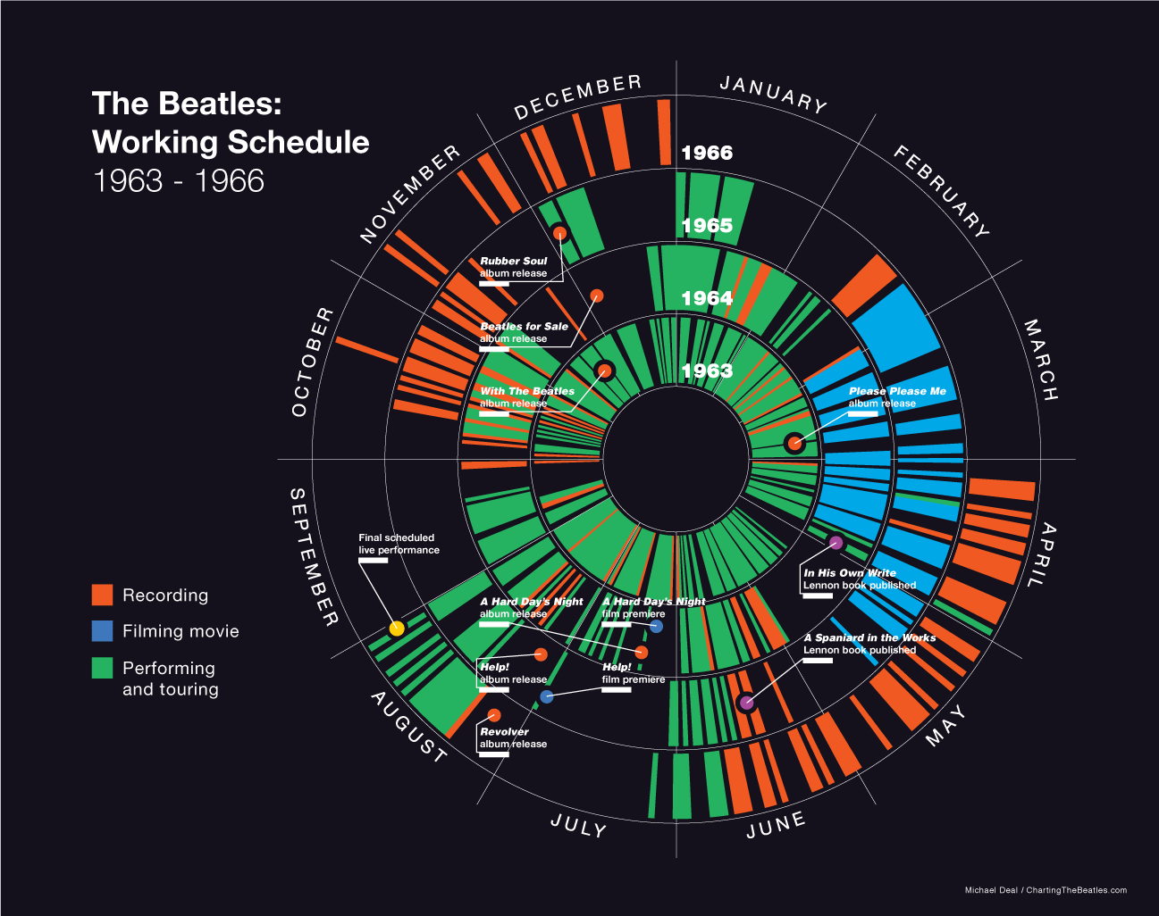
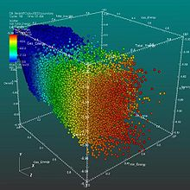
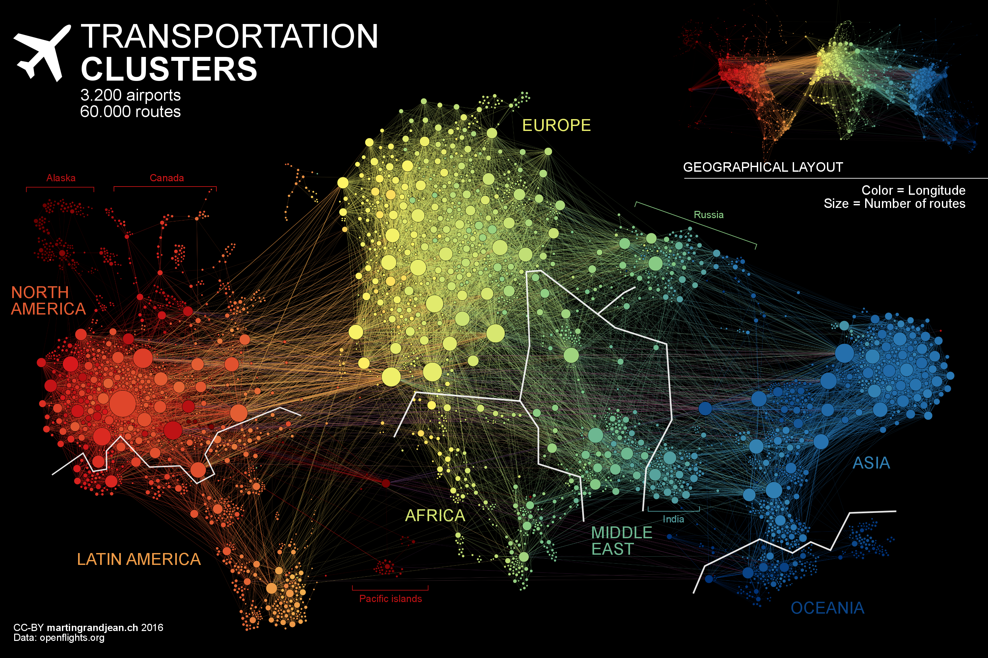
Data Visualization
Notes:
Demo example dataset, then general intro to visualization, then demo election visualiations

Slide 8
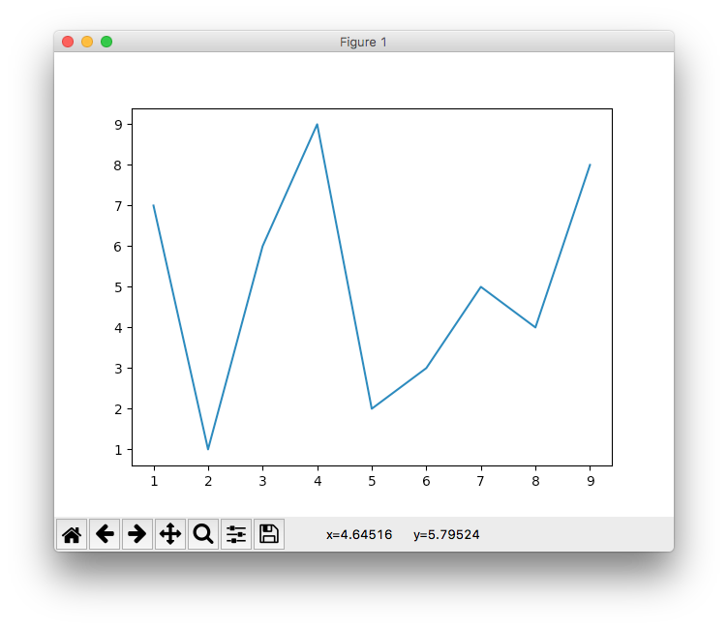
Data Visualization
matplotlib
https://matplotlib.org/index.html
based on Matlab
import matplotlib.pyplot as plt
from random import shuffle
x = list(range(1,10))
y = x.copy()
shuffle(y)
plt.plot(x, y)
plt.show()

Slide 9
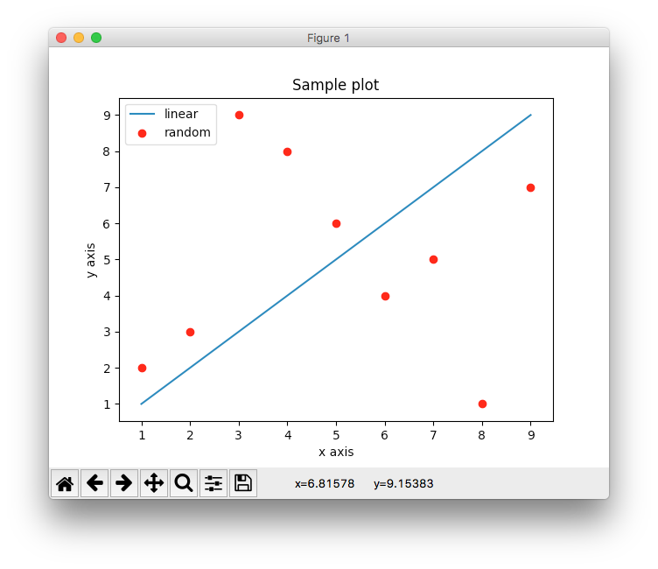
Customizing
import matplotlib.pyplot as plt
from random import shuffle
x = list(range(1,10))
y = x.copy()
shuffle(y)
plt.plot(x, x, label="linear")
p = plt.plot(x, y, 'r.' label="random")
plt.xlabel("x axis")
plt.ylabel("y axis")
plt.title("Sample plot")
plt.legend()
plt.show()

Slide 10
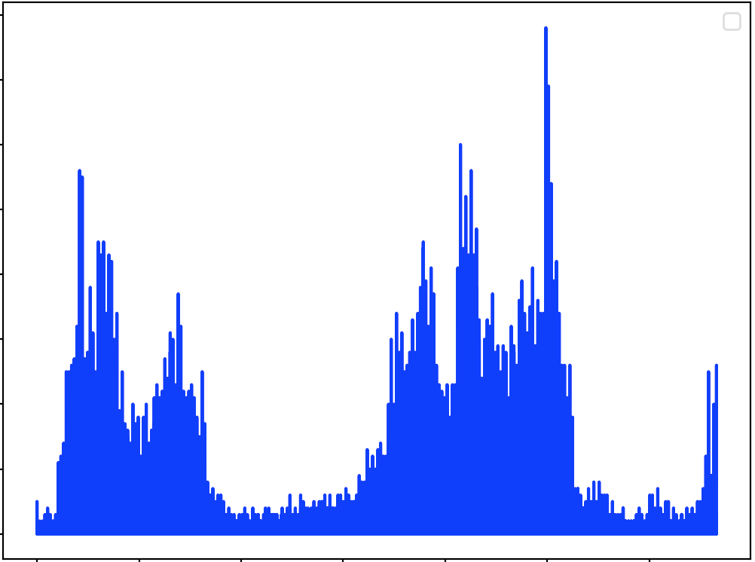
Exercise
Write a function plot_ppm that takes a filename as input and produces an image histogram (a plot of the number of pixels for each rgb value
Hint: r g b values in a ppm file are represented by three numbers (e.g., 250 50 100). You can represent this pixel as a number 250*(255*255) + 50*(255) + 100

Slide 11
Example: Word Count
Write a function that processes a file and returns a dictionary for handling repeated queries of the form "How many times does the word _____ appear?"

