Slide 1
Lecture 16: Algorithms
CS 51P November 4, 2019

Slide 3
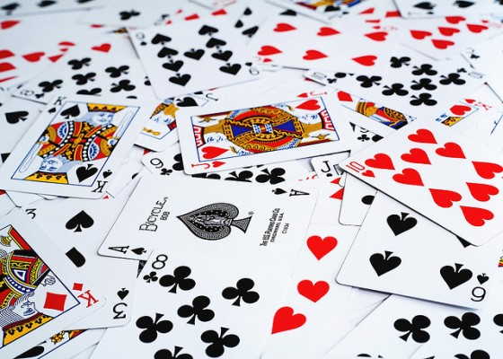
Example: Sorting
Notes:
Exercise: (1) think about how you would sort something, (2) turn to a partner: explain in detail how you would sort, (3) did you have the same answer? If not, have your partner explain how they would sort. If yes, discuss why you sort a deck that way.

Slide 4
Why Sorting?
Sorting is useful
Database indexing
Operations research
Compression
There are lots of ways to sort
There isn't one right answer
You need to be able to figure out the options and decide which one is right for your application.
Today, we'll learn about several different algorithms (and how to derive them)

Slide 5
An aside about memory…

Slide 6
Example: Sorting
Notes:
Exercise: (1) think about how you would sort something, (2) turn to a partner: explain in detail how you would sort, (3) did you have the same answer? If not, have your partner explain how they would sort. If yes, discuss why you sort a deck that way.

Slide 7
Three Possible Sorting Algorithms
For each position in the list:
Find the object that should be there; put it in the right place
For each object in the list:
If that object should be earlier in the list, put it in the right place
Recursively:
Sort the first half of the list
Sort the second half of the list
Merge the two halves together
Notes:
Demo: start implementing selection sort, get as far as "put it in the right place", move on to aside about memory

Slide 8
def selection_sort(alist):
for pos in range(0, len(alist)):
pos_of_min = pos
for spot in range(pos+1, len(alist)):
if alist[spot] < alist[pos_of_min]:
pos_of_min = spot
temp = alist[pos]
alist[pos] = alist[pos_of_min]
alist[pos_of_min] = temp
alist = [10, 46, -10, -100, 0, 47, 4, 23, -3]
selection_sort(alist)
print(alist)
Notes:
https://visualgo.net/bn/sorting

Slide 9
def insertion_sort(alist):
for index in range(1,len(alist)):
value = alist[index]
pos = index
while pos>0 and alist[pos-1]>value:
alist[pos]=alist[pos-1]
pos = pos-1
alist[pos]=value
alist = [10, 46, -10, -100, 0, 47, 4, 23, -3]
insertion_sort(alist)
print(alist)
Notes:
https://visualgo.net/bn/sorting

Slide 10
Merging
What if our list looked like two sorted lists end to end?
We could sort by merging the two lists!
4
5
10
24
1
2
6
12
sorted
sorted

Slide 11
Merging
What if our list looked like two sorted lists end to end?
We could sort by merging the two lists!
1
2
4
5
6
10
12
24
4
5
10
24
1
2
6
12
4
5
10
24
Notes:
def merge(lst):
middle = int(len(lst)/2)
olist = lst[:middle].copy()
pos = 0
i = 0
j = middle
while i < middle :
if j == len(lst) or olist[i] < lst[j]:
lst[pos] = olist[i]
i += 1
else:
lst[pos] = lst[j]
j += 1
pos += 1

Slide 12
Mergesort
Notes:
Image from: https://algorithms.tutorialhorizon.com/merge-sort/
Visualization: https://visualgo.net/bn/sorting

Slide 13
Sorting Algorithms
Selection Sort
Insertion Sort
def selection_sort(lst):
# for each pos in list for pos in range(len(lst)):
# find obj that should be there min_pos = pos for i in range(pos+1, len(lst)): if lst[i] < lst[min_pos]: min_pos = i # swap that obj into position pos
swap(lst, pos, min_pos)
def insertion_sort(lst):
# for each obj in list for pos in range(len(lst)):
# move obj to correct position curr_pos = pos while curr_pos > 0 and
lst[curr_pos]<lst[curr_pos-1]:
swap(lst, curr_pos-1, curr_pos) curr_pos = curr_pos - 1
Merge Sort
def merge_sort_helper(lst, start, end):
# Base Case
if end-start < 2:
return
# Recursive Case
middle = start + int((end-start) / 2)
merge_sort_helper(lst, start, middle)
merge_sort_helper(lst, middle, end)
merge(lst, start, end)
Which algorithm is better?

