Slide 1
Lecture 15: Nested Lists
CS 51P October 30, 2019

Slide 2
Lists
a list is an ordered set of elements:
many ways to create a list including:
a list is a sequence, so can index into, loop over, check for membership, slice, etc
operators: + and *
lists are mutable
[3, 6, 2, 1]
a_list = [3, 6, 2, 1]
b_list = []
c_list = "a b c d".split()
d_list = open("temp.txt","r").readlines()
Notes:
Note: file.readlines()?

Slide 3
adding to a list
removing from a list
a_list.extend(list)
a_list.append(elem)
a_list.insert(index, elem)
del(a_list[slice])
a_list.remove(elem)
error if elem not in a_list
a_list.pop()
returns (and removes) a_list[-1]
a_list.pop(index)
returns (and removes) a_list[index]
other
min(a_list), max(a_list), len(a_list)
elem in a_list
returns bool
a_list.index(elem)
returns int or error
modifying a list
direct assignment

Slide 4
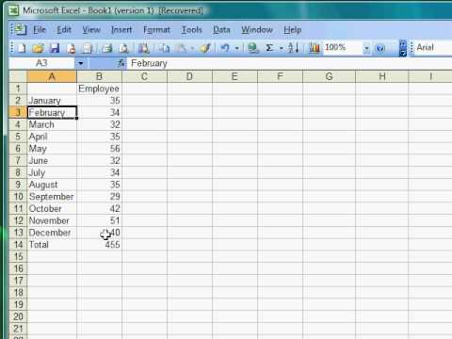
Matrices
Can think of lists as a one-dimensional matrix
What if you want to use a two-dimensional matrix?
Can create a list of lists aka a nested list!

Slide 5
Example
a_list = [ [4, [True, False], 6, 8], [888, 999] ]
if alist[0][1][0]:
print(alist[1][0])
else:
print(alist[1][1])

Slide 6
Example
Define a function nested_total that takes a list of lists of ints and returns the sum of all the values.
list = [[1,2], [3], [4,5,6]]
sum = nested_total(list)
print(sum)
21

Slide 7
Exercise
Define a function nested_avg that takes a list of lists of ints and returns a list with each sublist averaged
list = [[1,2], [3], [4,5,6]]
list_avg = nested_avg(list)
print(list_avg)
[1.5, 3.0, 5.0]

Slide 8
Example
board = [[0,0,9,6,0,7,4,3,1],
[8,0,0,0,5,3,0,0,9],
[0,6,0,2,0,0,5,0,0],
...
[4,0,0,1,0,2,6,5,0]]
write a function set_value that takes a nested list board and ints i, j, n and updates the (i,j)th entry of board to be the value n
write a function check_row_i that takes an int i and a nested list board. The function should return True if and only if row i contains each integer from 1 through 9 exactly once.

Slide 9
Exercise
board = [[0,0,9,6,0,7,4,3,1],
[8,0,0,0,5,3,0,0,9],
[0,6,0,2,0,0,5,0,0],
...
[4,0,0,1,0,2,6,5,0]]
write a function check_column_i that takes an int i and a nested list board. The function should return True if and only if column i contains each integer from 1 through 9 exactly once.
write a function check_block_ij that takes ints i and j and a nested list board. The function should return True if and only if the 3x3 block starting at row i, column j contains each integer from 1 through 9 exactly once
write a function check_solution that takes a nested list board and returns True if and only if board represents a correctly solved puzzle.

