Slide 1
Lecture 14: Lists (cont'd)
CS 51P October 28, 2019

Slide 2
Lists
a list is an ordered set of elements:
many ways to create a list including:
a list is a sequence, so can index into, loop over, check for membership, slice, etc
operators: + and *
lists are mutable
[3, 6, 2, 1]
a_list = [3, 6, 2, 1]
b_list = []
c_list = "a b c d".split()
d_list = open("temp.txt","r").readlines()
Notes:
Note: file.readlines()?

Slide 3
adding to a list
removing from a list
a_list.extend(list)
a_list.append(elem)
a_list.insert(index, elem)
del(a_list[slice])
a_list.remove(elem)
error if elem not in a_list
a_list.pop()
returns (and removes) a_list[-1]
a_list.pop(index)
returns (and removes) a_list[index]
other
min(a_list), max(a_list), len(a_list)
elem in a_list
returns bool
a_list.index(elem)
returns int or error
modifying a list
direct assignment

Slide 4
Tuples
a tuple is an ordered set of elements:
ways to create a tuple:
a tuple is a sequence, so can index into, loop over, check for membership, slice, etc
operators: + and *
tuples are immutable
(3, 6, 2, 1)
tup1 = (3, 6, 2, 1)
tup2 = ()
tup3 = tuple(["a","b","c"])
Notes:
Note: file.readlines()?

Slide 5
Example
Can we define a variable that stores the colors of the rainbow?
colors = ("red", "orange", "yellow", "green", "blue", "purple")

Slide 6
functions that operate on lists
write a function odds that takes a list of ints and returns a list of the odd elements
write a function double that takes a list of ints and returns a list with every number doubled
write a function max that takes a list of ints and returns the largest value
filter
map
reduce
Notes:
Do odds as an example
double and max as exercises

Slide 7
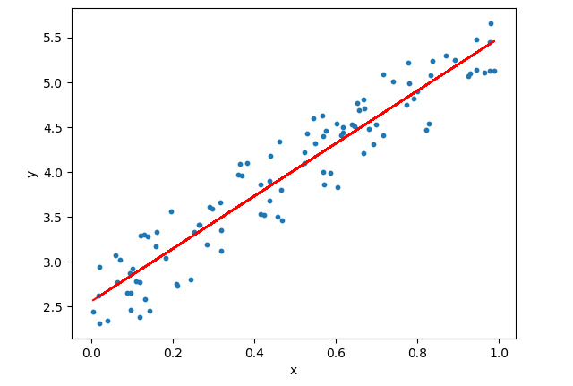
Example: Mean Square Error

Slide 8
Example: Mean Square Error
data = [(y0,y_hat0),(y1,y_hat1),…,(yn,y_hatn)]
Write a function that takes a list of pairs (two-element tuples where the first element is the observed value and the second element is the estimated value) and replaces each element with the square of the differences between those two elements
Write a function that takes a list of numeric values and returns the mean (average) of those values
Write a function that takes a list of pairs (two-element tuples where the first element is the observed value and the second element is the estimated value) returns the mean square error of that estimator.

Slide 9
MapReduce (map + reduce)

Slide 10
list comprehension (filter + map)
new_list = []
for i in old_list:
if filter(i):
new_list.append(map(i))
new_list = [map(i) for i in old_list if filter(i)]
Example: rewrite odds using list comprehension

Slide 11
list comprehension (filter + map)
new_list = []
for i in old_list:
if filter(i):
new_list.append(map(i))
new_list = [map(i) for i in old_list if filter(i)]
Exercise: rewrite double using list comprehension
Exercise: given a list of ints, create a new list that contains the squares of the even elements

