Slide 1
Lecture 12: Functional Programming
CS 51P October 16, 2019

Slide 2
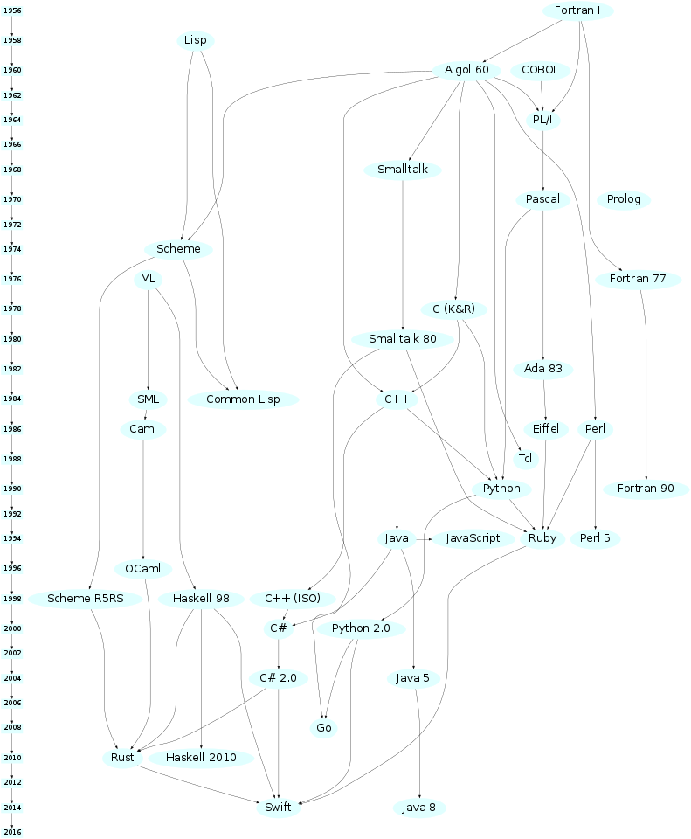
A History of Programming Languages
Notes:
clojure, erlang, scala, python3 (2008), matlab

Slide 3
Programming Paradigms
Imperative Languages
programs are sequences of instructions that tell the computer how to modify the program state (i.e., update values in variables)
Procedural Languages:
programs are organized sets as functions (aka. procedures) called modules
Examples: C, Python
Object-Oriented Languages:
programs are organized as values (called objects), each type of object has a set of component values (fields) and a set of functions (methods)
Examples: C++, Java, Swift, Python!
Functional Languages
programs define what stuff is
Examples: Haskell, OCaml, F#, Coq

Slide 4
Pure Functional Programming Languages
stateless
use recursion instead of loops
Today we'll use OCaml as an example. It's not actually purely functional, but for simplicity we'll pretend it is

Slide 5
OCaml Values and Types
# 47;; - : int = 47
# 47.;; - : float = 47.
# true;; - : bool = true
# ‘a’;; -: char=’a’
# “CS51p”;; - : string = “CS51p”

Slide 6
Function Values
# fun n ->n + 47 ;; - : int ->int = <fun>
We just defined a (anonymous) function
It takes one argument n
The function returns the sum of the argument and 47
The function is of type int -> int

Slide 7
OCaml Expressions
Same general idea
Slightly different syntax
No shared operators, no automatic casting,
# 33 + 14;; - : int = 47
# 33. +. 14.;; - : float = 47.
# 33. +. 14;; Error

Slide 8
Variables and let
Use keyword let to define (ie., bind a value to) a variable
# let v = 33 + 14 ;; val v: int=47
Same syntax to define a function
# let add47 n = n + 47 ;; val add47 : int -> int = <fun>
So functions are values!

Slide 9
Applying Functions
# add47 1 ;; -: int=48
# add47 (add47 1) ;; -: int=95
# add47 (add47 (add47 (add47 1)));;
-: int=189
Notes:
example: let apply f a b = f a b;;

Slide 10
Multi-Parameter Functions
# let xPlus2y x y = x + 2 * y;; val xPlus2y : int -> int -> int= <fun>
We just defined a function called xPlus2y
It takes two arguments x and y
It computes x + 2y
The function is of type int -> int -> int
xPlus2y 6 5;;
-: int=16
xPlus2y 6;;
-: int -> int = <fun>
(xPlus2y 6) 5;;
-: int =16

