Slide 1
Lecture 11: Recursion
CS 51P October 14, 2019

Slide 2
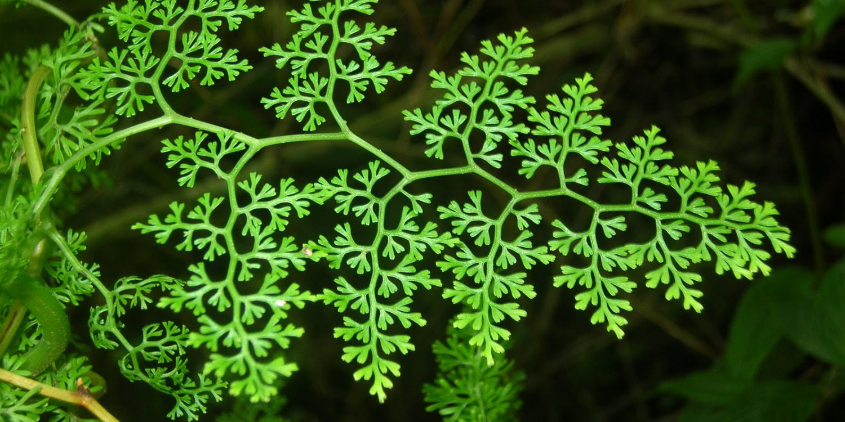
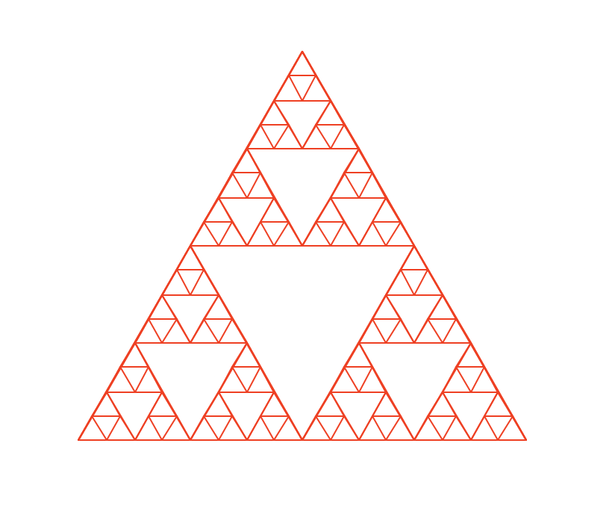
Recursion
EVE
CIVIC
MADAM
AVID DIVA
STEP ON NO PETS
STRESSED DESSERTS
ABLE WAS I ERE I SAW ELBA
LIVED ON DECAF FACED NO DEVIL
1, 1, 2, 3, 5, 8, 13, 21, ...

Slide 3
Writing Recursive Functions
Come up with a recursive definition of your problem
a _x_ is a _y_ plus _n_ smaller _x_s, unless it is really small, in which case it is _z_
Define a base case:
Some conditions when the function doesn't recursively call the function (the "really small" case)
Define a recursive case:
Some conditions when the function recursively calls itself
Make sure it calls itself with different (usually "smaller") arguments
Define the return value:
Combine answers from recursive call(s) into answer for full problem
0)
Notes:
Demo: palindrome_recursive

Slide 4
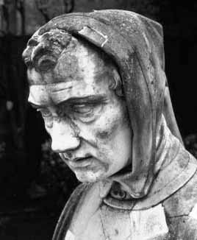
Review: Fibonacci Numbers
Fibonacci sequence: 0 1 1 2 3 5 8 13 …
Where $φ=\frac{1+√5}{2}$ and $ψ=1 −φ$
Recursive definition:
fib(0) = 0
fib(1) = 1
fib(n) = fib(n − 1) + fib(n − 2) n ≥ 2
Fibonacci (Leonardo Pisano) 1170-1240?
base cases

Slide 5
Exponentiation
$x^{n}=x⋅x⋅…⋅x$

Slide 6
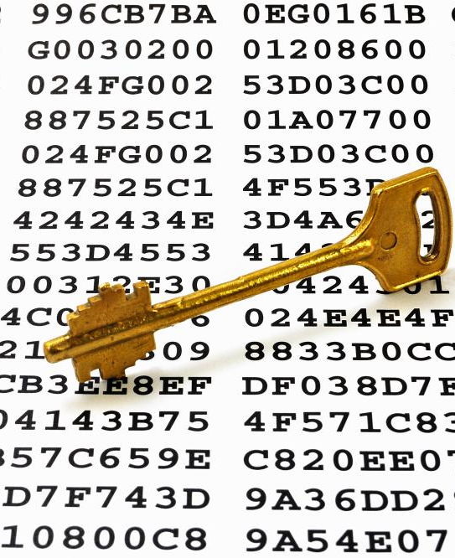
Cryptography
Encrypt: $c = m^{e} mod n$
Decrypt: $m=c^{d} mod n$

Slide 7
Exponentiation
$x^{n}=x⋅x⋅…⋅x$
OR
$x^{n}={\left(x^{2}\right)}^{\frac{n}{2}}$ (if n is even)
$x^{n}=x⋅{\left(x^{2}\right)}^{\frac{\left(n−1\right)}{2}}$ (if n is odd)

Slide 8
Square-and-Multiply
def square_and_mult(x, n):
# base case
if n == 0
return 1
# handle odd values
if n % 2 == 1:
return x * square_and_mult(x*x, (n-1)/2)
# handle even values
return square_and_mult(x*x, n/2)
We can recursively compute exponentiation with square
(and optional multiply) and division by 2!

Slide 9
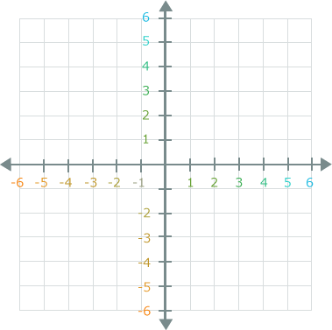
Turtle graphics

Slide 10
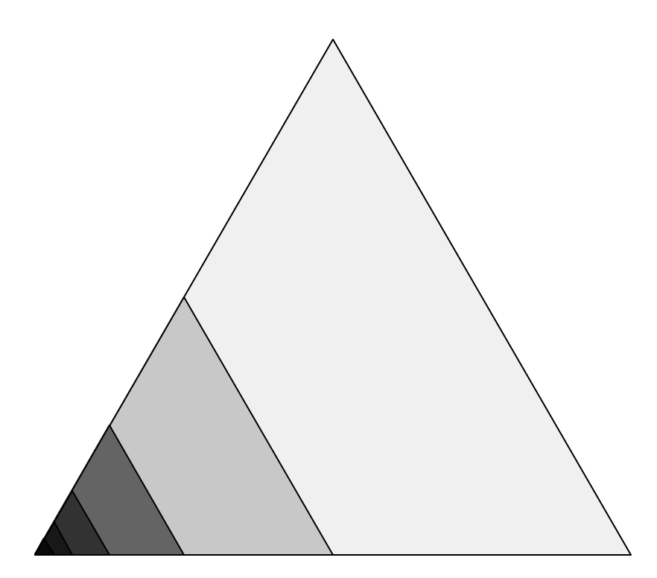
Recursive Graphics
Notes:
Example: define recusively
Example: implement with turtle
Example: implement with turtle and return count

Slide 11
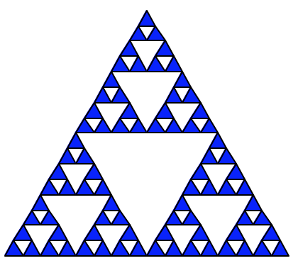
Counting Triangles
Notes:
Exercise: define recursively
Example: implement
Exercise: implement with count

Slide 12
Triangle Pyramid
Notes:
Exercise: define & implement

