Slide 1
Lecture 10: Recursion
CS 51P October 9, 2018

Slide 2
Example: Palindromes
EVE
CIVIC
MADAM
AVID DIVA
STEP ON NO PETS
STRESSED DESSERTS
ABLE WAS I ERE I SAW ELBA
LIVED ON DECAF FACED NO DEVIL
Notes:
Review: palindrome_five (from checkpoint 1)
Exercise: write a function palindrome_loop that works for any length of string

Slide 3
Example: Palindromes
One way to think about palindromes:
Another way to think about palindromes:
ABLE WAS I ERE I SAW ELBA
…
ABLE WAS I ERE I SAW ELBA
palindrome

Slide 4
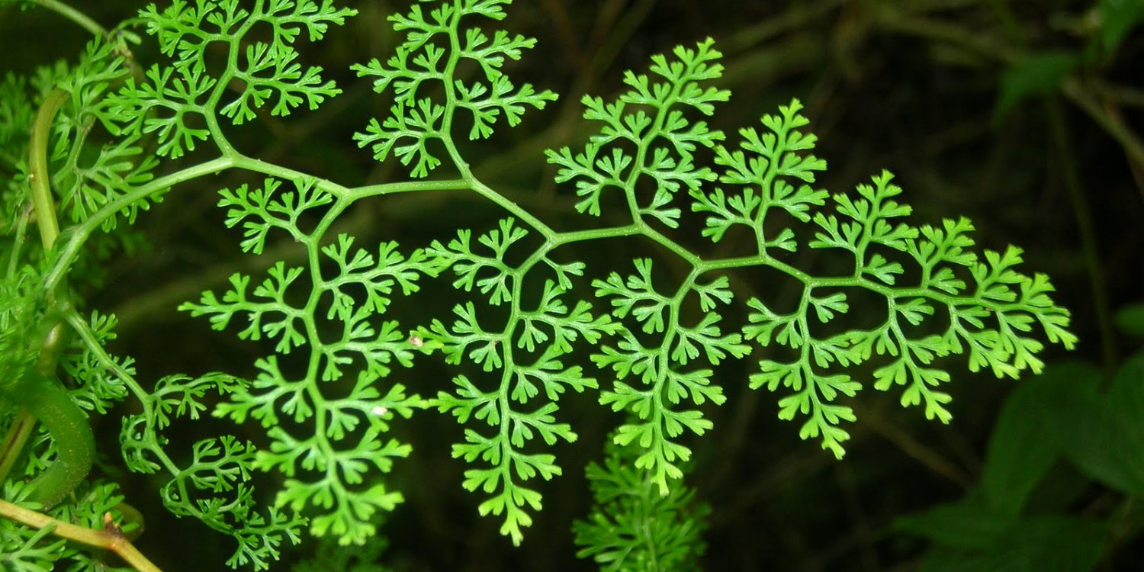
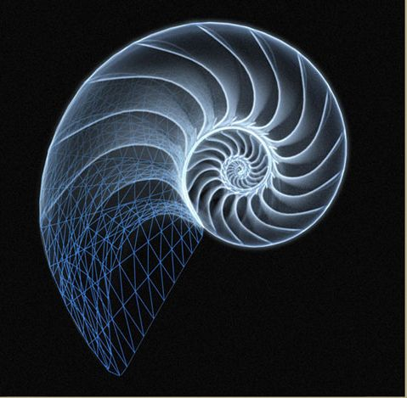
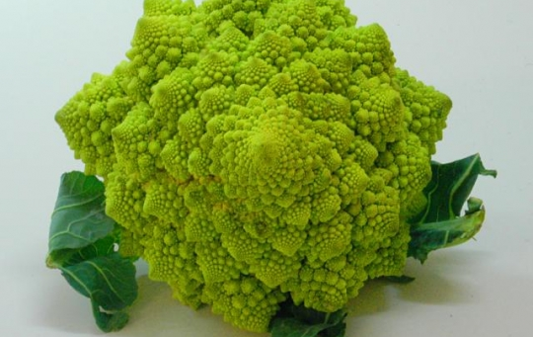
Recursion

Slide 5
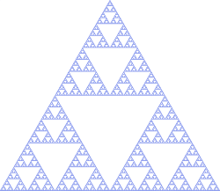
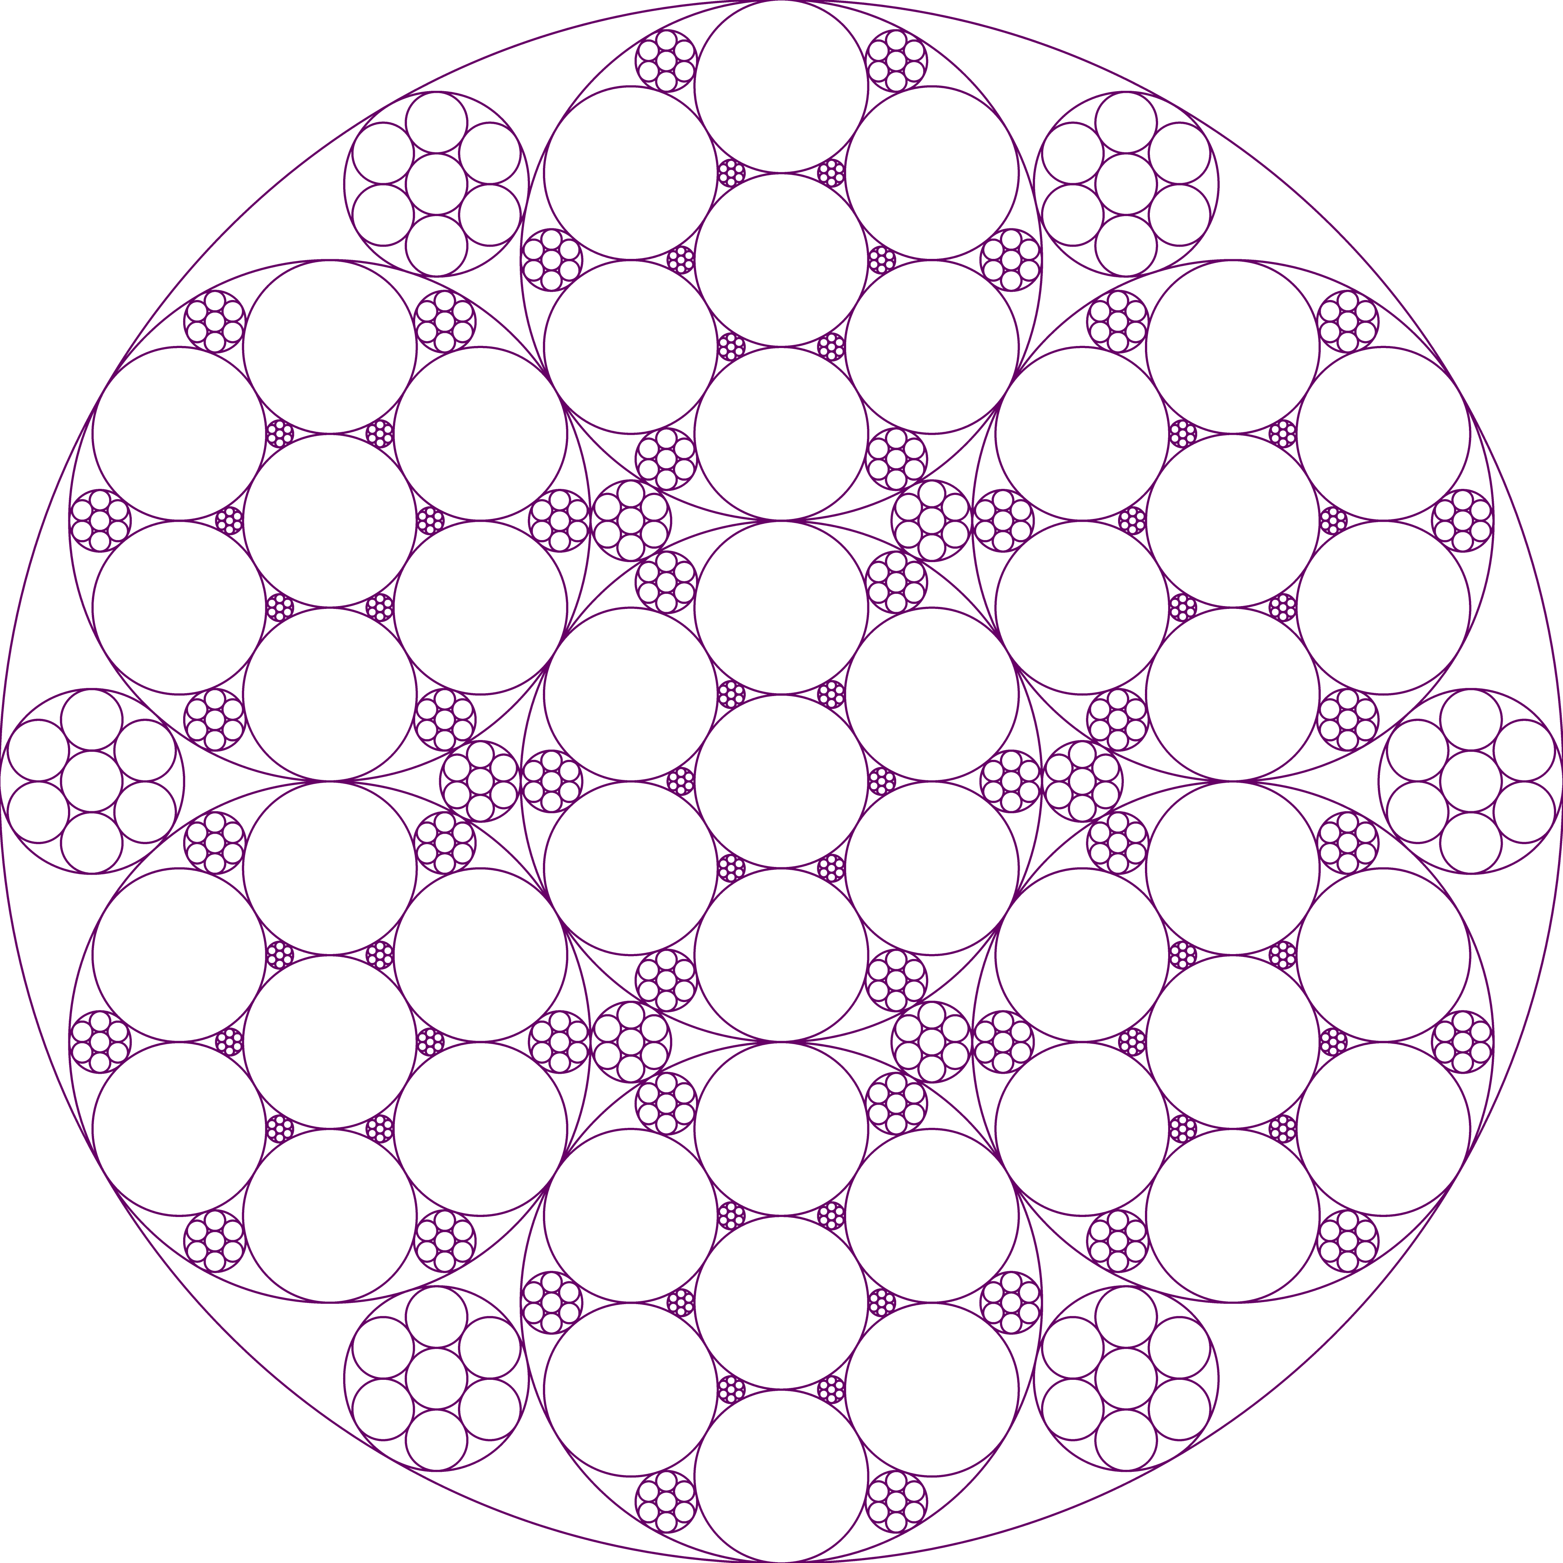
Recursion

Slide 6
Recursion
Notes:
https://en.wikipedia.org/wiki/T-square_(fractal)

Slide 7
Recursive definition
a _x_ is _y_ plus _#_ smaller _x_. unless it is very small, in which case it is _z_.
A t_square is a square
plus 4 smaller t_squares
of half the size
centered at each of the corners of the large square
unless it's very small in which case it's nothing

Slide 8
Exmple: matryoshka
a _x_ is _y_ plus _#_ smaller _x_. unless it is very small, in which case it is _z_.
What is a matryoshka?
a matryoshka is a doll plus 1 smaller matryoshka. unless it is very small, in which case it is nothing.

Slide 9
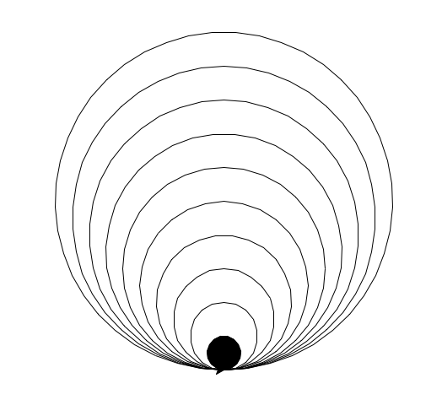
Example: circle_drawing
a _x_ is _y_ plus _#_ smaller _x_. unless it is very small, in which case it is _z_.
What is a circle_drawing?
a circle_drawing is a circle plus 1 smaller circle_drawing. unless it is very small, in which case it is a filled circle

Slide 10
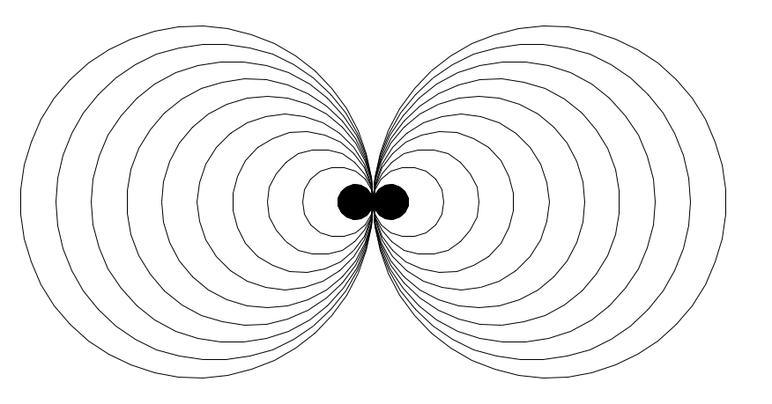
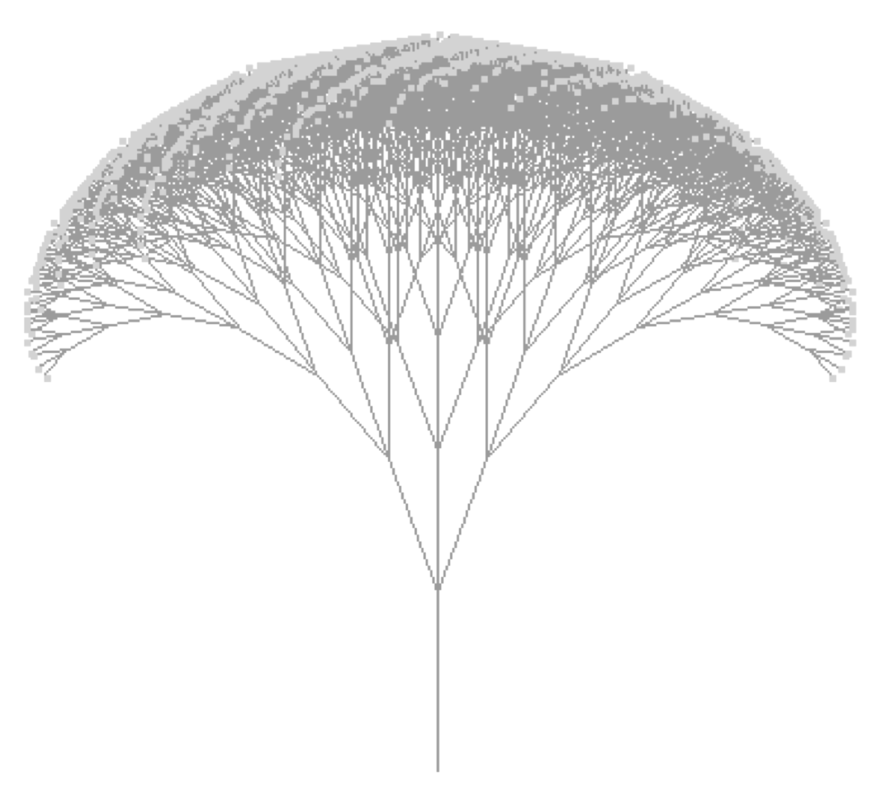
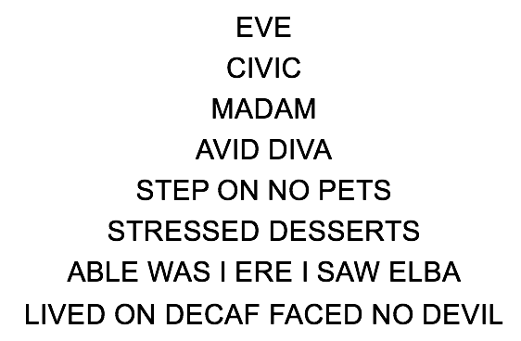
Exercise: seeing recursion

Slide 11
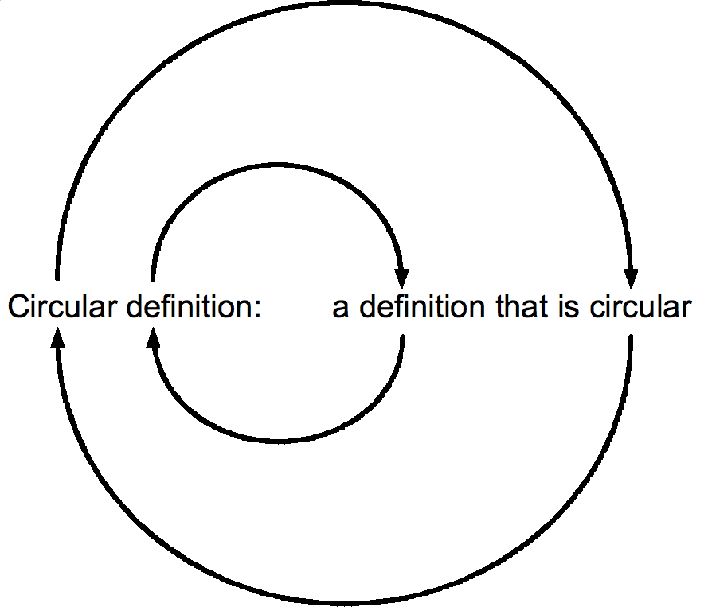
Recursion
Recursive functions are functions that call themselves

Slide 12
Avoiding Infinite Recursion:
Define a base case:
Some conditions when the function doesn't recursively call the function (usually the "smallest" case)
Define a recursive case:
Some conditions when the function recursively calls itself
Make sure it calls itself with different (usually "smaller") arguments!
Sanity Check: does the recursive case create smaller/simpler versions of itself? will the code eventually reach the base case?
Notes:
Demo: palindrome_recursive

Slide 13
Example: Palindromes
EVE
CIVIC
MADAM
AVID DIVA
STEP ON NO PETS
STRESSED DESSERTS
ABLE WAS I ERE I SAW ELBA
LIVED ON DECAF FACED NO DEVIL

Slide 14
Exercise
def mystery(n):
if n == 1:
return 1
else: return n + mystery(n-1)
what is returned by mystery(3)? mystery(5)? mystery(k)?

Slide 15
Exercise
Fibonacci numbers:
1, 1, 2, 3, 5, 8, 13, 21, ...
Define a function fib which takes a parameter n (an int) and returns the n^{th} Fibonacci number

