Slide 1
Lecture 8: Debugging and Testing
CS 51P September 30, 2019

Slide 2
Announcements
First exam next Monday (Checkpoint 1)
  Lots of office hours/mentor sessions this week
  Mentor sessions this weekend 2-4pm Saturday, 2:30-4:30 Sunday in Edmunds 229
  One-on-one tutoring available through QSC
  Previous checkpoints available on Piazza
A3 graded
A4 released, due Friday

Slide 3
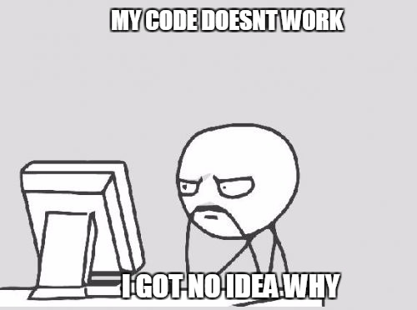

Slide 4
Common Types of Errors
Syntax Errors: there is something wrong with the structure of the program, and Python doesn't understand it
Runtime Errors: something goes wrong while the program is running
Semantic Errors: the program runs, but it doesn't do what you want it to do

Slide 5
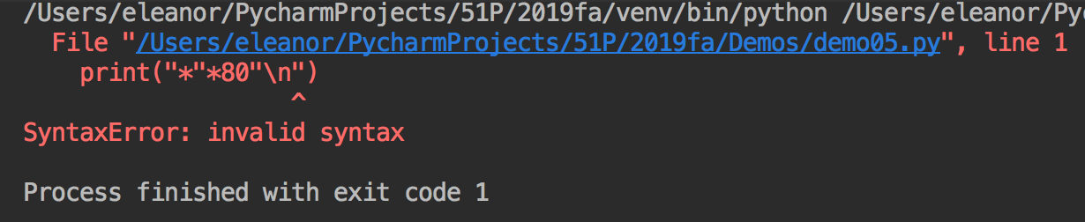
Handling Syntax Errors
Find the bug
Do you see the problem?
  If yes, fix it!
  If no, try running through the list of common syntax bugs
  If still no, check your class notes, discuss the problem abstractly with a friend ("what's the right syntax for…"), or ask a TA/instructor (it's ok to get help!)

Slide 6
Common Syntax Errors
Misspelling a variable name or a function name
Missing quotation marks around a string
Mismatched parentheses or quotation marks
Missing a colon at the end of an if/while/for statement
Using = instead of ==
Using a Python keyword as a variable name
Make sure you remembered to save your file after making your changes!

Slide 7
Example
in = int(input("Pick a number\n"))
if in = 13:
print("I am also fond of the number 13!")
elif in > 13:
print("I am fond of the number 13, which is " + str(in-13) + " less than " + str(in)
else
print("I am fond of the number 13, which is "
+ str(13-in) + " more than " + str(in)
in2 = input("Do you like tea?)
while in2 != "yes" and != "no":
in2 = input("Please answer yes or no. Do you like tea?")
if in2 == "yes":
print("Great!")
else:
print("That's too bad.")
print("Bye!)
SyntaxError
SyntaxError
SyntaxError
SyntaxError
SyntaxError
SyntaxError
SyntaxError
SyntaxError

Slide 8
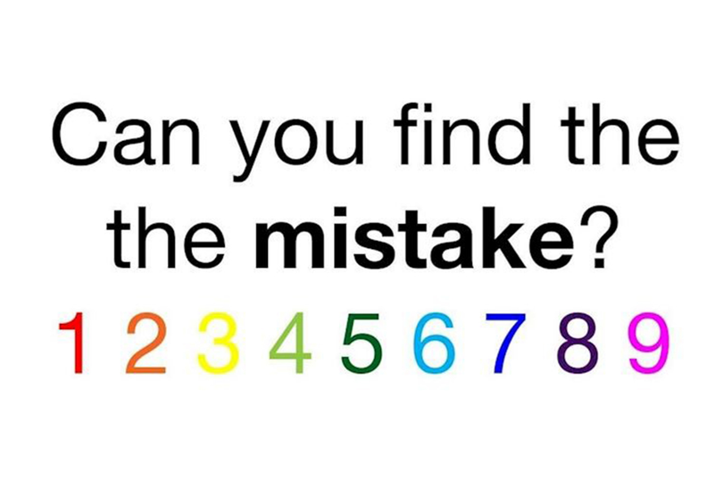

Slide 9
Handling Runtime Errors: Program Hangs
You are probably in an infinite loop!
Add print statements to figure out how far you got
Add print statements to find line(s) that repeat over and over
Your program might also just be waiting for an input

Slide 10
Handling Runtime Errors: Exceptions
NameError: Python doesn't recognize a (variable) name
  Find the bug!
  Did you forget quotation marks around a string?
  Did you misspell a variable name? Make a typo?
  Is the variable you are trying to use in scope? Use before define?

Slide 11
Scope
Storing a value in a variable:
  If there is a variable with that name in the current function's stack frame, store the value in that variable
  Otherwise create a new variable in the current function's stack frame and store the value there
Using a variable:
  Check for a local variable with that name. If it exists, use the value stored in that variable
  Else if there exists a global variable with that name, use the value stored in that global variable
  Otherwise get a NameError
fav = 13
def good_choice(num):
b = (num == fav)
return b
def main():
in_str = input()
fav = int(in_str)
if good_choice(fav):
print("yay")
else:
print("boo")
Notes:
note: shadowing
if comment out fav def the global!
try print in_str and b in opposite functions (will fail)

Slide 12
Exercise
def print_example(s4,s5):
s1 = 3*s4
s2 = s4+s5
print(s1)
print(s2)
return s1+s2
s1 = '!'
s2 = '?'
print(s1)
s3 = print_example(s1,s2) print(s2)
print(s3)
print(s4)

Slide 13
Handling Runtime Errors: Exceptions
NameError: Python doesn't recognize a (variable) name
  Find the bug!
  Did you forget quotation marks around a string?
  Did you misspell a variable name? Make a typo?
  Is the variable you are trying to use in scope? Use before define?
TypeError: Python can't perform that operation/function on that type
  Find the bug!
  Are the types that the error reports the type you expected?
  Add a print statement on the previous line and print out all the variables/values on that line. Are they what you expect?
ValueError: Python can't perform that operation/function on that value
  Find the bug!
  Add a print statement on the previous line and print out all the variables/values on that line. Are they what you expect?

Slide 14
Exercise
Notes:
TODO: write buggy code

Slide 15
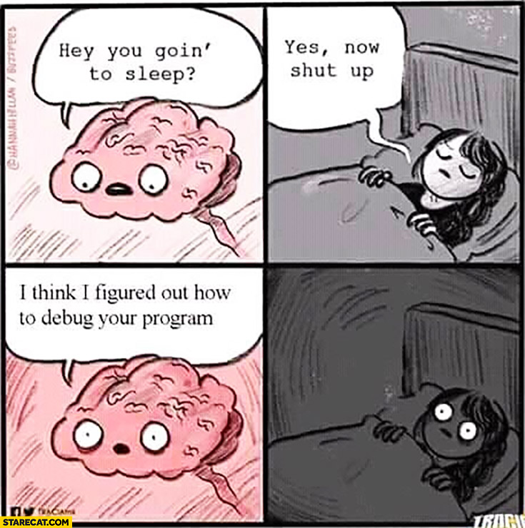
Take a break

Slide 16
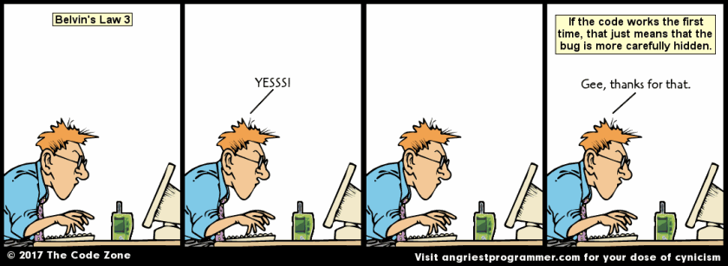
When your code runs…

Slide 17
Testing
Try running your function with different values, called test cases, and make sure it returns the right value
Branch Testing (white-box testing)
  make sure that every line of code is executed by at least once
  for conditionals, try include a test case that makes the condition evaluate to True and a test case that makes the condition evaluate to False
  for loops, try to include test cases that make the program go through the loop 0 times, 1 time, and lots of times
Corner-Case Testing (black-box testing)
  include the "weird" values in your test cases
  e.g., for ints, include negative numbers and zero, as well as positive
  e.g., for strings, include the empty string
Notes:
Mention fuzz testing

Slide 18
Testing in Python
Create a new file called <program_name>_tester.py
Import the functions you want to test
from demo08 import sum_even
Using assert statements to test program behavior
assert <condition>

Slide 19
Example
demo08.py
demo08_tester.py
def sum_even(start, end):
"""
Computes the sum of the
even numbers between <start>
and <end> (inclusive).
:param start: (int) one end
of range
:param end: (int) other end
of range
:return: (int) sum of evens
"""
for i in range(start, end):
if(i % 2 = 0):
sum = i
from demo08 import sum_even
def main():
assert type(sum_even(1,5)) == int
assert sum_even(1,5) == 6
assert sum_even(1,6) == 12
assert sum_even(2,5) == 6
assert sum_even(2,6) == 12
assert sum_even(1,1) == 0
assert sum_even(2,2) == 2
assert sum_even(6,2) == 6
if __name__ == "__main__":
main()
Notes:
Note: code is buggy!

Slide 20
Code Tracing
Execute the program line by line by hand
If you get the right answer by hand, add print statements to determine where your code starts doing something different
num = add_one(46)
X
add_one
2
1
n
46
ERASE WHOLE FRAME
x
47
return
47
None

Slide 21
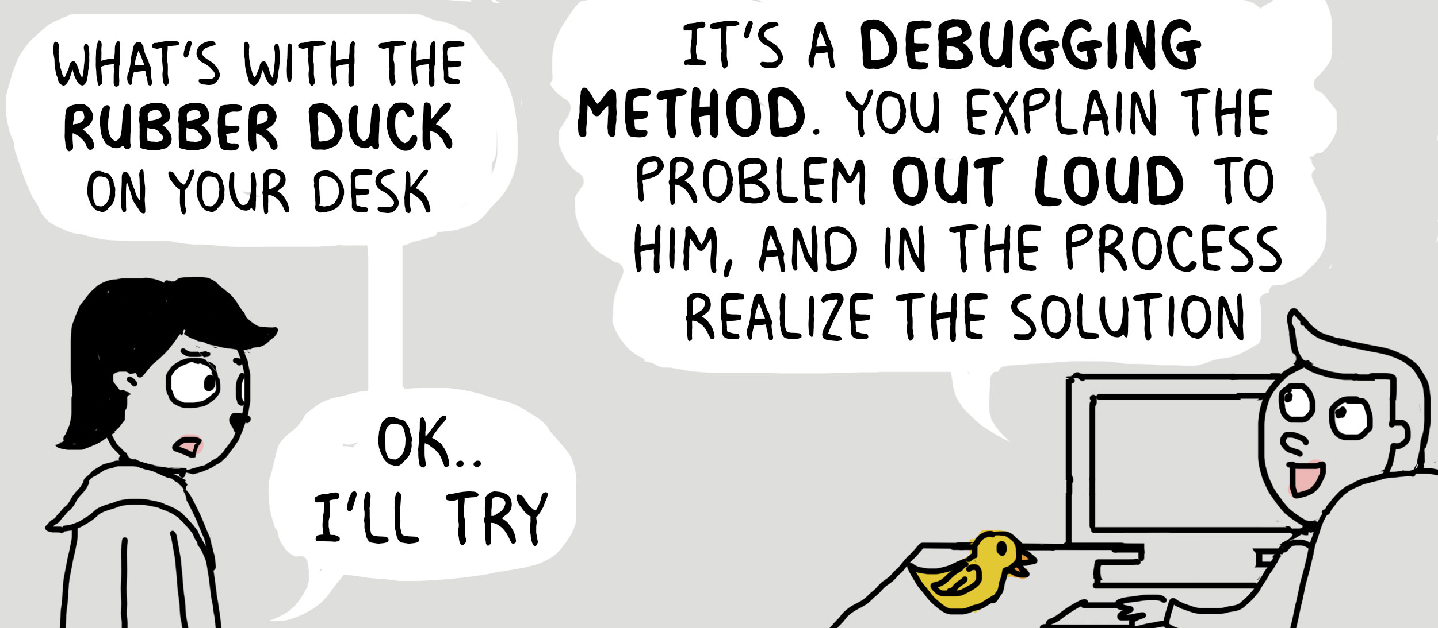
Rubber-Duck Debugging

Slide 22
Exercise
def move(steps, direction):
"""
Attempts to move the player <steps> steps in
direction <direction>
:param steps: (int) number of steps to move (may be
negative)
:param direction: (int) direction to move (a multiple
of 90)
:return: (int) number of steps successfully taken by
player (equal to steps if didn't hit a wall)
"""
if steps < 0:
steps = -1*steps
direction = direction + 180
direction = direction % 360
return forward_move(steps, direction)

Slide 23
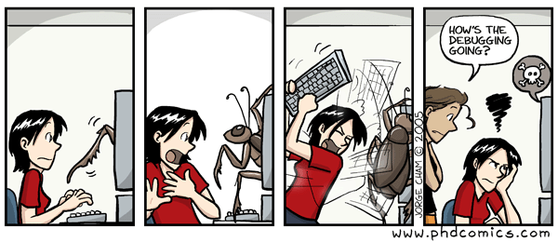
Debugging…

Slide 24
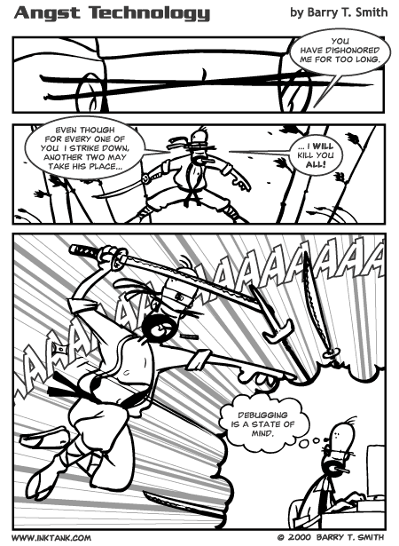
Debugging…

