Slide 1
Lecture 2: Input and Conditionals
Eleanor Birrell September 9, 2019

Slide 2
Announcements
A0 has been graded
Remember to check your filenames
Remember to check that you've included your name
You must submit all files together in the same submission
You may submit as many times as you like; only the last submission will be graded
Lab tonight/tomorrow in Edmunds 229. Attend the lab you are enrolled in
A1 has been posted
Slides are posted before class, handouts and demos are posted after
Optional readings are listed
Links to (free) textbook, Piazza, Submit, Gradescope

Slide 3
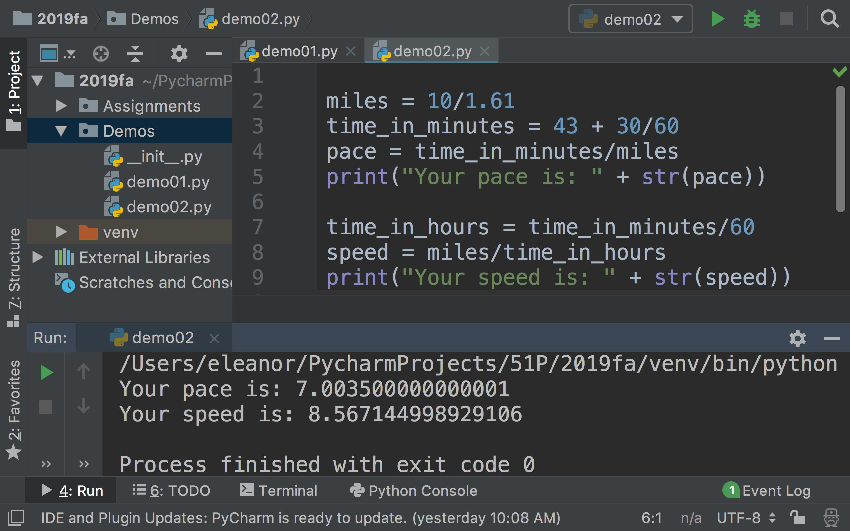
Review: Values, Types, Operations, Expressions, Variables

Slide 4
Review: Useful (simple) Functions
Example Functions
print( )
type( )
str( ), int( ), float( )
print(1+2.001)
print(1*3)
print("1.0"+"2.0")
print("Happy"*2 + "?!"*3)
print(1*2 + "2"*2)
print(type("2"))
print(1*2 + int("2")*2)
print(str(1)*2 + "2"*2)

Slide 5
Input
input() is a function that allows you to get a value from your user
Notes:
Demo input

Slide 6
Example
How would you change this program so that it asks the user for their time in minutes and seconds and then prints out their average time per mile for the 10K race?
miles = 10/1.61 time_in_minutes = 43 + 30/60 pace = time_in_minutes/miles print("Your pace is: " + str(pace)) time_in_hours = time_in_minutes/60 speed = miles/time_in_hours print("Your speed is: " + str(speed))

Slide 7
Exercise
Write a program that asks the user for word and a number, then prints the word followed by an exclamation point and a space that many times. For example:
Enter a word:
happy
Enter a positive integer:
3
happy! happy! happy!

Slide 8
What about?
what's your favorite positive integer?
13
that's my favorite number too!
what's your favorite positive integer?
20
mine is 13.

Slide 9
if-statements
syntax
condition must be an expression that evaluates to True or False (type bool)
condition
if x == 13 :
print("that's my favorite number too!")
spaces matter!

Slide 10
bool datatype - values
Values: True and False
Operators: and, or, not
<bool expression> and <bool expression>
True if both expressions True, False otherwise
<bool expression> or <bool expression>
True if at least one expression True, False otherwise
not <bool expression>
returns True if expression is False, False otherwise
Notes:
Be a little careful mixing ints and floats
1 == 1.0000000000000001
True
1 == 1.0000000000001
False

Slide 11
Boolean Expressions
Examples of operations that return a bool:
relational operators: ==, !=, >, <, >=, <=
10 < 0
11 >= 11
11 > 11.0
10 == 10.1
x != 3
y <= x
x = 5

Slide 12
Example
Assume the variable n currently stores the value 25.
What will the following expressions evaluate to?
2 < n and n < 30
(2 > n) or (n == 25)
not (n == n)
not (n != 3)

Slide 13
Exercise
After executing each snippet of code, the variable val stores a value of type bool. What value does it store?
A) val = (5 > 0 and 5 < 10)
B) n = 25
val = (n % 2 == 0 or n % 3 == 0)
C) s = "string"
val = ("String" != s)
D) val = not(True and False)

Slide 14
if-statements
syntax
condition must be an expression that evaluates to True or False (type bool)
Booleans: True, False
relational operators: ==, !=, >, <, >=, <=
logical operators: and, or, not
functions that evaluate to type bool
condition
if x == 13 :
print("that's my favorite number too!")

Slide 15
if-else statements
syntax
if x == 13:
print("that's my favorite number too!")
else:
print("mine is 13")

Slide 16
Exercise
s1 = int(input())
if s1 % 4 == 0:
print(4*s1)
if s1 % 2 == 0:
print(2*s1)
else:
print(s1)
What gets printed if the user inputs 2?
If they input 3?
If they input 4?
If they input 5.0?

