Slide 1
Lecture 1: Introduction to Computer Science
CS 51P September 4, 2019
Notes:
Discussion: What is computer science

Slide 2
Computer Science
Notes:
What do these areas have in common?

Slide 3

Computational Thinking
Notes:
Computational Thinking is the thought processes involved in formulating a problem and expressing its solution(s) in such a way that a computer—human or machine—can effectively carry out.
Computational Thinking is an iterative process based on three stages:
Problem formulation (abstraction)
Solution expression (automation)
Solution execution and evaluation (analyses)
https://en.wikipedia.org/wiki/Computational_thinking
checked 1/16/2018

Slide 4

Programming
Notes:
A program is a sequence of instructions that specifies how to perform a computation, in a language that a computer can execute
A programming language is a set of instructions that are used to write programs

Slide 5
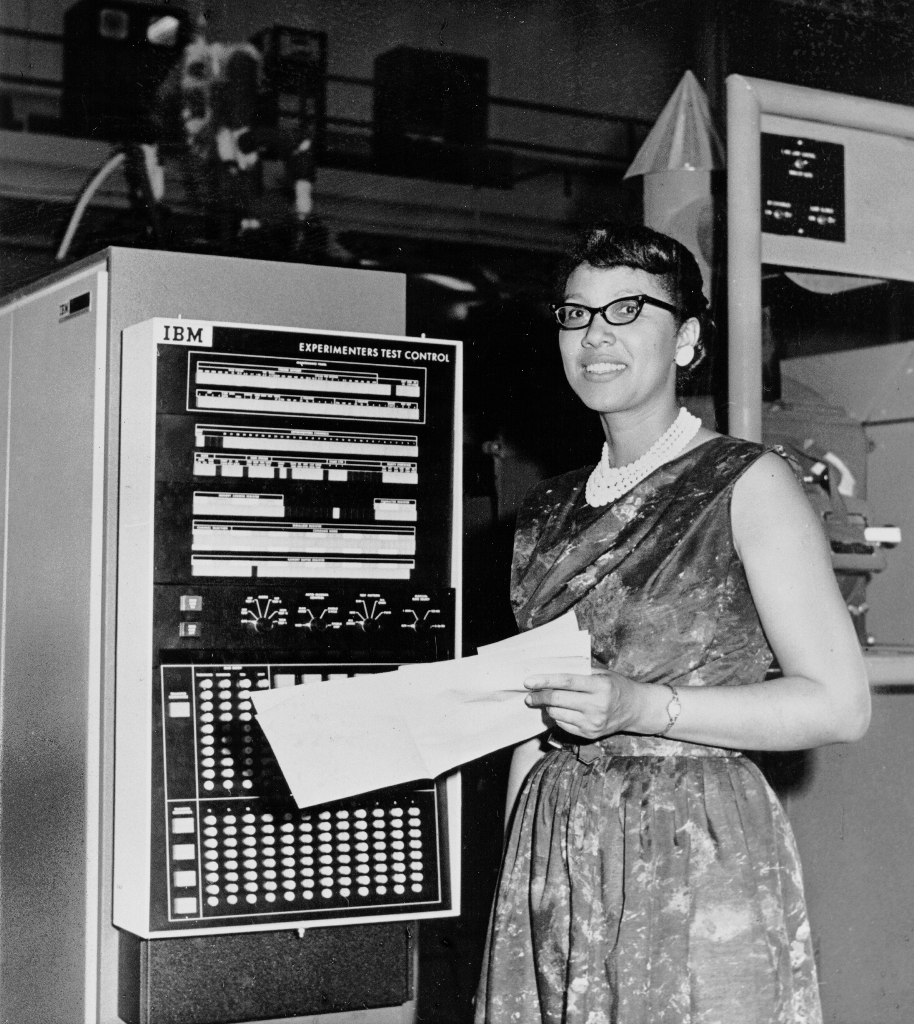
Example
If you run a 10 kilometer race in 43 minutes 30 seconds, what is your average time per mile? (Hint: there are 1.61 kilometers in a mile).
What is your average speed in miles per hour?
Notes:
Dorothy Vaughan, computer at Nasa

Slide 6
Machine Language
lcfi2:
movl %edi, -4(%rbp)
cmpl $0, -4(%rbp)
jle LBB0_2
## BB#1:
leaq L_.str(%rip), %rdi
movb $0, %al
callq _printf
LBB0_2:
xorl %eax, %eax
retq
L_.str:
.asciz "x is a positive number"
if (x>0):
print ("x is a positive number")
Notes:
Note: assembly compiled from C
Note: omitted stack pointer/base pointer adjustments, byte spill, and compiler commands

Slide 7
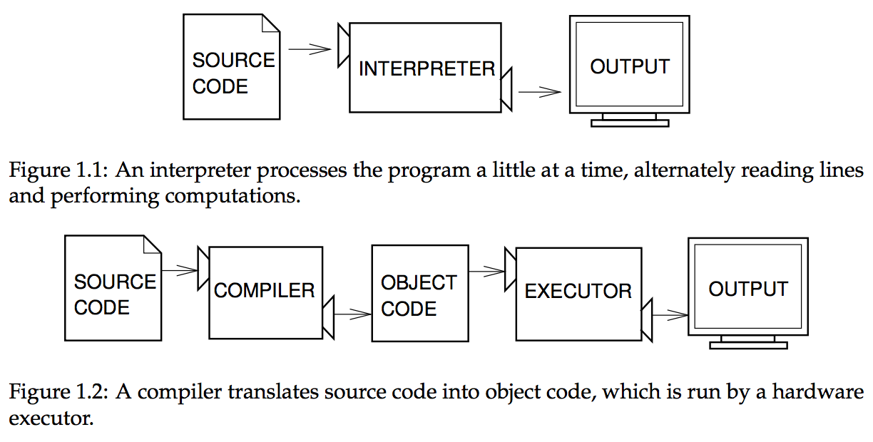
High-level languages
Notes:
citation: page 2, Think Python 2nd edition

Slide 8
Python
Python 3.7
PyCharm CE
  projects
  editor window
  console at bottom
If you run a 10 kilometer race in 43 minutes 30 seconds, what is your average time per mile? (Hint: there are 1.61 kilometers in a mile).
What is your average speed in miles per hour?

Slide 9
Terminology
Value
Type
Operator
Expression
Error
Notes:
A value is one of the basic things a program works with, like a letter or a number (e.g., 47, 2.0, "Hello, World!")
Every value has a type
A type is a set of values + a set of operations on those values
Operators are special symbols that represent computations like addition, subtraction, and multiplication
int, float: +,-,/,*,** (exponentiation), % (remainder), // (integer division)
string: +, *

Slide 10
Types
A type is a set of values and operations on those values
int
string
Values: 0, 1, -10, 34022, …
    Operations: +, -, /, *
            ** (exponent),
            % (remainder)
            // (truncated division)
Values: "Hi!", "", "2.0",…
Operations: + (concatenation)
            * (duplication),
All values have types
Common types: int, float, str, bool
You can determine the type of a value
using the command type(<value>)

Slide 11
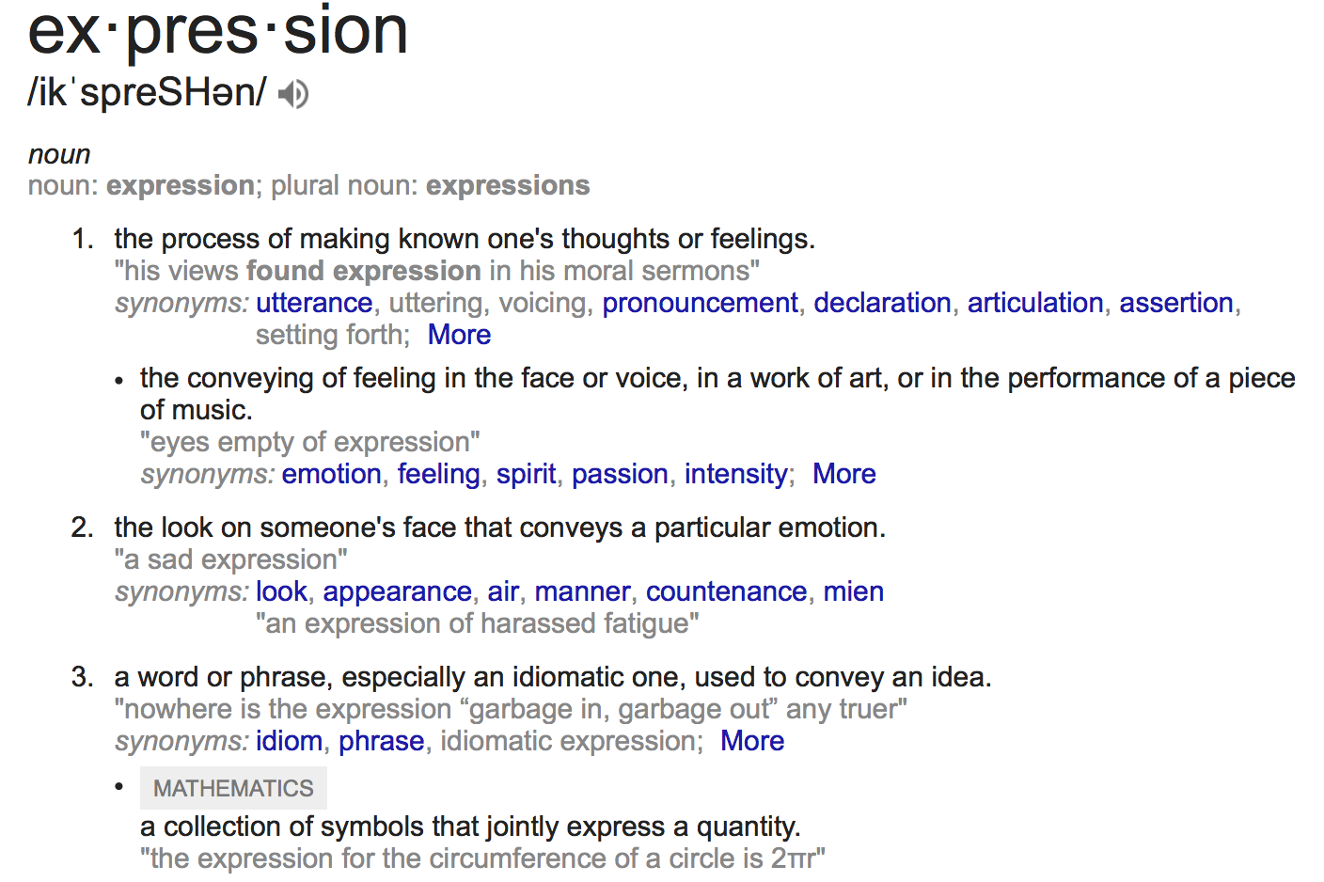
Expressions

Slide 12
Python Expressions
Expressions represent a value
Python evaluates expressions (similar to a calculator)
Values
1+2.001
1/3
"1.0"+"2.0"
Hi!
"Happy"*2 + "?!"*3
1*2 + "2"*2
Operators
Errors

Slide 13
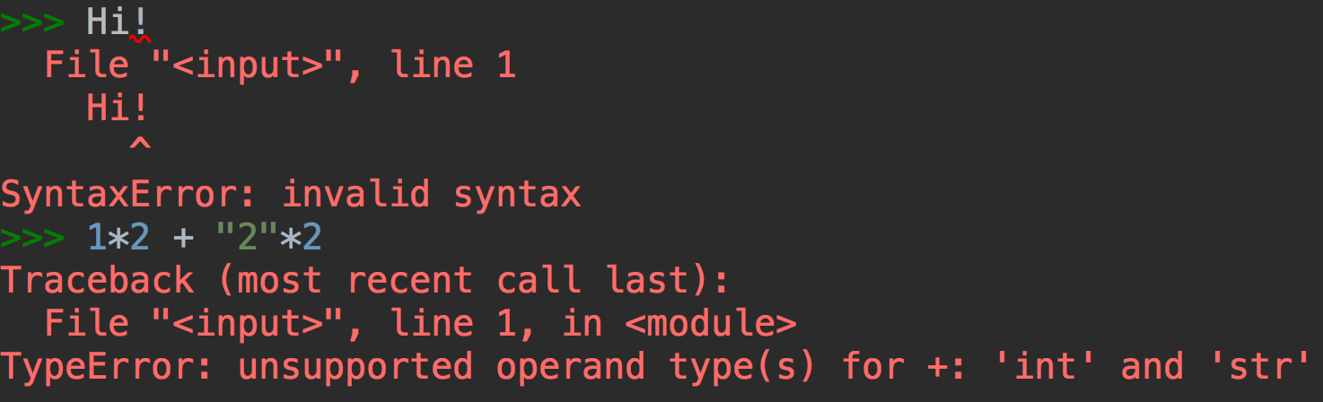
Errors
1+2.001
1*3
"1.0"+"2.0"
Hi!
"Happy"*2 + "?!"*3
1*2 + "2"*2
Two types of errors:
  SyntaxError: invalid syntax
  TypeError: unsupported operand type(s) for +: 'int' and 'str'

Slide 14
Types and Functions
How to find out the type?
What if you want to change the type?
Functions
  type( )
  str( ), int( ), float( )
"Happy"*2 + "?!"*3
1*2 + "2"*2
type(3.0)
1*2 + int("2")*2
str(1)*2 + "2"*2

Slide 15
Exercise
3 * 2.001
( "A"*2 + "?"*3 ) * 2
1/2
"1.0"+2.0
1.0*2 + 2*2
14 % 5
1.1 ** 2

Slide 16
Python Programs
If you run a 10 kilometer race in 43 minutes 30 seconds, what is your average time per mile? (Hint: there are 1.61 kilometers in a mile).
variables!

Slide 17
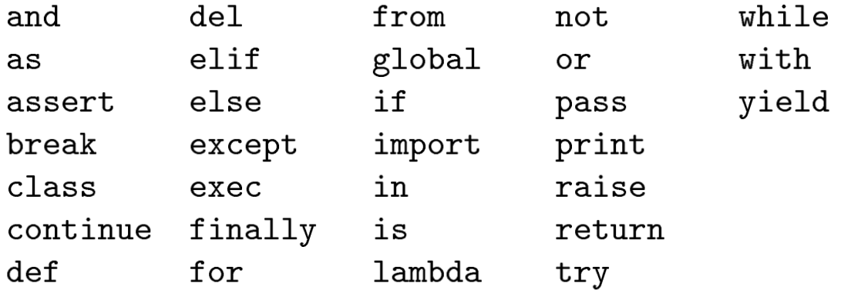
Variables
A variable is a name that refers to a value
  names should be meaningful
  by convention words separated by an underscore
  names cannot be a keyword (e.g. print), cannot include spaces, must begin with a letter

Slide 18
Assigning variables
Can assign a value to a variable
Right hand side can be any expression (anything that is, or that evaluates to, a value)
x = 12.001
a_string = 1*str(2) + "2"*2
x_type = type(1+2.001)
Notes:
Demo: variables don't have types type(x) ; x = 10; type(x); x = "10"; type(x)

Slide 19
Example: Writing a Python Program
If you run a 10 kilometer race in 43 minutes 30 seconds, what is your average time per mile? (Hint: there are 1.61 kilometers in a mile).
If you run a 10 kilometer race in 43 minutes 30 seconds, what is your average speed in miles per hour? (Hint: there are 1.61 kilometers in a mile).

Slide 20
Course Logistics
All information is on the Course website:
http://www.cs.pomona.edu/~ebirrell/classes/cs51p/2019fa/

