Slide 1
Lecture 23: Web Security
CS 181S December 5, 2018

Slide 2
Networking Stack
7 - Application
Deliver content
HTTP
6 - Presentation
Manage encoding
User Space
5 - Session
Manage sessions
TLS/SSL
4 - Transport
Deliver (un)reliably
TCP/UDP
3 - Network
Deliver globally
IP
Operating System
2 - Data Link
Deliver locally
Ethernet
1 - Physical
Deliver signals
0s and 1s

Slide 3
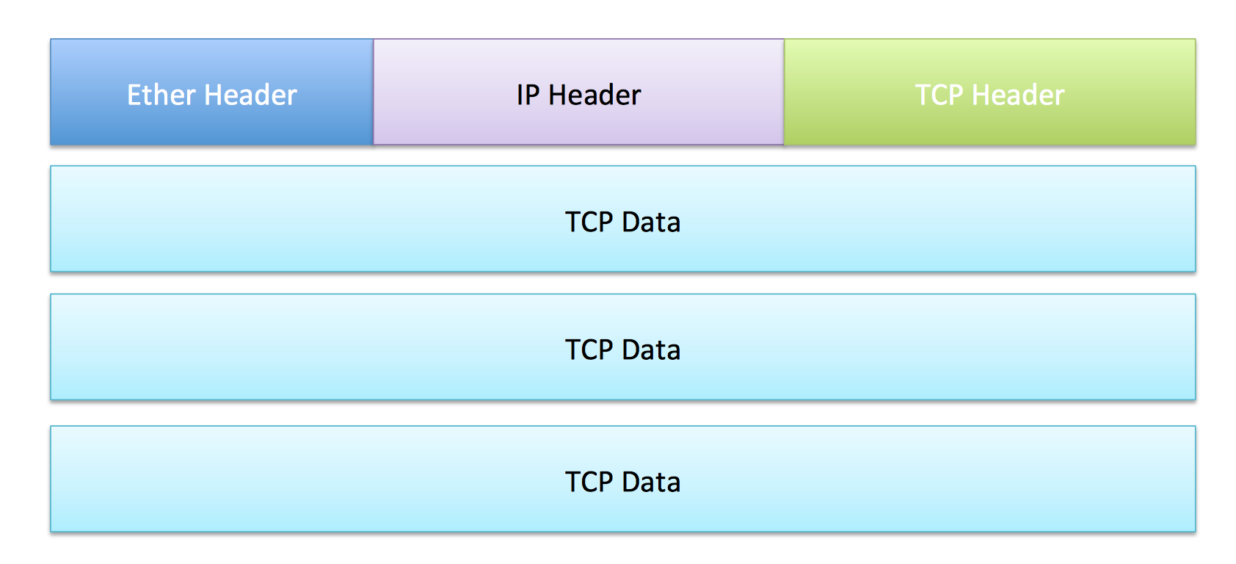
OS Layers
Layer 1: Physical
Layer 2: Data Link
Layer 3: Network
Layer 4: Transport

Slide 4


SSL/TLS Handshake
Version, cipher suites, rClient
ClientHello
Version, cipher suite, rServer,
certificate
ServerHello
ServerKeyExchange
(optional)
ClientKeyExchange
Enc_pks(ms_p)
Compute master secret
Compute master secret
ChangeCipherSpec
ChangeCipherSpec

Slide 5
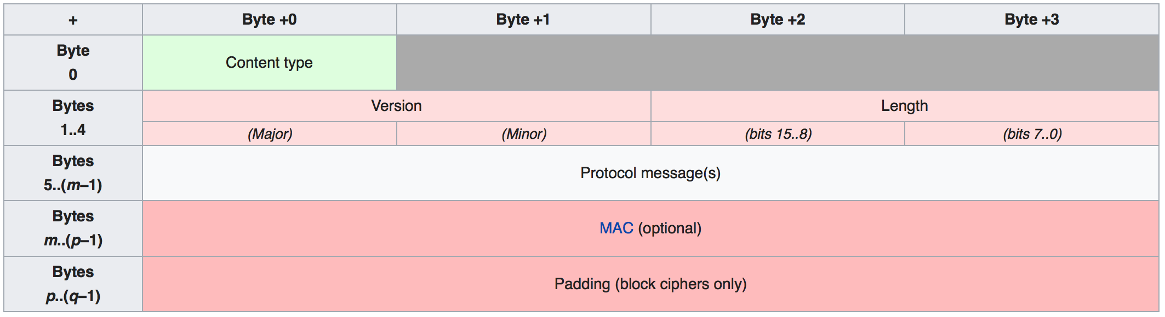
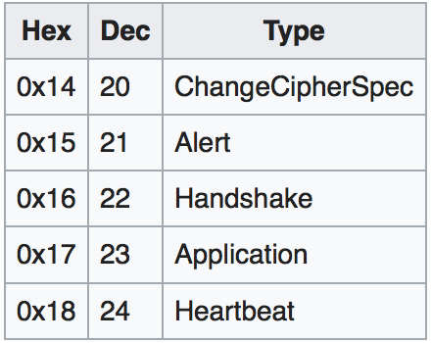
TLS record

Slide 6
Application Layer: HTTP
Hypertext Transfer Protocol (HTTP) is an application protocol for distributed information systems
Stateless request-response protocol
Requests resources identified by Uniform Resource Locatars (URLs)
Request | Response
GET | Retrieve resource (no side effects)
HEAD | Retrieve header for GET request (no body)
POST | Requests that server accept new object (e.g., results of form or new database item) and store it as subordinate of resource identified by URI
PUT | Requests that server store new object under supplied URI
DELETE | Delete specified resource

Slide 7
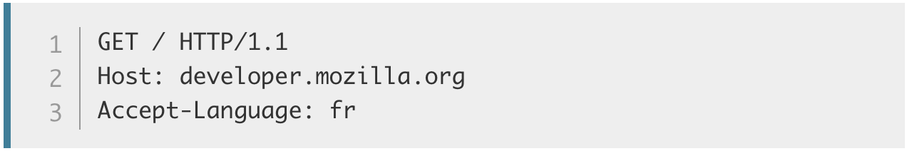
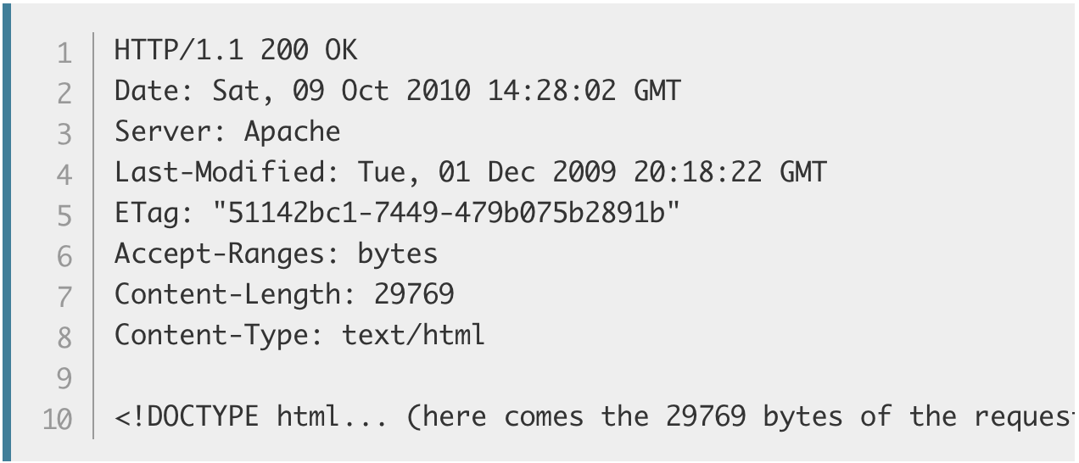
Example Request
HTTP Request:
HTTP Response:
Request Method
Path
Protocol Version
Headers
Header
Body
Notes:
Demo: course website w/ web inspector + wireshark

Slide 8
HTTP Response Codes
Code | Message
200 | OK
201 | Created
302 | Found
401 | Unauthorized
403 | Forbidden
404 | Not Found
409 | Conflict
500 | Internal Server Error
502 | Bad Gateway

Slide 9
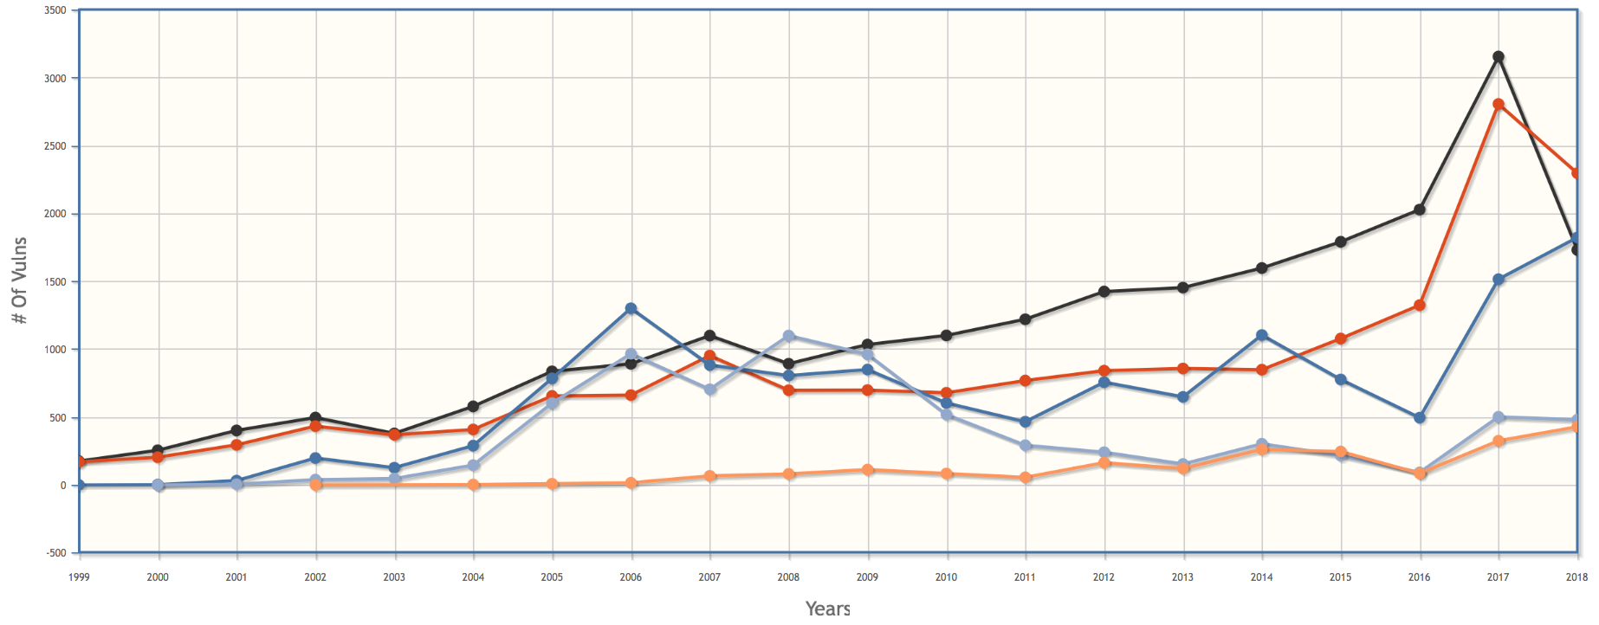
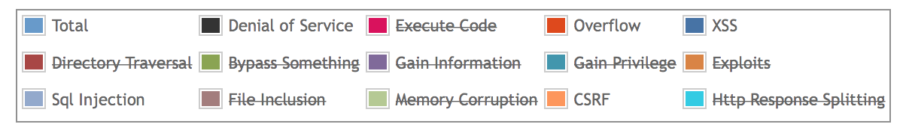
Vulnerabilities by Year
Notes:
https://www.cvedetails.com/vulnerabilities-by-types.php

Slide 10
Vulnerability Occurrence in Applications
Notes:
https://www2.trustwave.com/rs/815-RFM-693/images/2016%20Trustwave%20Global%20Security%20Report.pdf
https://www2.trustwave.com/rs/815-RFM-693/images/Trustwave_2018-GSR_20180329_Interactive.pdf

Slide 11
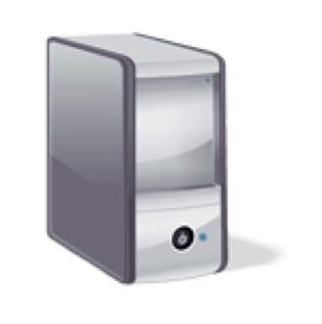

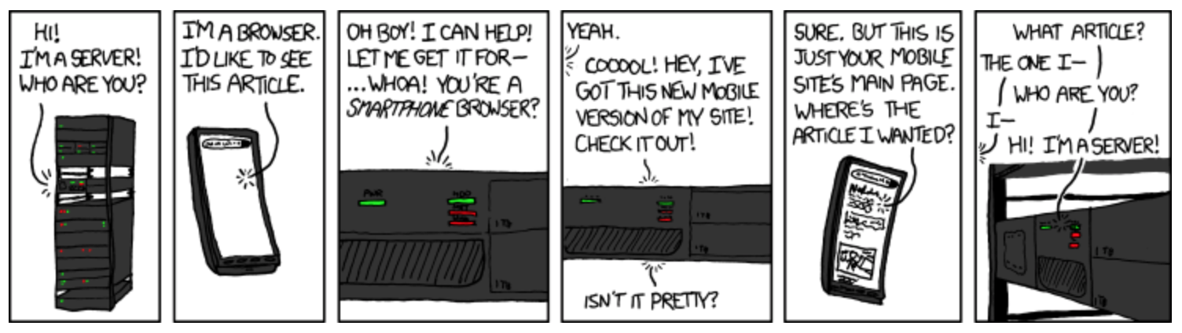
HTTP is stateless
GET /index.html HTTP/1.1
Host: www.example.com
HTTP/1.1 200 OK
Date: Fri, 17 March 2017 10:10:00 EDT
Content-Type: text/html; charset=UTF-8
Content-Length: 138
Connection: close
<html>
<head><title>An Example Page</title>
</head>
<body>
Hello World!
</body>
</html>

Slide 12

Session Management
HTTP GET
HTTP OK
HTTP GET
HTTP OK

Slide 13
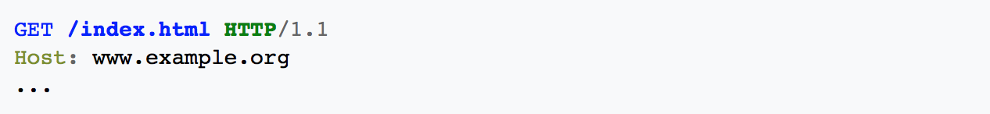
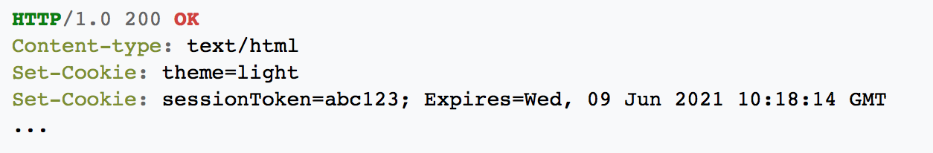
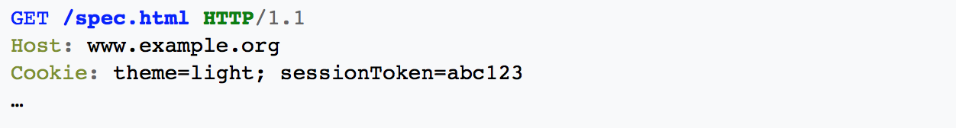
Cookies
Optional: path, domain
Notes:
Demo: show nytimes cookies in browser inspectkor

Slide 14

Cookie Side-jacking
SSL(login)
SSL(redirect; set-cookie)
Request; cookie=SID

Slide 15

FireSheep (October 2010)
Notes:
Session side-jacking has historically been common because it is easy to achieve; applications that implement side-jacking have been made available as Firefox extensions (FireSheep), Android applications (WhatsAppSniffer, DroidSheep), and Java applications (CookieCadger).

Slide 16
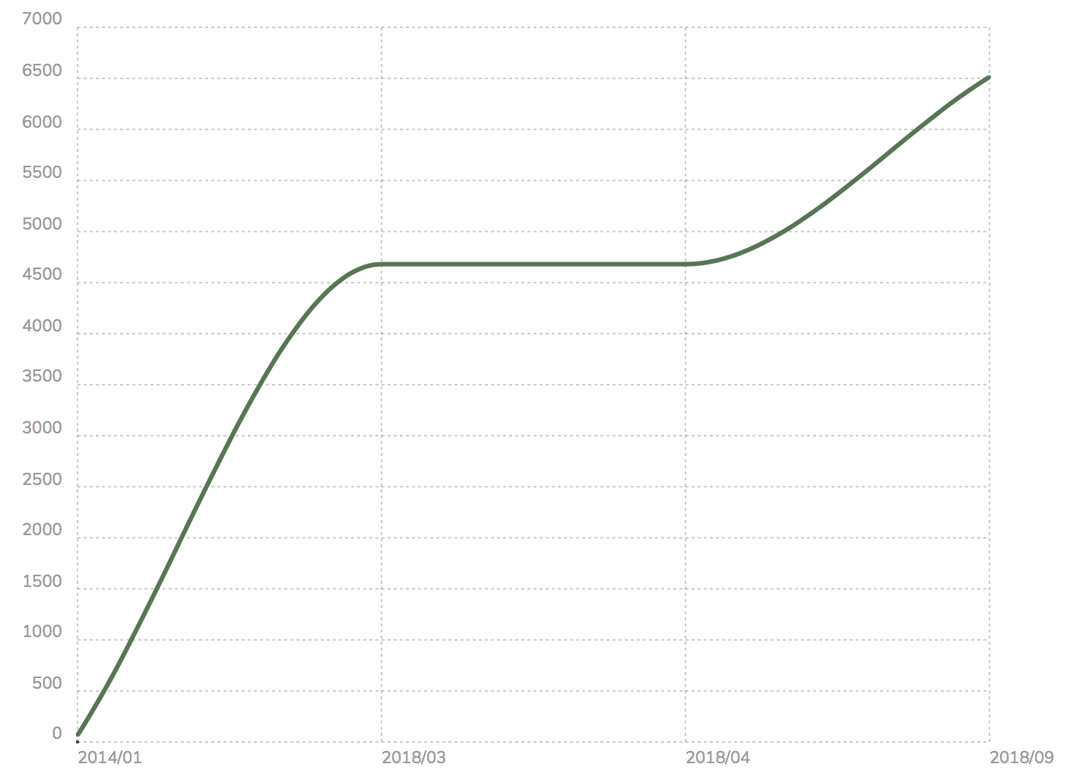
SSL by Default (top 10k)
Notes:
https://trends.builtwith.com/ssl/SSL-by-Default
The most common strategy for mitigating session side-jacking is to always run HTTP over a secure (SSL) channel. Since 2010 (when FireSheep was released), major sites have started allowing users to opt-in to always using SSL or just adopting SSL by default; as of March 2017, 18.9\% of the top 10,000 sites have adopted SSL by default. More recently, Google announced plans to have its Chrome browser label all unencrypted websites as insecure.
Secure cookies as solution

Slide 17
Cookie Forgery
SSL(login)
SSL(redirect; set-cookie)
Request; cookie=SSID

Slide 18

Cookie Forgery
Notes:
If session cookies are predictable, an attacker can simply guess the session cookie and send a request with that cookie value, thereby gaining access to any resources authorized for the account that corresponds to the forged (guessed) cookie. This attack strategy has been successfully used in practice; in February 2017, Yahoo announced that 32 million accounts had been compromised by successful cookie forging. Best practice calls for using long, random numbers or strings as session ids to minimize the probability of successful cookie forging.

Slide 19

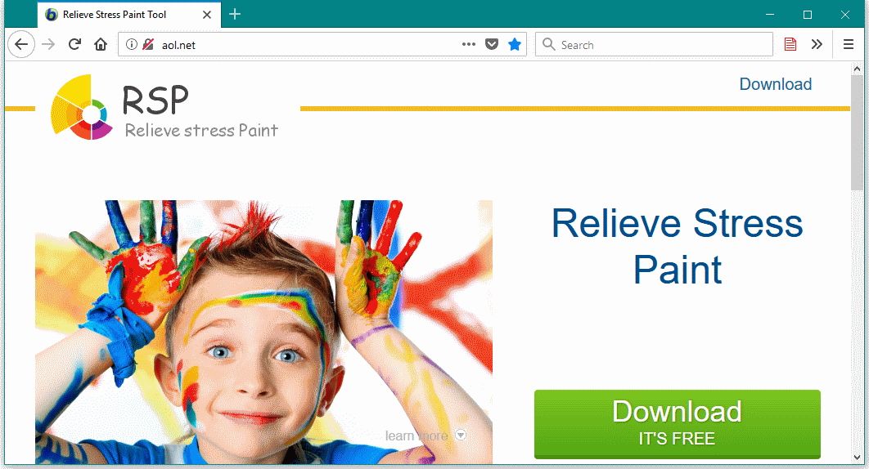
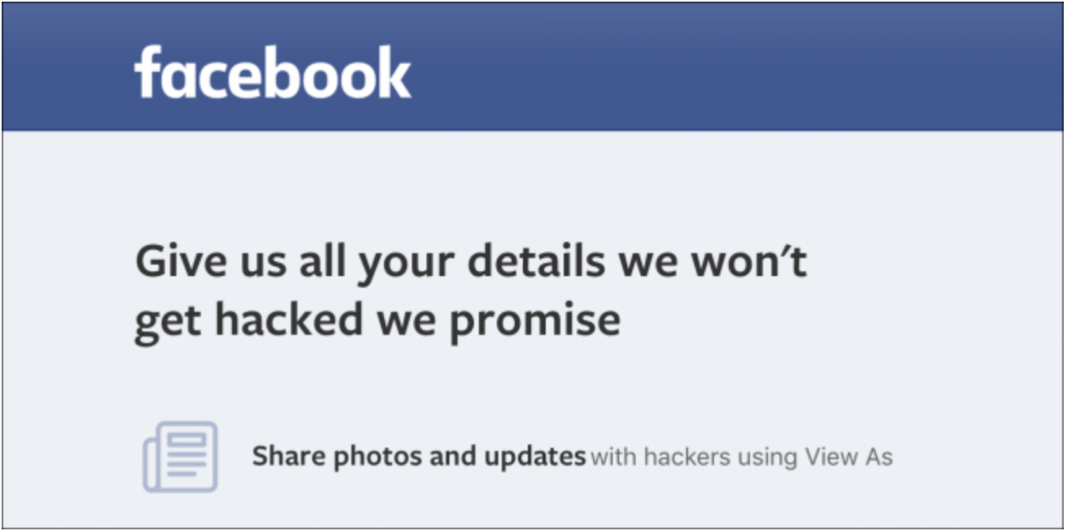
Cookie Theft
Malware sometimes targets local browser state
Notes:
May 2017: malware in javascript file hijacked wordpress cookies
https://threatpost.com/session-hijacking-cookie-stealing-wordpress-malware-spotted/125586/
April 2018: trojan called stresspaint stole stored session cookies
September 2018: bug in view-as feature allowed facebook session cookies to be stolen

Slide 20
Chrome Encrypted Cookies
salt is 'saltysalt'
key length is 16
iv is 16 bytes of space b' ' * 16
on Mac OSX:
  password is in keychain: security find-generic-password -w -s "Chrome Safe Storage"
  1003 iterations
on Chrome OS:
  password is in keychain: "security find-generic-password -wga Chrome”
  1003 iterations
on Linux:
  password is peanuts
  1 iteration
On Windows:
  password is current user password
  CryptProtectData uses 4000 iterations

