Slide 1
Blockchains and Audit
CS 181S November 28, 2018
Notes:
Based on slides by Ethan Cecchetti from CS 5430 (Cornell University, Spring 2018)

Slide 2
Blockchain: A public tamper-proof log
Publicly visible
Publicly writable
Unmodifiable
Event 1
Event 2
Event 3
✔
Useful for an audit log!
✔

Slide 3
Preventing Tampering
VS

Slide 4
Traditional Consensus
Members Vote
Event 1?
✔
“Byzantine fault-tolerant (BFT) consensus”
Tolerates < 1/3 faulty
Must know who everyone is!
✔
✔
X
✔

Slide 5
Sybil Attacks
What if anyone can join?
Event 1?
✔
✔
✔
X
X
✔
X
X
X

Slide 6
Defending against Sybil
Need a scarce resource
BFT consensus uses identity – you only get one
What else can we use?
Money (Proof of Stake)
Computational power (Proof of Work)

Slide 7
Computation as a scarce resource: Proof of Work

Slide 8
Proof of Work: The basics
Find x such that Hash(x) < N
This could take a while…
What about replays?
Add a nonce r
Look for Hash(r || x) < N
x₁
x₂
x_{k}
…
Hash
y₁
> N
y₂
> N
…
y_{k}
< N

Slide 9
Proof of Work: Building a log
Make the nonce useful
Use a message digest!
d = Digest(m)
Find x such that Hash(d || x) < N
x₁
x₂
x_{k}
…
Hash
y₁
> N
y₂
> N
…
y_{k}
< N

Slide 10
Proof of Work: Building a log
To add a message, generate a proof of work with that message
Connect each message to previous
Hash < N
Hash < N
Hash < N
0
d₁
x₁
h₁
d₂
x₂
h₂
d₃
x₃
Msg 1
Msg 2
Msg 3

Slide 11
Proof of Work: Coming to consensus
What can go wrong?
Forks
d₃
x₃
d₄
x₄
d₁
x₁
d₂
x₂
d'₃
x'₃
Take the heaviest fork
(one with the most work)

Slide 12
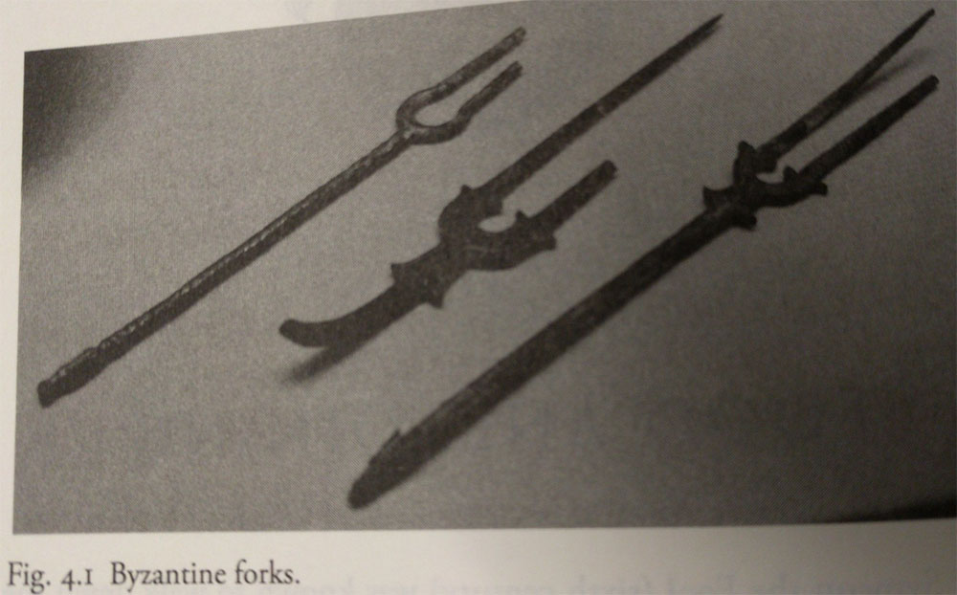
Nakamoto Consensus
If majority of computation is honest, honest parties will agree (eventually)
Log is tamper-proof
It would require redoing all of the work to tamper

Slide 13
Blockchains for Audit
Individual accountability
Everything is visible. Everyone is accountable.
Event reconstruction
All of the events are there. Easy to reconstruct.
Real-time intelligence
Miners can verify everything as it goes on the log.
before!

Slide 14
Not just a log!
Authoritative record
Instead of logging events elsewhere, the blockchain can record the definition of events (e.g. transactions)
Online validation can prevent illegal events from ever happening!

Slide 15
What restrictions make sense?
Transaction Processing System
Each block has a limited number of transactions (1 MB)
Transactions cannot create money
Except coinbase transaction to reward miner
Coins can only be spent once (spending creates new unspent coins)
To spend a coin conditions must be met (e.g., owner authorizes)
Bitcoin

Slide 16
Blockchains and Confidentiality

Slide 17
What do we do with private data?
Cannot put it on the blockchain – everything is public
Only publish commitments
d₁
x₁
d₂
x₂
C₁
C₂
Secret M₁
Secret M₂
Commit(M₁)
Commit(M₂)

Slide 18
Commitment Schemes
A commitment scheme Com is a two-phase, two-party protocol such that:
Secrecy: receiver does not learn anything about x from Com(x)
Binding: sender cannot produce alternative x' such that Com(x) = x'
Example Protocol
B->A: r
A: choose random bit b. If b=0, Com(x) = Hash(x) else Com(x) = Hash(x) xor r
A->B: Com(x)
…
A->B: x

Slide 19
What do we do with private data?
Cannot put it on the blockchain – everything is public
Only publish commitments
Still tamper-proof ✔
No longer able to see actions
Cannot reconstruct events X
Cannot perform online validation X
☹

Slide 20
Doing better with private data
Verify data validity without leaking secrets
Ongoing research with two main tools
Heavy-duty cryptographic constructs
Complex zero-knowledge proofs
Trusted hardware
Places trust in hardware instead of crypto or a large group

Slide 21
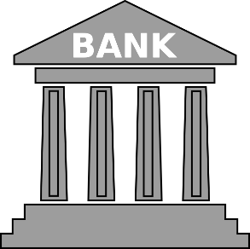
Cryptographic Example: Solidus
Bank-base confidential transactions
Alice | $10-x
…
Bob | $5+x
…
$x

Slide 22
Cryptographic Example: Solidus
Sending bank can see sender and value
✔
Alice | $10-x
…
Bob | $5+x
…
$x

Slide 23
Cryptographic Example: Solidus
Receiving bank can see recipient and value
✔
Alice | $10-x
…
Bob | $5+x
…
$x

Slide 24
Cryptographic Example: Solidus
Everyone can see banks involved
✔
✔
✔
Alice | $10-x
…
Bob | $5+x
…
$x

Slide 25
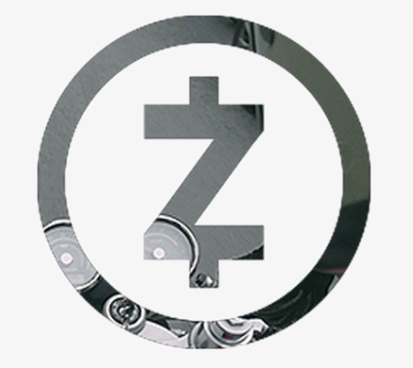
Cryptographic Example: Solidus
Strong publicly verifiable integrity guarantees
Sender authorized transaction
Sender had money to send
Transaction value was not negative
Transaction was processed correctly
Can (provably) furnish transaction details to external auditor

Slide 26
Trusted Hardware
Special machine instructions
Isolate process from the surrounding system
Can remotely attest that they’re running specific code
Uses (literally) hard-wired keys in the CPU
Trustworthy code can operate on secret data and attest to correctness
Examples:
Intel Software Guard eXtensions (SGX)
ARM TrustZone

