Slide 1
Lecture 20: Audit
CS 181S November 26, 2018

Slide 2
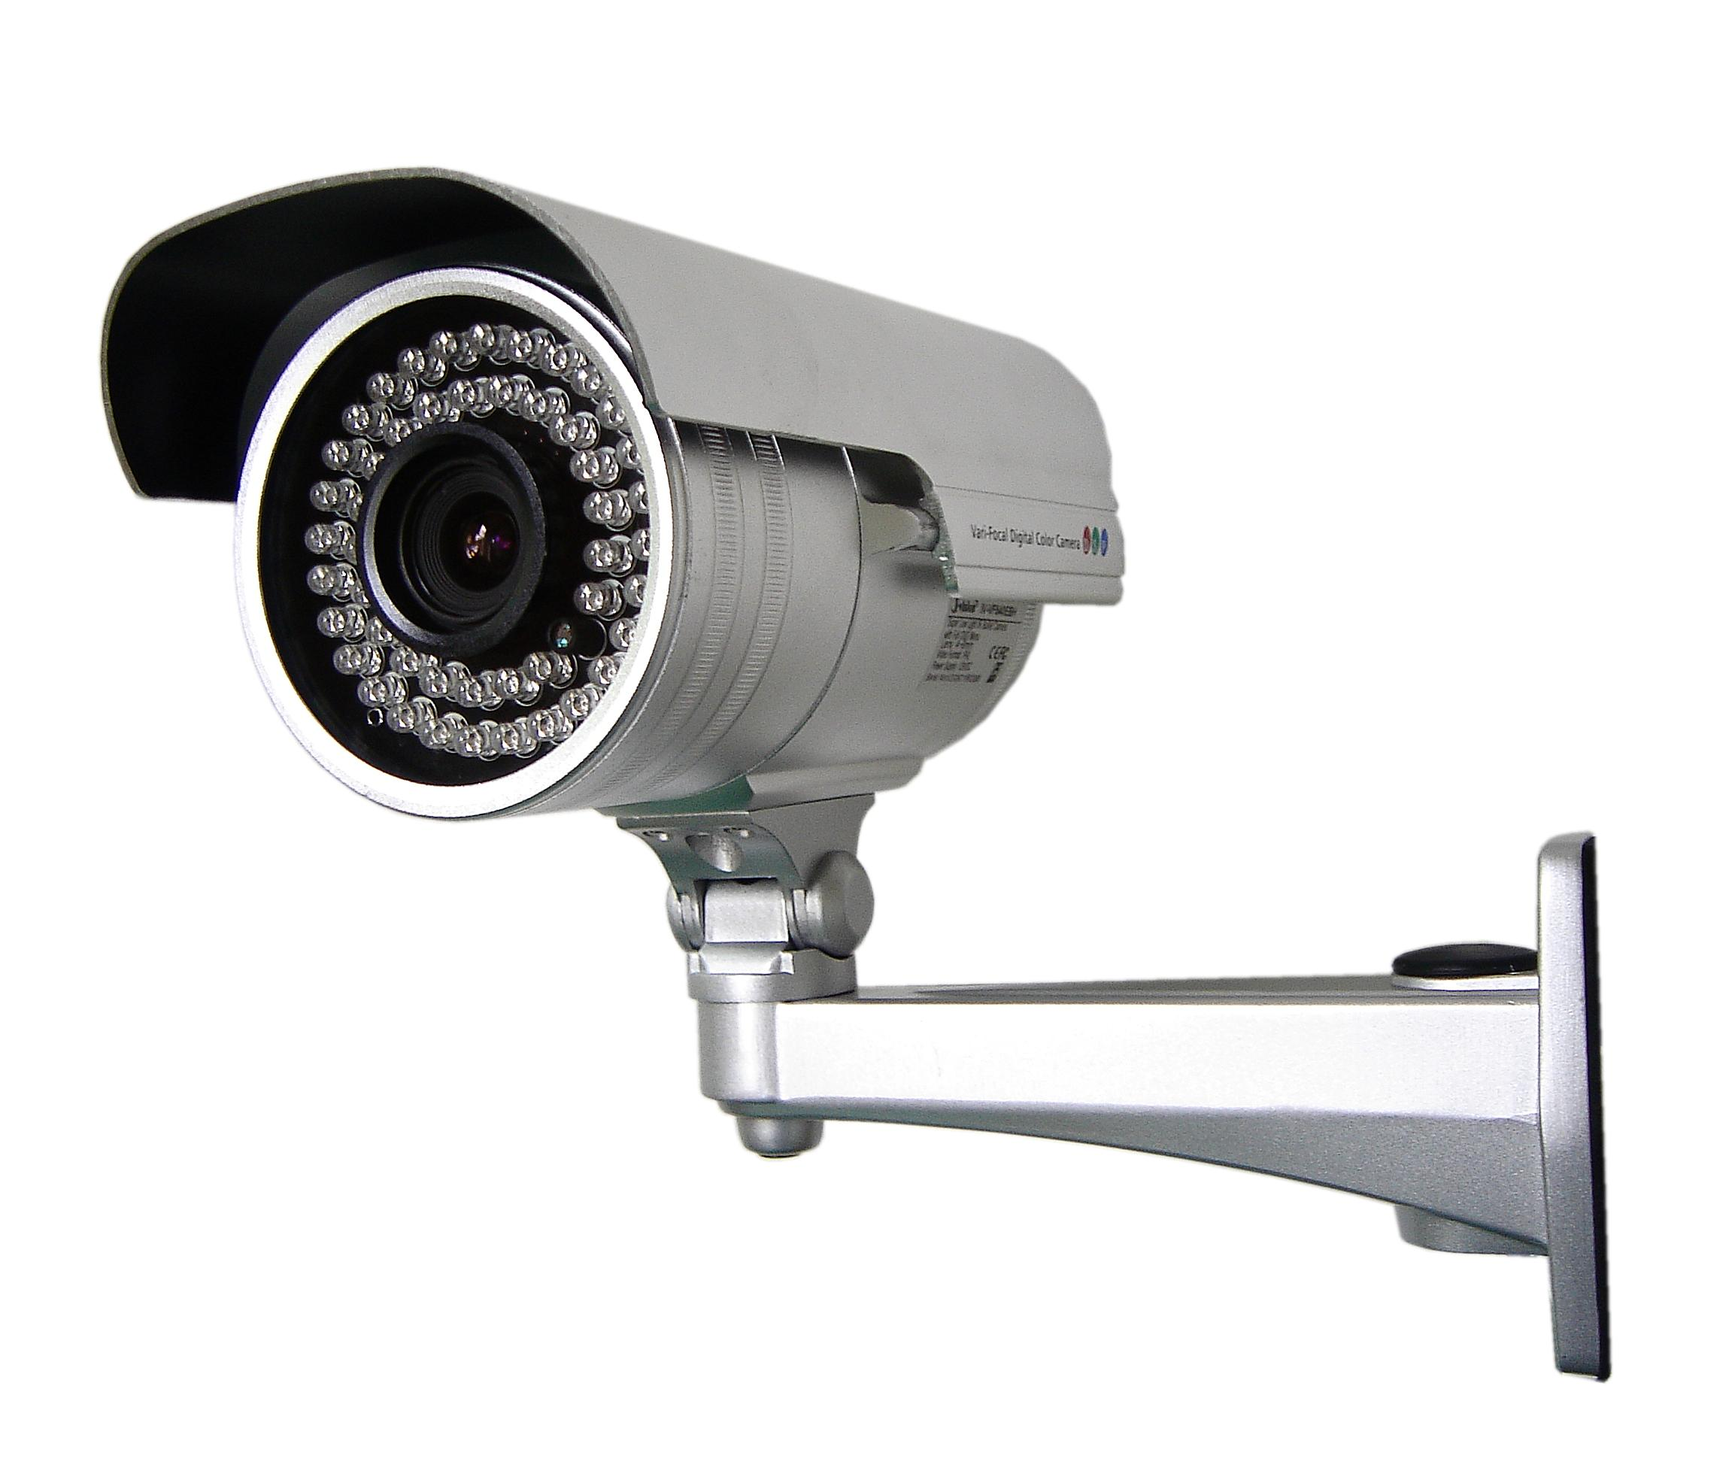
Classes of Countermeasures
Authentication: mechanisms that bind principals to actions
Authorization: mechanisms that govern whether actions are permitted
Audit: mechanisms that record and review actions

Slide 3
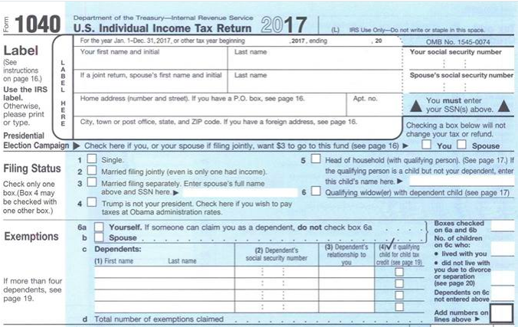
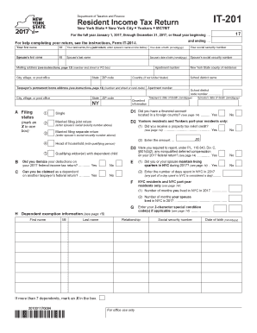
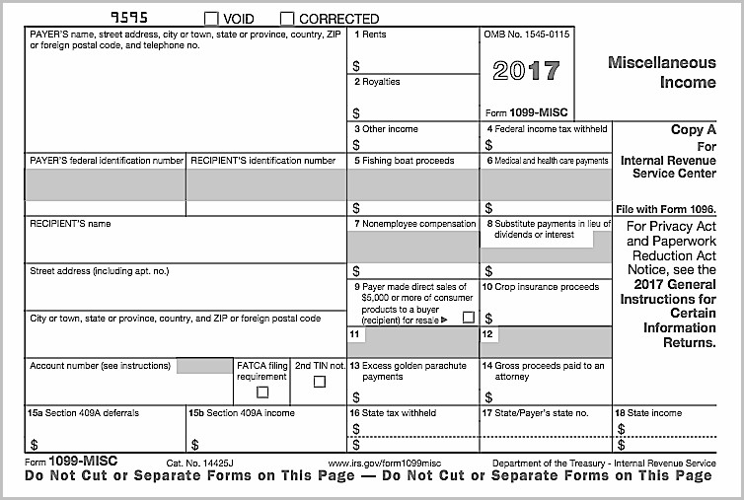
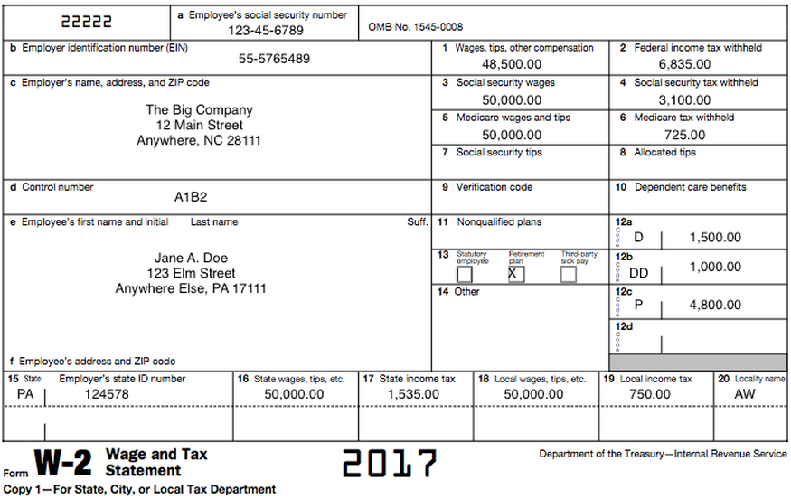
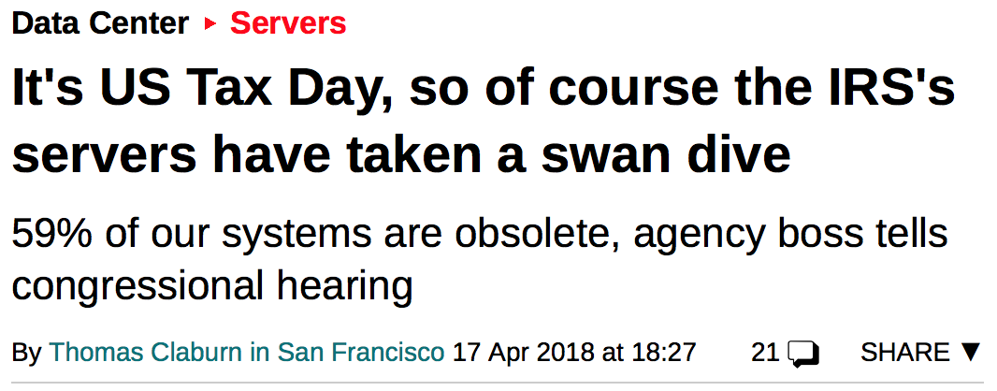
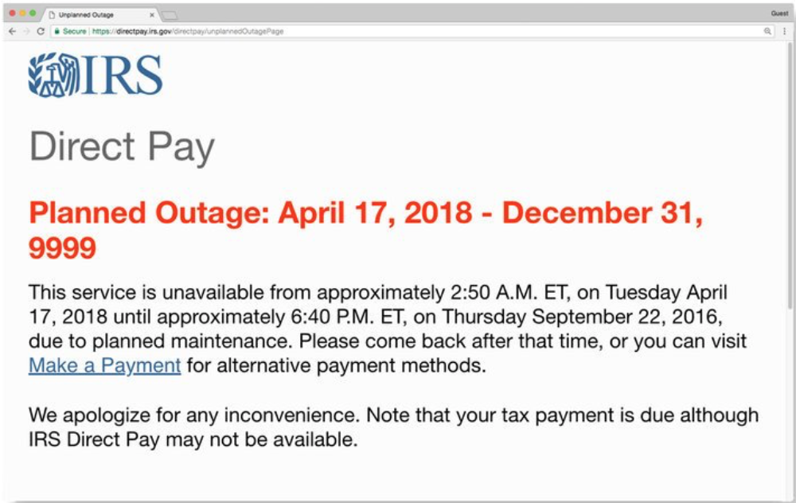
Uses of audit
Deterrence through accountability: deter misbehavior
Detection and recovery: determine what happened and how to recover
Problem monitoring: real-time intelligence
Notes:
Deterrence through accountability: santa, panopticon, chilling effect

Slide 4
Audit tasks
Recording:
what to log
what not to log
how to log
locally
remotely
how to protect the log
Reviewing:
automated analysis
manual exploration

Slide 5
What to Log

Slide 6
What to log?
Example: US State Department pilot program (1980s)
Requirements:
log every transaction related to protected electronic documents
system administrator reviews log daily to search for malicious behavior
Experiment:
test system for 5 users, 10 minutes
audit log was a stack of paper over a foot high
real system would have been 1000s of users working 24/7
Lessons learned:
logging and review of everything by a human is impractical
need to reduce information logged: log reduction
need automated review

Slide 7
States vs. events
States: data, what the system is
backup, or more
survive power failures, crashes, attacks
what state? memory, disk, network, ...
consistent snapshot of distributed system is hard
Events: actions, how the system came to be
login, access to protected resource, elevation and attenuation of privileges, ...
our focus
which events?

Slide 8
Recall: Security requirements
Functional requirement: something system should do
e.g., allow people to cash checks
Security goal: something system should/shouldn't do
e.g., prevent loss of revenue through bad checks
Security requirement: constraint on functional requirement to achieve goal
e.g., check must be drawn on bank where being cashed, or person cashing must be customer at that bank and deposit in their account

Slide 9
Events to log
Any event that involves a security requirement
Fact that requirement was checked
Whether it was met or not
The information that led to that decision
Typically involves the gold standard...
whether a principal was authenticated, or
whether an action was authorized

Slide 10
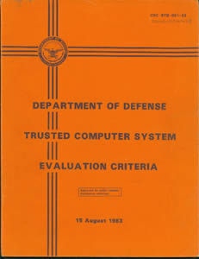
Orange Book logging
For minimal C2 level certification:
Events to log:
Use of identification and authentication mechanisms
Introduction of objects into a user's address space (e.g., file open, program initiation)
Deletion of objects
Actions taken by computer operators and system administrators and/or system security officers
Notes:
"Orange Book" (DoD Trusted Computer System Evaluation Criteria)
Used approx. 1985-2000 for US government systems
http://csrc.nist.gov/publications/history/dod85.pdf
D: meets no higher requirements
C1: DAC & authentication (but maybe not at the level of individual users), TCB with integrity verification, security testing, documentation of security features/testing/design
C2: improved DAC (at the level of single users, failsafe defaults, limits on propagation), audit (of specified security relevant events and details of those events)
- IBM mainframes and Windows NT got this certification
B: MAC
A: Verified

Slide 11
Orange Book logging
For minimal C2 level certification:
What to log:
Date and time of the event
User
Type of event
Success or failure of the event
For identification/authentication events: origin of request
For events involving objects: name of the object

Slide 12
What not to log
Some information might be too sensitive for log files:
plaintext keys, passwords
the details of company's shiny new product
the GPS coordinates of undercover secret agents
Possibilities:
log it anyway, protect the log
sanitize log
Notes:
Bug: whenever a user creates a new APFS volume and chooses an encryption password, the Disk Utility.app will log the encryption password in the unified OS log. Issue confirmed to affect to affect only macOS 10.13 and 10.13.1

Slide 13
Sanitization
Protect confidential information in log
by deleting
by modifying
e.g., replace with user names with pseudonyms, keep separate protected map between names and pseudonyms

Slide 14
Sanitization
Before writing to log:
Pro: protects users from system administrators; maybe surveillance warranted only with probable cause
Con: have to decide in advance, as part of system design, what information to keep vs. discard
After writing to log:
Con: confidentiality of log must be (more) protected
Pro: can decide afterwards what information to discard, perhaps even redact logs and send to 3rd party for analysis

Slide 15
Examples: CMS and Sakai
Notes:
Show live demo of CMS log---students really perked up at that in 2016

Slide 16
Example: CMS
Details logged:
Event type
Acting NetID
Acting IP address
Affected NetIDs
Simulated NetID
Assignment, if any
Event details (no sanitization of grades)

Slide 17
How to Log

Slide 18
Say what you mean
Main principle: Every log entry should say what it means
Interpretation of log entry should depend only upon content of log entry
Hence reviewer can recover meaning without needing to assume or supply any context
Notes:
Writing down a straightforward English sentence describing the meaning of each log entry is good practice

Slide 19
Log file format
Keeping log files in standard format enables...
Reuse of tools for log analysis
Correlation across logs from multiple applications
Standard formats:
Common Log Format (used by web servers)
syslog (used by Unix)
originated with sendmail
became a de facto standard
then standardized by IETF: RFC 5424
examples: take a look in your local /var/log directory
Notes:
sendmail: general purpose send email facility released 1983

Slide 20
Common Log Format
client IP
client id
user id
timestamp
127.0.0.1 user-identifier eleanor [10/Oct/2000:13:55:36 -0700] "GET /apache_pb.gif HTTP/1.0" 200 2326
HTTP request
response code
response len

Slide 21
syslog example message
timestamp
hostname
appliction
process id
Mar 6 00:48:29 ariel kernel[0]: AppleThunderboltNHIType2::prePCIWake - power up complete - took 1624 us
message
Notes:
Violates syslog RFC standard in various ways: timestamp omits information, hostname isn't fully qualified

Slide 22
syslog message format
facility: category
kernel, mail, security, printer, clock, ...
severity
emergency, alert, critical, error, warning, notice, informational, debug
timestamp
hostname
application name
process id
no standard meaning; sometime co-opted by application to provide identifier that groups related messages (e.g. a transaction)
message type
also no standard meaning; just a string that can be used for (e.g.) filtering
message
can be structured as key-value pairs, or unstructured

Slide 23
Log space
What happens if log size grows too large?
Halt system
Overwrite previous entries
Stop logging

Slide 24
Securing the log

Slide 25
Approaches to Securing Audit Log
Limit access to log files
Transmit entries to remote audit server
Use cryptography

Slide 26
Limit Access to Log files
least privilege
limit who can read
limit how principals can write (append-only for most users)

Slide 27
Remote Audit Servers
how often?
how secure log entries en route?

Slide 28
syslog architecture
Originators: source of messages
might duplicate to multiple relays
Relays: forward messages
might filter or duplicate messages
Collectors: sink of messages
might collect from many sources

Slide 29
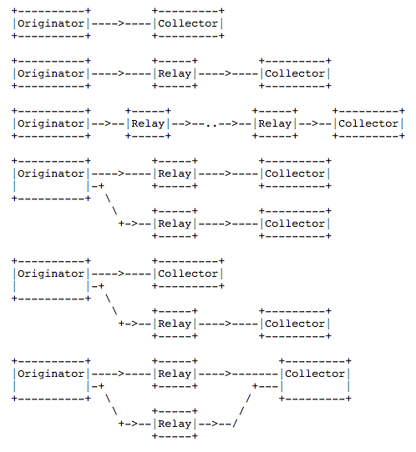
syslog architecture

Slide 30
Security concerns with syslog
Base syslog protocol has no security goals
Recommended to use SSL to protect communication channel
Nonetheless, receivers are permitted to truncate or drop messages
Even with SSL, end-to-end integrity of messages from originator to collector not guaranteed
Concerns include provenance, message integrity, replays, sequencing, detection of missing messages
Digital signatures provide solution [RFC 5848]

Slide 31
Securing the log with crypto
Threat: Attacker who compromises host that stores log. Attacker can read/write log file and can access secret keys
Harm: log can be read, modified, deleted
Vulnerability: log protected only by access control mechanisms on host (prior to archiving on remote server)

Slide 32
Securing the log with crypto
System:
machine M maintains a local log
periodically M synchs log to trusted remote log server S
might be very long periods between synch: if short periods are possible, no real need for this protocol
Goals: assume attacker compromises M at time t...
Contents of log messages entered before t are not disclosed to anyone who can read log at M (Confidentiality)
Contents of log messages and their sequence before time t cannot be changed in a way that is undetectable by S (Integrity)
Countermeasure: cryptography: use iterated hashing: H(H(H(...H(v)...))) to create tamper-resistant log

Slide 33
Protocol
M, to record message m in log:
1. ek = H("encrypt", ak)
2. x = AuthEnc(m; ek; ak)
3. record x in log
4. ak = H("iterate", ak)
Notes:
Simplified from [Schneier and Kelsey 1999]
current value of ak revealed
previous values not recoverable because hash function is one way

Slide 34
Protocol analysis
If M becomes compromised...
Current value of ak revealed
Attacker can control new log entries from now on
But old ak's cannot be recovered, because hash function is one way
Attacker can’t read old log entries
Attacker can’t selectively change old log entries

Slide 35
Protocol analysis
Weaknesses (non-goals): after time t...
Attacker can read and modify new log messages (Confidentiality+Integrity)
Attacker can truncate from log any messages not yet synched (maybe even from before t) to S (Availability); but still can't undetectably add after that truncation (Integrity)
Assumption: M and S share a secret key ak

Slide 36
Audit tasks
Recording:
what to log
what not to log
how to protect the log
Reviewing:
manual exploration
automated analysis

Slide 37
Reviewing the log

Slide 38
Manual review
Enable administrators to explore logs and look for {states, events}
Issues:
Designers might not have anticipated the right {states, events} to record
Visualization, query, expressivity (HCI/DB issues)
Correlation amongst multiple logs

Slide 39
Interfaces
Flat text [example: last time's syslog]
Hypertext
DBMS [example: queries in CMS]
Visualization tools
Notes:
http://seclab.cs.ucdavis.edu/projects/awb/vabhg/demos/rdist/root.html
Discuss SUID attack example

Slide 40
Techniques
Temporal replay: animate what happened when
Slice: display minimal set of log events that affect a given object
Notes:
Idea comes from program slicing: debugging technique that reveals program statements that led to current value of variable
Discuss example systems: splunk, logz.io, etc
https://www.keycdn.com/blog/log-analysis-tools/
https://youtu.be/OD1_I9IDvBs?t=213

Slide 41
Automated review and response
Review: detect suspicious behavior that looks like an attack, or detect violations of explicit policy
Custom-built systems
Classic AI techniques like training neural nets, expert systems, etc.
Modern applications of machine learning
Response: report, take action

