Slide 1
Lecture 3: Threat Models
CS 181S September 12, 2018
Notes:
Last time: lots of vulnerabilities. So how to we build secure systems?

Slide 2

Idea 1: Eliminate Vulnerabilities

Slide 3

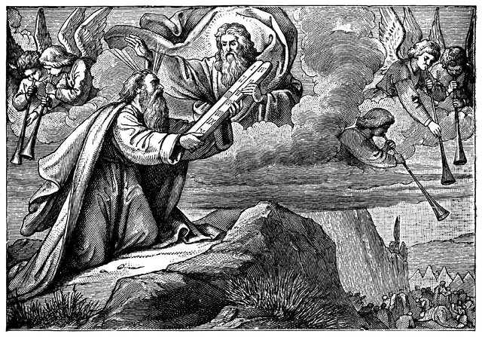

Bases for Trust
Synthetic Trust
Analytic Trust
Axiomatic Trust
Synthetic Trust: Trust derived from modification of the system. Trust in the whole derives from how components are combined. Examples: OS isolation, reference monitors, firewalls
Analytic Trust: Trust derived from testing and/or reasoning to justify conclusions about what a component or system will and/or will not do. Trust in an artifact is justified by trust in some method of analysis.
Axiomatic Trust: Trust derived from beliefs that we accept on faith. We might trust some hardware or software, for example, because it is built or sold by a given company. We are putting our faith in the company's reputation.

Slide 4
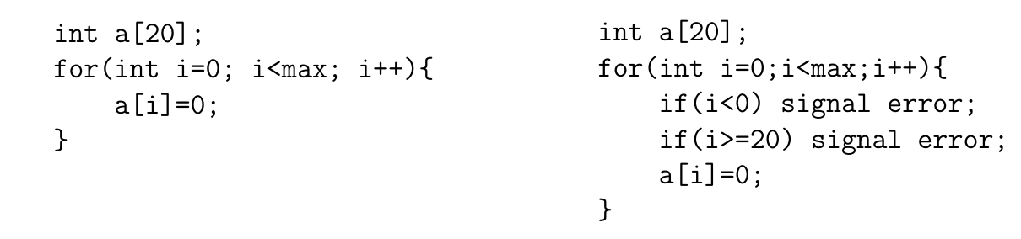
Language Support

Slide 5
Bases for Trust
Synthetic Trust
Analytic Trust
Axiomatic Trust
Synthetic Trust: Trust derived from modification of the system. Trust in the whole derives from how components are combined. Examples: OS isolation, reference monitors, firewalls
Analytic Trust: Trust derived from testing and/or reasoning to justify conclusions about what a component or system will and/or will not do. Trust in an artifact is justified by trust in some method of analysis.
Axiomatic Trust: Trust derived from beliefs that we accept on faith. We might trust some hardware or software, for example, because it is built or sold by a given company. We are putting our faith in the company's reputation.

Slide 6
Testing
Goal is to expose existence of faults, so that they can be fixed
Unit testing: isolated components
Integration testing: combined components
System testing: functionality, performance, acceptance

Slide 7
Testing
When do you stop testing?
Bad answer: when time is up
Bad answer: what all tests pass
Better answer: when methodology is complete (code coverage, paths, boundary cases, etc.)
Future answer: statistical estimation says Pr[undetected faults] is low enough (active research)
Testing for security?

Slide 8
Penetration testing
Experts attempt to attack
  Internal vs. external
  Overt vs. covert
Typical vulnerabilities exploited:
  Passwords (cracking)
  Buffer overflows
  Bad input validation
  Race conditions / TOCTOU
  Filesystem misconfiguration
  Kernel flaws

Slide 9
Fuzz testing
[Barton Miller, 1989, 2000, 2006]
Generate random inputs and feed them to programs:
  Crash? hang? terminate normally?
  Of ~90 utilities in '89, crashed about 25-33% in various Unixes
  Crash implies buffer overflow potential
Since then, "fuzzing" has become a standard practice for security testing
Results have been repeated for X-windows system, Windows NT, Mac OS X
  Results keep getting worse in GUIs but better on command line
Notes:
Literally was a dark and stormy night: noise on telephone line was inserting random character into shell session, causing Unix utilities to crash

Slide 10
Fuzz testing
Testing strategy:
Purely random no longer so good, just gets low-hanging fruit
Better:
  Use grammar to generate inputs
  Or randomly mutate good inputs in small ways
    especially for testing of network protocols
  Research: use analysis of source code to guide mutation of inputs
Notes:
Literally was a dark and stormy night: noise on telephone line was inserting random character into shell session, causing Unix utilities to crash
Example of research: Microsoft SAGE for finding bugs in media and Office applications; not released AFAIK

Slide 11
FindBugs
Looks for patterns in code that are likely faults and that are likely to cause failures
Categorizes and prioritizes bugs for presentation to developer
Watch video of Prof. Bill Pugh, developer of FindBugs, present it to a Google audience:
  https://www.youtube.com/watch?v=8eZ8YWVl-2s

Slide 12
Formal Verification
prove program is correct with respect to some formal specification
Examples: seL4, CompCert
Problems: correctness of specification, scale

Slide 13
Bases for Trust
Synthetic Trust
Analytic Trust
Axiomatic Trust
Synthetic Trust: Trust derived from modification of the system. Trust in the whole derives from how components are combined. Examples: OS isolation, reference monitors, firewalls
Analytic Trust: Trust derived from testing and/or reasoning to justify conclusions about what a component or system will and/or will not do. Trust in an artifact is justified by trust in some method of analysis.
Axiomatic Trust: Trust derived from beliefs that we accept on faith. We might trust some hardware or software, for example, because it is built or sold by a given company. We are putting our faith in the company's reputation.

Slide 14
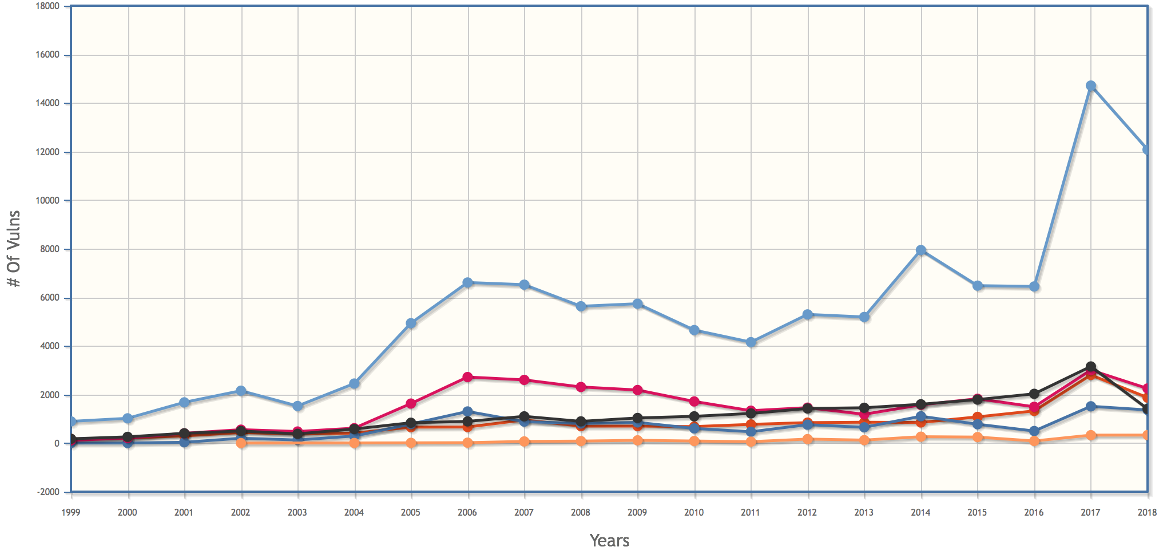
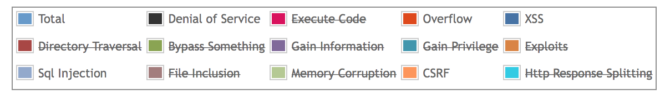
Vulnerabilities by Year
Notes:
https://www.cvedetails.com/vulnerabilities-by-types.php

Slide 15
Idea 2: Engineer Countermeasures
Attacks
are perpetrated by
threats
that inflict
harm
by exploiting
vulnerabilities
which are controlled by
countermeasures.

Slide 16
Engineering methodology
Threat analysis
Functional requirements
Harm analysis
Security goals
Feasibility analysis
Security requirements

Slide 17
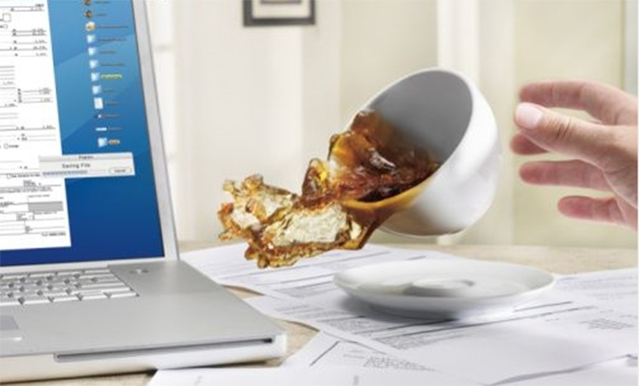
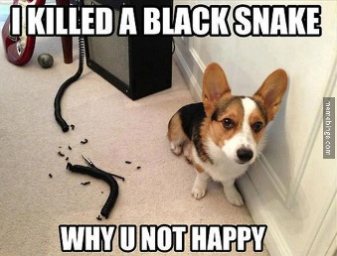
Threats
A principal that has potential to cause harm to assets
Adversary or attacker: a human threat, motivated and capable
Sometimes humans aren't malicious: accidents happen
Sometimes non-humans cause harm: floods, earthquakes, power outage, hardware failure

Slide 18
Threat Models
Identify threats of concern to system
  Especially malicious, human threats
  What kinds of attackers will system resist?
  What are their motivations, resources, and capabilities?
Best if analysis is specific to system and its functionality
Non threats?
  Trusted hardware
  Trusted environment
  e.g., physically secured machine room reachable only by trustworthy system operators

Slide 19
Threats
Inquisitive people, unintentional blunders
Hackers driven by technical challenges
Disgruntled employees or customers seeking revenge
Criminals interested in personal financial gain, stealing services, or industrial espionage
Organized crime with the intent of hiding something or financial gain
Organized terrorist groups attempting to influence policy by isolated attacks
Foreign espionage agents seeking to exploit information for economic, political, or military purposes
Tactical countermeasures intended to disrupt specific weapons or command structures
Multifaceted tactical information warfare applied in a broad orchestrated manner to disrupt major military missions
Large organized groups or nation states intent on overthrowing a government

Slide 20
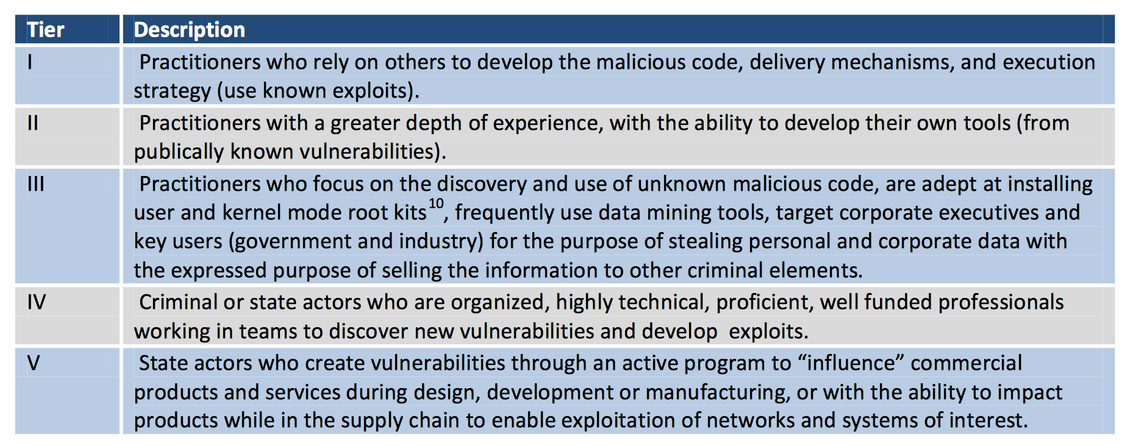
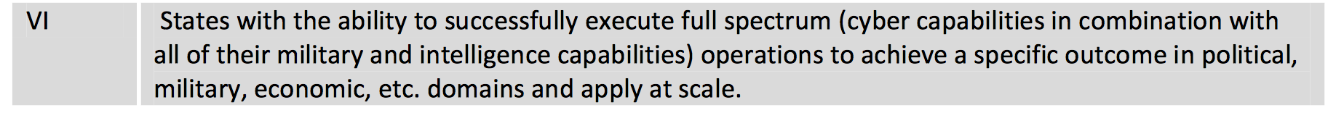
Threats (DoD)

Slide 21
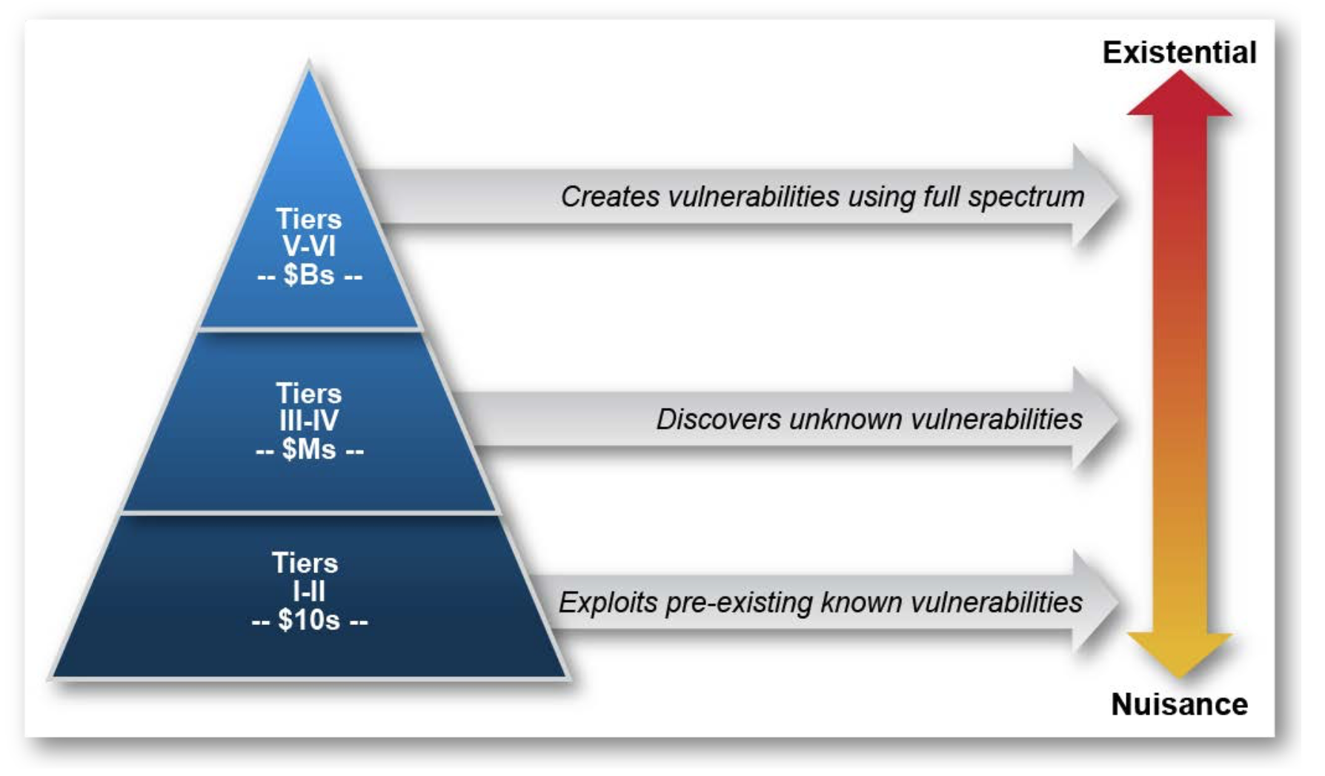
Threats (DoD)

Slide 22

Threat Model = Capabilities
Threat model: The adversary desires to prevent baby deliveries. The adversary has access to radio equipment that transmits and receives on the same frequencies that providence uses for communication with a stork. The adversary also controls weapons systems that can destroy a stork in flight.

Slide 23
Threat Model = Capabilities
privilege levels
disk access
memory access
physical access
key access
network access

Slide 24
Threat Model = Capabilities
privilege levels
disk access

Slide 25


Slide 26
Threat Model = Capabilities
privilege levels
disk access
memory access

Slide 27

Heartbleed

Slide 28
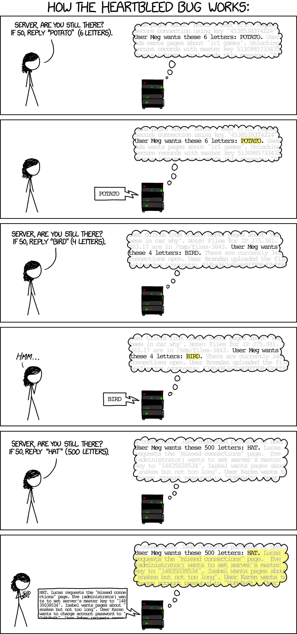
Heartbleed

Slide 29
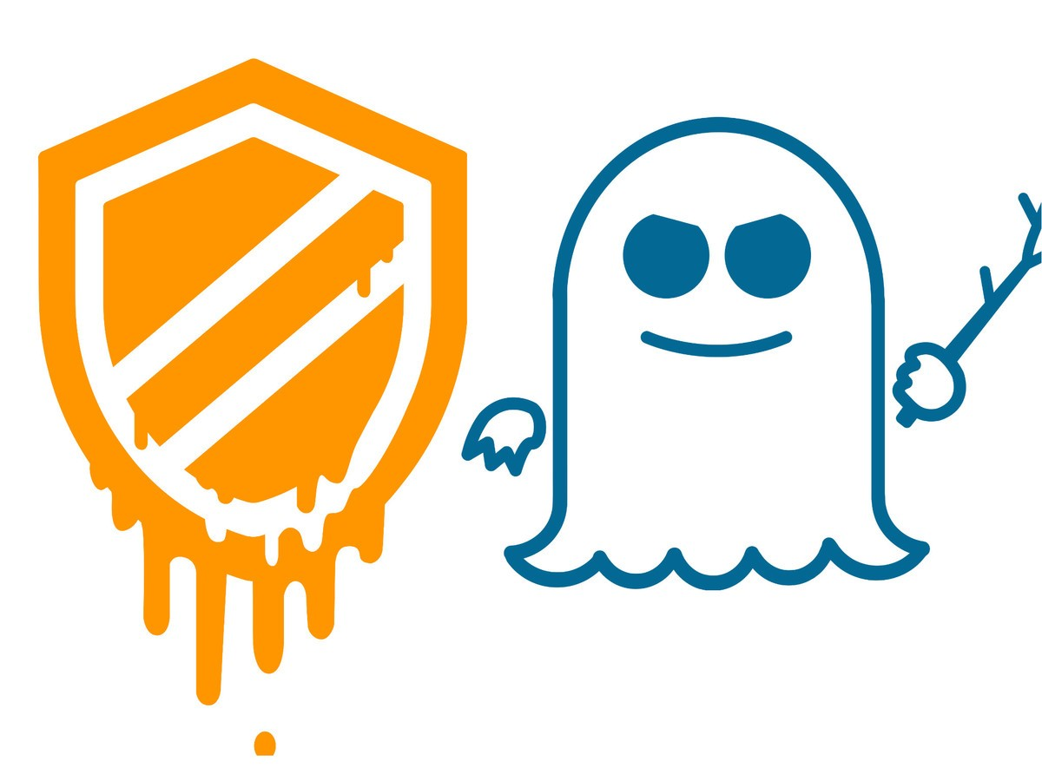

Slide 30

Memory Management
Notes:
Translation: if(Access(Page)): Frame(Page)||Offset
Lots of implementation details: size, caching, indexing
Pros: easy allocation (keep bitmap of free frames), no external fragmentation, still allows access permissions, still allows sharing, easy to grow
Cons: internal fragmentation, slower (size of page tables etc -> multiple lookups)
Cons:

Slide 31
Speculative Execution
int i1, i2;
boolean b1,b2;
boolean[] a1,a2;
if (i1 < a1.length()) {
boolean bval= a1[i1];
if(bval){i2= 1;} else{i2= 0;}
if(i2 < a2.length()){
b2 = a2[i2];
}
}
Notes:
If arr1->length is uncached, the processor can speculatively load data from arr1->data[untrusted_offset_from_caller]. This is an out-of-bounds read. That should not matter because the processor will effectively roll back the execution state when the branch has executed

Slide 32
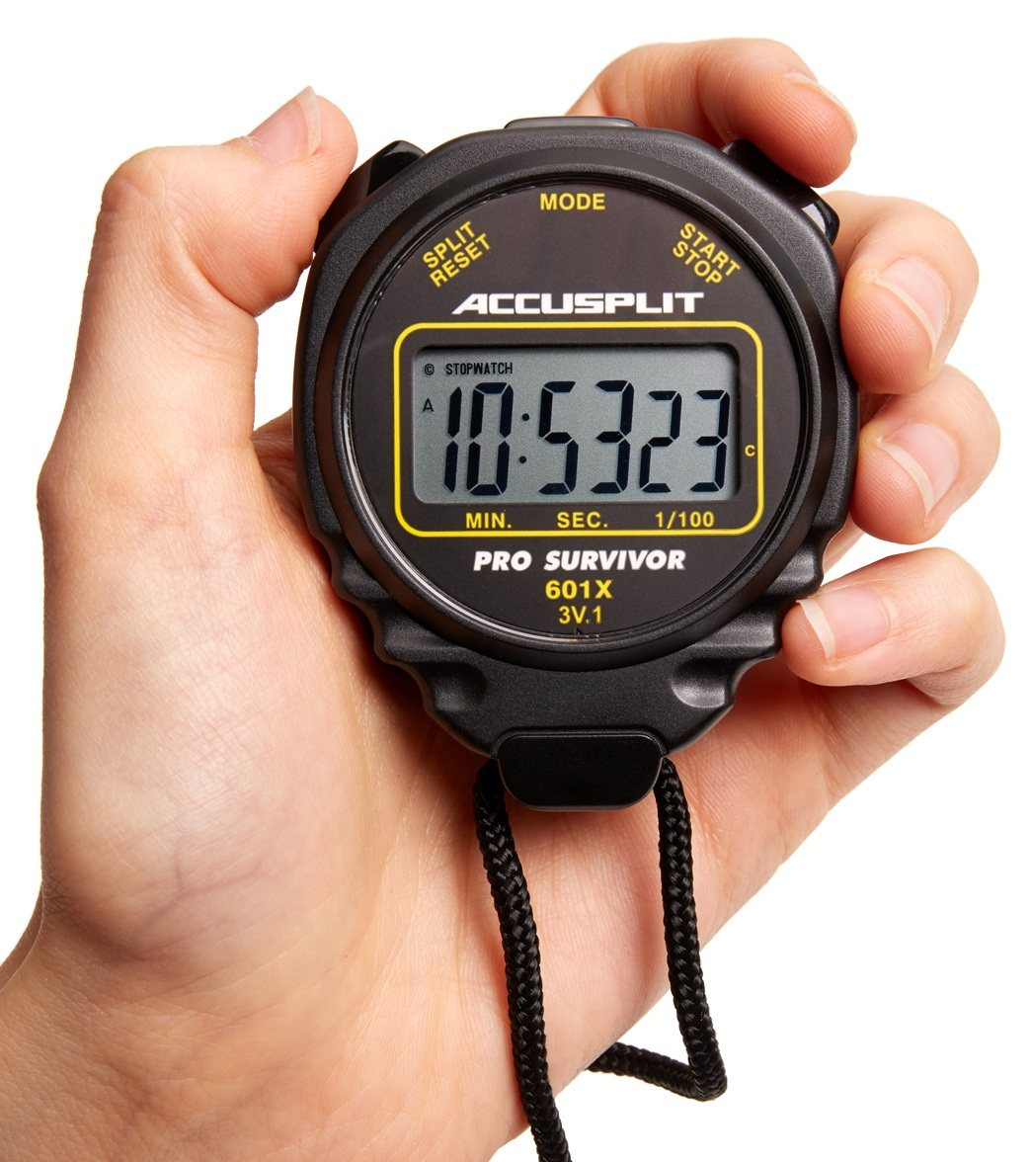
Timing

Slide 33
Threat Model = Capabilities
privilege levels
disk access
memory access
physical access

Slide 34

Stuxnet
Notes:
cold boot attack: https://www.youtube.com/watch?v=E6gzVVjW4yY&feature=youtu.be

Slide 35
Threat Model = Capabilities
privilege levels
disk access
memory access
physical access
key access

Slide 36

FileVault

Slide 37
Threat Model = Capabilities
privilege levels
disk access
memory access
physical access
key access
network access

Slide 38
Network Adversaries
Attacker Properties
Membership | insider |  | outsider
Method | active |  | passive
Adaptability | dynamic |  | static
Organization | cooperative |  | individual
Scope | global | extended | local
Motivation | malicious | rational | opportunistic

Slide 39
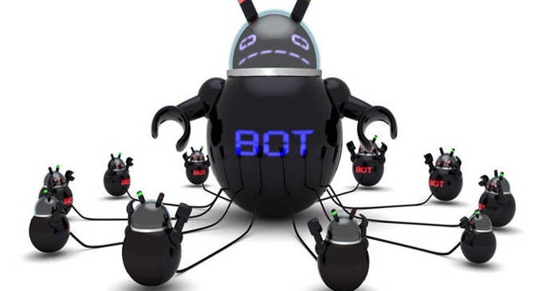
Dyn DDoS

Slide 40
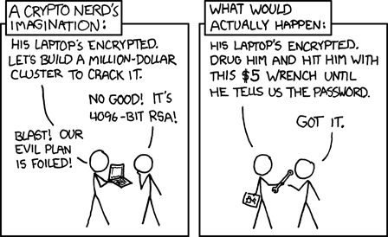
Threat Models

