Slide 1
Lecture 1: Introduction to Security
CS 181S 9/5/2018

Slide 2
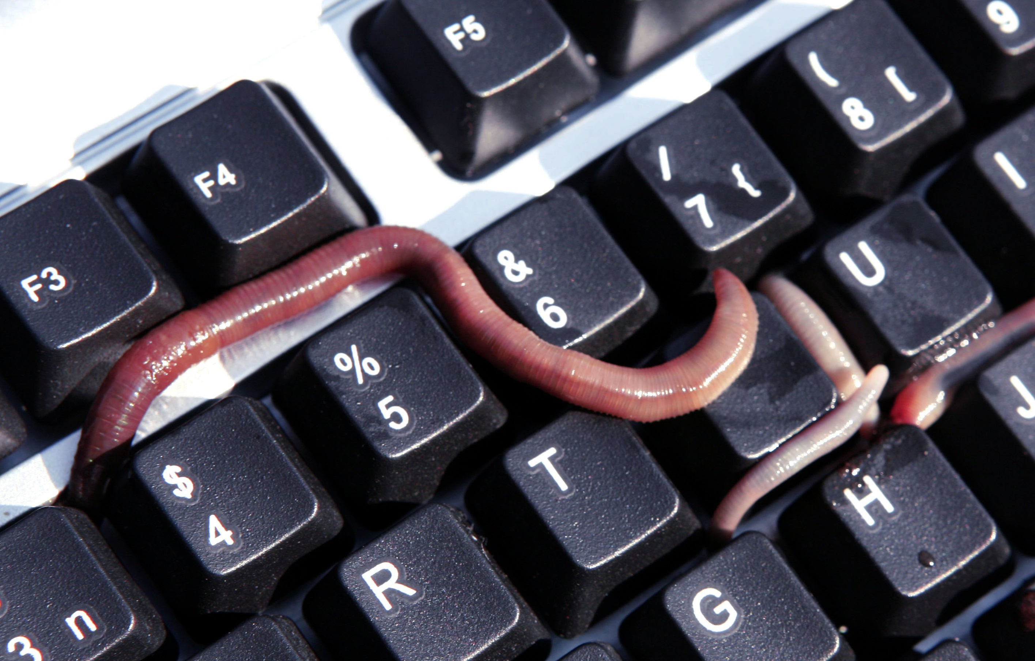
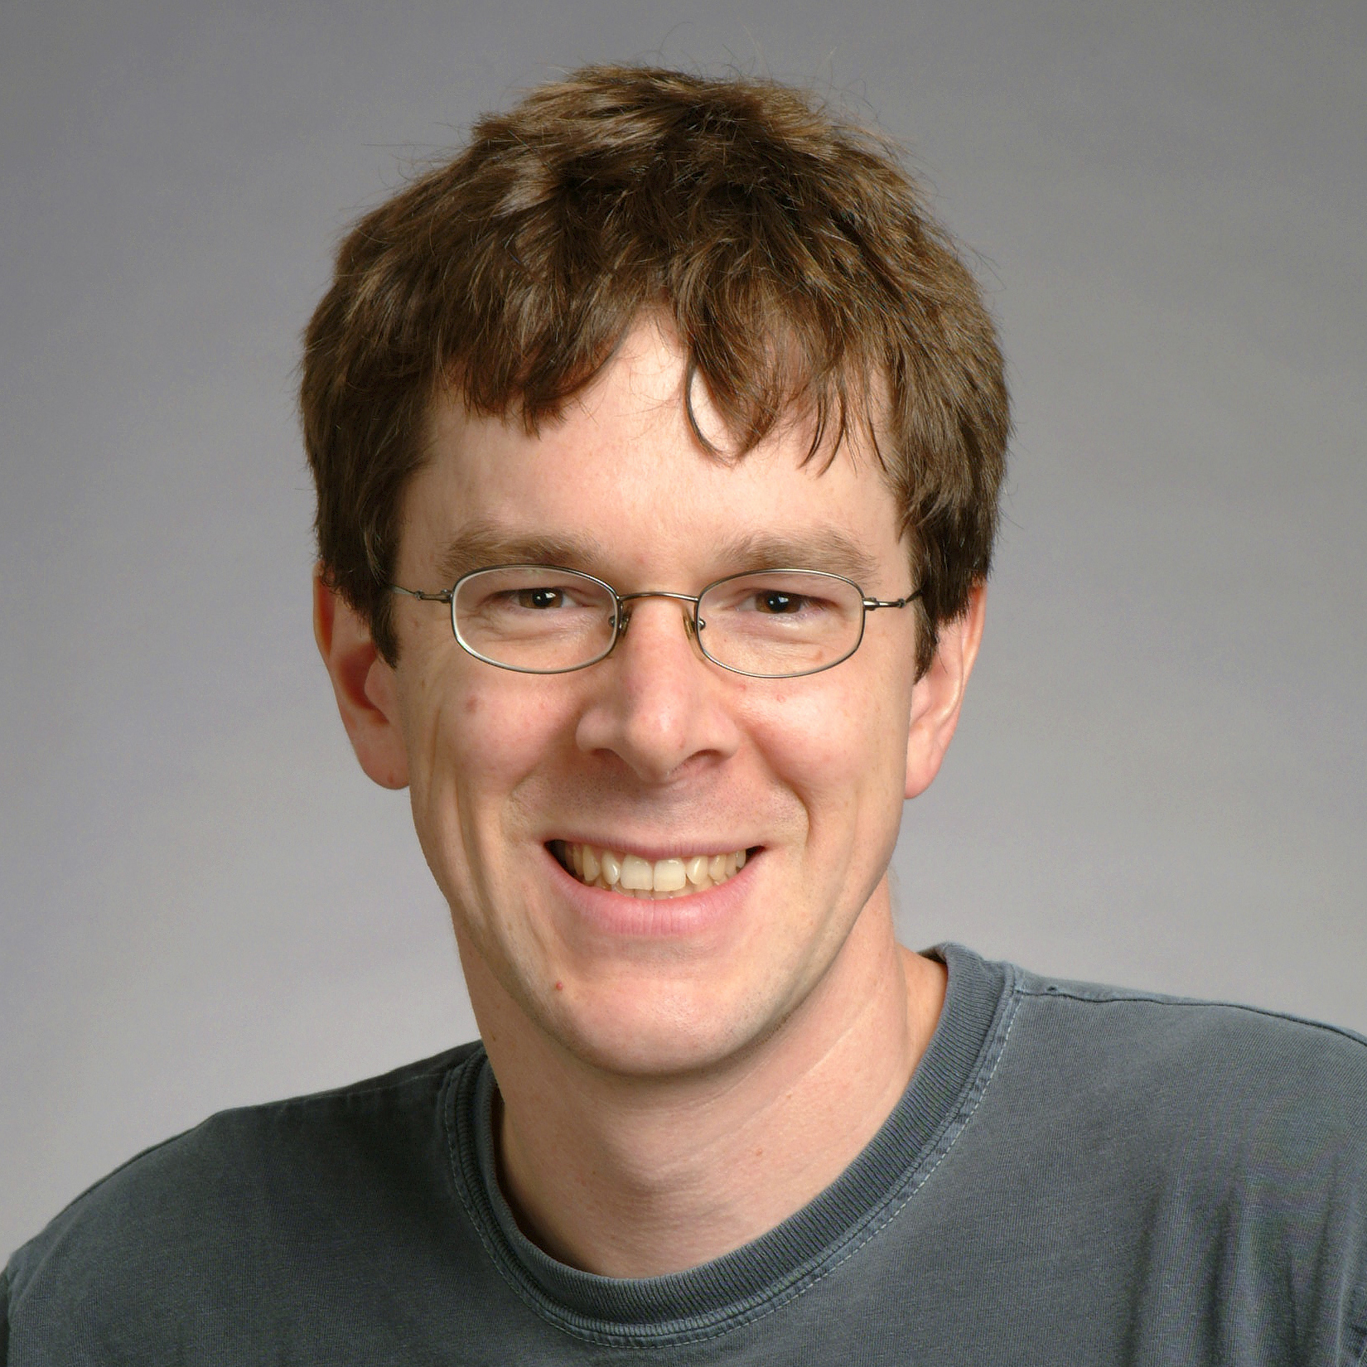
static report_breakin(arg1, arg2) /* 0x2494 */
{
int s;
struct sockaddr_in sin;
char msg;
if (7 != random() % 15)
return;
bzero(&sin, sizeof(sin));
sin.sin_family = AF_INET;
sin.sin_port = REPORT_PORT;
sin.sin_addr.s_addr = inet_addr(XS("128.32.137.13"));
November 2, 1988
Notes:
Robert Tappan Morris, Jr. released the "great worm." (His dad, Bob Morris, was chief scientist at NSA's National Computer Security Center.) This was the first worm; the first malware to get media attention; and the first conviction under the Computer Fraud and Abuse Act. Morris was 23 years old, and a first year grad student at Cornell. (He released the worm from MIT, though.) He later claimed the worm's purpose was to measure size of Internet, but the immediate effect was denial of service (DoS). The Internet "came apart" as hosts were overloaded by invisible processes. System admins had to disconnect from the network to isolate their systems from infection. The US GAO later estimated the cost of recovery was somewhere in $100k to $10m. Morris was tried in US District Court. His sentence: 3 years probation, 400 hours community service, and a $13k fine. In 1999, he received a PhD from Harvard. And now he's a professor at MIT.

Slide 3
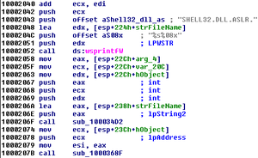
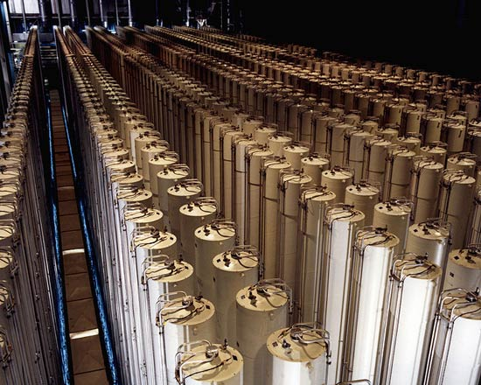
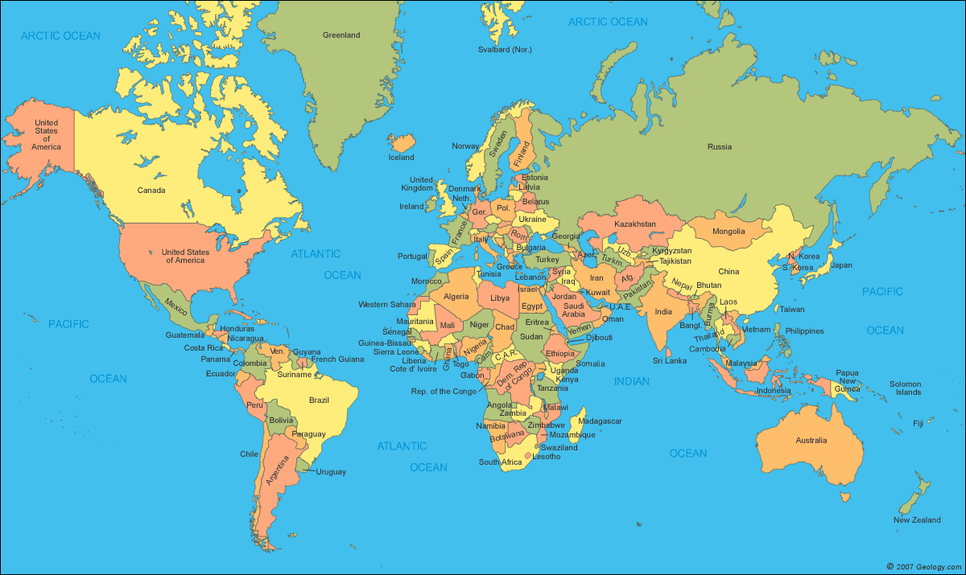
June 1, 2012
?
Notes:
The New York Times reports that the US and Israel created Stuxnet, the first (publicly known) cyberweapon. Its provenance was initially unknown. The weapon first infects Windows systems, then subsequently infects an industrial control device, causing it to vary the frequency of its motor and do physical harm. But, the weapon hides that frequency change from the device's monitoring system, so that the harm won't be noticed until it's too late. The purpose of the weapon seemed to be destruction of centrifuges in Iranian uranium enrichment facilities.

Slide 4
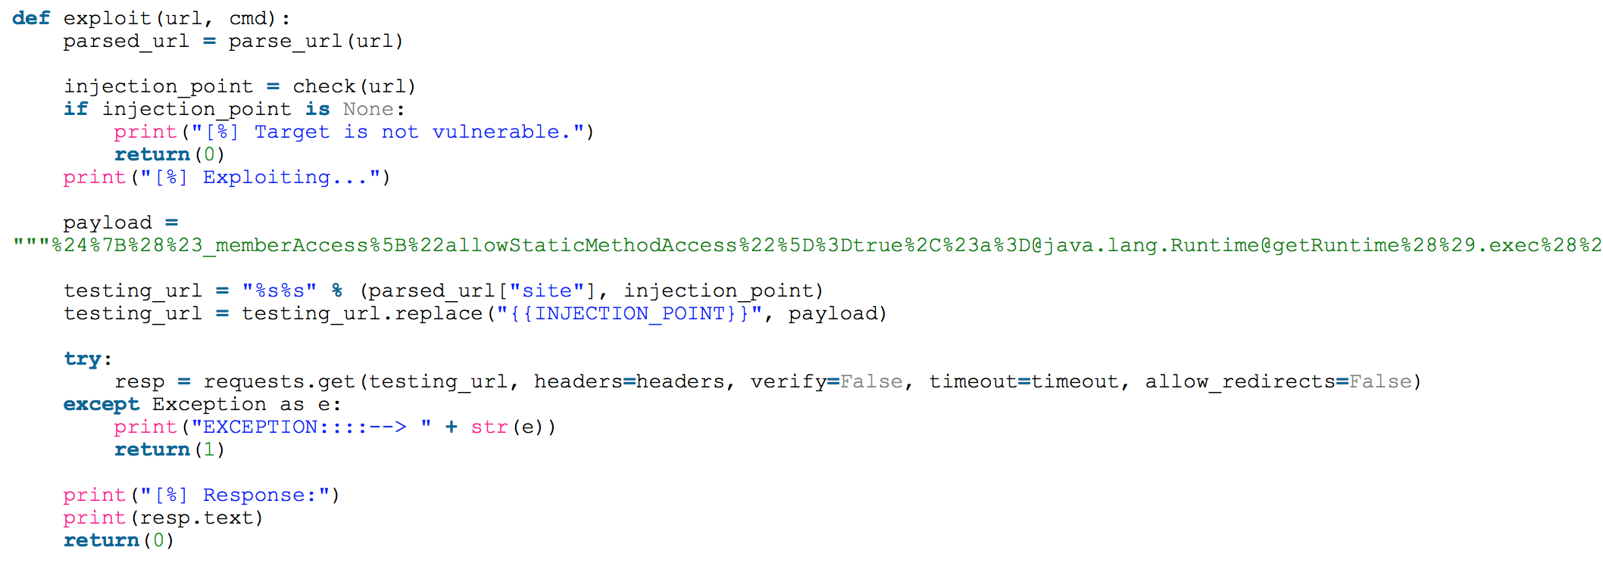
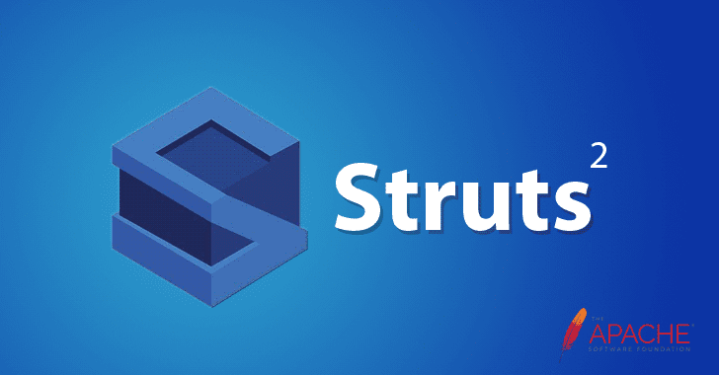
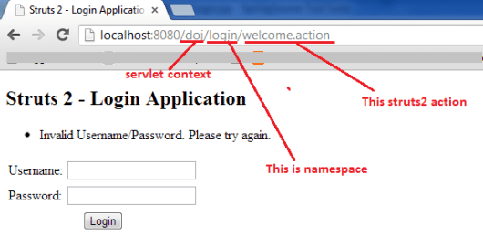
August 30, 2018

Slide 5
INTERESTING
Today
HARD
FUN
IMPORTANT
Notes:
Today, security is
hard: we don't (fully) know how to accomplish it,
interesting: involves lots of cool ideas, and
important: society depends on computers, hence their security.
That's what makes this such a fun field of study

Slide 6
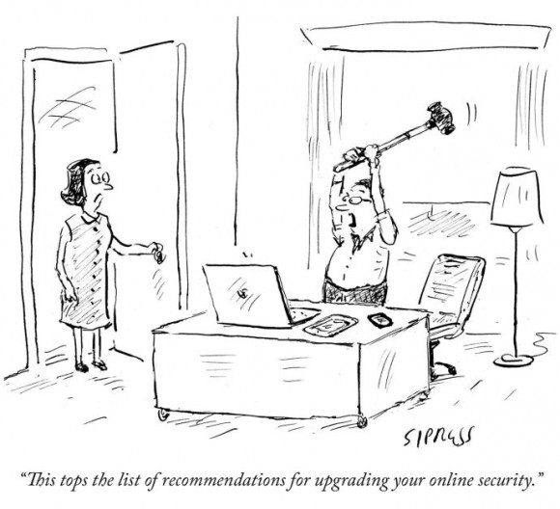
Defining security
Notes:
A computer system is secure when it
- does what it should
- and nothing more.
A security policy stipulates what should and should not be done.

Slide 7
Security Goals
"The system shall prevent/detect action on/to/with asset."
e.g., "The system shall prevent theft of money"
e.g., "The system shall prevent erasure of account balances"
Poor goals:
"the system shall use encryption to prevent reading of messages"
"the system shall use authentication to verify user identities"
"the system shall resist attacks"
Security goals should specify what not how

Slide 8
C I A

Slide 9
C I A
Confidentiality
Integrity
Availability

Slide 10
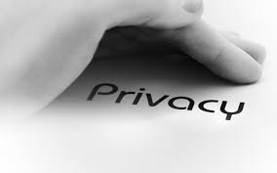
Privacy
Privacy concerns information about individuals (people, organizations, etc.)
Often construed as legal right
Privacy is not a synonym for confidentiality or for secrecy

Slide 11
Confidentiality Goals
Protection of assets from unauthorized disclosure
i.e., which principals are allowed to learn what
Examples:
Keep contents of a file from being read (access control: more later)
Keep information secret (information flow: more later)
value of variable secret
behavior of system
information about individual
Notes:
Examples of iflow:
pub :=0; if (sec=1) { pub := 1; }
system load goes up when processing secret information
power consumed when processing secret information (DPA)
Database linking: Gender, DOB, ZIP uniquely identify about 99% of people in Cambridge, MA

Slide 12
Integrity Goals
Protection of assets from unauthorized modification
i.e., what changes are allowed to system and its environment, including inputs and outputs
Examples:
Output is correct according to (mathematical) specification
No exceptions thrown
Only certain principals may write to a file (access control)
Data are not corrupted or tainted by downloaded programs (information flow)

Slide 13
Availability Goals
Protection of assets from loss of use
i.e., what has to happen when/where
Examples:
Operating system must accept inputs periodically
Program must produce output by specified time
Requests must be processed fairly (order, priority, etc.)
Denial of service (DoS) attacks compromise availability

Slide 14
Aspects of security
Confidentiality: protection of assets from unauthorized disclosure
Integrity: protection of assets from unauthorized modification
Availability: protection of assets from loss of use
Notes:
This course will mostly focus on C and I, not A

Slide 15
Ex 1
Attack: John copies Mary's homework
What is a security goal this attack would violate?
Which aspect of security does that policy address?
Notes:
Even if there aren't right answers, some are better than others---simpler, more clear cut, easier to argue, etc.

Slide 16
Ex 2
Attack: Paul causes Linda's system to freeze
Goal?
Aspect?

Slide 17
Exercise: Security Goals

Slide 18
Stork Baby Delivery
The stork baby delivery system allows an autonomous aircraft (a stork) to deliver a payload (a baby) to a geographic location prespecified by some higher authority (providence). Prior to take-off, providence programs a stork with the geographic location describing where the baby should be delivered. Throughout the mission, the stork transmits back to providence a video of the landscape (labeled with geographic location coordinates) that the stork flies over. While a stork is in flight, providence may issue commands to that stork and change the location for the delivery, alter the path being followed to that location, or abort the mission.
Threat model: The adversary desires to prevent baby deliveries. The adversary has access to radio equipment that transmits and receives on the same frequencies that providence uses for communication with a stork. The adversary also controls weapons systems that can destroy a stork in flight.

Slide 19
The Bigger Picture
Attacks are perpetrated by threats that inflict harm by exploiting vulnerabilities which are controlled by countermeasures.

Slide 20
Logistics

Slide 21
Course Logistics
Prof. Eleanor Birrell
Edmunds 221
Research in security and privacy
OH: M 8-10pm, T/W 4:30-6:30pm
Class Meetings:
Monday and Wednesday, 2:45-4pm in Lincoln 1125
Attendance is required

Slide 22
Course Work
4 Theory assignments (35%)
T1 has been released, due 9/12
3 Applied assignments (30%)
Course project (35%)
Design and build a secure system
Done in groups of 3-5
All assignments will be due Wednesdays at 11:55pm

Slide 23
Course website
http://www.cs.pomona.edu/classes/cs181s/2018fa/
ding)
All information is on the course website
Various reading materials: slides, notes, links to online readings, pointers to text book chapters
Optional? Yes. But...
the more of these you read, the more you will get out of the course
assignments are often inspired by this material
Lectures are the ground truth for material we cover

Slide 24
PERMs
If you are already registered in the class, welcome!
If you are not registered:
Make sure you have submitted a PERM request
Put your name on the sign-up sheet
Arrange to meet with me this week

