Slide 1
Lecture 24: Distributed Systems
CS 105 December 10, 2019

Slide 2
What is a distributed system?
A distributed system is a collection of autonomous computing elements that appears to its users as a single, coherent system
A distributed system is several computers doing something together. Thus, a distributed system has three primary characteristics: multiple computers, interconnections, and shared state.

Slide 3
Why not just use one computer?
computers fail
limited resources
physical location
nonuniform hardware

Slide 4
Example: Cluster Computing
Master Node
Compute Node
Compute Node
Compute Node
Management application
Parallel Application
Parallel Application
Parallel Application
…
Parallel libraries
Local OS
Local OS
Local OS
Local OS
Remote Access
Network
Local Network
cluster computing is use for parallel programming in which a single (compute intensive) program is run in parallel on multiple machines
Master node provides interface for users and is responsible for task scheduling
Examples: MOSIX, MapReduce, Hadoop

Slide 5
Example: Distributed File Systems
Master Node
Chunk Server
Chunk Server
Chunk Server
Management application
…
File1, Chunk1
File1, Chunk1
File1, Chunk2
Parallel libraries
File2, Chunk2
File1, Chunk2
File2, Chunk2
Local OS
File1, Chunk2
File2, Chunk1
File2, Chunk1
Remote Access
Network
Local Network
files are divided into fixed-size chunks and stored on chuck servers
each chunk is replicated
master server stores chunk metadata

Slide 6
Properties we want
Transparency: Hide that resource is physically distributed across multiple computers
Consistency: appears as all one system
Reliability: system doesn't go down/go wrong when component(s) fail
Scalability: can grow (add more nodes, memory, etc.)

Slide 7
Replication
In distributed systems, data are typically replicated
increases reliability
improves scalability
reduces latency for global systems
Problem: how do you ensure consistency when data are replicated?

Slide 8
The Model
Shared data is kept in a data store
a register, a file system, a database, a distributed file system, a distributed key-value store
Clients access the data store through read and write operations
Consistency Semantics: a contract between the data store and its clients that specifies the results that clients can expect to obtain when accessing the data store
sequential consistency
causal consistency
eventual consistency

Slide 9
Sequential Consistency
“The result of any execution is the same as if the operations of all the processes were executed in some sequential order and the operations of each individual process appear in this sequence in the order specified by its program” (Lamport, 1979)
In other words: create a total order that includes all the operations of the execution, such that:
the total order respects the local history of each process
every read returns the result of the latest write, according to the total order (data coherence)

Slide 10
Example: Sequential Consistency
P1: | W(x): a
P2: |  | W(x): b
P3: |  |  | R(x): b |  | R(x): a
P4: |  |  |  | R(x): b | R(x): a
4
1
2
5
3
6
Is this data store sequentially consistent?

Slide 11
Example: Sequential Consistency
P1: | W(x): a
P2: |  | W(x): b
P3: |  |  | R(x): b |  | R(x): a
P4: |  |  |  | R(x): a | R(x): b
Is this data store sequentially consistent?
Notes:
no

Slide 12
Exercise: Sequential Consistency
P1: | W(x): a |  |  | W(x): c
P2: |  | R(x): a | W(x): b
P3: |  | R(x): a |  | R(x): c | R(x): b
P4: |  | R(x): a |  | R(x): b | R(x): c
Is this data store sequentially consistent?
Notes:
no

Slide 13
Causal Consistency
Writes that are potentially causally related must be seen by all processes in the same order. Concurrent writes may be seen in a different order on different machines. (Hutto and Ahamad, 1990)
The following pairs of operations are causally related:
Two writes by the same process to the same location
A read followed by a write of the same process (even if the write addresses a different location)
A read that returns the value of a write from any process
Two operations that are transitively related according to the above conditions

Slide 14
Example: Causal Consistency
P1: | W(x): a
P2: |  | W(x): b
P3: |  |  | R(x): b |  | R(x): a
P4: |  |  |  | R(x): a | R(x): b
Is this data store causally consistent?
Notes:
no

Slide 15
Example: Causal Consistency
P1: | W(x): a
P2: | R(x): a | W(x): b
P3: |  |  | R(x): b |  | R(x): a
P4: |  |  |  | R(x): a | R(x): b
Is this data store causally consistent?
Notes:
no

Slide 16
Exercise: Causal Consistency
P1: | W(x): a |  |  | W(x): c
P2: |  | R(x): a | W(x): b
P3: |  | R(x): a |  | R(x): c | R(x): b
P4: |  | R(x): a |  | R(x): b | R(x): c
Is this data store causally consistent?
Notes:
yes

Slide 17
Eventual Consistency
If no updates take place for a long time, all replicas will eventually have the same data stored (Vogels, 2009)
In the absence of write-write conflicts, updates will eventually propagate to all replicas
Convenient model for applications where updates are made by a single authority (e.g., web with caching)

Slide 18
What semantics do you want
want a consistency model that is easy to understand (otherwise it is hard to write correct programs that use the data store)
need to be able to guarantee the consistency model

Slide 19
Primary-based protocols
Client
Client
W1
W5
R1
R2
W2
Primary Server for x
W3
W3
W4
W4
W3
W4
Backup Server
straightforward implementation of sequential consistency
primary server orders writes
performance vs. fault tolerance tradeoff

Slide 20
Replicated-write protocols
General idea: require clients to request and acquire the permission of multiple servers before either reading or writing a replicated data item
To write a replicated item:
client must first contact a majority of servers and get them to agree to the update
once majority of servers have agreed, file is changed and a new version number is associated with
To read a replicated file:
client must obtain same version of file from a majority of servers

Slide 21
Failure Models
Crash
Fault-Stop
Send Omission
Receive Omission
Omission
Byzantine

Slide 22
Chain Replication
Req. | UID
r1 | 1
r0 | 2
Head
Tail
X = 3
X = 3
X = 3
X = 3
put(x,30)
r0
r1
put(x,10)
Client
Client

Slide 23
Chain Replication
Req. | UID
r1 | 1
Req. | UID
Req. | UID
Req. | UID
r1 | 1
r0 | 2
Head
Tail
X = 10
X = 3
X = 3
X = 3
put(x,30)
r0
r1
put(x,10)
Client
Client

Slide 24
Chain Replication
Req. | UID
r1 | 1
r0 | 2
Req. | UID
r1 | 1
Req. | UID
Req. | UID
r1 | 1
r0 | 2
Head
Tail
X = 30
X = 10
X = 3
X = 3
put(x,30)
r0
r1
put(x,10)
Client
Client

Slide 25
Chain Replication
Req. | UID
r1 | 1
r0 | 2
Req. | UID
r1 | 1
Req. | UID
r1 | 1
Req. | UID
r1 | 1
r0 | 2
Head
Tail
X = 30
X = 10
X = 10
X = 10
put(x,30)
r0
r1
put(x,10)
Client
Client

Slide 26
Chain Replication
Req. | UID
r1 | 1
r0 | 2
Req. | UID
r1 | 1
Req. | UID
r1 | 1
Req. | UID
r1 | 1
r0 | 2
Head
Tail
X = 30
X = 10
X = 10
X = 10
x=10
put(x,30)
r0
r1
put(x,10)
Client
Client

Slide 27
Chain Replication
Req. | UID
r1 | 1
r0 | 2
Req. | UID
r1 | 1
Req. | UID
r1 | 1
Req. | UID
r1 | 1
r0 | 2
Head
Tail
X = 30
X = 10
X = 10
X = 10
put(x,30)
r0
Client

Slide 28
Chain Replication
Req. | UID
r1 | 1
r0 | 2
Req. | UID
r1 | 1
r0 | 2
Req. | UID
r1 | 1
Req. | UID
r1 | 1
r0 | 2
Head
Tail
X = 30
X = 30
X = 10
X = 10
put(x,30)
r0
Client

Slide 29
Chain Replication
Req. | UID
r1 | 1
r0 | 2
Req. | UID
r1 | 1
r0 | 2
Req. | UID
r1 | 1
Req. | UID
r1 | 1
r0 | 2
Head
Tail
X = 30
X = 30
X = 30
X = 10
put(x,30)
r0
Client

Slide 30
Chain Replication
Req. | UID
r1 | 1
r0 | 2
Req. | UID
r1 | 1
r0 | 2
Req. | UID
r1 | 1
r0 | 2
Req. | UID
r1 | 1
r0 | 2
Head
Tail
X = 30
X = 30
X = 30
X = 10
put(x,30)
r0
Client

Slide 31
Chain Replication
Req. | UID
r1 | 1
r0 | 2
Req. | UID
r1 | 1
r0 | 2
Req. | UID
r1 | 1
r0 | 2
Req. | UID
r1 | 1
r0 | 2
Head
Tail
X = 30
X = 30
X = 30
X = 30
put(x,30)
r0
x= 30
Client

Slide 32
Fault Tolerance
Req. | UID
r1 | 1
r0 | 2
Req. | UID
Req. | UID
Req. | UID
Head
Tail
X = 30
X = 3
X = 3
X = 3

Slide 33
Fault Tolerance
Req. | UID
r1 | 1
r0 | 2
Req. | UID
Req. | UID
Req. | UID
Head
Tail
X = 30
X = 3
X = 3
X = 3
Dropped requests r1 and r0

Slide 34
Fault Tolerance
Req. | UID
r1 | 1
r0 | 2
Req. | UID
r1 | 1
r0 | 2
Req. | UID
r1 | 1
Req. | UID
r1 | 1
r0 | 2
Head
Tail
X = 30
X = 30
X = 30
X = 10

Slide 35
Fault Tolerance
Req. | UID
r1 | 1
r0 | 2
Req. | UID
r1 | 1
r0 | 2
Req. | UID
r1 | 1
Req. | UID
r1 | 1
r0 | 2
Head
Tail
X = 30
X = 30
X = 30
X = 10
New tail is stable for superset of old tail’s requests

Slide 36
Fault Tolerance
Req. | UID
r1 | 1
r0 | 2
Req. | UID
r1 | 1
r0 | 2
Req. | UID
r1 | 1
Req. | UID
r1 | 1
r0 | 2
Head
Tail
X = 30
X = 30
X = 10
X = 10

Slide 37
Fault Tolerance
Req. | UID
r1 | 1
r0 | 2
Req. | UID
r1 | 1
r0 | 2
Req. | UID
r1 | 1
Req. | UID
r1 | 1
r0 | 2
Head
Tail
X = 30
X = 30
X = 10
X = 10

Slide 38
Fault Tolerance
Req. | UID
r1 | 1
r0 | 2
Req. | UID
r1 | 1
r0 | 2
Req. | UID
r1 | 1
Req. | UID
r1 | 1
r0 | 2
Head
Tail
X = 30
X = 30
X = 10
X = 10
Need to re-send r0

Slide 39
Fault Tolerance
Req. | UID
r1 | 1
r0 | 2
Req. | UID
r1 | 1
r0 | 2
Req. | UID
r1 | 1
r0 | 2
Req. | UID
r1 | 1
r0 | 2
Head
Tail
X = 30
X = 30
X = 10
X = 10
Need to re-send r0
How is all of this assignment managed?
Notes:
Trusted Master
Fault-tolerant state machine
Trusted by all replicas
Monitors all replicas & issues commands

Slide 40
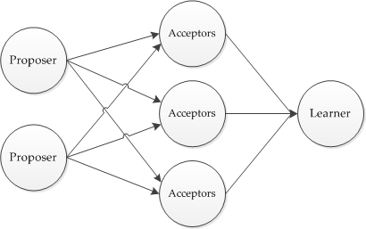
Paxos
Assumptions:
communication is unreliable. messages may be lost, duplicated, or reordered
messages that are corrupted can be detected
all operations are deterministic
processes might exhibit crash failures but not arbitrary failures
no collusion between processes

Slide 41
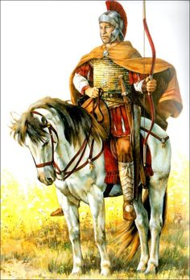
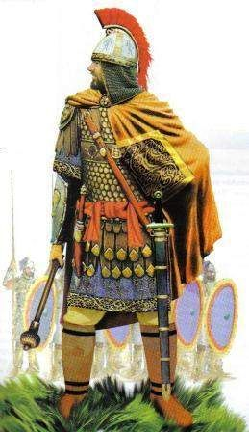
Byzantine Fault Tolerance

Slide 42
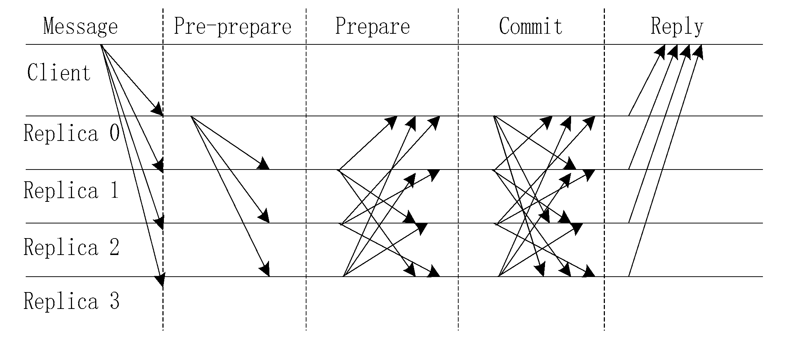
Byzantine Fault Tolerance
want consistent state (consensus) even in the presence of arbitrary (possibly malicious) failures
need to make assumptions on how many failures can occur

