Slide 1
Lecture 23: Reliable Storage
CS 105 December 5, 2019

Slide 2
File System Goals
Persistence: maintain/update user data + internal data structures on persistent storage devices
Flexibility: need to support diverse file types and workloads
Performance: despite limitations of disks
Reliability: must store data for long periods of time despite OS crashes or hardware malfunctions

Slide 3
Types of Failures
Isolated Disk Sectors
Transient: data corrupted but new data can be successfully written to / read from sector
Permanent: physical malfunction (magnetic coating, scratches, contaminants)
Full Disk Failure
Damage to disk head, electronic failure, wear out

Slide 4
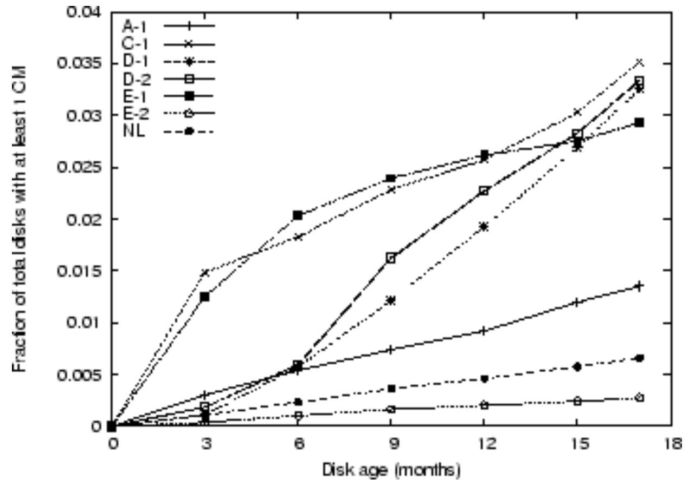
Data Corruption
data corruption can be caused by write interference, head height, leaked charge, cosmic rays, etc.
approximately one sector will be corrupted per 10^14 bits read (about a 2% chance if you read a 2TB disk)
Notes:
https://www.usenix.org/legacy/event/fast08/tech/full_papers/bairavasundaram/bairavasundaram_html/main.html

Slide 5
Checksums
a checksum is the result of a function that takes a chunk of data (e.g., a 4KB block) and returns a short summary (e.g., 4 or 8 bytes)
File systems can store checksums for metadata and/or file contents
Example:
xor
addition
Fletcher check-sum
cyclic redundancy check (CRC)
Notes:
CRC: treat block as int, store value mod k

Slide 6
XOR-based Checksum
Consider a 16-byte data block
Represented in binary, we get
We then perform an XOR over each column to compute the checksum
365e
c4cd
ba14
8a92
ecef
2c3a
40be
f666
00110110
01011110
11000100
11001101
10111010
00010100
10001010
10010010
11101100
11101111
00101100
00111010
01000000
10111110
11110110
01100110
00100000
00011011
10010100
00000011
= 0x201b9403
Notes:
Advantages: cheap and easy, but it won't detect all corruptions

Slide 7
Using Checksums
datablocks are stored with checksums
When reading a datablock $D$ from disk, the OS also reads its stored checksum $C_{S}(D)$. It then computes the checksum of the datablock $C_{C}\left(D\right)$ and check whether ${C_{C}\left(D\right)==C}_{S}(D)$.

Slide 8
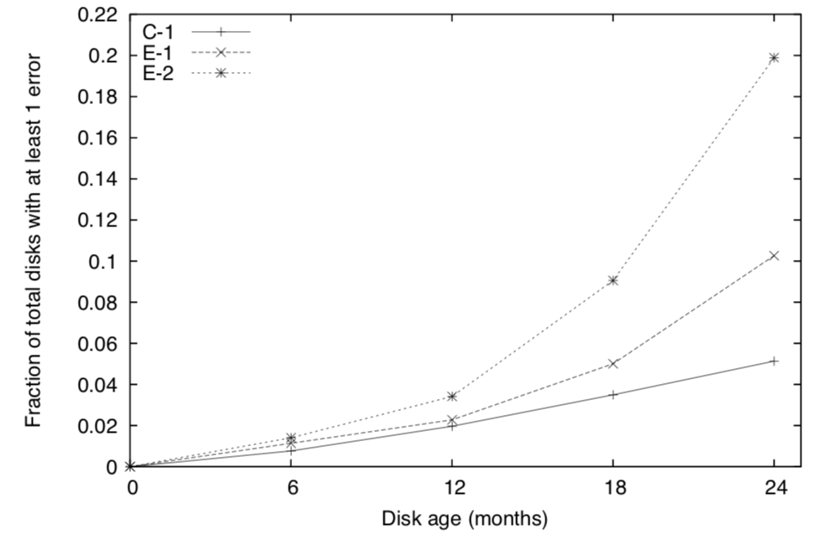
Latent-Sector Errors
latent-sector errors arise when a disk sector (or group of sectors) has been damaged in some way
Example: head crash

Slide 9
Error Correcting Codes
an error-correcting code is a redundant encoding of data that allows information to be recovered from a corrupted copy
used by disks to automatically correct for disk errors
balances storage overhead versus error rate

Slide 10
Read-Solomon Coding
Consider a 16-byte data block d
It is mapped to a polynomial $p_{d}\left(x\right)=d_{0}+d_{1}x+ …+d_{15}x^{15}$ evaluated modulo $2^{8}$
The error-correction code is simply $p_{d}$ evaluated at $n$ different points
365e
c4cd
ba14
8a92
ecef
2c3a
40be
f666

Slide 11
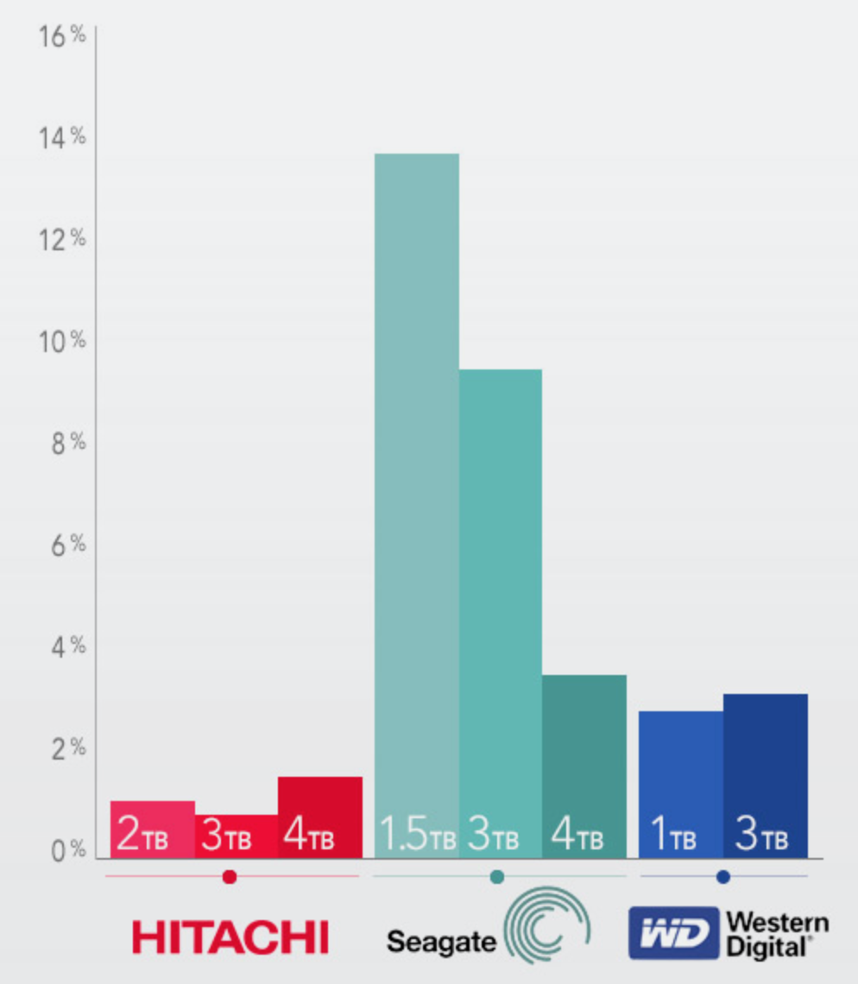
Full Disk Error
Damage to disk head, electronic failure, wear out

Slide 12
RAID
a redundant array of inexpensive disks (RAID) is a system that spreads data redundantly across multiple disks in order to tolerate individual disk failures

Slide 13
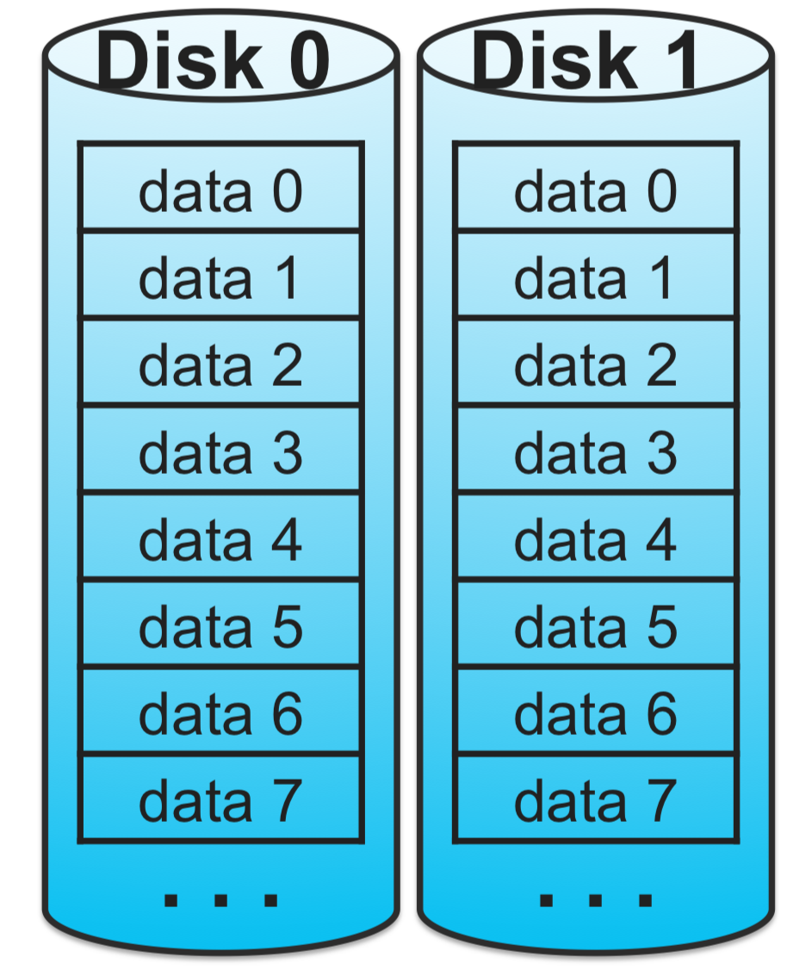
RAID-1: Mirroring
Each block is stored on 2 separate disks.
Read either copy
If error is detected, read other copy
write both copies (in parallel)

Slide 14
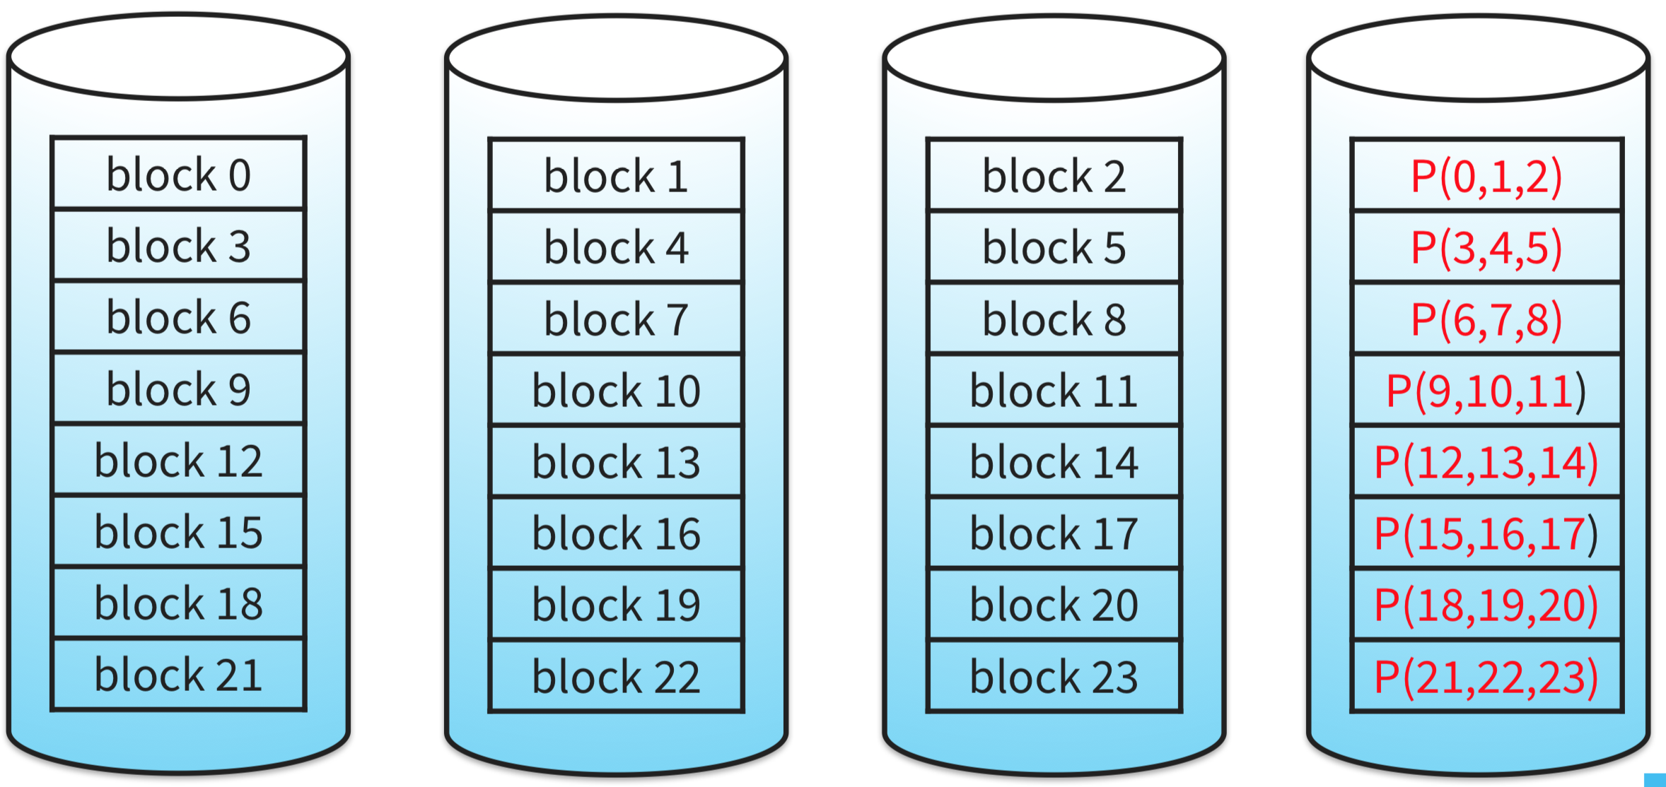
RAID-4: Parity for Errors
block-level striping with a dedicated parity disk
RAID-2 and RAID-3 are variants that stripe at the bit and byte levels (not used in practice)
parity disk becomes the bottleneck

Slide 15
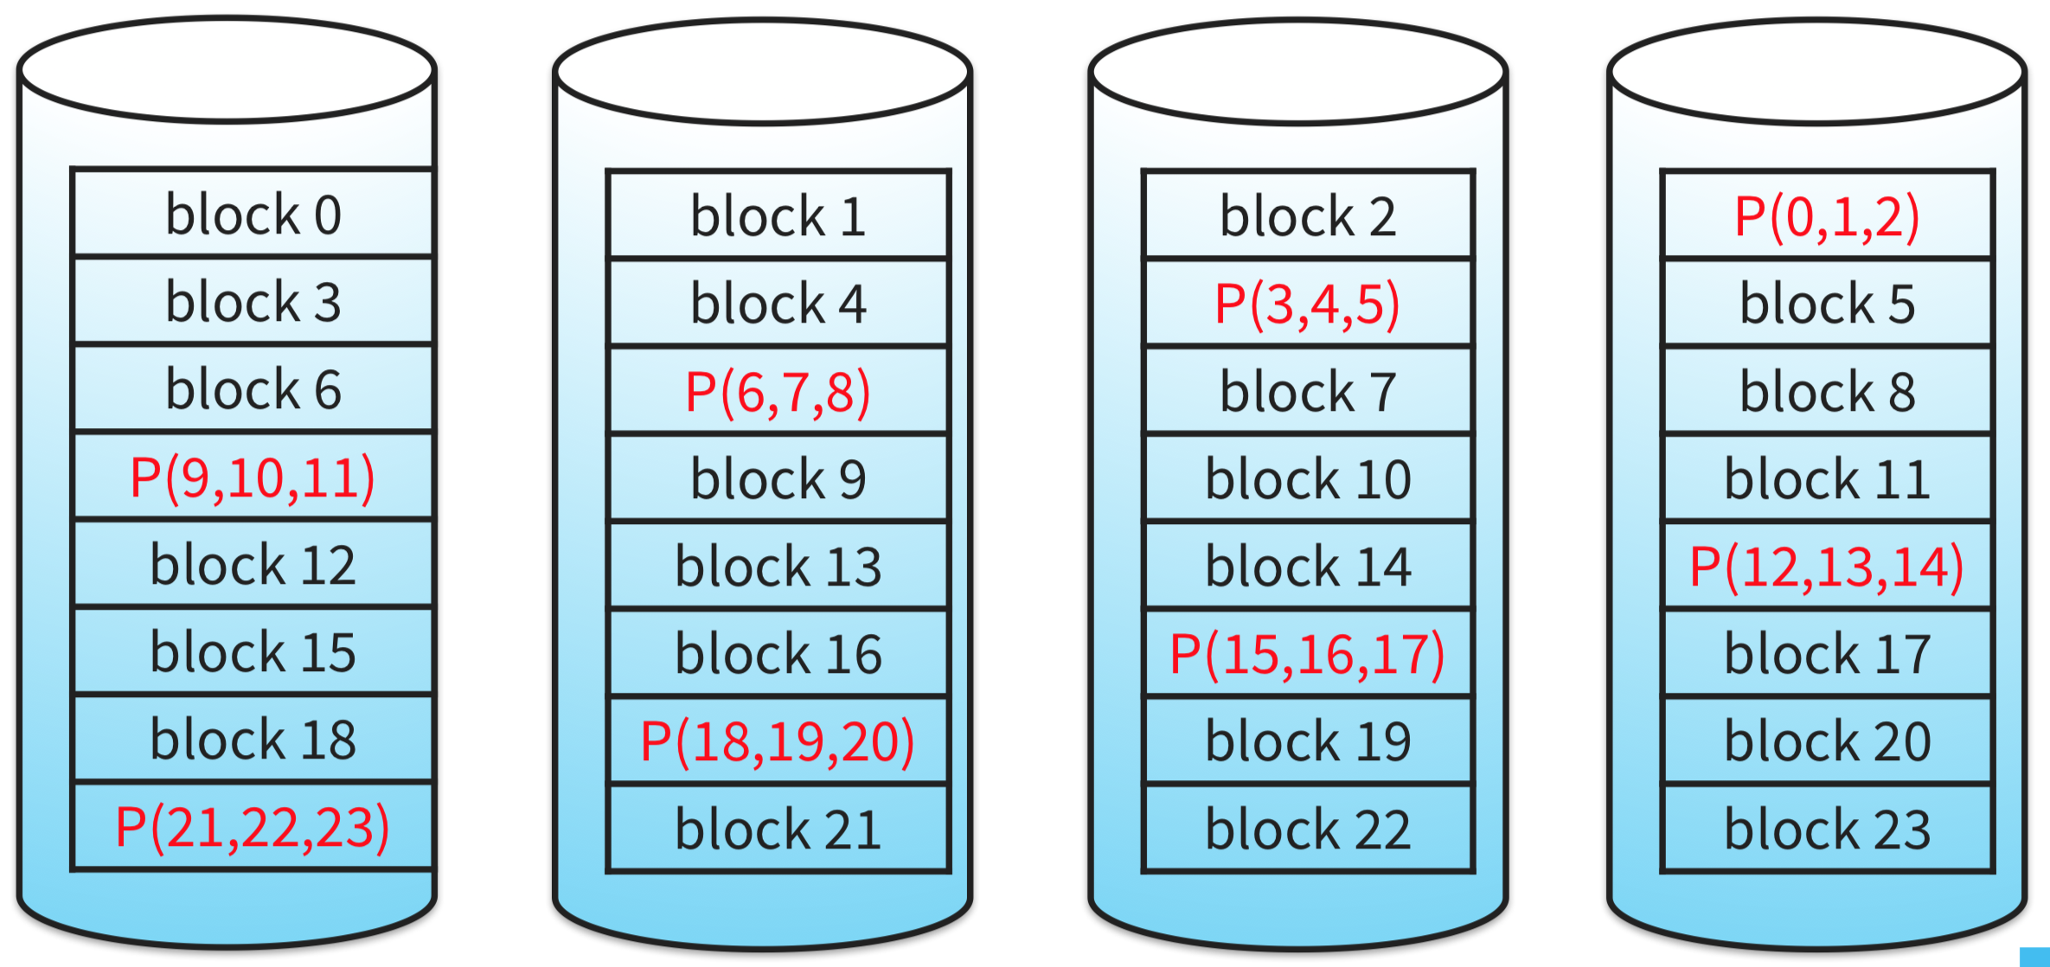
RAID-5: Rotating Parity
write-load for parity block spread across all disks

Slide 16
Scrubbing
most data is rarely accessed
many systems utilize disk scrubbing, that is , periodically reading through every block of the system and checking whether checksums are still valid

Slide 17
Tolerating Crash Failures
If a processor crashes then only some blocks on a disk might get updated.
Data is lost
On-disk data structures might become inconsistent.
E.g.
starting state: A, B
update: A -> A’ and B -> B’
Possible result when there is a crash: A, B’ or A’, B
Solutions:
Add fsync: programmer forces writes to disk
Detect and recover
Fault-tolerant disk update protocols

Slide 18
File System Consistency Checks
fsck (UNIX) & scandisk (Windows)
observation: writing a new data block involves 3 writes (write data block, update freelist, update inode)
Detection Algorithm for File Blocks:
Build table with info about each block
initially each block is unknown (except superblock)
Scan through the inodes and the freelist
Keep track in the table
If block already in table, note error
Finally, see if all blocks have been visited

Slide 19
Fault-tolerant Disk Update
Use Journaling (aka) Write-Ahead Logging
Idea: Protocol where performing a single disk write causes multiple disk writes to take effect.
Implementation: New on-disk data structure (“journal”) with a sequence of blocks containing updates plus …

Slide 20
Journal-Update Protocol Step
write x; write y; write z
E.g., write to inode, write to freelist (bitmap), write to datablock
implemented by:
Append to journal: TxBegin, x, y, z
Wait for completion of disk writes.
Append to journal: TxEnd
Wait for completion of disk write.
Write x, y, z to final locations in file system
Recovery protocol for TxBegin ... TxEnd:
if TxEnd present then redo writes to final locations
else ignore journal entries following TxBegin

