Slide 1
Lecture 22: File Systems (cont'd)
CS 105 December 3, 2019

Slide 2
Review: File Systems 101
Long-term information storage goals
Persistence: maintain/update user data + internal data structures on persistent storage devices
Flexibility: need to support diverse file types and workloads
Performance: despite limitations of disks
Reliability: must store data for long periods of time despite OS crashes or hardware malfunctions
Solution: the File System Abstraction
interface that provides operations involving
files
directories (a special kind of file)

Slide 3
Review: File System Layout
File systems are stored on disks
disks can be divided into one or more partitions
Sector 0 of disk called Master Boot Record
executable boot loader
end of MBR: partition table (contains partitions' start & end addr.)
Remainder of disk divided into partitions
First block of each partition is boot block (loaded by MBR on boot)
The rest of the partition stores the file system (organized as blocks)
FILE SYSTEM
Notes:
MBR contains information on how partitions are organized + executable boot loader

Slide 4
Review: Storing Files
Possible ways to allocate files:
Continuous allocation: all bytes together, in order
simple, efficient read, but low utility (external fragmentation) and usability
Linked structure: each block points to the next block
still simple, better utilization, slower read (random access), ptr overhead
Indexed structure: index block points to many other blocks
Log structure: sequence of segments, each containing updates

Slide 5
Indexed Allocation: Fast File System (FFS)
tree-based, multi-level index
superblock identifies file system's key parameters
inodes store metadata and pointers
datablocks store data

Slide 6
FFS Superblock
Identifies file system’s key parameters:
type
block size
inode array location and size
location of free list

Slide 7
FFS inodes
inode blocks contain an array of inodes
each inode contains:
Metadata
12 data pointers
3 indirect pointers

Slide 8
inode Metadata
Type
ordinary file
directory
symbolic link
special device
Size of the file (in #bytes)
# links to the i-node
Owner (user id and group id)
Protection bits
Times: creation, last accessed, last modified

Slide 9
FFS Index Structures

Slide 10
FFS Index Structures

Slide 11
FFS Directory Structure
Originally: array of 16 byte entries
14 byte file name
2 byte i-node number
Now: implicit list. Each entry contains:
4-byte inode number
Full record length
Length of filename
Filename
First entry is “.”, points to self
Second entry is “..”, points to parent inode

Slide 12
Exercise: Reading Files with FFS
To read file /foo/bar/baz, Read & Open:
inode #2 (root always has inumber 2), find root’s blocknum (912)
root directory (in block 912), find foo’s inumber (31)
inode #31, find foo’s blocknum (194)
foo (in block 194), find bar’s inumber (73)
inode #73, find bar’s blocknum (991)
bar (in block 991), find baz’s inumber (40)
inode #40, find data blocks (302, 913, 301)
data blocks 302
data block 913
data block 301

Slide 13
Key Characteristics of FFS
Tree Structure
efficiently find any block of a file
High Degree (or fan out)
minimizes number of seeks
supports sequential reads & writes
Fixed Structure
implementation simplicity
Asymmetric
not all data blocks are at the same level
supports large files
small files don’t pay large overheads

Slide 14
Exercise: File organization
Imagine you are trying to organize your (large) collection of photographs. You consider two possible ways to store your files
Put all the files in a director called /photos/
e.g., /photos/xyzstu.jpg, /photos/xeftuv.jpg, /photos/xywqre.jpg
Organize the photos into nested subdirectories organized by the first three characters of the filename
e.g., /photos/x/y/z/xyzstu.jpg, /photos/x/e/f/xeftuv.jpg, /photos/x/y/w/xywqre.jpg
What are the tradeoffs between these two approaches, and which one would you adopt?

Slide 15
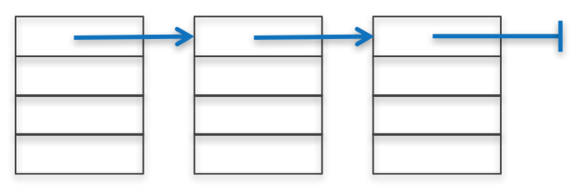
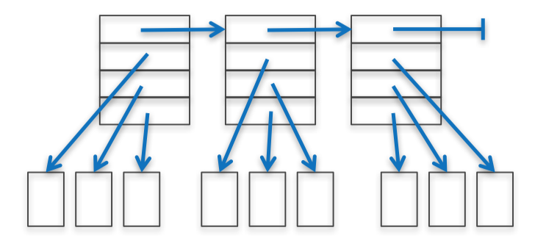
Free List
To write files, need to keep track of which blocks are currently free
How to maintain?
linked list of free blocks
inefficient (why?)
linked list of metadata blocks that in turn point to free blocks
simple and efficient
bitmap
good because…

Slide 16
Problem 1: Poor Performance
In a naïve implementation of FFS, performance starts bad and gets worse
One early implementation delivered only 2% disk bandwidth
The root of the problem: poor locality
data blocks of a file were often far from its inode
file system would end up highly fragmented: accessing a logically continuous file would require going back and forth across the
Notes:
Note: this early implementation also had a block size that was too small (512 bytes), increasing the number of blocks per file aka number of seeks required to read/write a file

Slide 17
Solution 1: Disk Awareness
Single track (e.g., dark gray)
Cylinder: tracks at same distance from center
(e.g., all dark gray tracks)
Cylinder group: set of n consecutive cylinders
(e.g., all gray cylinders, for n=3)

Slide 18
Abstracting Disk Awareness
modern drives export a logical address space of blocks that are (temporally) close
modern versions of FFS (ext2, ext3, ext4) organize the drive into block groups composed of consecutive portions of the disk's logical address space

Slide 19
Locality in File System Accesses

Slide 20
Allocating Blocks
FFS manages allocation per block group
A per-group inode bitmap (ib) and data bitmap (db)
Allocating directories:
find a group with a low number of allocated directories & high number of free inodes; put the directory data + inode there
Allocating files:
place a file in the same group as the directory that contains it; allocate inode and data in same group
uses first-fit heuristic
reserves ~10% space to avoid deterioration of first-fit
ib
db
Notes:
actually, indirect blocks in different groups

Slide 21
Solution 2: Page Cache
To reduce costs of accessing files, most operating systems make aggressive use of caching
page cache contains
heap and stack pages for each process
file data and metadata from devices (accessed with read() and write() calls)
memory-mapped files

Slide 22
What about writes?
need to durably store data means writes often dominate performance
small writes are expensive

Slide 23
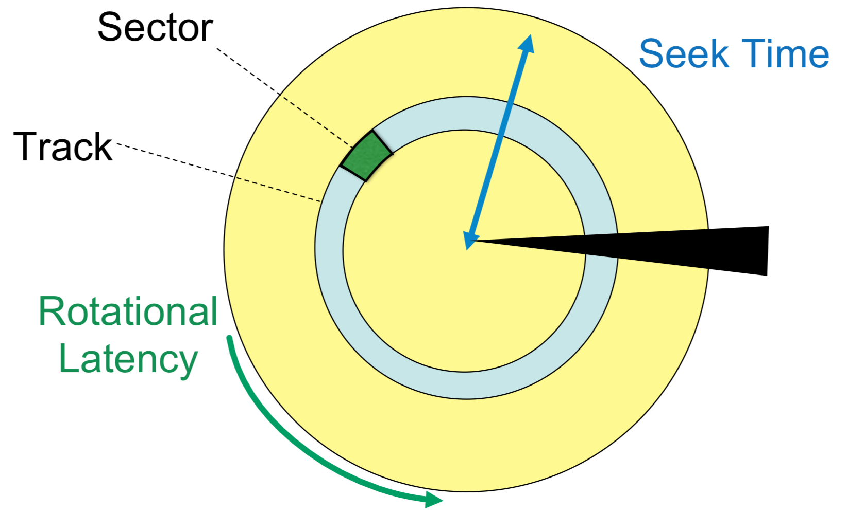
Writing on Magnetic Disks
Seek: to get to the track (1-15ms)
Rotational Latency: to get to the sector (2-8ms)
Transfer: get bits off the disk (.005ms/512-byte sector)

Slide 24
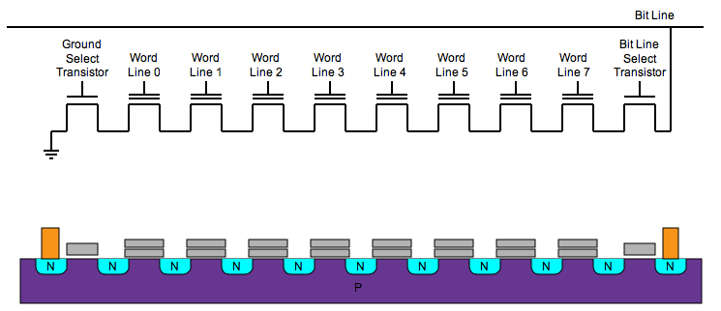
Writing on Flash Disks (SSDs)
can’t write 1 byte/word (must write whole blocks)
limited # of erase cycles per block (memory wear)
103-106 erases and the cell wears out
reads can “disturb” nearby words and overwrite them with garbage

Slide 25
Solution 1: Copy-on-write (COW)
key idea: never overwrite files or directories in place; write new copy of updated version to previously unused location on disk.
also used to optimize copies from fork(), exec(), etc.

Slide 26
Solution 2: write buffering
page cache tracks if each page is "dirty" (aka modified)
dirty pages are periodically flushed to disk
amortizes write overhead
allows re-ordering of disk accesses
can introduce inconsistency in the event of crash failures

