Slide 1
Lecture 21: File Systems
CS 105 November 21, 2019

Slide 2
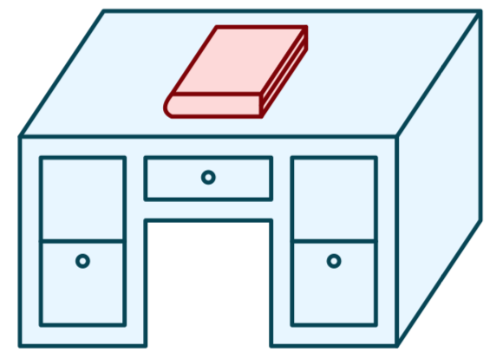
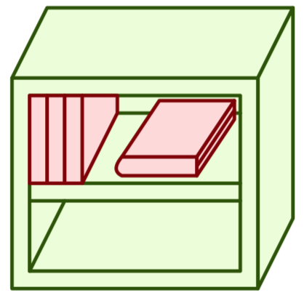
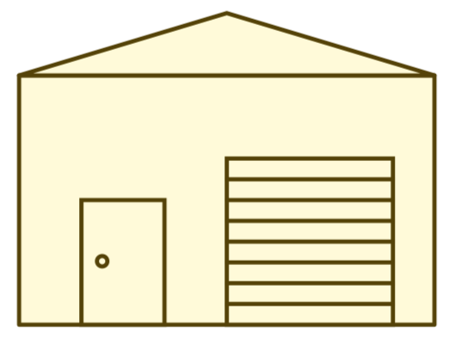
Memory Hierarchy
L0:
Regs
CPU registers hold words retrieved from the L1 cache.
L1:
L1 cache
(SRAM)
L1 cache holds cache lines retrieved from the L2 cache.
Smaller,
faster,
and
costlier
(per byte)
storage
devices
L2:
L2 cache
(SRAM)
L2 cache holds cache lines
retrieved from L3 cache
L3:
L3 cache
(SRAM)
L3 cache holds cache lines
retrieved from main memory.
L4:
Main memory
(DRAM)
Main memory holds
disk blocks retrieved
from local disks.
Larger,
slower,
and
cheaper
(per byte)
storage
devices
Local secondary storage
(local disks)
Local disks hold files retrieved from disks
on remote servers
L5:
L6:
Remote secondary storage
(e.g., cloud, web servers)

Slide 3
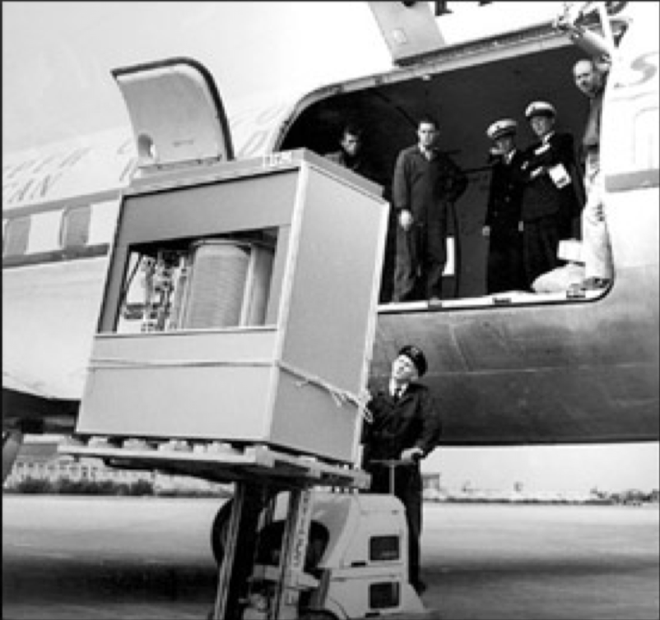
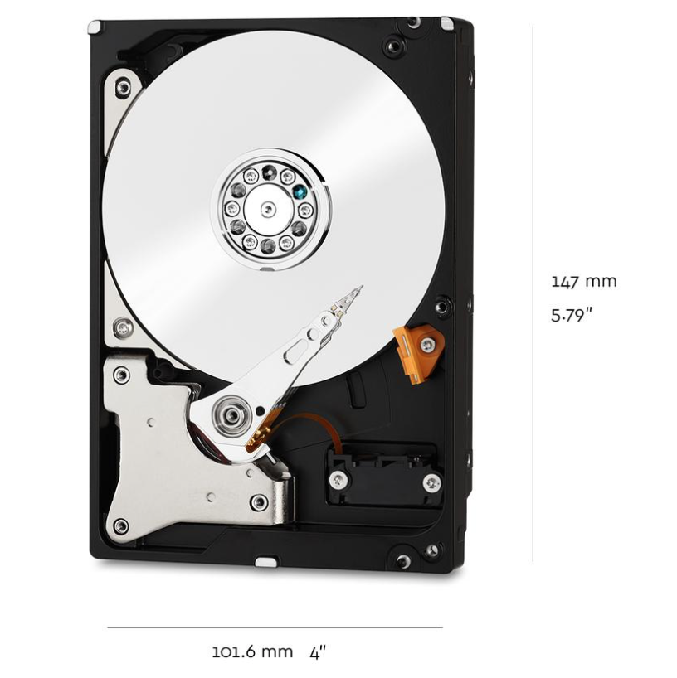
Storage Devices
1950s
IBM 350
5 MB
Magnetic Disks
Storage that rarely becomes corrupted
Large capacity at low cost
Block-level random access
Slow performance for random access
Better performance for streaming access
Solid State Disks (Flash Memory)
Storage that rarely becomes corrupted
Capacity at moderate cost ( 50x magnetic disk)
Block-level random access
Good performance for random reads
Not-as-good performance for random writes
2019
WD Red
10 TB
2019
Samsung 840
250 GB

Slide 4
Comparing Storage Media

Slide 5
File Systems 101
Long-term information storage goals
should be able to store large amounts of information
information must survive processes, power failures, etc.
processes must be able to find information
needs to support concurrent accesses by multiple processes
Solution: the File System Abstraction
interface that provides operations involving
files
directories (a special kind of file)

Slide 6
The File Abstraction
a file is a named collection of data
name is defined on creation
processes use name to subsequently access that file
a file is comprised of two parts:
data: information a user or application puts in a file
an array of untyped bytes
implemented as an array of fixed-size blocks
metadata: information added and managed by the OS
e.g., size, owner, security info, modification time

Slide 7
File Names
Each file has a unique low-level name
distinct from location; processes don't care where on disk a file is stored
file system provides mapping from low-level names to storage location
Each file has one or more human-readable names
file system provides mapping from human-readable names to low-level names
Naming conventions
up to 255 characters long
case sensitive (UNIX) or not case sensitive (Windows)
extensions not enforced (UNIX) or associated with meaning (Windows)

Slide 8
Directories
a directory is a file that provides mappings from human-readable names to low-level names (i.e., file numbers):
a list of human-readable names
a mapping from each name to a specific underlying file or directory

Slide 9
Path Names
Each path from root is a name for a leaf
/foo/foo.txt
/bar/baz/baz.txt
Each UNIX directory contains 2 special entries
"." = this directory
".." = parent directory
Absolute paths: path of file from the root directory
Relative paths: path from current working directory
/
foo
bar
foo.txt
bar.txt
baz
baz.txt
Notes:
current working directory stored in process control block (PCB)

Slide 10
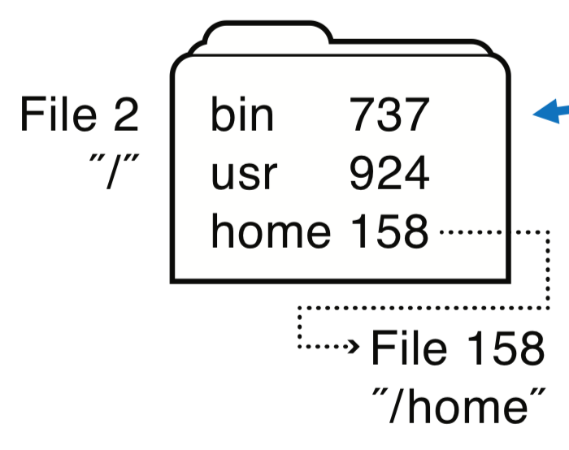
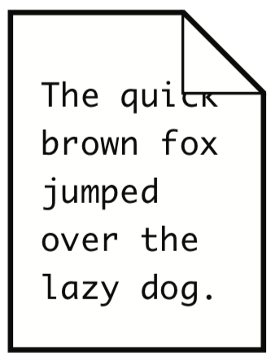
Directories
OS uses path name to find directories and files
Directory maps file name to attributes and locations
ada 682
eleanor 818
rett 830
File 158
"/home"
File 818
"/home/eleanor"
music 320
work 219
foo.txt 871
File 871
"/home/eleanor/foo.txt"

Slide 11
Basic File System Operations
Create a file
Write to a file
Read from a file
Seek to somewhere in a file
Delete a file
How should we implement this?

Slide 12
File System Challenges
Performance: despite limitations of disks
Flexibility: need to support diverse file types and workloads
Persistence: store data long term
Reliability: resilient to OS crashes and hardware failures

Slide 13
File System Properties
Most files are small
need strong support for small files (optimize the common case)
block size can't be too big
Directories are typically small
usually 20 or fewer entries
Some files are very large
must handle large files
large file access should be reasonably efficient
File systems are usually about half full
Notes:
Agrawal, Bolosky, Douceur, Lorch. A Five Year Study of File-System Metadata. FAST 2007.

Slide 14
Implementation Basics
Directories: file name -> low-level names (i.e., file numbers)
Index structures: file number -> block
Free space maps: find a free block (ideally nearby)
Locality heuristics:
group directories
make writes sequential
defragment

Slide 15
File System Layout
File systems are stored on disks
disks can be divided into one or more partitions
Sector 0 of disk called Master Boot Record
executable boot loader
end of MBR: partition table (contains partitions' start & end addr.)
Remainder of disk divided into partitions
First block of each partition is boot block (loaded by MBR on boot)
The rest of the partition stores the file system
Notes:
MBR contains information on how partitions are organized + executable boot loader

Slide 16
Storing Files
Possible ways to allocate files:
Continuous allocation: all bytes together, in order
Linked structure: each block points to the next block
Indexed structure: index block points to many other blocks
Log structure: sequence of segments, each containing updates
Which is the best?
For sequential access?
For random access?
For small files?
For large files?

Slide 17
Continuous Allocation
All bytes together, in order
Simple: state required per file = start block & size
Efficient: entire file can be read with one seek
Fragmentation: external is bigger problem
Usability: user needs to know size of file at time of creation
Notes:
Used in CDs, DVDs

Slide 18
Storing Files
Possible ways to allocate files:
Continuous allocation: all bytes together, in order
Linked structure: each block points to the next block
Indexed structure: index block points to many other blocks
Log structure: sequence of segments, each containing updates

Slide 19
Linked Allocation
Each file is stored as linked list of blocks: First word of each block points to next block, rest of disk block is file data
Space Utilization: no space lost to external fragmentation
Simple: only need to store 1st block of each file
Performance: random access is slow
Space Utilization: overhead of pointers

Slide 20
File Allocation Table (FAT) File System
Developed by Microsoft for MS-DOS
Still widely used for flash drives, camera cards, etc.
Fat-32 supports $2^{28}$ blocks and files of $2^{32}−1$ bytes
File table:
Linear map of all blocks on disk
Each file a linked list of blocks

Slide 21
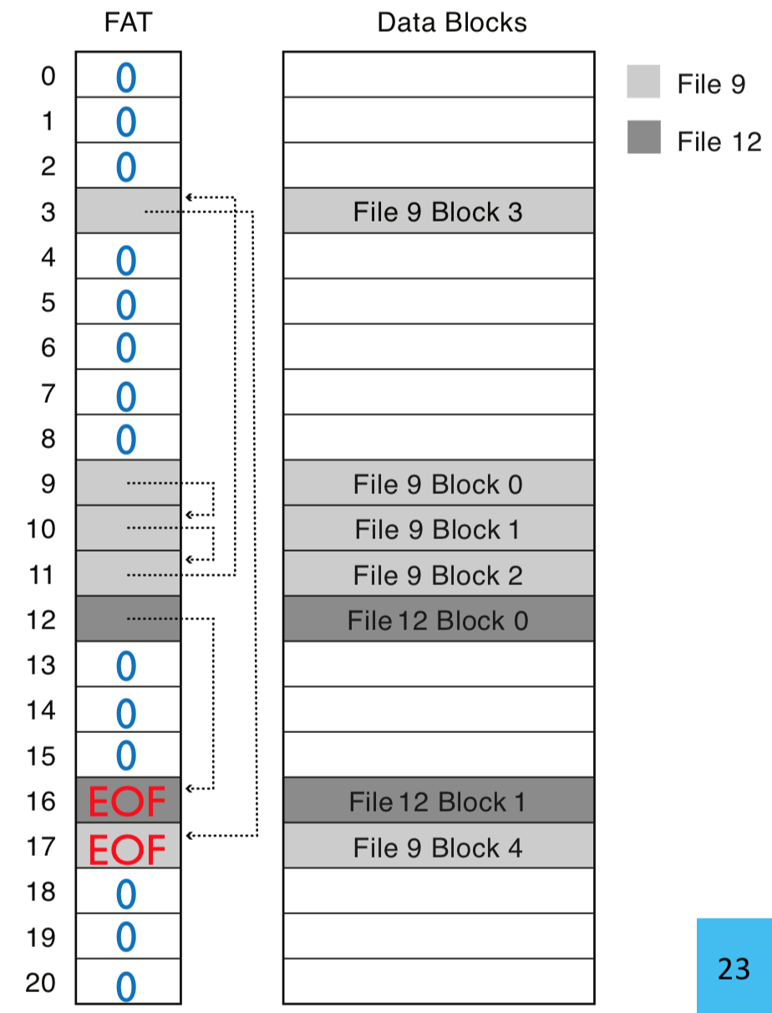
FAT File System
1 entry per block
EOF for last block
0 indicates free block
low-level name = FAT index of first block in file

Slide 22
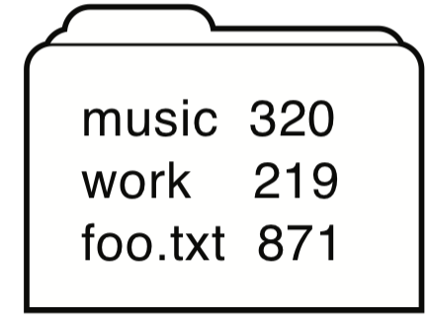
FAT Directory Structure
Folder: a file with 32-byte entries
Each Entry:
8 byte name + 3 byte extension (ASCII)
creation date and time
last modification date and time
first block in the file (index into FAT)
size of the file
Notes:
Long and Unicode file names take up multiple entries

Slide 23
Exercise
How many disk reads would be required to read (all of) a 2^15 byte file named /foo/bar/baz.txt
assume 4096 byte blocks
assume that all directories are small enough to fit in one block

Slide 24
Multiple human-readable names
Many file systems allow a given file to have multiple names
Hard links are multiple file directory entries that map different path names to the same file number
Symbolic Links or soft links are directory entries that map one name to another (effectively a redirect)
Exercise: how could we implement symbolic links in the FAT file system?

Slide 25
Evaluating Fat
How is FAT good?
Simple: state required per file: start block only
Widely supported
No external fragmentation
block used only for data
How is FAT bad?
Poor locality
Many file seeks (unless entire FAT in memory)
Poor random access
Limited metadata
Limited access control
Limitations on volume and file size
No support for reliability techniques

Slide 26
Storing Files
Possible ways to allocate files:
Continuous allocation: all bytes together, in order
Linked structure: each block points to the next block
Indexed structure: index block points to many other blocks
Log structure: sequence of segments, each containing updates

