Slide 1
Lecture 20: Networking and the Internet
CS 105 November 19, 2019

Slide 2
What is the Internet?
Notes:
https://www.summithosting.com/blog/picturing-the-internet/

Slide 3
The Big Picture
Application
messages
Application

Slide 4
Continuing up the Network Stack…

Slide 5
Domain Name System (DNS)
Principals are identified by names
for web hosts, typically a domain name
e.g., www.cs.pomona.edu
Internet hosts are identified by IP addresses
used by network layer to route packets between hosts
The role of DNS is to translate between domain names and IP addresses

Slide 6
Properties of DNS Mappings
Can explore properties of DNS mappings using nslookup
Each host has a locally defined domain name localhost which always maps to the loopback address 127.0.0.1
Use hostname to determine real domain name of local host:
linux> nslookup www.cs.pomona.edu
Address: 134.173.71.56
linux> nslookup localhost
Address: 127.0.0.1
linux> hostname
pom-nat-84-6.pomona.edu

Slide 7
Properties of DNS Mappings (cont)
Simple case: one-to-one mapping between domain name and IP address:
Multiple domain names mapped to the same IP address:
linux> nslookup little.cs.pomona.edu
Address: 134.173.66.223
linux> nslookup cs.mit.edu
Address: 18.25.0.23
linux> nslookup eecs.mit.edu
Address: 18.25.0.23

Slide 8
Properties of DNS Mappings (cont)
Multiple domain names mapped to multiple IP addresses:
Some valid domain names don’t map to any IP address:
linux> nslookup www.twitter.com
Address: 199.16.156.6
Address: 199.16.156.70
Address: 199.16.156.102
Address: 199.16.156.230
linux> nslookup twitter.com
Address: 199.16.156.102
Address: 199.16.156.230
Address: 199.16.156.6
Address: 199.16.156.70

Slide 9
Domain Name System (DNS)
Distributed, hierarchical database
Application-level protocol: hosts and DNS servers communicate to resolve names
Names are separated into components by dots
lookup occurs top down
.net
.edu
.gov
.com
hmc
cmc
pomona
scripps
pitzer
amazon
cs
math
www
176.32.98.166
www
134.173.66.214

Slide 10
DNS Lookup
the client asks its local nameserver
the local nameserver asks one of the root nameservers

Slide 11
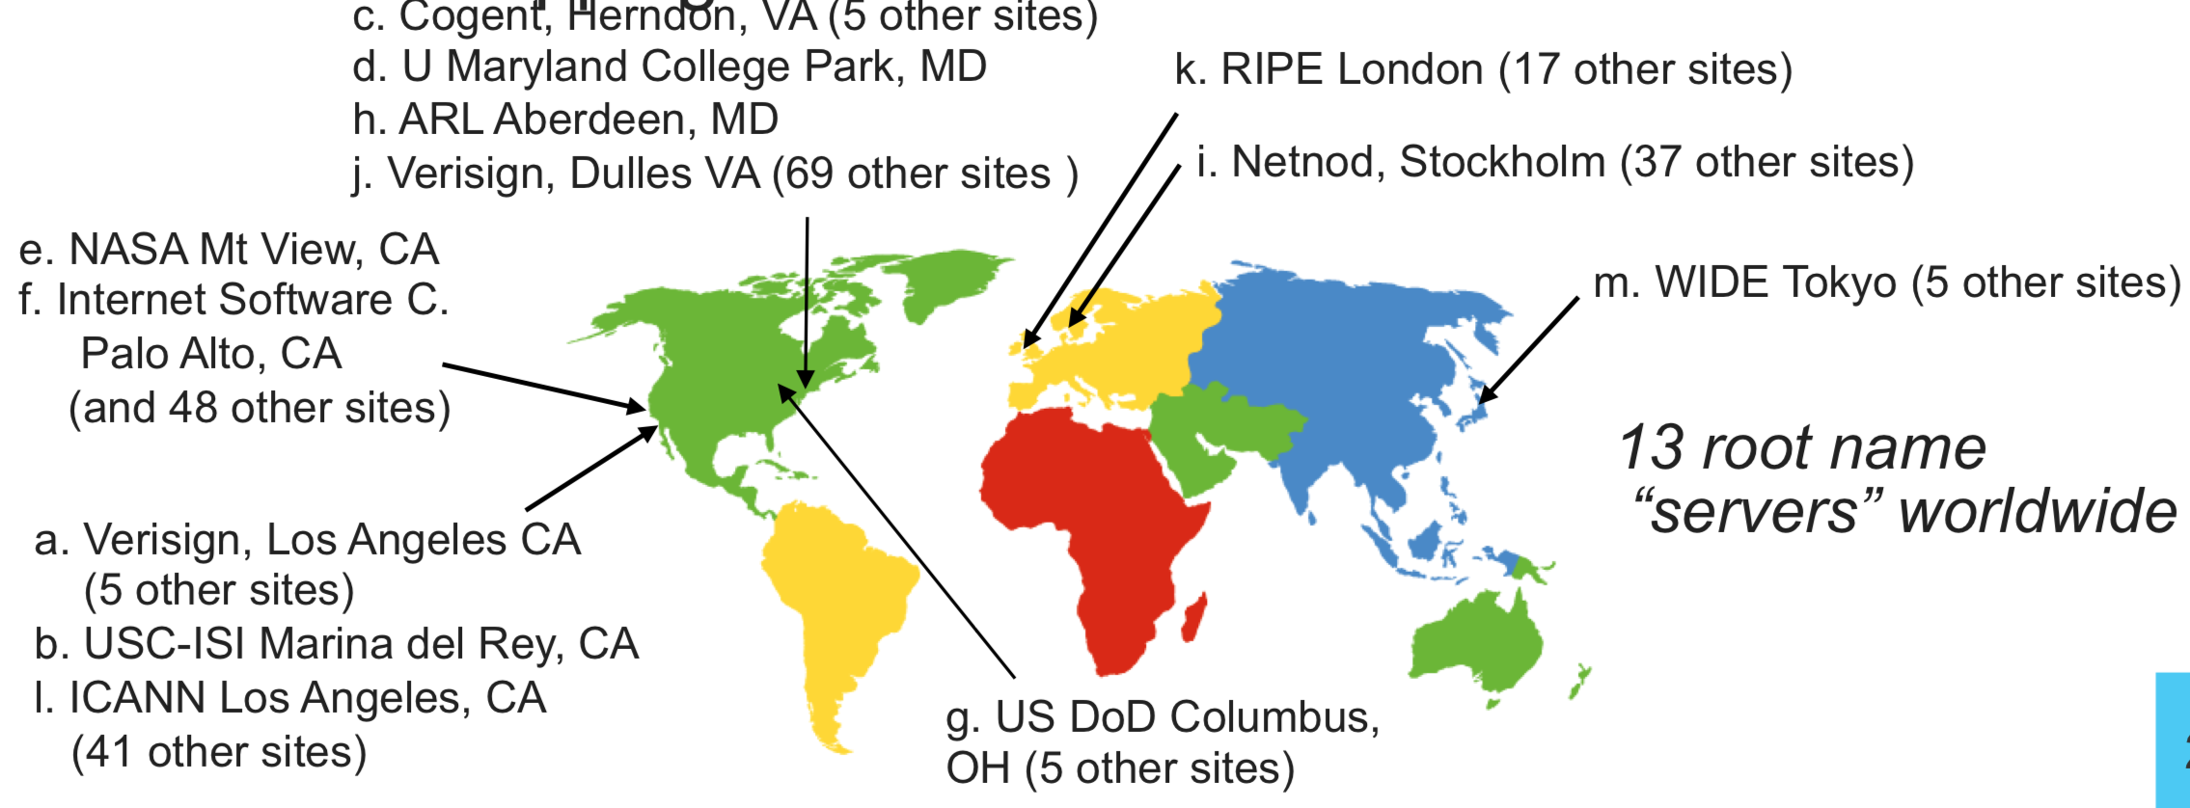
DNS Root Name Servers
contacted by local name server that can't resolve name
owned by Internet Corporation for Assigned Names & Numbers (ICANN)
contacts authoritative name server if name mapping not known, gets mapping
returns mapping to local name server

Slide 12
DNS Lookup
the client asks its local nameserver
the local nameserver asks one of the root nameservers
the root nameserver replies with the address of the top level nameserver
the server then queries that nameserver
the top level nameserver replies with the address of the authoritative nameserver
the server then queries that nameserver
repeat until host is reached, cache result.
Example: Client wants IP addr of www.amazon.com
Queries root server to find com DNS server
Queries .com DNS server to get amazon.com DNS server
Queries amazon.com DNS server to get IP address for www.amazon.com
Notes:
Q: Why not centralize? - Single point of failure - Traffic volume - Distant Centralized Database
- Maintenance A: Does not scale! What about security?

Slide 13
The Big Picture
Application
messages
Application

Slide 14
HTTP
Clients and servers communicate using the HyperText Transfer Protocol (HTTP)
Client and server establish TCP connection
Client requests content
Server responds with requested content
Client and server close connection (eventually)
Current version is HTTP/2.0
RFC 7540, 2015
Includes protocol negotiation
HTTP/1.1 still in use (RFC 2616, 1999)
HTTP/3 proposed
Web
client
(browser)
HTTP request
Web
server
HTTP response
(content)
HTTP
Web content
TCP
Streams
IP
Datagrams

Slide 15
URLs
Unique name for a file: URL (Universal Resource Locator)
Example URL: http://www.cs.pomona.edu:80classes/cs105/index.html
Clients use prefix (http://www.cs.pomona.edu:80) to infer:
What kind (protocol) of server to contact (HTTP)
Where the server is (www.cs.pomona.edu)
What port it is listening on (80)
Servers use suffix (/classes/cs105/index.html) to:
Determine if request is for static or dynamic content.
No hard and fast rules for this
One convention: executables reside in cgi-bin directory
Find file on file system
Initial “/” in suffix denotes home directory for requested content.
Minimal suffix is “/”, which server expands to configured default filename (usually, index.html)

Slide 16
HTTP Requests
HTTP request is a request line, followed by zero or more request headers
Request line: <method> <uri> <version>
<method> is one of GET, POST, OPTIONS, HEAD, PUT, DELETE, or TRACE
<uri> is typically URL for proxies, URL suffix for servers
A URL is a type of URI (Uniform Resource Identifier)
See http://www.ietf.org/rfc/rfc2396.txt
<version> is HTTP version of request (HTTP/1.0 or HTTP/1.1)
Request headers: <header name>: <header data>
Provide additional information to the server

Slide 17
HTTP Responses
HTTP response is a response line followed by zero or more response headers, possibly followed by content
a blank line (“\r\n”) separates headers from content.
Response line: <version> <status code> <status msg>
<version> is HTTP version of the response
<status code> is numeric status
<status msg> is corresponding English text
200 OK Request was handled without error
301 Moved Provide alternate URL
404 Not found Server couldn’t find the file
Response headers: <header name>: <header data>
Provide additional information about response
Content-Type: MIME type of content in response body
Content-Length: Length of content in response body

Slide 18
Web Content
Web servers return content to clients
content: a sequence of bytes with an associated MIME (Multipurpose Internet Mail Extensions) type
Example MIME types
text/html HTML document
text/plain Unformatted text
image/gif Binary image encoded in GIF format
image/png Binar image encoded in PNG format
image/jpeg Binary image encoded in JPEG format
You can find the complete list of MIME types at:
http://www.iana.org/assignments/media-types/media-types.xhtml

Slide 19
Static and Dynamic Content
The content returned in HTTP responses can be either static or dynamic
Static content: content stored in files and retrieved in response to an HTTP request
Examples: HTML files, images, audio clips
Request identifies which content file
Dynamic content: content produced on-the-fly in response to an HTTP request
Example: content produced by a program executed by the server on behalf of the client
Request identifies file containing executable code
Bottom line: Web content is associated with a file that is managed by the server

Slide 20
Tiny Web Server
Tiny Web server described in text
Tiny is a sequential Web server
Serves static and dynamic content to real browsers
text files, HTML files, GIF, PNG, and JPEG images
239 lines of commented C code
Not as complete or robust as a real Web server
You can break it with poorly-formed HTTP requests (e.g., terminate lines with “\n” instead of “\r\n”)

Slide 21
Tiny Operation
Accept connection from client
Read request from client (via connected socket)
Split into <method> <uri> <version>
If method not GET, then return error
If URI contains “cgi-bin” then serve dynamic content
(Would do wrong thing if had file “abcgi-bingo.html”)
Fork process to execute program
Otherwise serve static content
Copy file to output

Slide 22
Tiny Serving Static Content
void serve_static(int fd, char *filename, int filesize)
{
int srcfd;
char *srcp, filetype[MAXLINE], buf[MAXBUF];
/* Send response headers to client */
get_filetype(filename, filetype);
sprintf(buf, "HTTP/1.0 200 OK\r\n");
sprintf(buf, "%sServer: Tiny Web Server\r\n", buf);
sprintf(buf, "%sConnection: close\r\n", buf);
sprintf(buf, "%sContent-length: %d\r\n", buf, filesize);
sprintf(buf, "%sContent-type: %s\r\n\r\n", buf, filetype);
Rio_writen(fd, buf, strlen(buf));
/* Send response body to client */
srcfd = Open(filename, O_RDONLY, 0);
srcp = Mmap(0, filesize, PROT_READ, MAP_PRIVATE, srcfd, 0);
Close(srcfd);
Rio_writen(fd, srcp, filesize);
Munmap(srcp, filesize);
}
tiny.c

Slide 23
Serving Dynamic Content
Client sends request to server
If request URI contains the string “/cgi-bin”, the Tiny server assumes that the request is for dynamic content
GET /cgi-bin/env.pl HTTP/1.1
Client
Server

Slide 24
Serving Dynamic Content (cont)
The server creates a child process and runs the program identified by the URI in that process
Client
Server
fork/exec
env.pl

Slide 25
Serving Dynamic Content (cont)
The child runs and generates the dynamic content
The server captures the content of the child and forwards it without modification to the client
Client
Server
Content
Content
env.pl

Slide 26
Issues in Serving Dynamic Content
How does the client pass program arguments to the server?
How does the server pass these arguments to the child?
How does the server pass other info relevant to the request to the child?
How does the server capture the content produced by the child?
These issues are addressed by the Common Gateway Interface (CGI) specification.
Request
Client
Server
Content
Content
Create
env.pl

Slide 27
CGI
Because the children are written according to the CGI spec, they are often called CGI programs.
However, CGI really defines a simple standard for transferring information between the client (browser), the server, and the child process.
CGI is the original standard for generating dynamic content. Has been largely replaced by other, faster techniques:
E.g., fastCGI, Apache modules, Java servlets, Rails controllers
Avoid having to create process on the fly (expensive and slow).

Slide 28
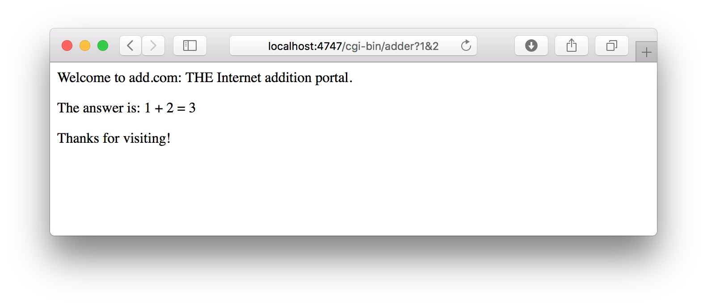
The add.com Experience
host
port
CGI program
arguments
Output page

Slide 29
Serving Dynamic Content With GET
Question: How does the client pass arguments to the server?
Answer: The arguments are appended to the URI
Can be encoded directly in a URL typed to a browser or a URL in an HTML link
http://add.com/cgi-bin/adder?15213&18213
adder is the CGI program on the server that will do the addition.
argument list starts with “?”
arguments separated by “&”
spaces represented by “+” or “%20”

Slide 30
Serving Dynamic Content With GET
URL suffix:
cgi-bin/adder?15213&18213
Result displayed on browser:
Welcome to add.com: THE Internet addition portal.
The answer is: 15213 + 18213 = 33426
Thanks for visiting!

Slide 31
Serving Dynamic Content With GET
Question: How does the server pass these arguments to the child?
Answer: In environment variable QUERY_STRING
A single string containing everything after the “?”
For add: QUERY_STRING = “15213&18213”
/* Extract the two arguments */
if ((buf = getenv("QUERY_STRING")) != NULL) {
p = strchr(buf, '&');
*p = '\0';
strcpy(arg1, buf);
strcpy(arg2, p+1);
n1 = atoi(arg1);
n2 = atoi(arg2);
}
adder.c

Slide 32
Serving Dynamic Content with GET
Question: How does the server capture the content produced by the child?
Answer: The child generates its output on stdout. Server uses dup2 to redirect stdout to its connected socket.
void serve_dynamic(int fd, char *filename, char *cgiargs)
{
char buf[MAXLINE], *emptylist[] = { NULL };
/* Return first part of HTTP response */
sprintf(buf, "HTTP/1.0 200 OK\r\n");
Rio_writen(fd, buf, strlen(buf));
sprintf(buf, "Server: Tiny Web Server\r\n");
Rio_writen(fd, buf, strlen(buf));
if (Fork() == 0) { /* Child */
/* Real server would set all CGI vars here */
setenv("QUERY_STRING", cgiargs, 1);
Dup2(fd, STDOUT_FILENO); /* Redirect stdout to client */
Execve(filename, emptylist, environ); /* Run CGI program */
}
Wait(NULL); /* Parent waits for and reaps child */
}
tiny.c

Slide 33
Serving Dynamic Content with GET
Notice that only the CGI child process knows the content type and length, so it must generate those headers.
/* Make the response body */
sprintf(content, "Welcome to add.com: ");
sprintf(content, "%sTHE Internet addition portal.\r\n<p>", content);
sprintf(content, "%sThe answer is: %d + %d = %d\r\n<p>",
content, n1, n2, n1 + n2);
sprintf(content, "%sThanks for visiting!\r\n", content);
/* Generate the HTTP response */
printf("Content-length: %d\r\n", (int)strlen(content));
printf("Content-type: text/html\r\n\r\n");
printf("%s", content);
fflush(stdout);
exit(0);
adder.c

Slide 34
Serving Dynamic Content With GET
bash:makoshark> telnet whaleshark.ics.cs.cmu.edu 15213
Trying 128.2.210.175...
Connected to whaleshark.ics.cs.cmu.edu (128.2.210.175).
Escape character is '^]'.
GET /cgi-bin/adder?15213&18213 HTTP/1.0
HTTP/1.0 200 OK
Server: Tiny Web Server
Connection: close
Content-length: 117
Content-type: text/html
Welcome to add.com: THE Internet addition portal.
<p>The answer is: 15213 + 18213 = 33426
<p>Thanks for visiting!
Connection closed by foreign host.
bash:makoshark>
HTTP request sent by client
HTTP response generated
by the server
HTTP response generated
by the CGI program

Slide 35
Testing Servers Using telnet
The telnet program is invaluable for testing servers that transmit ASCII strings over Internet connections
Our simple echo server
Web servers
Mail servers
Usage:
linux> telnet <host> <portnumber>
Creates a connection with a server running on <host> and listening on port <portnumber>

Slide 36
Proxies
A proxy is an intermediary between a client and a server
To the client, the proxy acts like a server
To the server, the proxy acts like a client
1. Client request
2. Proxy request
Client
Proxy
Origin
Server
4. Proxy response
3. Server response

Slide 37
Why Proxies?
Can perform useful functions as requests and responses pass by
Examples: Caching, logging, anonymization, filtering
Client
A
Request foo.html
foo.html
Request foo.html
Origin
Server
Proxy
cache
foo.html
Request foo.html
Slower more
expensive
global network
Client
B
foo.html
Fast inexpensive local network

