Slide 1
Lecture 19: TCP
CS 105 November 14, 2019

Slide 2
OSI Network Model
Notes:
http://www.cs.cornell.edu/courses/cs4410/2018sp/schedule/slides/09-networking.pdf

Slide 3
Transport Layer Protocols
User Datagram Protocol (UDP)
Transmission Control Protocol (TCP)
unreliable, unordered delivery
connectionless
best-effort, segments might be lost, delivered out-of-order, duplicated
reliability (if required) is the responsibility of the app
reliable, inorder delivery
connection setup
flow control
congestion control
Notes:
Note: neither guarantees latency or bandwidth

Slide 4
UDP: tradeoffs
fast:
no connection setup
no rate-limiting
simple:
no connection state
small header
(possibly) extra work for applications
reordering
duplicate suppression
handle missing packets

Slide 5
Transport Protocols by Application
Application | Application-Level Protocol | Transport Protocol
Name Translation | DNS | Typically UDP
Routing Protocol | RIP | Typically UDP
Network Management | SNMP | Typically UDP
Remote File Server | NFS | Typically UDP
Streaming multimedia | (proprietary) | UDP or TCP
Internet telephony | (proprietary) | UDP or TCP
Remote terminal access | Telnet | TCP
File Transfer | (S)FTP | TCP
Email | SMTP | TCP
Web | HTTP(S) | TCP

Slide 6
Transport-Layer Segment Formats
UDP
TCP
Source Port #
Dest. Port #
Source Port #
Dest. Port #
application message (payload)
sequence number
acknowledgement number
HL
U
A
P
R
S
F
receive window
checksum
U data pointer
options
application message (payload)
Notes:
S,A,F flags used to manage connection
sequence number and acknowledgement number (+ A flag) are used to implement reliable transport

Slide 7
TCP Connections
TCP is connection-oriented
A connection is initiated with a three-way handshake
Recall: server will typically create a new socket to handle the new connection
FIN works (mostly) like SYN but to teardown a connection
SYN
SYN, ACK
ACK
…
FIN
ACK

Slide 8
Reliable Transport
Each SYN segment will include a randomly chosen sequence number
Sequence number of each segment is incremented by data length
Receiver sends ACK segments acknowledging latest sequence number received
Sender maintains copy of all sent but unacknowledged segments; resends if ACK does not arrive within timeout
Timeout is dynamically adjusted to account for round-trip delay
SYN
SYN, ACK
ACK
data (Seq = 47)
ACK 47
data (Seq = 48)
data (Seq = 49)
ACK 49
data (Seq = 50)
Send Timeout
data (Seq = 50)
ACK 49
FIN
ACK

Slide 9
Pipelined Protocols
Pipelining allows sender to send multiple "in-flight", yet-to-be-acknowledged packets
increases throughput
needs buffering at sender and receiver
how big should the window be?
what if a packet in the middle goes missing?

Slide 10
Example: Window Size = 4
sender can have up to 4 unacknowledged messages
when ACK for first message is received, it can send another message
data (Seq = 47)
data (Seq = 48)
data (Seq = 49)
data (Seq = 50)
ACK 47
ACK 48
ACK 49
ACK 50
data (Seq = 51)
data (Seq = 52)
data (Seq = 53)
data (Seq = 54)

Slide 11
TCP Fast Retransmit
Receiver always acks the last id it successfully received
Sender detects loss without waiting for timeout, resends missing packet
data (Seq = 47)
data (Seq = 48)
data (Seq = 49)
data (Seq = 50)
ACK 47
ACK 47
ACK 50
data (Seq = 51)
data (Seq = 48)
data (Seq = 48)
ACK 47
ACK 51
ACK 51

Slide 12
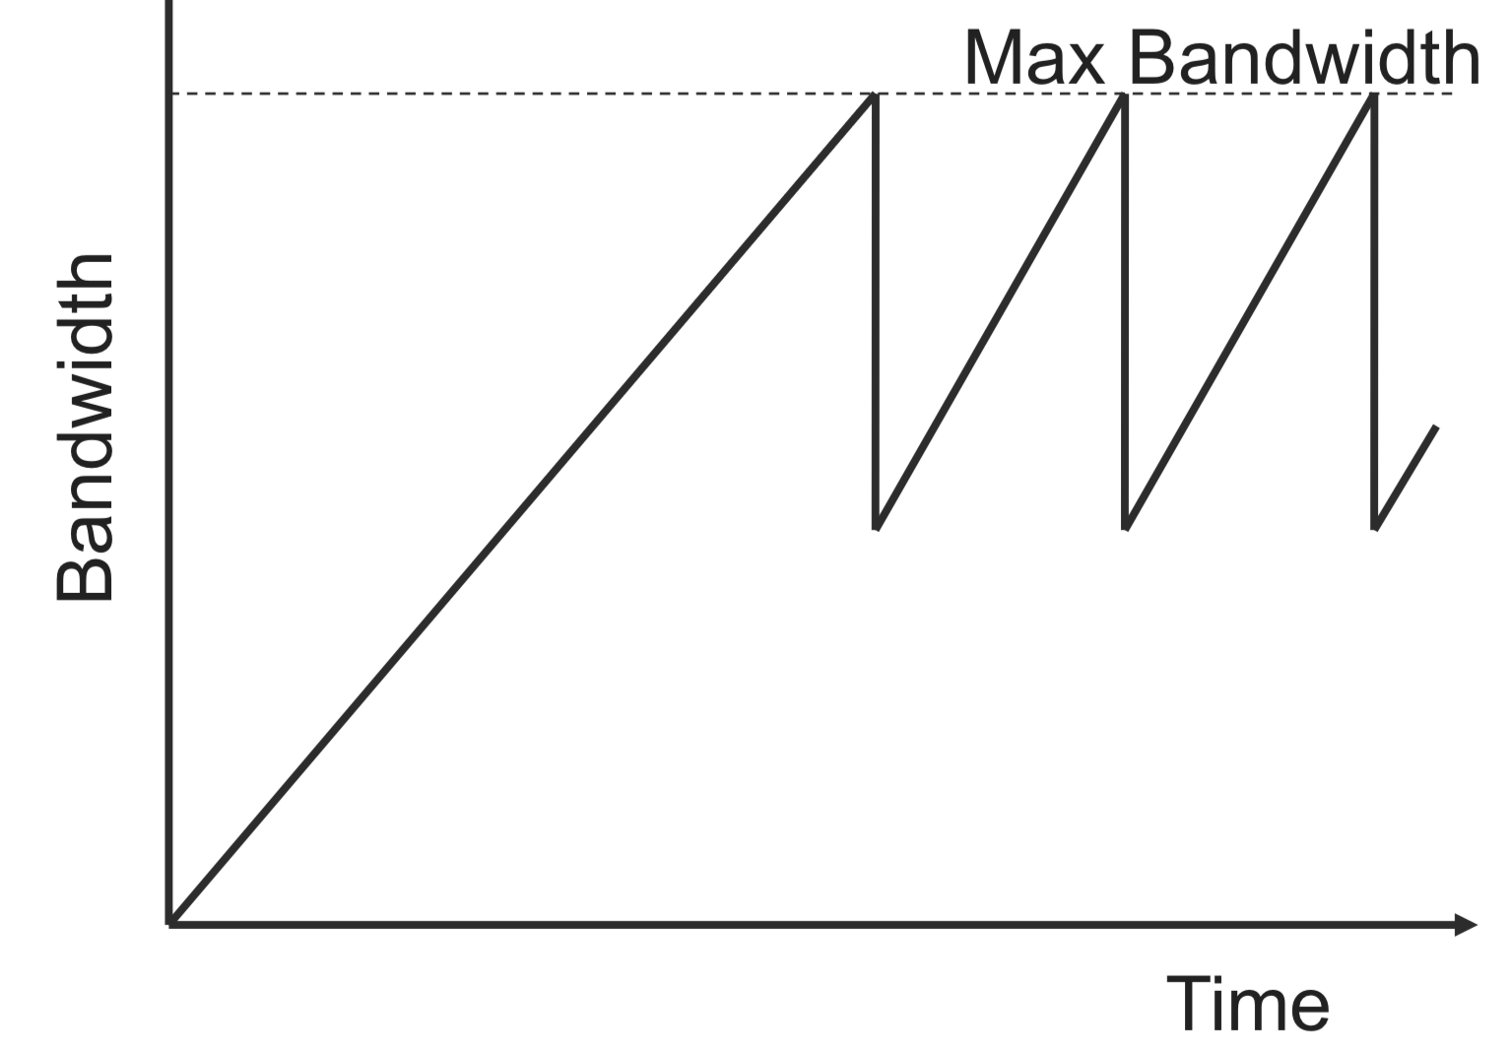
TCP Congestion Control
TCP operates under a principle of additive increase-multiplicative decrease
window size++ every RTT if no packets lost
window size/2 if a packet is dropped

Slide 13
TCP Fairness
Goal: if k TCP sessions share same bottleneck link of bandwidth R, each should have average rate of R/k
R
Loss: decreases throughput proportional to current bandwidth
Connection 2 throughput
Congestion avoidance: increases throughput linearly (evenly)
Connection 1 throughput
R

Slide 14
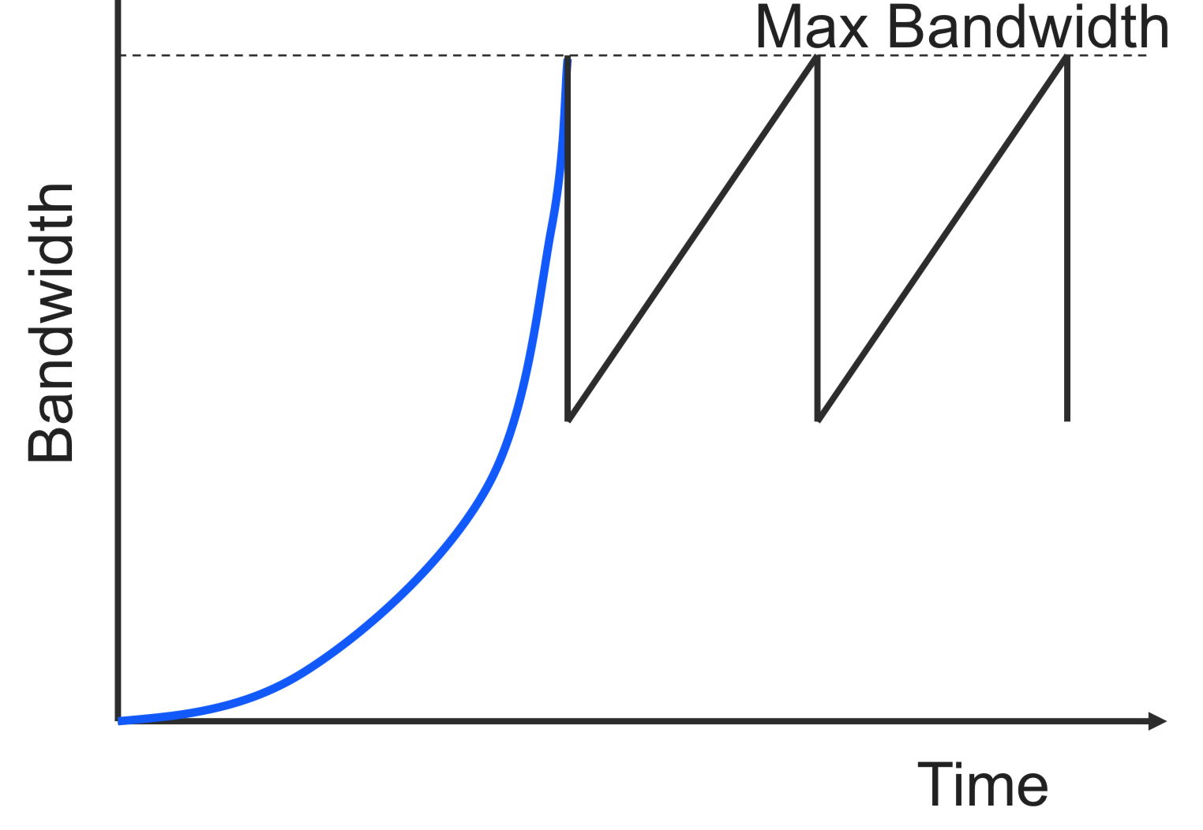
TCP Slow Start
Problem: linear increase takes a long time to build up a decent window size, and most transactions are small
Solution: allow window size to increase exponentially until first loss

Slide 15
TCP Summary
Reliable, in-order message delivery
Connection-oriented, three-way handshake
Transmission window for better throughput
timeouts based on link parameters (e.g., RTT, variance)
Congestion control
Linear increase, exponential backoff
Fast adaptation
Exponential increase in the initial phase

Slide 16
Sockets Interface
1. Start server
getaddrinfo
2. Start client
socket
getaddrinfo
open_listenfd
bind
socket
open_clientfd
listen
Connection
request
connect
accept
3. Exchange
data
Client / Server
Session
write
read
Await connection
request from
next client
read
write
4. Disconnect client
EOF
5. Drop client
close
rio_readlineb
close

Slide 17
Sockets Interface
getaddrinfo
socket
getaddrinfo
open_listenfd
bind
socket
open_clientfd
listen
Connection
request
connect
accept
Client / Server
Session
write
read
Await connection
request from
next client
read
write
close
EOF
rio_readlineb
close

Slide 18
Host and Service Conversion: getaddrinfo
getaddrinfo is the modern way to convert string representations of hostnames, host addresses, ports, and service names to socket address structures.
Replaces obsolete gethostbyname and getservbyname funcs.
Advantages:
Reentrant (can be safely used by threaded programs).
Allows us to write portable protocol-independent code
Works with both IPv4 and IPv6
Disadvantages
Somewhat complex
Fortunately, a small number of usage patterns suffice in most cases.

Slide 19
Sockets Interface
getaddrinfo
socket
getaddrinfo
open_listenfd
bind
socket
open_clientfd
listen
Connection
request
connect
accept
Client / Server
Session
write
read
Await connection
request from
next client
read
write
close
EOF
rio_readlineb
close

Slide 20
Sockets Interface: socket
Clients and servers use the socket function to create a socket descriptor:
Example:
Protocol specific! Best practice is to use getaddrinfo to generate the parameters automatically, so that code is protocol independent.
int socket(int domain, int type, int protocol)
int clientfd = Socket(AF_INET, SOCK_STREAM, 0);
Indicates that we are using 32-bit IPV4 addresses
Indicates that the socket will be the end point of a connection

Slide 21
Sockets Interface
getaddrinfo
socket
getaddrinfo
open_listenfd
bind
socket
open_clientfd
listen
Connection
request
connect
accept
Client / Server
Session
write
read
Await connection
request from
next client
read
write
close
EOF
rio_readlineb
close

Slide 22
Sockets Interface: bind
A server uses bind to ask the kernel to associate the server’s socket address with a socket descriptor:
The process can read bytes that arrive on the connection whose endpoint is addr by reading from descriptor sockfd.
Similarly, writes to sockfd are transferred along connection whose endpoint is addr.
Best practice is to use getaddrinfo to supply the arguments addr and addrlen.
int bind(int sockfd, SA *addr, socklen_t addrlen);

Slide 23
Sockets Interface
getaddrinfo
socket
getaddrinfo
open_listenfd
bind
socket
open_clientfd
listen
Connection
request
connect
accept
Client / Server
Session
write
read
Await connection
request from
next client
read
write
close
EOF
rio_readlineb
close

Slide 24
Sockets Interface: listen
By default, kernel assumes that descriptor from socket function is an active socket that will be on the client end of a connection.
A server calls the listen function to tell the kernel that a descriptor will be used by a server rather than a client:
Converts sockfd from an active socket to a listening socket that can accept connection requests from clients.
backlog is a hint about the number of outstanding connection requests that the kernel should queue up before starting to refuse requests.
int listen(int sockfd, int backlog);

Slide 25
Sockets Interface
getaddrinfo
socket
getaddrinfo
open_listenfd
bind
socket
open_clientfd
listen
Connection
request
connect
accept
Client / Server
Session
write
read
Await connection
request from
next client
read
write
close
EOF
rio_readlineb
close

Slide 26
Sockets Interface: accept
Servers wait for connection requests from clients by calling accept:
Waits for connection request to arrive on the connection bound to listenfd, then fills in client’s socket address in addr and size of the socket address in addrlen.
Returns a connected descriptor that can be used to communicate with the client via Unix I/O routines.
int accept(int listenfd, SA *addr, int *addrlen);

Slide 27
Sockets Interface
getaddrinfo
socket
getaddrinfo
open_listenfd
bind
socket
open_clientfd
listen
Connection
request
connect
accept
Client / Server
Session
write
read
Await connection
request from
next client
read
write
close
EOF
rio_readlineb
close

Slide 28
Sockets Interface: connect
A client establishes a connection with a server by calling connect:
Attempts to establish a connection with server at socket address addr
If successful, then clientfd is now ready for reading and writing.
Resulting connection is characterized by socket pair
(x:y, addr.sin_addr:addr.sin_port)
x is client address
y is ephemeral port that uniquely identifies client process on client host
Best practice is to use getaddrinfo to supply the arguments addr and addrlen.
int connect(int clientfd, SA *addr, socklen_t addrlen);

Slide 29
accept Illustrated
listenfd(3)
Client
Server
1. Server blocks in accept, waiting for connection request on listening descriptor listenfd
clientfd
Connection
request
listenfd(3)
Client
Server
2. Client makes connection request by calling and blocking in connect
clientfd
listenfd(3)
3. Server returns connfd from accept. Client returns from connect. Connection is now established between clientfd and connfd
Client
Server
clientfd
connfd(4)

Slide 30
Connected vs. Listening Descriptors
Listening descriptor
End point for client connection requests
Created once and exists for lifetime of the server
Connected descriptor
End point of the connection between client and server
A new descriptor is created each time the server accepts a connection request from a client
Exists only as long as it takes to service client
Why the distinction?
Allows for concurrent servers that can communicate over many client connections simultaneously
E.g., Each time we receive a new request, we fork a child to handle the request

Slide 31
Exercise: Concurrent Connections
int main(int argc, char **argv){
int listenfd, connfd;
socklen_t clientlen;
struct sockaddr_storage clientaddr;
char client_hostname[MAXLINE], client_port[MAXLINE];
listenfd = Open_listenfd(argv[1]);
while (1) {
clientlen = sizeof(struct sockaddr_storage);
connfd = Accept(listenfd, clientaddr, &clientlen);
Getnameinfo(&clientaddr, clientlen, client_hostname, MAXLINE,
client_port, MAXLINE, 0);
printf("Connected to (%s, %s)\n", client_hostname, client_port);
echo(connfd);
Close(connfd);
}
return 0;
}

