Slide 1
Lecture 16: Threads and Synchronization
CS 105 October 31, 2019

Slide 2
Processes
Definition: A program is a file containing code + data that describes a computation
Definition: A process is an instance of a running program.
One of the most profound ideas in computer science
Not the same as “program” or “processor”
Process provides each program with two key abstractions:
Private address space
Each program seems to have exclusive use of main memory.
Provided by kernel mechanism called virtual memory
Logical control flow
Each program seems to have exclusive use of the CPU
Provided by kernel mechanism called context switching
Memory
Stack
Heap
Data
Code
CPU
Registers
Notes:
a process is alive, same program can be run twice at the same time (two processes)

Slide 3
Traditional View of a Process
Process = process context + (virtual) memory state
Process context
(virtual) memory
Program context:
Data registers
Condition codes
Stack pointer (SP)
Program counter (PC)
SP
Stack
Shared libraries
brk
Run-time heap
Kernel context:
VM structures
Descriptor table
brk pointer
Read/write data
PC
Read-only code/data
0

Slide 4
Alternate View of a Process
Process = thread + other state
Thread (main thread)
Other data
Shared libraries
SP
Stack
brk
Run-time heap
Thread context:
Data registers
Condition codes
Stack pointer (SP)
Program counter (PC)
Read/write data
PC
Read-only code/data
0
Kernel context:
VM structures
Descriptor table
brk pointer

Slide 5
A Process With Multiple Threads
Multiple threads can be associated with a process
Each thread has its own logical control flow
Each thread has its own stack for local variables
Each thread has its own thread id (TID)
Each thread shares the same code, data, and kernel context
Thread 1 (main thread)
Thread 2 (peer thread)
Shared data
stack 1
stack 2
shared libraries
Thread 1 context:
Data registers
Condition codes
SP1
PC1
Thread 2 context:
Data registers
Condition codes
SP2
PC2
run-time heap
read/write data
read-only code/data
0
Kernel context:
VM structures
Descriptor table
brk pointer

Slide 6
Threads vs. Processes
How threads and processes are similar
Each has its own logical control flow
Each can run concurrently with others (possibly on different cores)
Each is context switched
How threads and processes are different
Threads share all code and data (except local stacks)
Processes (typically) do not
Threads are somewhat less expensive than processes
Thread control (creating and reaping) is half as expensive as process control
~20K cycles to create and reap a process
~10K cycles (or less) to create and reap a thread
Thread context switches are less expensive (e.g., don't flush TLB)

Slide 7
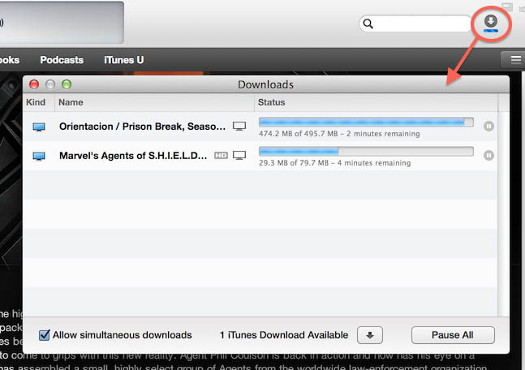
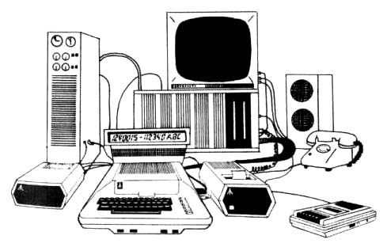
Why Concurrent Programs?
Program Structure: expressing logically
concurrent programs
Responsiveness: shifting work to run
in the background
Performance: exploiting multiprocessors
Performance: managing I/O devices

Slide 8
Posix Threads (Pthreads) Interface
Pthreads: Standard interface for ~60 functions that manipulate threads from C programs
Creating and reaping threads
pthread_create()
pthread_join()
Determining your thread ID
pthread_self()
Terminating threads
pthread_cancel()
pthread_exit()
exit() [terminates all threads] , RET [terminates current thread]

Slide 9
The Pthreads "hello, world" Program
/*
* hello.c - Pthreads "hello, world" program
*/
#include "csapp.h"
void *thread(void *vargp);
int main()
{
pthread_t tid;
Pthread_create(&tid, NULL, thread, NULL);
Pthread_join(tid, NULL);
exit(0);
}
Thread attributes
(usually NULL)
Thread ID
Thread routine
Thread arguments
(void *p)
hello.c
Return value
(void **p)
void *thread(void *vargp) /* thread routine */
{
printf("Hello, world!\n");
return NULL;
}
hello.c

Slide 10
Logical View of Threads
Threads associated with process form a pool of peers
Unlike processes which form a tree hierarchy
Process hierarchy
Threads associated with process foo
P0
T2
T4
T1
P1
shared code, data
and kernel context
sh
sh
sh
T5
T3
foo
bar

Slide 11
Threads Memory Model
Conceptual model:
Multiple threads run within the context of a single process
Each thread has its own separate thread context
Thread ID, stack, stack pointer, PC, condition codes, and GP registers
All threads share the remaining process context
Code, data, heap, and shared library segments of the process virtual address space
Open files and installed handlers
Operationally, this model is not strictly enforced:
Register values are truly separate and protected, but…
Any thread can read and write the stack of any other thread
The mismatch between the conceptual and operation model is a source of confusion and errors

Slide 12
Example Program to Illustrate Sharing
char **ptr; /* global var */
int main()
{
long i;
pthread_t tid;
char *msgs[2] = {
"Hello from foo",
"Hello from bar"
};
ptr = msgs;
for (i = 0; i < 2; i++)
Pthread_create(&tid,
NULL,
thread,
(void *)i);
Pthread_exit(NULL);
}
void *thread(void *vargp)
{
long myid = (long)vargp;
static int cnt = 0;
printf("[%ld]: %s (cnt=%d)\n",
myid, ptr[myid], ++cnt);
return NULL;
}
Peer threads reference main thread’s stack
indirectly through global ptr variable
sharing.c

Slide 13
Mapping Variable Instances to Memory
Global variables
Def: Variable declared outside of a function
Virtual memory contains exactly one instance of any global variable
Local variables
Def: Variable declared inside function without static attribute
Each thread stack contains one instance of each local variable
Local static variables
Def: Variable declared inside function with the static attribute
Virtual memory contains exactly one instance of any local static variable.

Slide 14
Mapping Variable Instances to Memory
Global var: 1 instance (ptr [data])
Local vars: 1 instance (i.m, msgs.m)
char **ptr; /* global var */
int main()
{
long i;
pthread_t tid;
char *msgs[2] = {
"Hello from foo",
"Hello from bar"
};
ptr = msgs;
for (i = 0; i < 2; i++)
Pthread_create(&tid,
NULL,
thread,
(void *)i);
Pthread_exit(NULL);
}
Local var: 2 instances (
myid.p0 [peer thread 0’s stack],
myid.p1 [peer thread 1’s stack]
)
void *thread(void *vargp)
{
long myid = (long)vargp;
static int cnt = 0;
printf("[%ld]: %s (cnt=%d)\n",
myid, ptr[myid], ++cnt);
return NULL;
}
Local static var: 1 instance (cnt [data])
sharing.c

Slide 15
Shared Variable Analysis
Which variables are shared?
A variable x is shared iff multiple threads reference at least one instance of x.
ptr, cnt, and msgs are shared
i and myid are not shared
Variable Referenced by Referenced by Referenced by
instance main thread? peer thread 0? peer thread 1?
ptr
cnt
i.m
msgs.m
myid.p0
myid.p1
yes
yes
yes
no
yes
yes
yes
no
no
yes
yes
yes
no
yes
no
no
no
yes

Slide 16
Why not Concurrent Programs?
/* Global shared variable */
volatile long cnt = 0; /* Counter */
int main(int argc, char **argv)
{
long niters;
pthread_t tid1, tid2;
niters = atoi(argv[1]);
Pthread_create(&tid1, NULL,
thread, &niters);
Pthread_create(&tid2, NULL,
thread, &niters);
Pthread_join(tid1, NULL);
Pthread_join(tid2, NULL);
/* Check result */
if (cnt != (2 * niters))
printf("BOOM! cnt=%ld\n", cnt);
else
printf("OK cnt=%ld\n", cnt);
exit(0);
}
/* Thread routine */
void *thread(void *vargp)
{
long i, niters;
niters = *((long *)vargp);
for (i = 0; i < niters; i++){
cnt++;
}
return NULL;
}
linux> ./badcnt 10000
OK cnt=20000
linux> ./badcnt 10000
BOOM! cnt=13051
linux>
badcnt.c

Slide 17
Assembly Code for Counter Loop
C code for counter loop in thread i
for (i = 0; i < niters; i++)
cnt++;
Asm code for thread i
movq (%rdi), %rcx
testq %rcx,%rcx
jle .L2
movl $0, %eax
.L3:
movq cnt(%rip),%rdx
addq $1, %rdx
movq %rdx, cnt(%rip)
addq $1, %rax
cmpq %rcx, %rax
jne .L3
.L2:
H_{i} : Head
L_{i} : Load cnt
U_{i} : Update cnt
S_{i} : Store cnt
T_{i} : Tail

Slide 18
Race conditions
A race condition is a timing-dependent error involving shared state
whether the error occurs depends on thread schedule
program execution/schedule can be non-deterministic
compilers and processors can re-order instructions

Slide 19
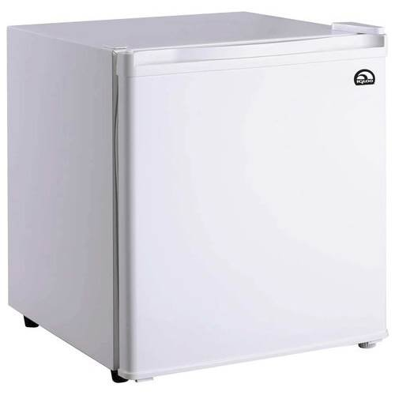
A concrete example…
You and your roommate share a refrigerator. Being good roommates, you both try to make sure that the refrigerator is always stocked with milk.
Liveness: if you are out of milk, someone buys milk
Safety: you never have more than one quart of milk
Algorithm 1:
Look in fridge.
If out of milk:
go to store,
buy milk,
go home
put milk in fridge
Algorithm 1:
if (milk == 0) { // no milk
milk++; // buy milk
}

Slide 20
A problematic schedule
You
Your Roommate
3:00 Look in fridge; out of milk
3:05 Leave for store
3:10 Arrive at store
3:15 Buy milk
3:20 Arrive home; put milk in fridge
3:10 Look in fridge; out of milk
3:15 Leave for store
3:20 Arrive at store
3:25 Buy milk
3:30 Arrive home; put milk in fridge
Safety violation:
You have too much milk and it spoils

Slide 21
Solution 1: Leave a note
You and your roommate share a refrigerator. Being good roommates, you both try to make sure that the refrigerator is always stocked with milk.
Algorithm 2:
if (milk == 0) { // no milk
if (note == 0) { // no note
note = 1; // leave note
milk++; // buy milk
note = 0; // remove note
}
}
Safety violation: you've introduced a Heisenbug!

Slide 22
Solution 2: Leave note before check note
You and your roommate share a refrigerator. Being good roommates, you both try to make sure that the refrigerator is always stocked with milk.
Algorithm 3:
note1 = 1
if (note2 == 0) { // no note from
roommate
if (milk == 0) {// no milk
milk++; // buy milk
}
}
note1 = 0
Liveness violation: No one buys milk

Slide 23
Solution 3: Keep checking for note
You and your roommate share a refrigerator. Being good roommates, you both try to make sure that the refrigerator is always stocked with milk.
Algorithm 4:
note1 = 1
while (note2 == 1) { // wait until
; // no note
}
if (milk == 0) { // no milk
milk++; // buy milk
}
note1 = 0
Liveness violation: You've introduced deadlock

Slide 24
Solution 4: Take turns
You and your roommate share a refrigerator. Being good roommates, you both try to make sure that the refrigerator is always stocked with milk.
Algorithm 5:
note1 = 1
turn = 2
while (note2 == 1 and turn == 2){
;
}
if (milk == 0) { // no milk
milk++; // buy milk
}
note1 = 0
(probably) correct, but complicated and inefficient
Notes:
Note: this solution might fail if the compiler or hardware reorders instruction

Slide 25
Rewind…
What problem are we actually trying to solve?
We want to limit the possible schedules so that checking for milk and buying milk act as a single atomic operation
Algorithm 1:
if (milk == 0) { // no milk
milk++; // buy milk
}

Slide 26
Locks
A lock (aka a mutex) is a synchronization primitive that provides mutual exclusion. When one thread holds a lock, no other thread can hold it.
a lock can be in one of two states: locked or unlocked
a lock is initially unlocked
function acquire(&lock) waits until the lock is unlocked, then atomically sets it to locked
function release(&lock) sets the lock to unlocked

Slide 27
Solution 5: use a lock
You and your roommate share a refrigerator. Being good roommates, you both try to make sure that the refrigerator is always stocked with milk.
Algorithm 6:
acquire(&lock)
if (milk == 0) { // no milk
milk++; // buy milk
}
release(&lock)
Correct!

Slide 28
Atomic Operations
Solution: hardware primitives to support synchronization
A machine instruction that (atomically!) reads and updates a memory location
Example: xchg src, dest
one instruction
semantics: TEMP ← DEST; DEST ← SRC; SRC ← TEMP;

Slide 29
Spinlocks
acquire:
mov $1, eax ; Set EAX to 1
xchg eax, (rdi) ; Atomically swap EAX w/ lock val
test eax, eax ; check if EAX is 0 (lock unlocked)
jnz acquire ; if was locked, loop
ret ; lock has been acquired, return
release:
xor eax, eax ; Set EAX to 0
xchg eax, (rdi) ; Atomically swap EAX w/ lock val
ret ; lock has been released, return

Slide 30
Locks in C (pthreads)
Defines lock type pthread_mutex_t
Defines functions to create/destroy locks:
int pthread_mutex_init(pthread_mutex_t *restrict lock, const pthread_mutexattr_t *restrict attr);
int pthread_mutex_destroy(pthread_mutex_t *mutex);
Defines functions to acquire/release a lock:
int pthread_mutex_lock(pthread_mutex_t *lock);
int pthread_mutex_trylock(pthread_mutex_t *lock);
int pthread_mutex_unlock(pthread_mutex_t *lock);

Slide 31
Exercise
/* Global shared variable */
volatile long cnt = 0; /* Counter */
int main(int argc, char **argv)
{
long niters;
pthread_t tid1, tid2;
niters = atoi(argv[1]);
Pthread_create(&tid1, NULL,
thread, &niters);
Pthread_create(&tid2, NULL,
thread, &niters);
Pthread_join(tid1, NULL);
Pthread_join(tid2, NULL);
/* Check result */
if (cnt != (2 * niters))
printf("BOOM! cnt=%ld\n", cnt);
else
printf("OK cnt=%ld\n", cnt);
exit(0);
}
/* Thread routine */
void *thread(void *vargp)
{
long i, niters =
*((long *)vargp);
for (i = 0; i < niters; i++)
cnt++;
return NULL;
}
TODO: Modify this example to guarantee correctness

Slide 32
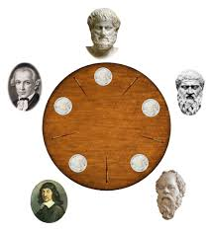
Exercise: Dining Philosophers
eat_thread(i){
while(True){
think();
pickup_fork(i);
pickup_fork(i+1%n);
eat();
putdown_fork(i);
putdown_fork(i+1%n);
}
}
Notes:
ordering solution
atomic solution

Slide 33
Performance problems
threads that fail to acquire a lock on the first attempt must "spin", which wastes CPU cycles
replace no-op with yield()
threads get scheduled and de-scheduled while the lock is still locked
need a better synchronization primitive

Slide 34
Better Synchronization Primitives
Semaphores
stateful synchronization primitive
Condition variables
event-based synchronization primitive

