Slide 1
Lecture 15: Virtual Memory
CS 105 October 29, 2019

Slide 2
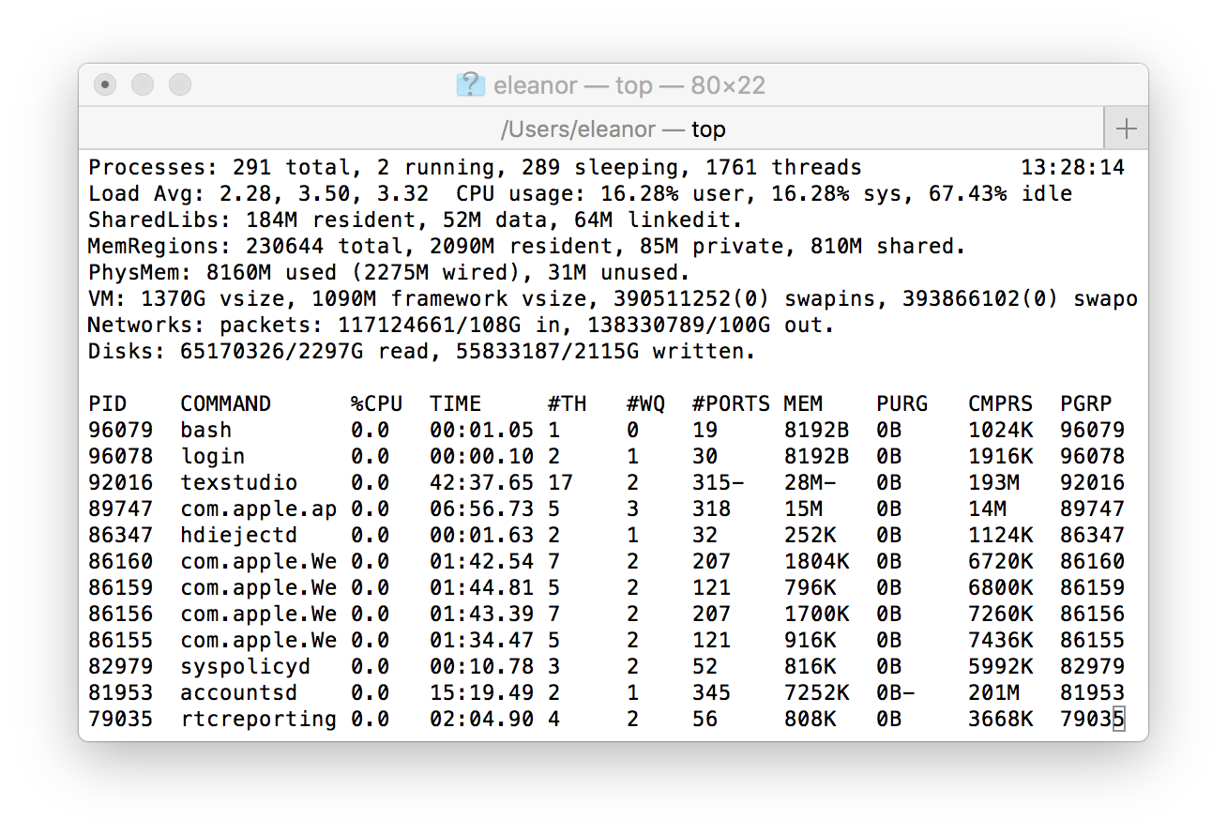
Multiprocessing
Computer runs many processes simultaneously
Running program “top” on Mac
  System has 123 processes, 5 of which are active
  Identified by Process ID (PID)
Notes:
What happens when there are multiple processes/threads? OS has to manage resources
%Possible considerations:
%fairness
%efficiency/optimize resources
%security

Slide 3
Multiprocessing: The Illusion
Memory
Memory
Memory
Stack
Stack
Stack
Heap
Heap
…
Heap
Data
Data
Data
Code
Code
Code
CPU
CPU
CPU
Registers
Registers
Registers
Process provides each program with two key abstractions:
  Logical control flow
    Each program seems to have exclusive use of the CPU
    Provided by kernel mechanism called context switching
  Private address space
    Each program seems to have exclusive use of main memory.
    Provided by kernel mechanism called virtual memory
Notes:
Each process has its own registers, memory, I/O resources, "thread of control"

Slide 4
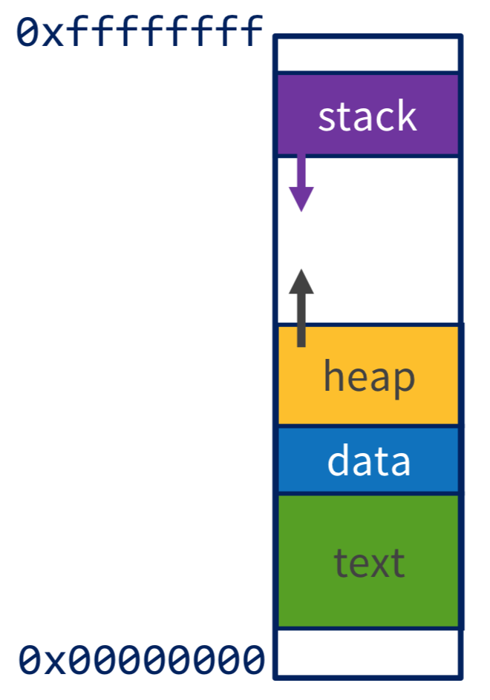
Virtual Memory Goals
Isolation: don’t want different process states collided in physical memory
Utilization: want best use of limited resource
Virtualization: want to create illusion of more resources
Efficiency: want fast reads/writes to memory
Sharing: want option to overlap for communication

Slide 5
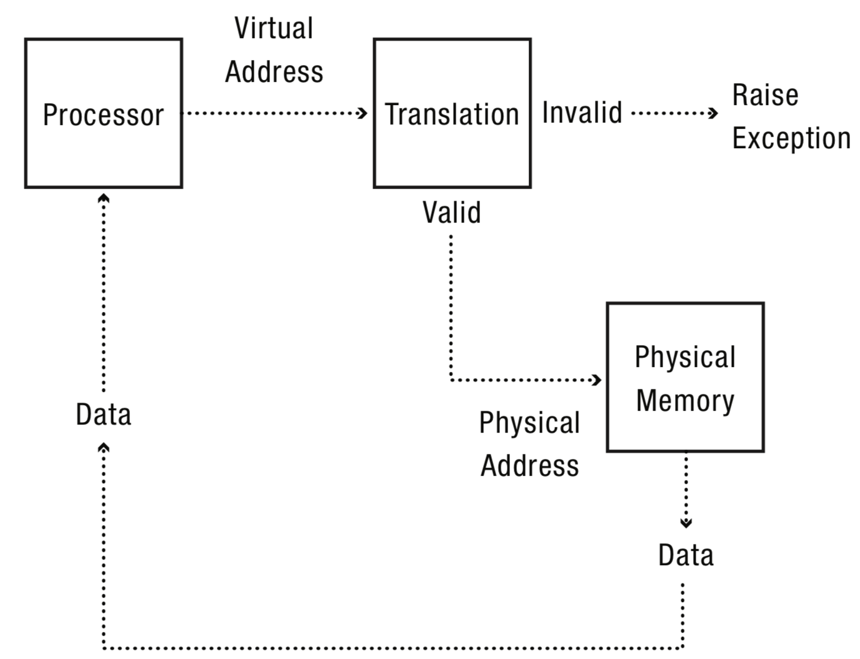

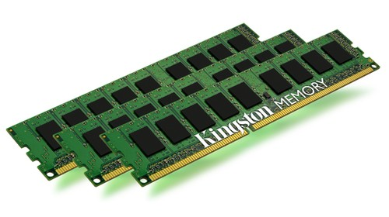
Address Translation
Notes:
Define MMU

Slide 6


Base-and-Bound

Slide 7
Base-and-Bound
Notes:
Translation: if vaddr > Bound raise exception else paddr = vaddr+Base
Pro: simple, fast, can do in hardware
Con: external fragmentation/complex allocation, no sharing (comm. or lib), hard to dynamically allocate more/less space

Slide 8

Segmentation

Slide 9
Segmentation
Notes:
Translation: if vaddr > Bound(Segment) || Access not allowed by Access(Segment) Raise Exception, else paddr = Base(Segment) + vaddr
Pro: Still relatively simple/fast, allows access permissions, allows sharing, easier to grow
Con: memory allocation still complex, still external fragmentation

Slide 10
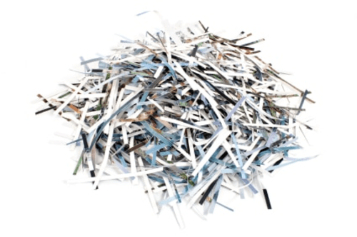
Paging

Slide 11
Paging

Slide 12
Paging
Notes:
Translation: if(Access(Page)): Frame(Page)||Offset
Lots of implementation details: size, caching, indexing
Pros: easy allocation (keep bitmap of free frames), no external fragmentation, still allows access permissions, still allows sharing, easy to grow
Cons: internal fragmentation, slower (size of page tables etc -> multiple lookups)
Cons:

Slide 13
Memory as a Cache
each page table entry has a valid bit
for valid entries, frame indicates physical address of page in memory
a page fault occurs when a program requests a page that is not currently in memory
  takes time to handle, so context switch
  evict another page in memory to make space (which one?)

Slide 14
Page Replacement Algorithms
Random: Pick any page to eject at random
  Used mainly for comparison
FIFO: The page brought in earliest is evicted
  Ignores usage
OPT: Belady’s algorithm
  Select page not used for longest time
LRU: Evict page that hasn’t been used for the longest
  Past could be a good predictor of the future
MRU: Evict the most recently used page
LFU: Evict least frequently used page

Slide 15
Thrashing
working set is the collection of a pages a process requires in a given time interval
if it doesn't fit in memory, program with thrash

Slide 16
Efficient Paging
How big should our pages be?
  How much internal fragmentation will there be?
  How big is the page table?
    Example: consider 64-bit address space, 4KB (2^12) page size, assume each page table entry is 8 bytes.
Performance: every data/instruction access requires two memory accesses:
  One for the page table
  One for the data/instruction
Notes:
problem 1: fill up all our memory with page table

Slide 17
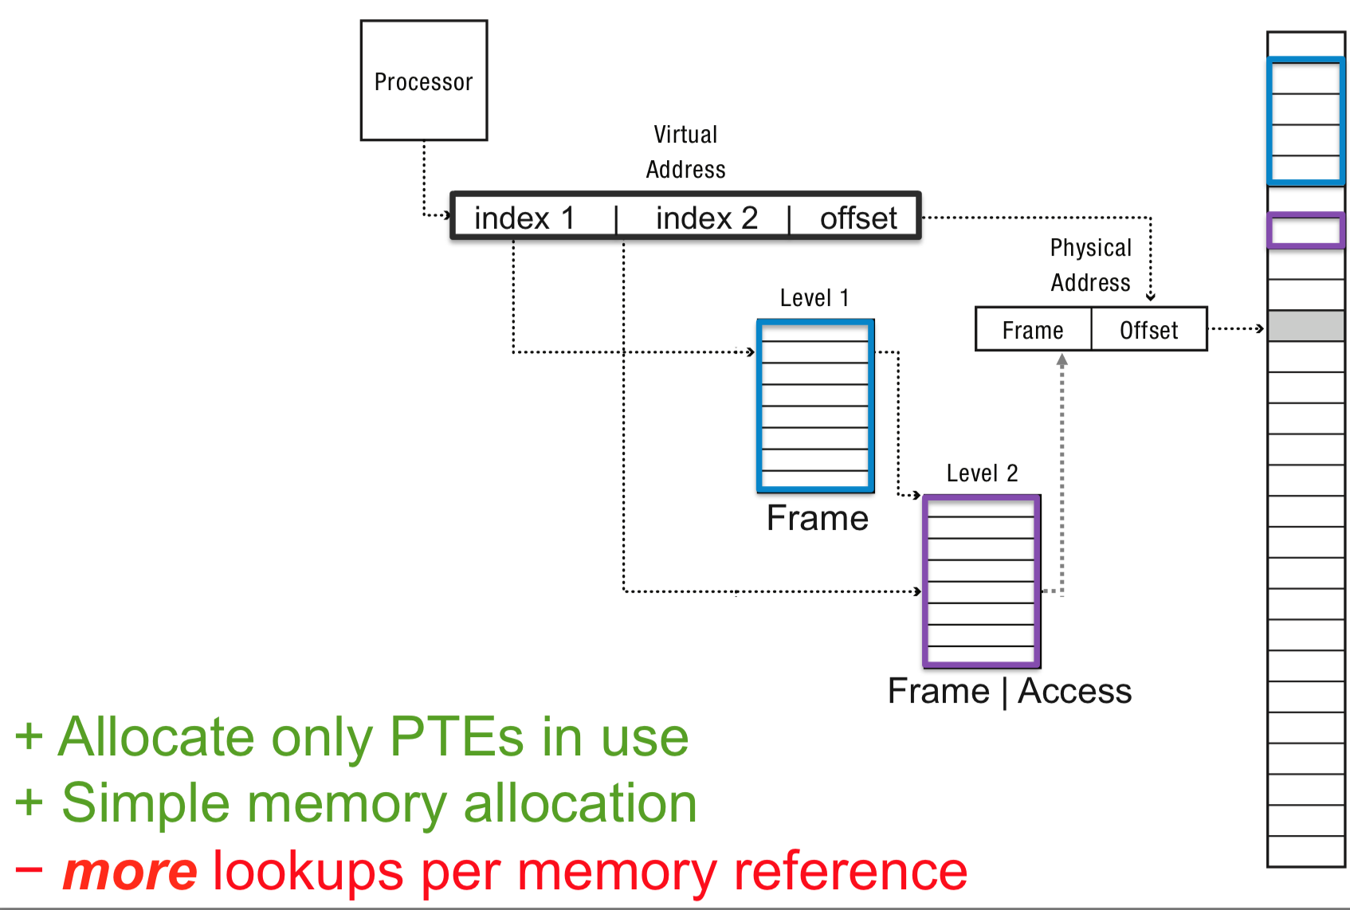
Multi-level page tables

Slide 18
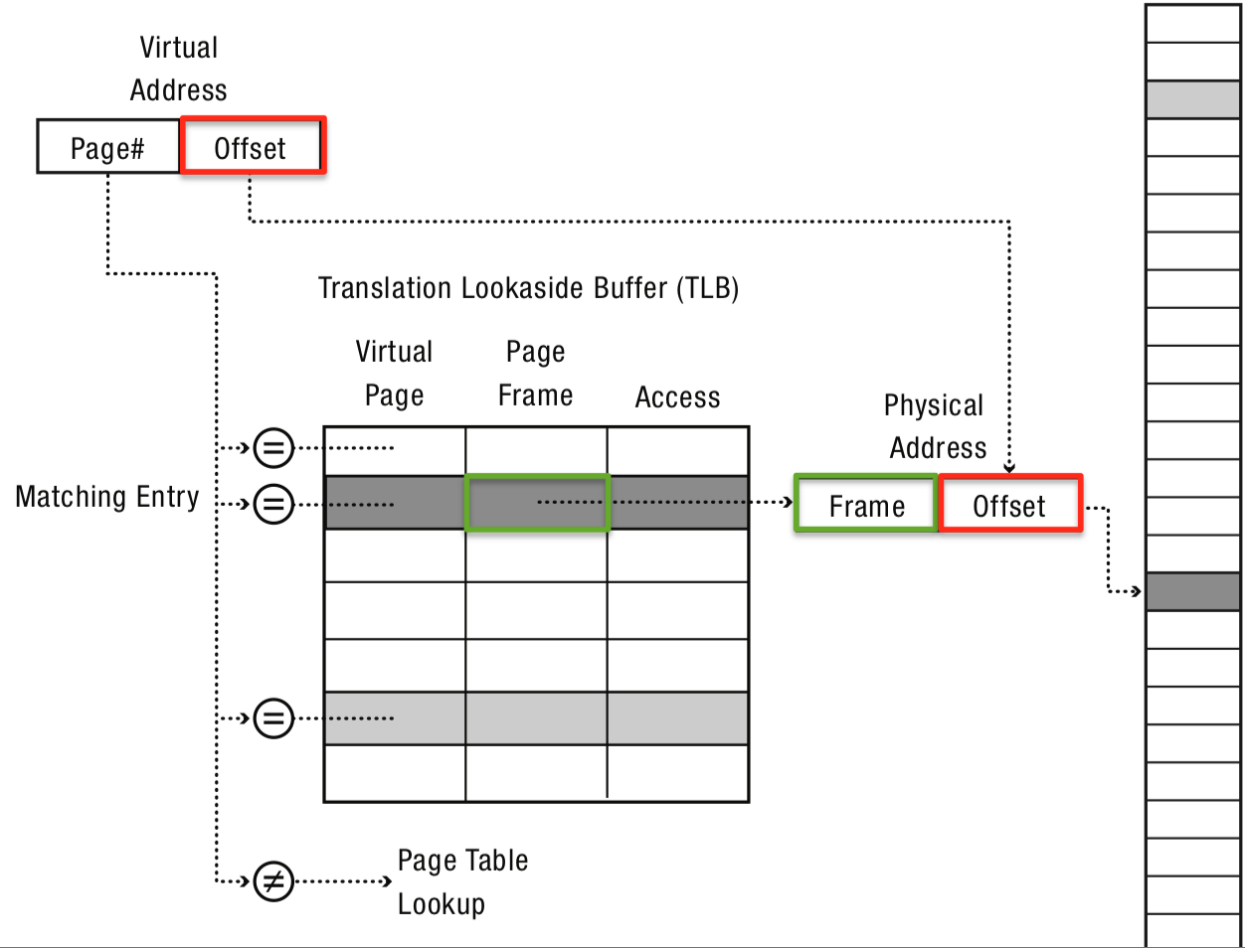
Translation Look-aside Buffer (TLB)
Translation lookaside buffer (TLB): special cache for page table entries

Slide 19
Example: Core i7 Address Translation
CPU
32/64
L2, L3, and
main memory
Result
Virtual address (VA)
36
12
VPN
VPO
L1
hit
L1
miss
32
4
TLBT
TLBI
L1 d-cache
(64 sets, 8 lines/set)
TLB
hit
TLB
miss
...
...
L1 TLB (16 sets, 4 entries/set)
9
9
9
9
40
12
40
6
6
VPN1
VPN2
VPN3
VPN4
PPN
PPO
CT
CI
CO
Physical
address
(PA)
CR3
PTE
PTE
PTE
PTE
Page tables

