Slide 1
Lecture 14: Processes
CS 105 October 24, 2019

Slide 2
Processes
Definition: A program is a file containing code + data that describes a computation
Definition: A process is an instance of a running program.
One of the most profound ideas in computer science
Not the same as “program” or “processor”
Memory
Stack
Heap
Data
Code
CPU
Registers
Notes:
a process is alive, same program can be run twice at the same time (two processes)

Slide 3
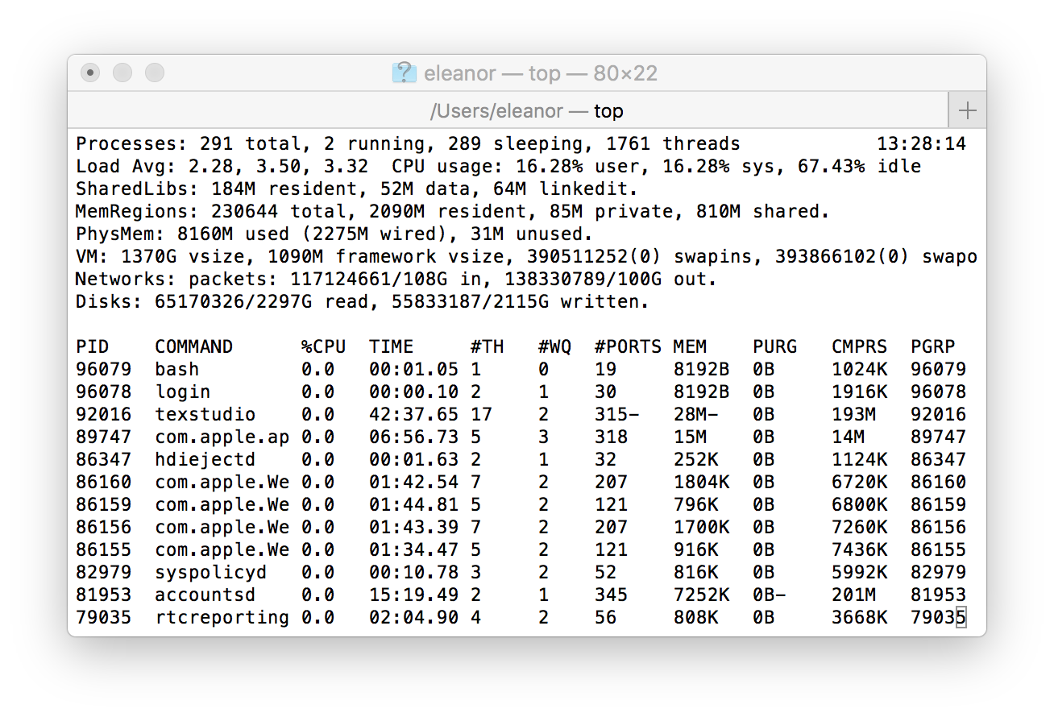
Multiprocessing
Computer runs many processes simultaneously
Running program “top” on Mac
System has 123 processes, 5 of which are active
Identified by Process ID (PID)
Notes:
Applications for one or more users
Web browsers, email clients, editors, …
Background tasks
Monitoring network & I/O devices

Slide 4
Multiprocessing: The Illusion
Memory
Memory
Memory
Stack
Stack
Stack
Heap
Heap
…
Heap
Data
Data
Data
Code
Code
Code
CPU
CPU
CPU
Registers
Registers
Registers
Process provides each program with two key abstractions:
Logical control flow
Each program seems to have exclusive use of the CPU
Provided by kernel mechanism called context switching
Private address space
Each program seems to have exclusive use of main memory.
Provided by kernel mechanism called virtual memory
Notes:
Each process has its own registers, memory, I/O resources, "thread of control"

Slide 5
Multiprocessing: The (Traditional) Reality
Memory
Stack
Stack
Stack
Heap
Heap
…
Heap
Data
Data
Data
Code
Code
Code
Saved registers
Saved registers
Saved registers
CPU
Registers
Single processor executes multiple processes concurrently
Process executions interleaved (multitasking)
Register values for nonexecuting processes saved in memory
Address spaces managed by virtual memory system

Slide 6
Multiprocessing: The (Traditional) Reality
Memory
Stack
Stack
Stack
Heap
Heap
…
Heap
Data
Data
Data
Code
Code
Code
Saved registers
Saved registers
Saved registers
CPU
Registers
Save current registers in memory

Slide 7
Multiprocessing: The (Traditional) Reality
Memory
Stack
Stack
Stack
Heap
Heap
…
Heap
Data
Data
Data
Code
Code
Code
Saved registers
Saved registers
Saved registers
CPU
Registers
Save current registers in memory
Schedule next process for execution

Slide 8
Multiprocessing: The (Traditional) Reality
Memory
Stack
Stack
Stack
Heap
Heap
…
Heap
Data
Data
Data
Code
Code
Code
Saved registers
Saved registers
Saved registers
CPU
Registers
Save current registers in memory
Schedule next process for execution
Load saved registers and switch address space

Slide 9
Process Control Block (PCB)
To implement a context switch, OS maintains a PCB for each process containing:
process table, which contains information about the process (id, user, privilege level, arguments, status)
register values (general-purpose registers, float registers, pc, eflags…)
memory state
file table
location of executable on disk
scheduling information
... and more!

Slide 10
Multiprocessing: The (Modern) Reality
Memory
Stack
Stack
Stack
Heap
Heap
…
Heap
Data
Data
Data
Code
Code
Code
Saved registers
Saved registers
Saved registers
CPU
CPU
Registers
Registers
Multicore processors
Multiple CPUs on single chip
Share main memory (and some of the caches)
Each can execute a separate process
Scheduling of processors onto cores done by kernel

Slide 11
Context Switching
Processes are managed by a shared chunk of memory-resident OS code called the kernel
Important: the kernel is not a separate process, but rather runs as part of some existing process.
Control flow passes from one process to another via a context switch
Process A
Process B
user code
Time
kernel code
context switch
user code
kernel code
context switch
user code

Slide 12
Interrupts (Asynchronous Exceptions)
Caused by events external to the processor
Indicated by setting the processor’s interrupt pin
Handler returns to “next” instruction
Examples:
Timer interrupt
Every few ms, an external timer chip triggers an interrupt
Used by the kernel to take back control from user programs
I/O interrupt from external device
Hitting Ctrl-C at the keyboard
Arrival of a packet from a network
Arrival of data from a disk

Slide 13
Exceptions
An exception is a transfer of control to the OS kernel in response to some event (i.e., change in processor state)
Kernel is the memory-resident part of the OS
Examples of events: timer interrupt, Divide by 0, page fault, I/O request completes, typing Ctrl-C
User code
Kernel code
Event
I_current
Exception
I_next
Exception processing
by exception handler
Return to I_current
Return to I_next
Abort

Slide 14
Exception Tables
Exception
numbers
Each type of event has a unique exception number k
k = index into exception table (a.k.a. interrupt vector)
Handler k is called each time exception k occurs
Code for
exception handler 0
Exception
Table
Code for
exception handler 1
0
1
Code for
exception handler 2
2
...
n-1
...
Code for
exception handler n-1

Slide 15
Synchronous Exceptions
Caused by events that occur as a result of executing an instruction:
Traps
Intentional
Examples: system calls, breakpoint traps, special instructions
Returns control to “next” instruction
Faults
Unintentional but possibly recoverable
Examples: page faults (recoverable), protection faults (unrecoverable), floating point exceptions
Either re-executes faulting (“current”) instruction or aborts
Aborts
Unintentional and unrecoverable
Examples: illegal instruction, parity error, machine check
Aborts current program

Slide 16
Process Life Cycle
Init
Terminated
fork
Runnable
Running
Stopped

Slide 17
Creating Processes
Parent process creates a new running child process by calling fork
int fork(void)
Returns 0 to the child process, child’s PID to parent process
Child is almost identical to parent:
Child get an identical (but separate) copy of the parent’s virtual address space.
Child gets identical copies of the parent’s open file descriptors
Child has a different PID than the parent
fork is interesting (and often confusing) because it is called once but returns twice

Slide 18
fork Example
Call once, return twice
Duplicate but separate address space
x has a value of 1 when fork returns in parent and child
Subsequent changes to x are independent
Shared open files
stdout is the same in both parent and child
int main()
{
pid_t pid;
int x = 1;
pid = Fork();
if (pid == 0) { /* Child */
printf("child : x=%d\n", ++x);
return 0;
}
/* Parent */
printf("parent: x=%d\n", --x);
return 0;
}
fork.c
Notes:
What are the possible outputs?
e.g.,
linux> ./fork
parent: x=0
child : x=2

Slide 19
Process Life Cycle
Init
Terminated
interrupt, yield
fork
Runnable
Running
scheduled
Stopped

Slide 20
fork Example
Call once, return twice
Duplicate but separate address space
x has a value of 1 when fork returns in parent and child
Subsequent changes to x are independent
Shared open files
stdout is the same in both parent and child
Concurrent execution
Can’t predict execution order of parent and child
int main()
{
pid_t pid;
int x = 1;
pid = Fork();
if (pid == 0) { /* Child */
printf("child : x=%d\n", ++x);
return 0;
}
/* Parent */
printf("parent: x=%d\n", --x);
return 0;
}
fork.c
Notes:
What are the possible outputs?
e.g.,
linux> ./fork
parent: x=0
child : x=2

Slide 21
Modeling fork with Process Graphs
A process graph is a useful tool for capturing the partial ordering of statements in a concurrent program:
Each vertex is the execution of a statement
a -> b means a happens before b
Edges can be labeled with current value of variables
printf vertices can be labeled with output
Each graph begins with a vertex with no inedges
Any topological sort of the graph corresponds to a feasible total ordering.
Total ordering of vertices where all edges point from left to right

Slide 22
Process Graph Example
int main()
{
pid_t pid;
int x = 1;
pid = Fork();
if (pid == 0) { /* Child */
printf("child : x=%d\n", ++x);
return 0;
}
/* Parent */
printf("parent: x=%d\n", --x);
return 0;
}
x=2 2
Child
printf
x=1
x=0 0
Parent
main
fork
printf
fork.c

Slide 23
Interpreting Process Graphs
Original graph:
Relabeled graph:
x=2 2
Child
printf
x=1
x=0 0
Parent
main
fork
printf
Feasible total ordering:
e
a
b
e
c
a
b
c
Infeasible total ordering:
a
e
b
c

Slide 24
fork Example: Two consecutive forks
Bye
void fork1()
{
printf("L0\n");
fork();
printf("L1\n");
fork();
printf("Bye\n");
}
printf
L1
Bye
printf
fork
printf
Bye
printf
L0
L1
Bye
printf
fork
printf
fork
printf
Which of these outputs are feasible?
L0
L1
Bye
Bye
L1
Bye
Bye
L0
Bye
L1
Bye
L1
Bye
Bye
Notes:
1 Feasible
2. Infeasible

Slide 25
fork Exercise: Nested forks in parent
void fork2()
{
printf("L0\n");
if (fork() != 0) {
printf("L1\n");
if (fork() != 0) {
printf("L2\n");
}
}
printf("Bye\n");
}
Bye
Bye
printf
printf
L0
L1
L2
Bye
printf
fork
printf
fork
printf
printf
Which of these outputs are feasible?
L0
L1
Bye
Bye
L2
Bye
L0
Bye
L1
Bye
Bye
L2
Notes:
Feasible
Infeasible

Slide 26
fork Exercise: Nested forks in children
void fork3()
{
printf("L0\n");
if (fork() == 0) {
printf("L1\n");
if (fork() == 0) {
printf("L2\n");
}
}
printf("Bye\n");
}
L2
Bye
printf
printf
L1
Bye
printf
fork
printf
L0
Bye
printf
fork
printf
Which of these outputs are feasible?
L0
Bye
L1
L2
Bye
Bye
L0
Bye
L1
Bye
Bye
L2

Slide 27
Process Life Cycle
Init
Terminated
interrupt, yield
fork
return from main,
exit, terminated
Runnable
Running
scheduled
Stopped

Slide 28
Terminating Processes
Process becomes terminated for one of three reasons:
Returning from the main routine
Calling the exit function
Receiving a signal whose default action is to terminate
void exit(int status)
Terminates with an exit status of status
Convention: normal return status is 0, nonzero on error
Another way to explicitly set the exit status is to return an integer value from the main routine
exit is called once but never returns.

Slide 29
Non-terminating Child
void fork4()
{
if (fork() == 0) {
/* Child */
printf("Running Child, PID = %d\n",
getpid());
while (1)
; /* Infinite loop */
} else {
printf("Terminating Parent, PID = %d\n",
getpid());
exit(0);
}
}
pid_t getpid(void)
Returns PID of current process
pid_t getppid(void)
Returns PID of parent process

Slide 30
void fork4()
{
if (fork() == 0) {
/* Child */
printf("Running Child, PID = %d\n",
getpid());
while (1)
; /* Infinite loop */
} else {
printf("Terminating Parent, PID = %d\n",
getpid());
exit(0);
}
}
linux> ./forks 4
Terminating Parent, PID = 6675
Running Child, PID = 6676
linux> ps
PID TTY TIME CMD
6585 ttyp9 00:00:00 tcsh
6676 ttyp9 00:00:06 forks
6677 ttyp9 00:00:00 ps
linux> kill 6676
linux> ps
PID TTY TIME CMD
6585 ttyp9 00:00:00 tcsh
6678 ttyp9 00:00:00 ps
Child process still active even though parent has terminated
Must kill child explicitly, or else will keep running indefinitely

Slide 31
Non-terminating Parent
void fork5() {
if (fork() == 0) {
/* Child */
printf("Terminating Child, PID = %d\n", getpid());
exit(0);
} else {
printf("Running Parent, PID = %d\n", getpid());
while (1)
; /* Infinite loop */
}
}
When process terminates, it still consumes system resources
Examples: Exit status, various OS tables
Called a “zombie”
Living corpse, half alive and half dead

Slide 32
void fork5() {
if (fork() == 0) {
/* Child */
printf("Terminating Child, PID = %d\n", getpid());
exit(0);
} else {
printf("Running Parent, PID = %d\n", getpid());
while (1)
; /* Infinite loop */
}
}
linux> ./forks 5 &
[1] 6639
Running Parent, PID = 6639
Terminating Child, PID = 6640
linux> ps
PID TTY TIME CMD
6585 ttyp9 00:00:00 tcsh
6639 ttyp9 00:00:03 forks
6640 ttyp9 00:00:00 forks <defunct>
6641 ttyp9 00:00:00 ps
linux> kill 6639
[1] Terminated
linux> ps
PID TTY TIME CMD
6585 ttyp9 00:00:00 tcsh
6642 ttyp9 00:00:00 ps
ps shows child process as “defunct” (i.e., a zombie)
Killing parent allows child to be reaped by init

Slide 33
Process Life Cycle
Init
Terminated
interrupt, yield
fork
return from main,
exit, terminated
Runnable
Running
scheduled
process or
I/O completion
wait, I/O operation
Stopped

Slide 34
Reaping Children
Reaping
Performed by parent on terminated child (using wait or waitpid)
Parent is given exit status information
Kernel then deletes zombie child process
int wait(int *child_status)
Suspends current process until one of its children terminates
Return value is the pid of the child process that terminated
If child_status != NULL, then the integer it points to will be set to a value that indicates reason the child terminated and the exit status:
Checked using macros defined in wait.h
WIFEXITED, WEXITSTATIS, WIFSIGNALED, WTERMSIG, WIFSTOPPED, WSTOPSIG, WIFCONTINUED
See textbook for details

Slide 35
wait Example
void fork6() {
int child_status;
if (fork() == 0) {
printf("HC: hello from child\n");
exit(0);
} else {
printf("HP: hello from parent\n");
wait(&child_status);
printf("CT: child has terminated\n");
}
printf("Bye\n");
}
HC
exit
printf
CT
Bye
HP
fork
printf
wait
printf
Feasible output:
HC
HP
CT
Bye
Infeasible output:
HP
CT
Bye
HC

Slide 36
Reaping Children
What if parent doesn’t reap?
If any parent terminates without reaping a child, then the orphaned child will be reaped by init process (pid == 1)
So, only need explicit reaping in long-running processes
e.g., shells and servers

Slide 37
execve: Loading and Running Programs
int execve(char *filename, char *argv[], char *envp[])
Loads and runs in the current process:
Executable file filename
Can be object file or script file beginning with #!interpreter (e.g., #!/bin/bash)
…with argument list argv
By convention argv[0]==filename
…and environment variable list envp
“name=value” strings (e.g., USER=droh)
getenv, putenv, printenv
Overwrites code, data, and stack
Retains PID, open files and signal context
Called once and never returns
…except if there is an error

Slide 38
Linux Process Heirarchy
[0]
init [1]
Daemon
e.g. httpd
…
…
…
Login shell
Login shell
Child
Child
Child
Grandchild
Grandchild
Note: you can view the hierarchy using the Linux pstree command

Slide 39
pstree on pom-itb-cs2
[ebac2018@pom-itb-cs2 ~]$ pstree
systemd─┬─NetworkManager───2*[{NetworkManager}]
…
├─attacklab-repor
├─attacklab-reque
├─attacklab-resul
├─attacklab.pl
…
├─crond
├─cupsd
…
├─sshd─┬─sshd───sshd───bash───pstree
│ └─28*[sshd───sshd───sftp-server]
├─systemd-journal
├─systemd-logind
├─systemd-udevd
…
└─xdg-permission-───2*[{xdg-permission-}]

