Slide 1
Lecture 12: Dynamic Memory
CS 105 October 15, 2019

Slide 2
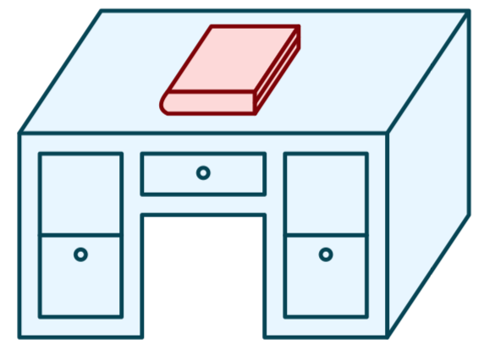
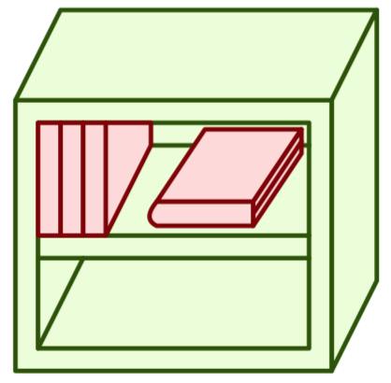
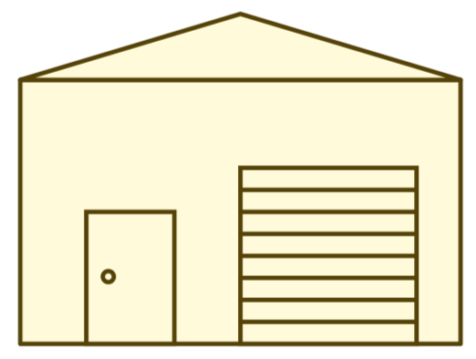
Memory Hierarchy
L0:
Regs
CPU registers hold words retrieved from the L1 cache.
L1:
L1 cache
(SRAM)
L1 cache holds cache lines retrieved from the L2 cache.
Smaller,
faster,
and
costlier
(per byte)
storage
devices
L2:
L2 cache
(SRAM)
L2 cache holds cache lines
retrieved from L3 cache
L3:
L3 cache
(SRAM)
L3 cache holds cache lines
retrieved from main memory.
L4:
Main memory
(DRAM)
Main memory holds
disk blocks retrieved
from local disks.
Larger,
slower,
and
cheaper
(per byte)
storage
devices
Local secondary storage
(local disks)
Local disks hold files retrieved from disks
on remote servers
L5:
L6:
Remote secondary storage
(e.g., cloud, web servers)

Slide 3
Memory
0x7FFFFFFF
Stack
the heap is an area of memory maintained by a dynamic memory allocator
programmers can use the dynamic memory allocator to acquire additional memory at run time
e.g., for data structures whose size is not known at compile time
the operating system kernel maintains a variable brk that points to the top of the heap
%rsp
brk
Heap
Data
%rip
Code
0x00000000

Slide 4
Dynamic Memory Allocation
Dynamic memory allocator
Manages the heap
organizes the heap as a collection of (variable-size) blocks, each of which is either allocated or free
allocates and deallocates memory
may ask OS for additional heap space
Part of the process’s runtime system
Linked into program
Example dynamic memory allocators
malloc and free in C
new and delete in C++
object creation & garbage collection in Java
object creation & garbage collection in Python
explicit allocators
implicit allocators

Slide 5
Allocation Example using malloc
#include <stdio.h>
#include <stdlib.h>
void foo(int n) {
int i, *p;
/* Allocate a block of n ints */
p = (int *) malloc(n * sizeof(int));
if (p == NULL) {
perror("malloc");
exit(0);
}
/* Initialize allocated block */
for (i=0; i<n; i++)
p[i] = i;
/* Return allocated block to the heap */
free(p);
}

Slide 6
Allocation Example
p1 = malloc(4)
p2 = malloc(5)
p3 = malloc(6)
free(p2)
p4 = malloc(2)

Slide 7
Allocator Requirements
Must handle arbitrary request sequences:
cannot control number, size, or order of requests
(but we'll assume that each free request corresponds to an allocated block)
Must respond immediately:
no reordering or buffering requests
Must not modify allocated blocks:
can only allocate from free memory on the heap
cannot modify or move blocks once they are allocated
Must align blocks:
8-byte (x86) or 16-byte (x86-64) alignment on Linux
Ensures that allocated blocks can hold any type of data
Must only use the heap:
any data structures used by the allocator must be stored in the heap

Slide 8
First Example: A Simple Allocator
void *brk; // top of heap
void *malloc (size_t size) {
void *p = brk;
brk += align(size);
return p;
}
void free (void *ptr) {
// do nothing
}
Advantages
Blazing fast
Simple
Disadvantages
Memory is never recycled

Slide 9
Performance Goals
Throughput and Memory Utilization
These goals are often conflicting
Throughput
Number of completed requests per unit time
Example: if your allocator processes 5,000 malloc calls and 5,000 free calls in 10 seconds then throughput is 1,000 operations/second
Peak Memory Utilization
Minimize wasted space

Slide 10
Peak Memory Utilization
Given some sequence of malloc and free requests R₀, R₁, ..., R_{k}, ... , R_{n-1} the peak memory utilization after request k is $U_{k}=\frac{\max_{i≤k}{P_{i}}}{H_{k}}$
P_{i}, is the aggregate payload, i.e., the sum of the currently allocated payloads after request i, where the payload of malloc(p) is p bytes
H_{k} is the current heap size
Assume H_{k} is monotonically nondecreasing

Slide 11
Utilization Blocker: Internal Fragmentation
For a given block, internal fragmentation occurs if payload is smaller than block size
Caused by
Overhead of maintaining heap data structures
Padding for alignment purposes
Explicit policy decisions (for example, returning a big block to satisfy a small request)
Depends only on the pattern of previous requests
Thus, easy to measure
Block
Internal
fragmentation
Payload
Internal
fragmentation

Slide 12
Utilization Blocker: External Fragmentation
Occurs when there is enough aggregate heap memory, but no single free block is large enough
Depends on the pattern of future requests
Thus, difficult to measure
p1 = malloc(4)
p2 = malloc(5)
p3 = malloc(6)
free(p2)
p4 = malloc(6)
Oops! (what would happen now?)

Slide 13
Challenges
Strategic: maximize throughput and peak memory utilization
Implementation:
How do we know how much memory to free given just a pointer?

Slide 14
Knowing How Much to Free
Standard method
Keep the length of a block in the word preceding the block.
This word is often called the header field or header
Requires an extra (4 byte) word for every allocated block
p0
p0 = malloc(4)
5
block size
payload
free(p0)

Slide 15
Challenges
Strategic: maximize throughput and peak memory utilization
Implementation:
How do we know how much memory to free given just a pointer?
How do we keep track of the free blocks?

Slide 16
Keeping Track of Free Blocks
Method 1: Implicit list using length—links all blocks
5
4
6
2

Slide 17
Method 1: Implicit List
For each block we need both size and allocation status
Could store this information in two words: wasteful!
Standard trick
If blocks are aligned, some low-order address bits are always 0
Instead of storing an always-0 bit, use it as a allocated/free flag
When reading size word, must mask out this bit
1 word
Size
a
a = 1: Allocated block
a = 0: Free block
Size: block size
Payload: application data
(allocated blocks only)
Format of
allocated and
free blocks
Payload
Optional
padding

Slide 18
Detailed Implicit Free List Example
Start
of
heap
Unused
8/0
16/1
32/0
16/1
0/1
Allocated blocks: shaded
Free blocks: unshaded
Headers: labeled with size in bytes/allocated bit
8-byte aligned

Slide 19
Challenges
Strategic: maximize throughput and peak memory utilization
Implementation:
How do we know how much memory to free given just a pointer?
How do we keep track of the free blocks?
How do we pick a block to use for allocation—many might fit?

Slide 20
Implicit List: Finding a Free Block
First fit. Search list from beginning, choose first free block that fits:
Can take linear time in total number of blocks (allocated and free)
In practice it can cause “splinters” at beginning of list
Next fit. Like first fit, but search list starting where previous search finished:
Should often be faster than first fit: avoids re-scanning unhelpful blocks
Some research suggests that fragmentation is worse
Best fit. Search the list, choose the best free block: fits, with fewest bytes left over:
Keeps fragments small—usually improves memory utilization
Will typically run slower than first fit
p = start;
while ((p < end) && \\ not passed end
((*p & 1) || \\ already allocated
(*p <= len))) \\ too small
p = p + (*p & -2); \\ goto next block (word addressed)

Slide 21
Challenges
Strategic: maximize throughput and peak memory utilization
Implementation:
How do we know how much memory to free given just a pointer?
How do we keep track of the free blocks?
How do we pick a block to use for allocation—many might fit?
What do we do with the extra space when allocating a structure that is smaller than the free block it is placed in?

Slide 22
Implicit List: Allocating in Free Block
Allocating in a free block: splitting
Since allocated space might be smaller than free space, we might want to split the block
4
4
6
2
p
addblock(p, 4)
4
4
4
2
2
void addblock(ptr p, int len) {
int newsize = ((len + 1) >> 1) << 1; // round up to even
int oldsize = *p & -2; // mask out low bit
*p = newsize | 1; // set new length
if (newsize < oldsize)
*(p+newsize) = oldsize - newsize; // set length in remaining
} // part of block

Slide 23
Challenges
Strategic: maximize throughput and peak memory utilization
Implementation:
How do we know how much memory to free given just a pointer?
How do we keep track of the free blocks?
How do we pick a block to use for allocation—many might fit?
What do we do with the extra space when allocating a structure that is smaller than the free block it is placed in?
How do we reinsert a freed block?

Slide 24
Implicit List: Freeing a Block
Simplest implementation:
Need only clear the “allocated” flag
void free_block(ptr p) { *p = *p & -2 }
But can lead to “false fragmentation”
4
4
4
2
2
free(p)
p
4
4
4
2
2
malloc(5)
Oops!
There is enough free space, but the allocator won’t be able to find it

Slide 25
Implicit List: Coalescing
Join (coalesce) with next/previous blocks, if they are free
Coalescing with next block
But how do we coalesce with previous block?
4
4
4
2
2
logically
gone
free(p)
p
4
4
6
2
2
void free_block(ptr p) { *p = *p & -2; // clear allocated flag next = p + *p; // find next block if ((*next & 1) == 0) *p = *p + *next; // add to this block if } // not allocated

Slide 26
Implicit List: Bidirectional Coalescing
Boundary tags [Knuth73]
Replicate size/allocated word at “bottom” (end) of free blocks
Allows us to traverse the “list” backwards, but requires extra space
Important and general technique!
4
4
4
4
6
6
4
4
Header
Size
a
a = 1: Allocated block
a = 0: Free block
Size: Total block size
Payload: Application data
(allocated blocks only)
Format of
allocated and
free blocks
Payload and
padding
Boundary tag
(footer)
Size
a

Slide 27
Constant Time Coalescing
Case 1
Case 2
Case 3
Case 4
Allocated
Allocated
Free
Free
Block being
freed
Allocated
Free
Allocated
Free

Slide 28
Constant Time Coalescing (Case 1)
m1
1
m1
1
m1
1
m1
1
n
1
n
0
n
1
n
0
m2
1
m2
1
m2
1
m2
1

Slide 29
Constant Time Coalescing (Case 2)
m1
1
m1
1
m1
1
m1
1
n
1
n+m2
0
n
1
m2
0
m2
0
n+m2
0

Slide 30
Constant Time Coalescing (Case 3)
m1
0
n+m1
0
m1
0
n
1
n
1
n+m1
0
m2
1
m2
1
m2
1
m2
1

Slide 31
Constant Time Coalescing (Case 4)
m1
0
n+m1+m2
0
m1
0
n
1
n
1
m2
0
m2
0
n+m1+m2
0

Slide 32
Implicit Lists: Summary
Implementation: very simple
Allocate cost: linear time in the worst case
Free cost: constant time worst case–even with coalescing
Memory usage: depends on the placement policy
First-fit, next-fit, or best-fit
Not used in practice for malloc/free because of linear-time allocation
used in many special purpose applications
However, the concepts of splitting and boundary tag coalescing are general to all allocators

Slide 33
Keeping Track of Free Blocks
Method 1: Implicit list using length—links all blocks
Method 2: Explicit list among the free blocks using pointers
Method 3: Segregated free list
Different free lists for different size classes
Method 4: Blocks sorted by size
Can use a balanced tree (e.g. Red-Black tree) with pointers within each free block, and the length used as a key
5
4
6
2
5
4
6
2
Notes:
Small group discussion: what data structure would you use?

Slide 34
Segregated Lists
Each size class of blocks has its own free list
Often have separate classes for each small size
For larger sizes: One class for each two-power size
1-2
3
4
5-8
9-inf

Slide 35
Segregated List Blocks
Allocated Blocks
Free Blocks
Block Size
1
Block Size
0
Padding (optional)
Free Space
Allocated
Payload
BK Free Block Ptr
FW Free Block Ptr
Block Size
1
Block Size
0

Slide 36
Seglist Allocator
To allocate a block of size n:
Search appropriate free list for block of size m > n
If an appropriate block is found:
Split block and place fragment on appropriate list (optional)
If no block is found:
try next larger class
Repeat until block is found
If no block is found in any list:
Request additional heap memory from OS (using sbrk())
Allocate block of n bytes from this new memory
Place remainder as a single free block in largest size class.

Slide 37
Seglist Allocator (cont.)
To free a block:
Coalesce and place on appropriate list
Advantages of seglist allocators
Higher throughput
log time for power-of-two size classes
Better memory utilization
First-fit search of segregated free list approximates a best-fit search of entire heap.
Extreme case: Giving each block its own size class is equivalent to best-fit.

Slide 38
Summary of Key Allocator Policies
Placement policy:
First-fit, next-fit, best-fit, etc.
Trades off lower throughput for less fragmentation
segregated free lists approximate a best fit placement policy without having to search entire free list
Splitting policy:
When do we go ahead and split free blocks?
How much internal fragmentation are we willing to tolerate?
Coalescing policy:
Immediate coalescing: coalesce each time free is called
Deferred coalescing: try to improve performance of free by deferring coalescing until needed. Examples:
Coalesce as you scan the free list for malloc
Coalesce when the amount of external fragmentation reaches some threshold

