Slide 1
Lecture 11: Caches (cont'd)
CS 105 October 10, 2019

Slide 2
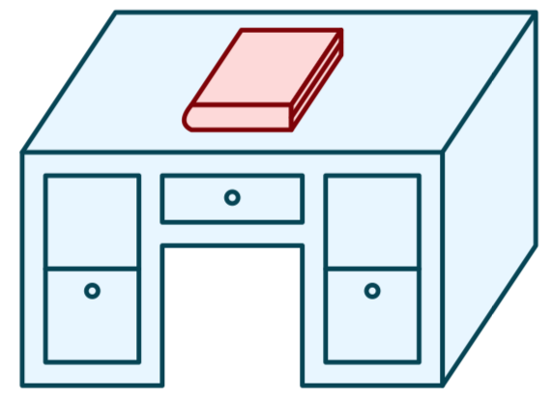
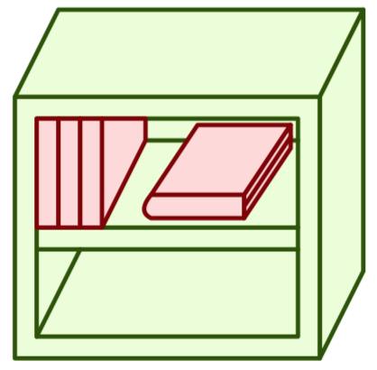
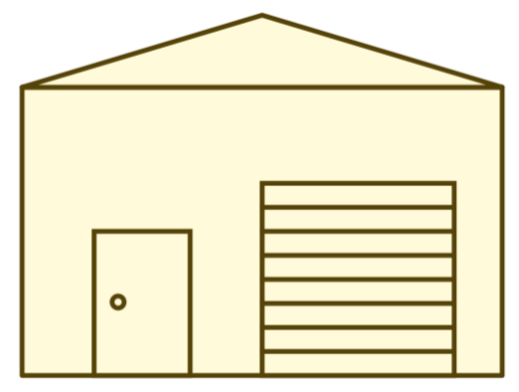
Memory Hierarchy
L0:
Regs
CPU registers hold words retrieved from the L1 cache.
L1:
L1 cache
(SRAM)
L1 cache holds cache lines retrieved from the L2 cache.
Smaller,
faster,
and
costlier
(per byte)
storage
devices
L2:
L2 cache
(SRAM)
L2 cache holds cache lines
retrieved from L3 cache
L3:
L3 cache
(SRAM)
L3 cache holds cache lines
retrieved from main memory.
L4:
Main memory
(DRAM)
Main memory holds
disk blocks retrieved
from local disks.
Larger,
slower,
and
cheaper
(per byte)
storage
devices
Local secondary storage
(local disks)
Local disks hold files retrieved from disks
on remote servers
L5:
L6:
Remote secondary storage
(e.g., cloud, web servers)

Slide 3
Principle of Locality
Programs tend to use data and instructions with addresses near or equal to those they have used recently
Temporal locality:
Recently referenced items are likely to be referenced again in the near future
Spatial locality:
Items with nearby addresses tend to be referenced close together in time

Slide 4
Cache Lines
valid bit
tag
data block
v
tag
0
1
2
3
4
5
6
7
data block: cached data
tag: uniquely identifies which data is stored in the cache line
valid bit: indicates whether or not the line contains meaningful information

Slide 5
Caching—The Organization
Address of data:
tag
index
offset
An address is decomposed into three parts
Low-order b bits, providing an offset into a block (2^{b} is the data block size)
Middle s bits, indicating which set in the cache to search (2^{s} is the number of sets)
Upper remaining bits, the tag to be matched

Slide 6
Direct-mapped Cache
log(block size) bits
log(# lines) bits
the rest of the bits
Address of data:
tag
index
offset
find line
v
tag
0
1
2
3
4
5
6
7
identifies byte in line
v
tag
0
1
2
3
4
5
6
7
v
tag
0
1
2
3
4
5
6
7
v
tag
0
1
2
3
4
5
6
7
How well does this take advantage of spacial locality?
How well does this take advantage of temporal locality?

Slide 7
2-way Set Associative Cache
log(block size) bits
log(# sets) bits
the rest of the bits
E = 2: Two lines per set
Assume: cache block size 8 bytes
Address of data:
tag
index
offset
v
tag
0
1
2
3
4
5
6
7
v
tag
0
1
2
3
4
5
6
7
v
tag
0
1
2
3
4
5
6
7
v
tag
0
1
2
3
4
5
6
7
v
tag
0
1
2
3
4
5
6
7
v
tag
0
1
2
3
4
5
6
7
v
tag
0
1
2
3
4
5
6
7
v
tag
0
1
2
3
4
5
6
7

Slide 8
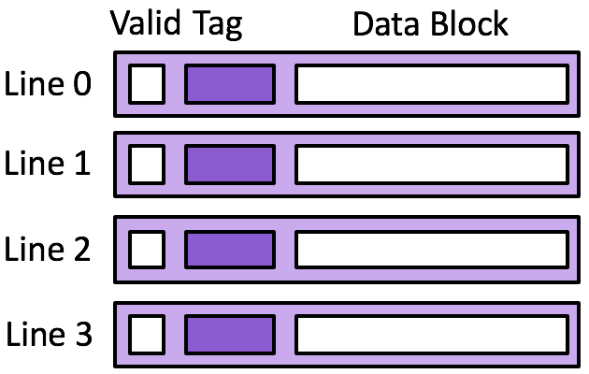
Exercise: 2-way Set Associative Cache
Memory
rd 0x14
rd 0x10
rd 0x0c
rd 0x08
rd 0x04
rd 0x00
Cache
Set 0
Set 1
18
17
16
15
14
Assume 8 byte data blocks
13
Set 0 | Set 1
Transaction | tag | index | h/m
rd 0x00
rd 0x04
rd 0x14
rd 0x00
rd 0x04
rd 0x10
rd 0x20
Line 0 | Line 1 | Line 0 | Line 1
? | ? | ? | ?
Notes:
1. Assume 4 byte data blocks, 4 cache lines
2. Assume 8 byte data blocks, 2 cache lines

Slide 9
Eviction from the Cache
On a cache miss, a new block is loaded into the cache
Direct-mapped cache: A valid block at the same location must be evicted—no choice
Associative cache: If all blocks in the set are valid, one must be evicted
Random policy
FIFO
LIFO
Least-recently used; requires extra data in each set
Most-recently used; requires extra data in each set

Slide 10
Caching Organization Summarized
A cache consists of lines
A line contains
A block of bytes, the data values from memory
A tag, indicating where in memory the values are from
A valid bit, indicating if the data are valid
Lines are organized into sets
Direct-mapped cache: one line per set
k-way associative cache: k lines per set
Fully associative cache: all lines in one set

Slide 11
Caching and Writes
What to do on a write-hit?
Write-through: write immediately to memory
Write-back: defer write to memory until replacement of line
Need a dirty bit (line different from memory or not)
What to do on a write-miss?
Write-allocate: load into cache, update line in cache
Good if more writes to the location follow
No-write-allocate: writes straight to memory, does not load into cache
Typical
Write-through + No-write-allocate
Write-back + Write-allocate

Slide 12
Example: Write-through + No-write-allocate
Memory
rd 0x24
rd 0x20
rd 0x1c
rd 0x18
rd 0x14
rd 0x10
Cache
22
21
20
19
18
17
Assume 4 byte data blocks
Transaction | tag | index | h/m
rd 0x10
wr 0x10
wr 0x24
rd 0x24
rd 0x20
Line 0 | Line 1 | Line 2 | Line 3 | W
? | ? | ? | ? | ?

Slide 13
Exercise: Write-back + Write-allocate
Memory
rd 0x24
rd 0x20
rd 0x1c
rd 0x18
rd 0x14
rd 0x10
Cache
22
21
20
19
18
17
Assume 4 byte data blocks
Transaction | tag | index | h/m
rd 0x10
wr 0x10
wr 0x24
rd 0x24
rd 0x20
Line 0 | Line 1 | Line 2 | Line 3 | W
? | ? | ? | ? | ?

Slide 14
Categorizing Misses
Compulsory: first-reference to a block
Capacity: cache is too small to hold all of the data
Conflict: collisions in a specific set
Classifying misses in a cache with a target capacity and associativity as a sequence of three questions:
Would this miss occur in a cache with infinite capacity? If the answer is yes, then this is a compulsory miss and we are done. If the answer is no, then consider question 2.
Would this miss occur in a fully associative cache with the desired capacity? If the answer is yes, then this is a capacity miss and we are done. If the answer is no, then consider question 3.
Would this miss occur in a cache with the desired capacity and associativity? If the answer is yes, then this is a conflict miss and we are done. If the answer is no, then this is not a miss – it is a hit!
Notes:
Larger block size will reduce compulsory misses
Larger associativity will reduce conflict misses
Larger cache will reduce capacity misses
But: larger block size yields larger miss penalty (more data to copy from memory)
larger cache (and larger associativity): increased hit time

Slide 15
Typical Intel Core i7 Hierarchy
Processor package
Core 0
Core 3
L1 i-cache and d-cache:
32 KB, 8-way,
Access: 4 cycles
L2 unified cache:
256 KB, 8-way,
Access: 10 cycles
L3 unified cache:
8 MB, 16-way,
Access: 40-75 cycles
Block size: 64 bytes for all caches.
Regs
Regs
L1
d-cache
L1
i-cache
L1
d-cache
L1
i-cache
…
L2 unified cache
L2 unified cache
L3 unified cache
(shared by all cores)
Main memory

Slide 16
Example: Cache-Aware Optimization
for (i=0; i<n; i++) {
for (j=0; j<n; j++) {
sum = 0.0;
for (k=0; k<n; k++)
sum += a[i][k] * b[k][j];
c[i][j] = sum;
}
}
ijk (& jik):
2 loads, 0 stores
misses/iter = 1.25
for (k=0; k<n; k++) {
for (i=0; i<n; i++) {
r = a[i][k];
for (j=0; j<n; j++)
c[i][j] += r * b[k][j];
}
}
kij (& ikj):
2 loads, 1 store
misses/iter = 0.5
for (j=0; j<n; j++) {
for (k=0; k<n; k++) {
r = b[k][j];
for (i=0; i<n; i++)
c[i][j] += a[i][k] * r;
}
}
jki (& kji):
2 loads, 1 store
misses/iter = 2.0

Slide 17
Core i7 Matrix Multiply Performance
jki / kji
ijk / jik
kij / ikj

Slide 18
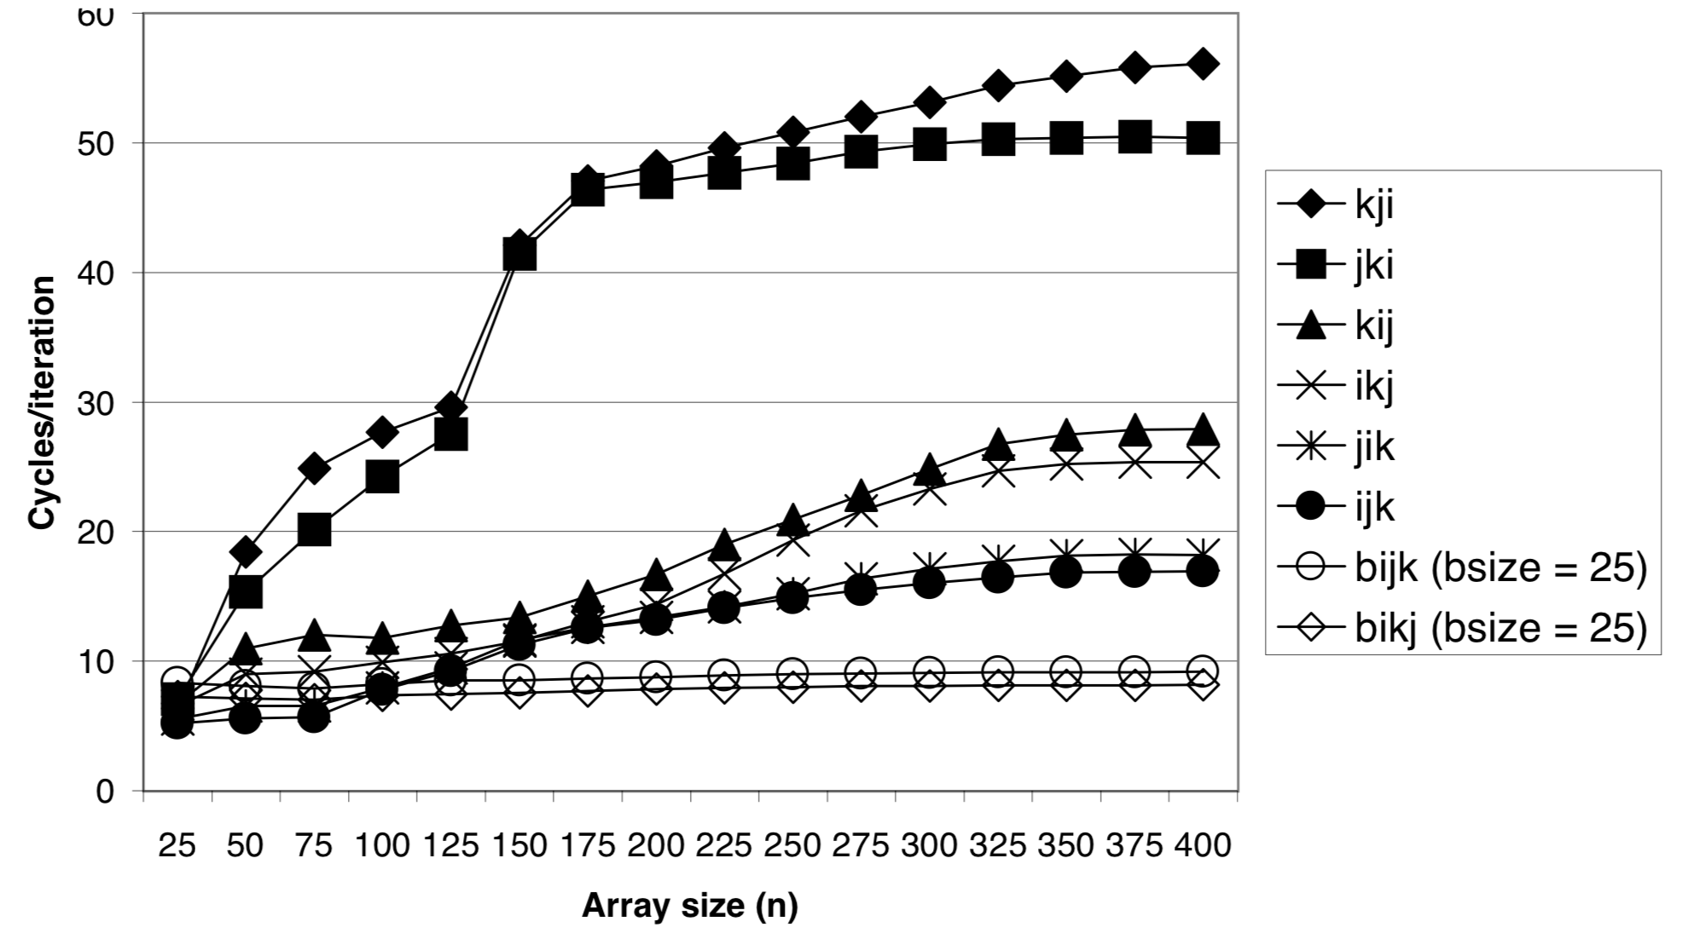
Pentium III Xeon Matrix Multiply Performance
jki / kji
kij / ikj
ijk / jik
blocked matrix mutiply

