Slide 1
Lecture 10: Caches
CS 105 October 8, 2019

Slide 2
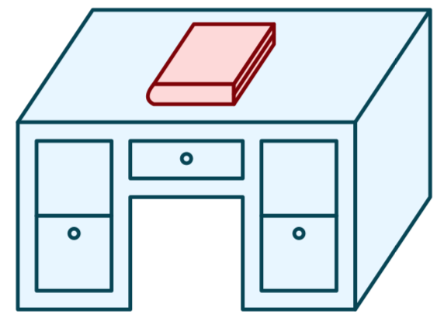
Life without caches
You decide that you want to learn more about computer systems than is covered in this course
The library contains all the books you could possibly want, but you don't like to study in libraries, you prefer to study at home.
You have the following constraints:
Desk
(can hold one book)
Library
(can hold many books)

Slide 3
Life without caches
Average latency to access a book: 40mins
Average throughput (incl. reading time): 1.2 books/hr

Slide 4
A Computer System
Register file
ALU
PC
System bus
Memory bus
Main
memory
Bus interface
I/O
bridge
CPU
I/O bus
Expansion slots for
other devices such
as network adapters
USB
controller
Graphics
adapter
Disk
controller
Mouse
Keyboard
Display
Disk
hello executable
stored on disk

Slide 5
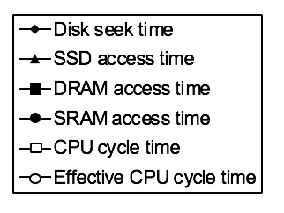
The CPU-Memory Gap
Disk
SSD
DRAM
SRAM
CPU
Notes:
SRAM: Faster (only 10 or so times slower than the CPU)
Expensive (1000x relative to DRAM)

Slide 6
Caching—The Very Idea
Keep some memory values nearby in fast memory
Modern systems have 3 or even 4 levels of caches
Cache idea is widely used:
Disk controllers
Web
(Virtual memory: main memory is a “cache” for the disk)

Slide 7
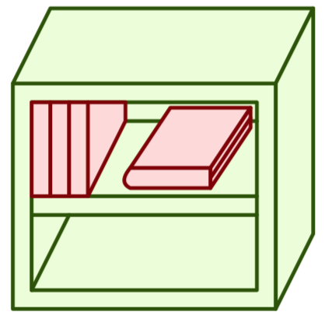
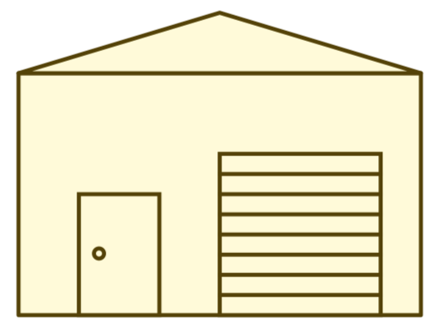
Memory Hierarchy
L0:
Regs
CPU registers hold words retrieved from the L1 cache.
L1:
L1 cache
(SRAM)
L1 cache holds cache lines retrieved from the L2 cache.
Smaller,
faster,
and
costlier
(per byte)
storage
devices
L2:
L2 cache
(SRAM)
L2 cache holds cache lines
retrieved from L3 cache
L3:
L3 cache
(SRAM)
L3 cache holds cache lines
retrieved from main memory.
L4:
Main memory
(DRAM)
Main memory holds
disk blocks retrieved
from local disks.
Larger,
slower,
and
cheaper
(per byte)
storage
devices
Local secondary storage
(local disks)
Local disks hold files retrieved from disks
on remote servers
L5:
L6:
Remote secondary storage
(e.g., cloud, web servers)

Slide 8
Latency numbers every programmer should know (2019)
L1 cache reference | 1 ns
Branch mispredict | 3 ns
L2 cache reference | 4 ns
Main memory reference | 100 ns
memory 1MB sequential read | 4,000 ns | 4 $μ$s
SSD random read | 16,000 ns | 16 $μ$s
SSD 1MB sequential read | 62,000 ns | 62 $μ$s
Disk random read | 3,000,000 ns | 3 ms
Disk 1MB sequential read | 947,000 ns | < 1 ms
Round trip in Datacenter | 500,000 ns | 500 $μ$s
Round trip CA<->Europe | 150,000,000 ns | 150 ms
Notes:
https://people.eecs.berkeley.edu/~rcs/research/interactive_latency.html

Slide 9
Life with caching
Average latency to access a book: <20mins
Average throughput (incl. reading time): ~2 books/hr

Slide 10
Caching—The Vocabulary
Size: the total number of bytes that can be stored in the cache
Cache Hit: the desired value is in the cache and returned quickly
Cache Miss: the desired value is not in the cache and must be fetched from a more distant cache (or ultimately from main memory)
Miss rate: the fraction of accesses that are misses
Hit time: the time to process a hit
Miss penalty: the additional time to process a miss
Average access time: hit-time + miss-rate * miss-penalty

Slide 11
Question: how do we decide which books to put on the bookshelf?

Slide 12
Example Access Patterns

Slide 13
Principle of Locality
Programs tend to use data and instructions with addresses near or equal to those they have used recently
Temporal locality:
Recently referenced items are likely to be referenced again in the near future
Spatial locality:
Items with nearby addresses tend to be referenced close together in time

Slide 14
Locality Example
sum = 0;
for (i = 0; i < n; i++)
sum += a[i];
return sum;
Data references
Reference array elements in succession (stride-1 reference pattern).
Reference variable sum each iteration.
Instruction references
Reference instructions in sequence.
Cycle through loop repeatedly.

Slide 15
Locality Example
Which of the following functions is better in terms of locality with respect to array src?
void copyij(int src[2048][2048],
int dst[2048][2048])
{
int i,j;
for (i = 0; i < 2048; i++)
for (j = 0; j < 2048; j++)
dst[i][j] = src[i][j];
}
void copyji(int src[2048][2048],
int dst[2048][2048])
{
int i,j;
for (j = 0; j < 2048; j++)
for (i = 0; i < 2048; i++)
dst[i][j] = src[i][j];
}
4.3ms
81.8ms
2.0 GHz Intel Core i7 Haswell

Slide 16
Another Locality Example
How would you permute the loops so that the function scans the 3-d array a with a stride-1 reference pattern (and thus has good spatial locality)?
int sum_array_3d(int a[M][N][N]){
int i, j, k, sum = 0;
for (i = 0; i < M; i++)
for (j = 0; j < N; j++)
for (k = 0; k < N; k++)
sum += a[i][j][k];
return sum;
}

Slide 17
Cache Organization

Slide 18
Word-oriented Memory Organization
32-bit
words
64-bit
words
Bytes
Addr.
Addresses Specify Byte Locations
Address of first byte in word
Addresses of successive words differ by m=4 (32-bit) or m=8 (64-bit)
There are (up to) $M=2^{m}$ unique addressable locations in memory
0015
Addr
=
??
0014
0012
0013
Addr
=
??
0012
0008
0011
Addr
=
??
0010
0008
0009
0008
0007
Addr
=
??
0006
0004
0005
Addr
=
??
0004
0000
0003
Addr
=
??
0002
0000
0001
0000
Notes:
I don't think words are really worth discussing

Slide 19
Cache Lines
valid bit
tag
data block
v
tag
0
1
2
3
4
5
6
7
data block: cached data
tag: uniquely identifies which data is stored in the cache line
valid bit: indicates whether or not the line contains meaningful information

Slide 20
Direct-mapped Cache
log(block size) bits
log(# lines) bits
the rest of the bits
Address of data:
tag
index
offset
find line
v
tag
0
1
2
3
4
5
6
7
identifies byte in line
v
tag
0
1
2
3
4
5
6
7
v
tag
0
1
2
3
4
5
6
7
v
tag
0
1
2
3
4
5
6
7
Notes:
Note: low-order bits are always zero if we assume 4-byte words (since we'll always be looking up the address of a word), but we'll just think about those bits as part of the offset

Slide 21
Example: Direct-mapped Cache
Assume: cache block size 8 bytes
Assume: assume 8-bit machine
Address of data:
0xB4
Line 0
1
110
0F
12
AB
34
FF
FF
EA
68
1011 0100
Line 1
1
001
00
00
00
00
00
40
06
1D
101
10
100
Line 2
1
101
0D
00
00
00
2F
00
00
00
3 bit tag
2 bit index
3 bit offset
Line 3
0
001
00
11
22
33
44
55
66
77

Slide 22
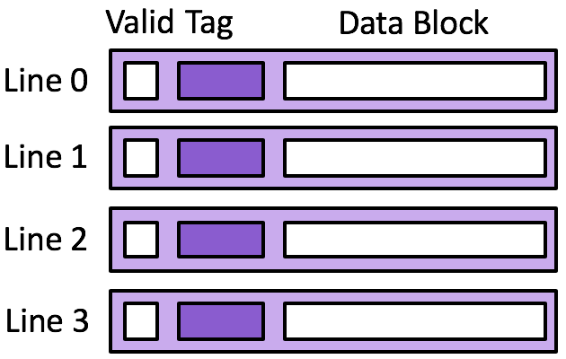
Exercise: Direct-mapped Cache
Transaction Stream
rd 0x00
rd 0x04
rd 0x10
rd 0x00
rd 0x04
rd 0x20
Memory
rd 0x14
rd 0x10
rd 0x0c
rd 0x08
rd 0x04
rd 0x00
Cache
18
17
16
15
14
13
Assume 4 byte data blocks
Transaction | tag | index | h/m | Line 0 | Line 1
rd 0x00 |  |  |  | ? | ?
rd 0x04
rd 0x10
rd 0x00
rd 0x04
rd 0x10
Line 2 | Line 3
? | ?
How well does this take advantage of spacial locality?
How well does this take advantage of temporal locality?
Notes:
1. Assume 4 byte data blocks, 4 cache lines
2. Assume 8 byte data blocks, 2 cache lines

Slide 23
Exercise: Direct-mapped Cache
Transaction Stream
rd 0x00
rd 0x04
rd 0x10
rd 0x00
rd 0x04
rd 0x20
Memory
rd 0x14
rd 0x10
rd 0x0c
rd 0x08
rd 0x04
rd 0x00
Cache
18
17
16
15
14
13
Assume 8 byte data blocks
Transaction | tag | index | h/m | Line 0 | Line 1
rd 0x00 |  |  |  | ? | ?
rd 0x04
rd 0x10
rd 0x00
rd 0x04
rd 0x10
How well does this take advantage of spacial locality?
How well does this take advantage of temporal locality?
Notes:
1. Assume 4 byte data blocks, 4 cache lines
2. Assume 8 byte data blocks, 2 cache lines

