Slide 1
Lecture 9: Use and Abuse of the Stack (cont'd)
CS 105 September 26, 2019

Slide 2
Review: Stack Frames
0x7FFFFFFF
Stack
Each function called gets a stack frame
Passing data:
calling procedure P uses registers (and stack) to provide parameters to Q.
Q uses register %rax for return value
Passing control:
call <proc>
Pushes return address (current %rip) onto stack
Sets %rip to first instruction of proc
ret
Pops return address from stack and places it in %rip
Local storage:
allocate space on the stack by decrementing stack pointer, deallocate by incrementing
saved registers
local variables
P's Stack Frame
Arguments 7..n
return address
saved registers
local variables
Q's Stack Frame
Arguments 7..n
return address
%rsp
Heap
Text
%rip
Code
0x00000000

Slide 3
Review: Buffer Overflow
Most common form of memory reference bug
Unchecked lengths on string inputs
Particularly for bounded character arrays on the stack
sometimes referred to as stack smashing
Stack Frame
for call_echo
/* Echo Line */ void echo() { char buf[4]; gets(buf); puts(buf); }
7f
ff
ff
ff
00
00
00
00
Return Address
(8 bytes)
saved
%rip
Return Address
(8 bytes)
00
40
06
f6
60
00
ea
40
34
00
32
31
30
20 bytes unused
Stack Frame
for echo
39
38
37
36
echo:
subq $18, %rsp
movq %rsp, %rdi
call gets
call puts
addq $18, %rsp
ret
35
34
33
32
31
30
39
38
37
36
35
34
33
32
31
30
%rsp
[3]
[2]
[1]
[0]
buf
Notes:
Note: works on linux
Demo: crash, jump

Slide 4
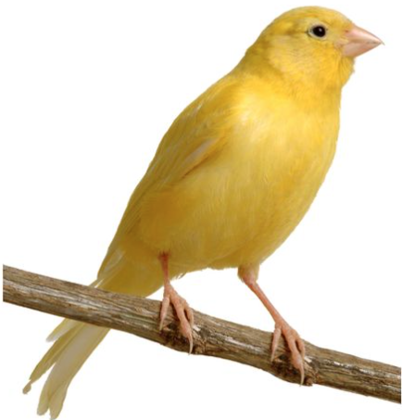
Review: Stack Canaries
/* Echo Line */ void echo() { char buf[4]; gets(buf); puts(buf); }
Stack Frame
for call_echo
00
00
00
00
Return Address
(8 bytes)
saved
%rip
Return Address
(8 bytes)
00
40
06
f6
Stack Frame
for echo
echo:
subq $24, %rsp
movq %rsp, %rdi
call gets
call puts
movq 24(%rsp), %rdx
xorq %fs:40, %rdx
je .L3
call __stack_chk_fail
.L3
addq $24, %rsp
ret
canary
34
00
32
31
30
20 bytes unused
Stack Frame
for echo
39
38
37
36
35
34
33
32
31
30
39
38
37
36
35
34
33
32
31
30
buf
%rsp
[3]
[2]
[1]
[0]

Slide 5
Review: Memory Tagging
W $⊕$ X

Slide 6
Code Reuse Attacks
Key idea: execute instructions that already exist
Defeats memory tagging defenses
Examples:
return to a function in the current program
return to a library function (e.g., return-into-libc)
return to some other instruction (return-oriented programming)

Slide 7
Returning to a function
0x7FFFFFFF
Stack
Overwrite the saved return address with the location of a function in the current program
caller stack frame
return address
callee stack frame
buffer
heap
data
0x00000000
code

Slide 8
Handling Arguments
what function expects
when it is called…
overflow with argument
0x7FFFFFFF
0x7FFFFFFF
Stack
Stack
arg1
rdi
?
rdi
caller
stack frame
arg1
caller stack frame
pc0+4
pc0
&fun
&fun
rip
&(c3)
rip
&(5f c3)
&fun
arg1
return address
return address
callee stack frame
misc filler
buffer
heap
heap
data
data
code
code
5f c3

Slide 9
Return-into-libc

Slide 10
ASCII Armoring
Make sure all system library addresses contain a null byte (0x00).
Can be done by placing this code in the first 0x01010101 bytes of memory
Notes:
With ASCII armoring, all the system libraries (e.g. libc) addresses contain a NULL byte(0x00). This is commonly done by placing them in the first 0x01010101 bytes of memory (a few pages more than 16 MB, dubbed the "ASCII armor region"), as every address up to (but not including) this value contains at least one NULL byte. This makes it impossible to emplace code containing those addresses using string manipulation functions such as strcpy(). However, this technique does not work if the attacker has a way to overflow NULL bytes into the stack. If the program is too large to fit in the first 16 MiB, protection may be incomplete.[

Slide 11
Properties of x86 Assembly
variable length instructions
not word aligned
dense instruction set

Slide 12
Gadgets
void setval(unsigned *p) {
*p = 3347663060u;
}
<setval>: 4004d9: c7 07 d4 48 89 c7 movl $0xc78948d4,(%rdi)
4004df: c3 ret
gadget address: 0x4004dc
encodes: movq %rax, %rdi
ret
executes: %rdi <- %rax
Notes:
https://defuse.ca/online-x86-assembler.htm

Slide 13
Example Gadgets
Load Constant
Load from memory
48 89 C0 C3
movq (%rax), %rax
ret
0xbad00001
5a c3
pop %rdx
ret
58 c3
pop %rax
ret
0xbad00002

Slide 14
Return-oriented Programming
Notes:
Image By: Dino Dai Zovi

Slide 15
Return-oriented Programming
gadget_N_code c3
…
gadget_2_code c3
gadget_1_code c3
Final ret in each gadget sets pc (%rip) to
beginning of next gadget code

Slide 16
Return-Oriented Shellcode
7fffffffea80
"\bin\sh\0"
7fffffffea78
0
7fffffffea70
7fffffffea68
0F 05 C3
7fffffffea60
5E 5A C3
syscall
ret
7fffffffea58
7fffffffea50
pop %rsi
pop %rdx
ret
7fffffffea48
40 00 F9 C3
7fffffffea40
48 89 D7 C3
add %cl, %dil
ret
7fffffffea38
mov %rdi, (%rdx)
ret
7fffffffea30
0x3B3B3B3B
7fffffffea28
59 5A C3
7fffffffea20
48 31 FF C3
pop %rcx
pop %rdx
ret
xor %rdi, %rdi
ret
Notes:
Note: syscall: number of syscall actually passed in register %rax.
System call index: http://blog.rchapman.org/posts/Linux_System_Call_Table_for_x86_64/

Slide 17
Address Space Layout Randomization
Notes:
information leakage attacks
format string vulnerabilities, side-channel attacks
Entropy reduction
NOP slides, heap spraying

Slide 18
Gadget Elimination
Notes:
compile time

Slide 19
Control Flow Integrity

Slide 20
CFI = Insert Monitors
Code
Code

Slide 21
CFI Overhead

Slide 22
Control Flow Guard
Approximate CFI implementation in Windows 8.1, 10
Jump is valid if it beginning of function
Granularity: 8 bytes
Check implemented as bitmap
Code
Code

Slide 23
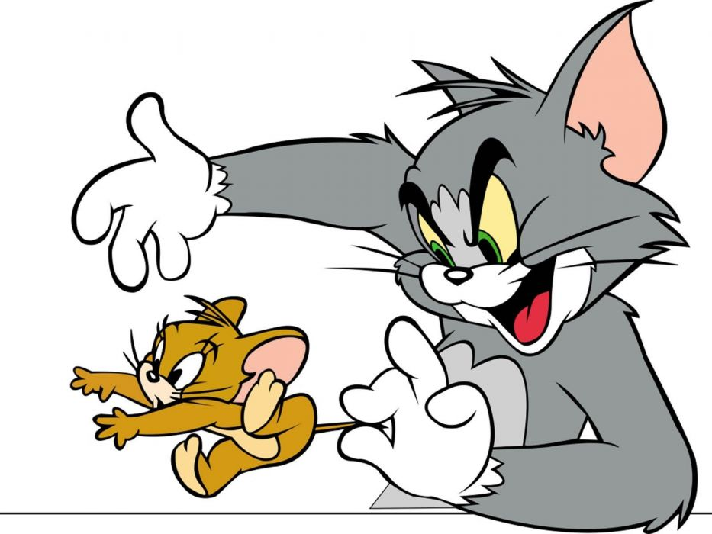
The state of the world
Defenses:
high-level languages
Stack Canaries
Memory tagging
ASLR
continuing research and development…
But all they aren't perfect!

Slide 24
The state of the world

