Slide 1
Lecture 8: Use and Abuse of the Stack
CS 105 September 24, 2019

Slide 2
Review: x86-64 Linux Memory Layout
0x7FFFFFFF
Stack
Stack
Runtime stack (8MB limit)
E. g., local variables
Heap
Dynamically allocated as needed
When calling malloc(), calloc(), new()
Data
Statically allocated data
E.g., global vars, static vars, string constants
Text / Shared Libraries
Executable machine instructions
Read-only
%rsp
Heap
Text
%rip
Code
0x00000000

Slide 3
Review: Stack Frames
0x7FFFFFFF
Stack
Each function called gets a stack frame
Passing data:
calling procedure P uses registers (and stack) to provide parameters to Q.
Q uses register %rax for return value
Passing control:
call <proc>
Pushes return address (current %rip) onto stack
Sets %rip to first instruction of proc
ret
Pops return address from stack and places it in %rip
Local storage:
allocate space on the stack by decrementing stack pointer, deallocate by incrementing
saved registers
local variables
P's Stack Frame
Arguments 7..n
return address
saved registers
local variables
Q's Stack Frame
Arguments 7..n
return address
%rsp
Heap
Text
%rip
Code
0x00000000

Slide 4
Memory Referencing Bug Example
int proc(int *p);
int example1(int x) {
int a[4];
a[3] = 10;
return proc(a);
}
example1:
subq $16, %rsp
movl $10, 12(%rsp)
movq %rsp, %rdi
call proc
addq $16, %rsp
ret
Notes:
Note: works on linux
Demo: crash, jump

Slide 5
Memory Referencing Bug Example
Most common form of memory reference bug
Unchecked lengths on string inputs
Particularly for bounded character arrays on the stack
sometimes referred to as stack smashing
Stack Frame
for call_echo
/* Echo Line */ void echo() { char buf[4]; gets(buf); puts(buf); }
00
00
00
00
Return Address
(8 bytes)
saved
%rip
Return Address
(8 bytes)
00
40
06
f6
34
00
32
31
30
20 bytes unused
Stack Frame
for echo
39
38
37
36
echo:
subq $18, %rsp
movq %rsp, %rdi
call gets
call puts
addq $18, %rsp
ret
35
34
33
32
31
30
39
38
37
36
35
34
33
32
31
30
%rsp
[3]
[2]
[1]
[0]
buf
Notes:
Note: works on linux
Demo: crash, jump

Slide 6
Example: server.c

Slide 7
Exercise
int authenticate(char *password){
char buf[4];
gets(buf);
int correct
= !strcmp(password, buf);
return correct;
}
int main(int argc,
char ** argv){
char * pw = "123456";
printf("Enter your password: ");
while(!authenticate(pw)){
printf("Incorrect. Try again: ");
}
printf("You are now logged in\n");
return 0;
}
authenticate:
pushq %rbx
subq $16, %rsp
movq %rdi, %rbx
movq %rsp, %rdi
movl $0, %eax
call gets
movq %rsp, %rsi
movq %rbx, %rdi
call strcmp
testl %eax, %eax
sete %al
movzbl %al, %eax
addq $16, %rsp
popq %rbx
ret

Slide 8
Buffer Overflow Vulnerabilities
Notes:
https://www.cvedetails.com/vulnerabilities-by-types.php

Slide 9
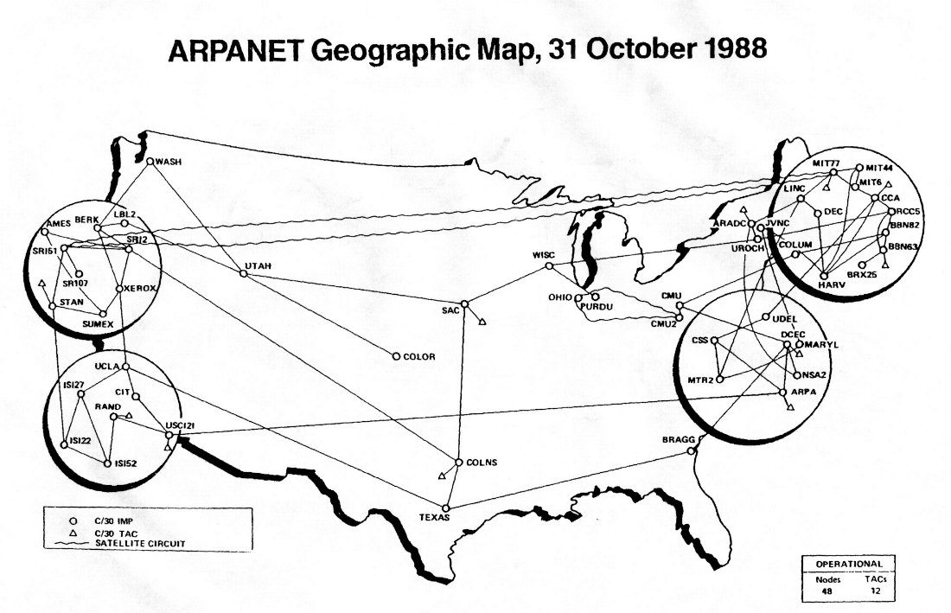
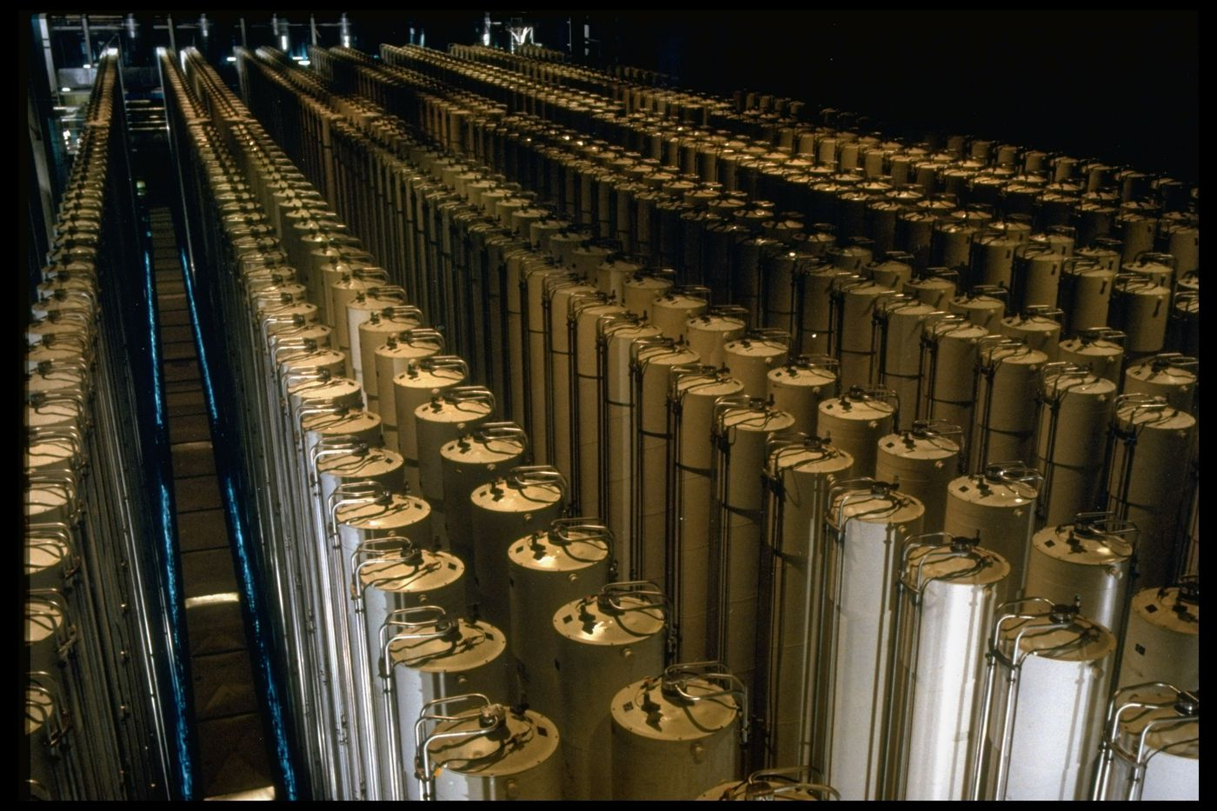
Buffer Overflow Examples
Notes:
Morris Worm (November 2, 1988), $100,000-$10mil, bugs in finger and sendmail
Stuxnet (discovered 2010): bug in functions that process files to display icons when USB connected to PC
Heartbleed (2014): bug in openssl library hearbeat

Slide 10
Defending against buffer overflow attacks
Avoid overflow vulnerabilities
Randomize the stack
Insert compiler checks
Employ system-level protections

Slide 11
1. Avoid Overflow Vulnerabilities in Code (!)
/* Echo Line */ void echo() { char buf[4]; /* Way too small! */ fgets(buf, 4, stdin); puts(buf); }
For example, use library routines that limit string lengths
fgets instead of gets
strncpy instead of strcpy
Don’t use scanf with %s conversion specification
Use fgets to read the string
Or use %ns where n is a suitable integer

Slide 12
2. Randomize the Stack (ASLR)

Slide 13
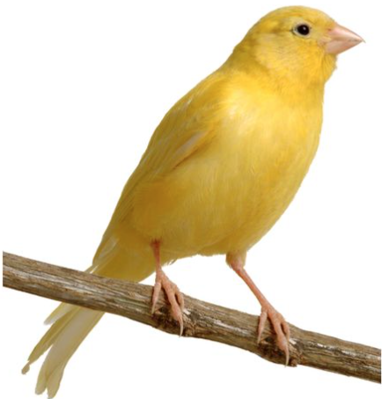
3. Compiler checks
0x7FFFFFFF
Stack
Idea
Place special value (“canary”) on stack just beyond buffer
Check for corruption before exiting function
GCC Implementation
-fstack-protector
Now the default (disabled earlier)
…
local variables
Arguments 7..n
return address
saved registers
local variables
Arguments 7..n
return address
0x00000000

Slide 14
Stack Canaries
authenticate:
pushq %rbx
subq $16, %rsp
movq %rdi, %rbx
movq %fs:40, %rax
movq %rax, 8(%rsp)
xorl %eax, %eax
movq %rsp, %rdi
call gets
movq %rsp, %rsi
movq %rbx, %rdi
call strcmp
testl %eax, %eax
sete %al
movq 8(%rsp), %rdx
xorq %fs:40, %rdx
je .L2
call __stack_chk_fail
.L2:
movzbl %al, %eax
addq $16, %rsp
popq %rbx
ret
Stack Frame
for call_echo
00
00
00
00
Return Address
(8 bytes)
saved
%rip
Return Address
(8 bytes)
00
40
06
f6
Stack Frame
for echo
canary
34
00
32
31
30
20 bytes unused
Stack Frame
for echo
39
38
37
36
35
34
33
32
31
30
39
38
37
36
35
34
33
32
31
30
buf
%rsp
[3]
[2]
[1]
[0]

Slide 15
4. System-level Protection: Memory Tagging
W $⊕$ X

Slide 16
Code-Reuse Attacks
Next time!

