Slide 1
Lecture 6: Procedure Calls in Assembly
CS 105 September 19, 2019

Slide 2
Assembly/Machine Code View
Memory
0x7FFF
CPU
Stack
Registers
Data
PC
Condition
Codes
Heap
Data
Addresses
Code
Instructions
0x0000
Programmer-Visible State
PC: Program counter
16 Registers
Condition codes
Memory
Byte addressable array
Code and user data
Stack to support procedures

Slide 3
Procedures
Procedures provide an abstraction that implements some functionality with designated arguments and (optional) return value
e.g., functions, methods, subroutines, handlers
To support procedures at the machine level, we need mechanisms for:
Passing Control: When procedure P calls procedure Q, program counter must be set to address of Q, when Q returns, program counter must be reset to instruction in P following procedure call
Passing Data: Must handle parameters and return values
Allocating memory: Q must be able to allocate (and deallocate) space for local variables

Slide 4
The Stack
0x7FFFFFFF
Stack
the stack is a region of memory (traditionally the "top" of memory)
grows "down"
provides storage for functions (i.e., space for allocating local variables)
%rsp holds address of top element of stack
%rsp
Heap
Text
%rip
Code
0x00000000

Slide 5
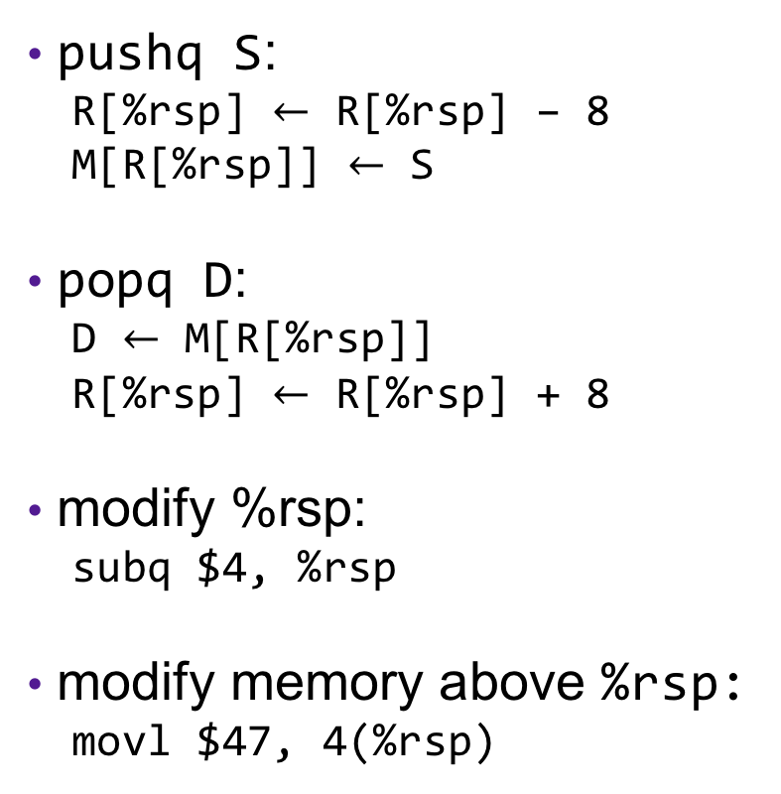
Modifying the Stack
0x7FFFFFFF
Stack
pushq S:
R[%rsp] $←$ R[%rsp] – 8
M[R[%rsp]] $←$ S
popq D:
D $←$ M[R[%rsp]]
R[%rsp] $←$ R[%rsp] + 8
modify %rsp:
subq $4, %rsp
modify memory above %rsp:
movl $47, 4(%rsp)
%rsp
S
Heap
Text
%rip
Code
0x00000000

Slide 6
X86-64 Register Usage Conventions
%rax, function result
%r8, fifth argument
%rbx
%r9, sixth argument
%rcx, fourth argument
%r10
%rdx, third argument
%r11
%rsi, second argument
%r12
%rdi, first argument
%r13
%rsp, stack pointer
%r14
%rbp
%r15
Callee-saved registers are in yellow

Slide 7
Procedure Calls, Division of Labor
Caller
Callee
Before
Save registers, if necessary
Prepare arguments
Make call
After
Restore registers, if necessary
Use result
Preamble
Save registers, if necessary
Allocate space on stack
Exit code
Put result in %rax
Restore registers, if necessary
Deallocate space on stack
Return

Slide 8
Stack Frames
0x7FFFFFFF
Stack
Each function called gets a stack frame
Passing data:
calling procedure P uses registers (and stack) to provide parameters to Q.
Q uses register %rax for return value
Passing control:
call <proc>
Pushes return address (current %rip) onto stack
Sets %rip to first instruction of proc
ret
Pops return address from stack and places it in %rip
Local storage:
allocate space on the stack by decrementing stack pointer, deallocate by incrementing
…
local variables
Arguments 7..n
%rsp
return address
saved registers
local variables
Heap
Text
%rip
Code
0x00000000

Slide 9
Procedure Call Example: Stack Frame
int proc(int *p);
int example1(int x) {
int a[4];
a[3] = 10;
return proc(a);
}
example1:
subq $16, %rsp
movl $10, 12(%rsp)
movq %rsp, %rdi
call proc
addq $16, %rsp
ret
Notes:
Note: works on linux

Slide 10
Procedure Call Example: Arguments
int func1(int x1, int x2, int x3,
int x4, int x5, int x6,
int x7, int x8){
int l1 = x1+x2;
int l2 = x3+x4;
int l3 = x5+x6;
int l4 = x7+x8;
int l5 = 4;
int l6 = 13;
int l7 = 47;
int l8 = l1 + l2 + l3 + l4 + l5
+ l6 + l5;
return l8;
}
int main(int argc, char *argv[]){
int x = func1(1,2,3,4,5,6,7,8);
return x;
}
func1:
movl 16(%rsp), %eax
addl %esi, %edi
addl %edx, %edi
addl %ecx, %edi
addl %r8d, %edi
addl %r9d, %edi
addl 8(%rsp), %edi
leal 21(%rax,%rdi), %eax
retq
main:
movl $1, %edi
movl $2, %esi
movl $3, %edx
movl $4, %ecx
movl $5, %r8d
movl $6, %r9d
pushq $8
pushq $7
callq _function1
addq $16, %rsp
retq
Notes:
note: clang actually assembly adds pushq rax to beginning and popq rcx to end to align to 16 bytes (seen in demo)

Slide 11
enter and leave Instructions
Complex instructions designed to speed up common operations
enterq size,0
pushq %rbp
movq %rsp, %rbp
subq size, %rsp
leaveq
movq %rbp, %rsp
popq %rbp
Rarely used
The second argument is the
nesting level--unimportant in C
Occasionally used,
usually before ret

Slide 12
Exercise
0x400540 <last>:
400540: 48 89 f8 mov %rdi, %rax L1
400543: 48 0f af c6 imul %rsi, %rax L2
400547: c3 ret L3
0x400548 <first>:
400548: 48 8d 77 01 lea 0x1(%rdi),%rsi F1
40054c: 48 83 ef 01 sub $0x1, %rdi F2
400550: e8 eb ff ff ff callq 400540 <last> F3
400555: f3 c2 rep; ret F4
0x400556 <main>:
...
400560: e8 e3 ff ff callq 400548 <first> M1
400565: 48 89 c2 mov %rax, %rdx M2
...

Slide 13
Recursion
Handled Without Special Consideration
Stack frames mean that each function call has private storage
Saved registers & local variables
Saved return pointer
Register saving conventions prevent one function call from corrupting another’s data
Unless the C code explicitly does so (more next week!)
Stack discipline follows call / return pattern
If P calls Q, then Q returns before P
Last-In, First-Out
Also works for mutual recursion
P calls Q; Q calls P

Slide 14
Recursive Function
bitcount_r:
movl $0, %eax
testq %rdi, %rdi
je .L6
pushq %rbx
movq %rdi, %rbx
andl $1, %ebx
shrq %rdi
call bitcount_r
addq %rbx, %rax
popq %rbx
.L6:
rep; ret
/* Recursive bitcount */
long bitcount_r(unsigned long x) {
if (x == 0)
return 0;
else
return (x & 1)
+ bitcount_r(x >> 1);
}
What is in the stack frame?

Slide 15
Preview
int proc(int *p);
int example1(int x) {
int a[5];
a[3] = 10;
return proc(a);
}
example1:
subq $16, %rsp
movl $10, 12(%rsp)
movq %rsp, %rdi
call proc
addq $16, %rsp
ret

