Slide 1
Lecture 5: Assembly Arithmetic and Conditionals
CS 105 September 17, 2019

Slide 2
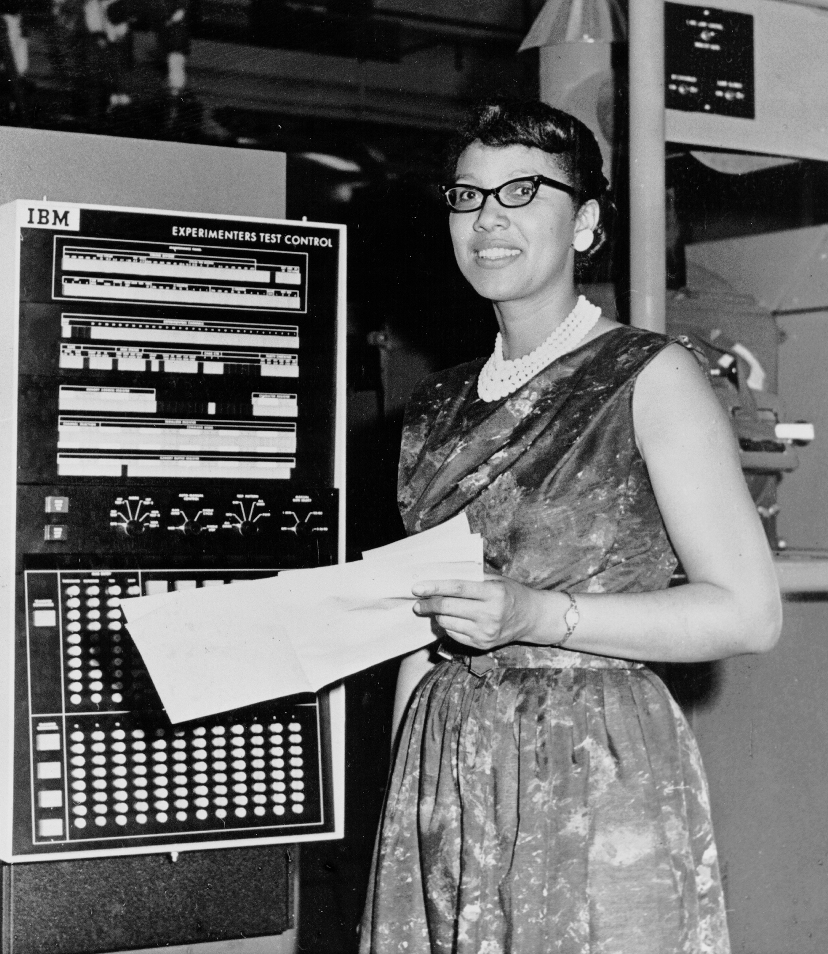
Programs
55
48 89 e5
48 83 ec 20
48 8d 05 25 00 00 00
c7 45 fc 00 00 00 00
89 7d f8
48 89 75 f0
48 89 c7
b0 00
e8 00 00 00 00
31 c9
89 45 ec
89 c8
48 83 c4 20
5d
c3
Notes:
A program is a sequence of instructions that specifies how to perform a computation, in a language that a computer can execute

Slide 3
Compilation
printf.o
Pre-
processor
(cpp)
Compiler
(cc1)
Assembler
(as)
Linker
(ld)
hello.c
hello.i
hello.s
hello.o
hello
Source
program
(text)
Modified
source
program
(text)
Assembly
program
(text)
Relocatable
object
programs
(binary)
Executable
object
program
(binary)
#include<stdio.h>
int main(int argc,
char ** argv){
printf("Hello
world!\n");
return 0;
}
…
int printf(const char *
restrict,
...) __attribute__((__format__ (__printf__, 1, 2)));
…
int main(int argc,
char ** argv){
printf("Hello
world!\n");
return 0;
}
pushq %rbp
movq %rsp, %rbp
subq $32, %rsp
leaq L_.str(%rip), %rax
movl $0, -4(%rbp)
movl %edi, -8(%rbp)
movq %rsi, -16(%rbp)
movq %rax, %rdi
movb $0, %al
callq _printf
xorl %ecx, %ecx
movl %eax, -20(%rbp)
movl %ecx, %eax
addq $32, %rsp
popq %rbp
retq
55
48 89 e5
48 83 ec 20
48 8d 05 25 00 00 00
c7 45 fc 00 00 00 00
89 7d f8
48 89 75 f0
48 89 c7
b0 00
e8 00 00 00 00
31 c9
89 45 ec
89 c8
48 83 c4 20
5d
c3

Slide 4
Assembly/Machine Code View
Memory
0x7FFF
Central Processing Unit (CPU)
Stack
Registers
Data
PC
Float registers
Heap
Condition
Codes
Addresses
Data
Code
Instructions
0x0000
Programmer-Visible State
  PC: Program counter (%rip)
  Register file: 16 Registers
  Float registers
  Condition codes
    Memory
    Byte addressable array
    Code and user data
    Stack to support procedures

Slide 5
Program Counter
Stores the address of the next instruction to be executed
Repeat forever:
  Fetch instruction at address in PC
  Execute the instruction
  Update PC

Slide 6
Assembly Characteristics: Operations
Transfer data between memory and register
  Load data from memory into register
  Store register data into memory
Perform arithmetic function on register or memory data
Transfer control
  Conditional branches
  Unconditional jumps to/from procedures

Slide 7
Data Transfer in Assembly

Slide 8
Data Movement Instructions
MOV source, dest Moves data source->dest

Slide 9
Sizes of C Data Types in x86-64
C declaration | Intel data type | Assembly suffix | Size (bytes)
char | Byte | b | 1
short | Word | w | 2
int | Double word | l | 4
long | Quad word | q | 8
char * | Quad word | q | 8
float | Single precision | s | 4
double | Double precision | l | 8

Slide 10
Data Movement Instructions
MOV source, dest Move data source->dest
  movb Move byte
  movw Move word
  movl Move double word
  movq Move quad word

Slide 11
Operand Forms
Immediate:
  Syntax: $Imm Value: Imm Example: $0x4050
Register:
  Syntax: r Value: R[r] Example: %rbp
Memory (Absolute):
  Syntax: Imm Value: M[Imm] Example: 0x4050
Memory (Indirect):
  Syntax: (r) Value: M[R[r]] Example: (%rbp)
Memory (Base+displacement):
  Syntax: Imm(r) Value: M[Imm+R[r]] Example: -12(%rbp)
Memory (Scaled indexed):
  Syntax: Imm(r1, r2, s) Value: M[Imm+R[r1]+R[r2]*s] Example: 7(%rdx, %rdx, 4)

Slide 12
movq Operand Combinations
Source
Dest
Src,Dest
C Analog
Reg
movq $0x4,%rax
temp = 0x4;
Imm
Mem
movq $-147,(%rax)
*p = -147;
Reg
movq %rax,%rdx
temp2 = temp1;
movq
Reg
Mem
movq %rax,(%rdx)
*p = temp;
Mem
Reg
movq (%rax),%rdx
temp = *p;
Cannot do memory-memory transfer with a single instruction

Slide 13
X86-64 Integer Registers
%rax
%r8
%ax
%eax
%al
%r8d
%rbx
%r9
%ebx
%r9d
%bx
%bl
%rcx
%r10
%ecx
%r10d
%cx
%cl
%rdx
%r11
%dx
%edx
%dl
%r11d
%rsi
%r12
%esi
%r12d
%si
%sil
%rdi
%r13
%edi
%r13d
%di
%dil
%rsp
%r14
%esp
%r14d
%sp
%bsl
%rbp
%r15
%ebp
%bp
%bpl
%r15d

Slide 14
Exercise
Register | Value
%rax | 0x100
%rcx | 0x1
%rdx | 0x3
Memory Address | Value
0x100 | 0xFF
0x104 | 0xAB
0x108 | 0x13
What are the values of the following operands (assuming register and memory state shown above)?
  %rax
  0x104
  $0x108
  (%rax)
  4(%rax)

Slide 15
X86-64 Register Usage Conventions
%rax, function result
%r8
%rbx
%r9
%rcx, fourth argument
%r10
%rdx, third argument
%r11
%rsi, second argument
%r12
%rdi, first argument
%r13
%rsp, stack pointer
%r14
%rbp, base pointer
%r15
15
Callee-saved registers are in yellow

Slide 16
Exercise
Register | Use(s)
%rdi | Argument xp
%rsi | Argument yp
%rdx | Argument zp
Write a C function void decode1(long *xp, long *yp, long *zp) that will do the same thing as the following assembly code:
  decode1:
  movq (%rdi), %r8
  movq (%rsi), %rcx
  movq (%rdx), %rax
  movq %r8, (%rsi)
  movq %rcx, (%rdx)
  movq %rax, (%rdi)
  ret
  void decode1(long *xp,
  long *yp,
  long *zp){
  }

Slide 17
Arithmetic in Assembly

Slide 18
Some Arithmetic Operations
char | b | 1
short | w | 2
int | l | 4
long | q | 8
pointer | q | 8
Two Operand Instructions:
  Format Computation
    andq Src,Dest Dest = Dest & Src
    orq Src,Dest Dest = Dest | Src
    xorq Src,Dest Dest = Dest ^ Src
    salq Src,Dest Dest = Dest << Src Also called shlq
    sarq Src,Dest Dest = Dest >> Src Arithmetic
    shrq Src,Dest Dest = Dest >> Src Logical
    addq Src,Dest Dest = Dest + Src
    subq Src,Dest Dest = Dest − Src
    imulq Src,Dest Dest = Dest * Src Signed multiply
Note: different instructions for signed/unsigned multiply and divide
Otherwise, no distinction between signed and unsigned int (why?)
Suffixes
Notes:
different signed and unsigned multiply b/c need to set condition bits differently (e.g., overflow for -1*-1 vs 0xFFFF*0xFFFF

Slide 19
Some Arithmetic Operations
char | b | 1
short | w | 2
int | l | 4
long | q | 8
pointer | q | 8
One Operand Instructions
    notq Dest Dest = ~Dest
    incq Dest Dest = Dest + 1
    decq Dest Dest = Dest − 1
    negq Dest Dest = − Dest
See text for more instructions
Suffixes

Slide 20
Assembly Operations
char | b | 1
short | w | 2
int | l | 4
long | q | 8
pointer | q | 8
addq $47, %rax
addq %rbx, %rax
addq (%rbx), %rax
addq %rbx, (%rax)
addq 12(%rbx,%rdi,2), %rax
Also movq, subq, andq, …
leaq 12(%rbx,%rdi,2), %rax
Suffixes
Notes:
D(rb,ri,S) = D + rb + ri*S

Slide 21
Address Computation Instruction
leaq Source, Dest
  Source is address mode expression
  Set Dest to address denoted by expression
Uses
  Computing addresses without a memory reference
    E.g., translation of p = &x[i];
  Computing arithmetic expressions of the form x + k*y
    k = 1, 2, 4, or 8
Example
long m12(long x)
{
return x*12;
}
Converted to ASM by compiler:
leaq (%rdi,%rdi,2), %rax # t <- x+x*2
salq $2, %rax # return t<<2

Slide 22
Arithmetic Example
Register | Use(s)
%rdi | Argument xp
%rsi | Argument yp
%rdx | Argument zp
%rax | return value
long arith(long x, long y,
long z){
long rval = x+y;
rval = rval+z;
z = y * 48;
long temp = y + z + 4;
rval = rval * temp;
return rval;
}
arith:
leaq (%rdi,%rsi), %rax
addq %rdx, %rax
leaq (%rsi,%rsi,2), %rdx
salq $4, %rdx
leaq 4(%rdi,%rdx), %rcx
imulq %rcx, %rax
ret
Interesting Instructions
  leaq: address computation
  salq: shift
  imulq: multiplication
    But, only used once

Slide 23
Arithmetic Exercise
Register | Use(s)
%rdi | Argument x
%rsi | Argument y
%rdx | Argument z
%rax | return value
long arith2(long x, long y,
long z){
}
arith2:
orq %rsi, %rdi
sarq $3, %rdi
notq %rdi
movq %rdx, %rax
subq %rdi, %rax
ret
Interesting Instructions
  sarq: arithmetic right shift

Slide 24
COnDITIONAL Branches

Slide 25
Branches and Jumps
Registers
Processor state (partial)
  Temporary data
  ( %rax, … )
  Location of runtime stack
  ( %rsp )
  Location of current code control point
  ( %rip, … )
  Status of recent tests
  ( CF, ZF, SF, OF )
%rax (return val)
%r8
%rbx
%r9
%rcx (4th arg)
%r10
%rdx (3rd arg)
%r11
%rsi (2nd arg)
%r12
%rdi (1st arg)
%r13
%rsp (stack ptr)
%r14
%rbp (base ptr)
%r15
%rip
Instruction pointer
CF
ZF
SF
OF
Condition codes

Slide 26
Condition Codes
Single bit registers
    SF Sign Flag (for signed)
    ZF Zero Flag
    CF Carry Flag (for unsigned)
    OF Overflow Flag (for signed)
Implicitly set (as a side effect) by arithmetic operations and comparison operations
Not set by leaq instruction

Slide 27
Condition Codes: compare
Explicit setting by compare instruction
  cmpq a,b like computing b-a without setting destination
  ZF set if a == b
  SF set if (b-a) < 0 (as signed)
  CF set if carry out from most significant bit (used for unsigned comparisons)
  OF set if two’s-complement (signed) overflow

Slide 28
Condition Codes: test
Explicit setting by test instruction
  testq b,a like computing a&b without setting destination
  Useful to have one of the operands be a mask
  testq $(1<<63), %rax
  Test for zero: testq %rax, %rax
  ZF set when a&b == 0
  SF set when a&b < 0

Slide 29
Reading Condition Codes
  Set low-order byte of destination to 0 or 1 based on combinations of condition codes
  Does not alter remaining 7 bytes
SetX | Condition | Description
sete | ZF | Equal / Zero
setne | ~ZF | Not Equal / Not Zero
sets | SF | Negative
setns | ~SF | Nonnegative
setg | ~(SF^OF)&~ZF | Greater (signed)
setge | ~(SF ^ OF) | Greater or Equal (signed)
setl | SF ^ OF | Less (signed)
setle | (SF^OF)|ZF | Less or Equal (signed)
seta | ~CF & ~ZF | Above (unsigned)
setb | CF | Below (unsigned)

Slide 30
Reading Condition Codes
Register | Use(s)
%rdi | Argument x
%rsi | Argument y
%rax | Return value
setX instruction: set a single byte based on condition codes
Does not alter remaining bytes of destination
Typically use movzbl to finish the job
  32 bit instruction, also sets upper 32 bits to zero
int gt (long x, long y){
return x > y;
}
gt:
cmpq %rsi, %rdi # set flags for x-y
setg %al # ~(SF^OF)&~ZF, True when x > y
movzbl %al, %eax # Zero rest of %rax
ret # return

Slide 31
Jumps
A jump instruction can cause the execution to switch to a completely new position in the program (updates the program counter)
  jmp Label
  jmp *Operand
.L0:
movq $0, %rax
jmp .L1
movq (%rax), %rdx
.L1:
movq %rcx, %rax
jmp *%rax

Slide 32
Jumping
jX instructions
  Jump to different part of code if condition is true
jX | Condition | Description
jmp | 1 | Unconditional
je | ZF | Equal / Zero
jne | ~ZF | Not Equal / Not Zero
js | SF | Negative
jns | ~SF | Nonnegative
jg | ~(SF^OF)&~ZF | Greater (Signed)
jge | ~(SF^OF) | Greater or Equal (Signed)
jl | (SF^OF) | Less (Signed)
jle | (SF^OF)|ZF | Less or Equal (Signed)
ja | ~CF&~ZF | Above (unsigned)
jb | CF | Below (unsigned)

Slide 33
Conditional Branching
Register | Use
%rdi | x
%rsi | y
%rax | return value
long absdiff(long x, long y){
long result;
if (x > y){
result = x-y;
} else {
result = y-x;
}
return result;
}
absdiff:
cmpq %rsi, %rdi
jle .L4
movq %rdi, %rax
subq %rsi, %rax
ret
.L4: # x <= y
movq %rsi, %rax
subq %rdi, %rax
ret

Slide 34
Exercise
test:
leaq (%rdi, %rsi), %rax
addq %rdx, %rax
cmpq $-3, %rdi
jge .L2
cmpq %rdx, %rsi
jge .L3
movq %rdi, %rax
imulq %rsi, %rax
ret
.L3:
movq %rsi, %rax
imulq %rdx, %rax
ret
.L2
cmpq $2, %rdi
jle .L4
movq %rdi, %rax
imulq %rdx, %rax
.L4:
rep; ret
long test(long x, long y, long z){
long val = ______;
if(_______){
if(_______){
val = ______;
} else {
val = ______;
}
} else if (______){
val = _______;
}
return val
}

Slide 35
Loops
All use conditions and jumps
  do-while
  while
  for

Slide 36
Do-while Loops
long bitcount(unsigned long x){
long result = 0;
do {
result += x & 0x1;
x >>= 1;
} while (x);
return result;
}
long bitcount(unsigned long x){
long result = 0;
loop:
result += x & 0x1;
x >>= 1;
if(x) goto loop;
return result;
}
movq $0, %rax # result = 0
.L2: # loop:
movq %rdi, %rdx
andq $1, %rdx # t = x & 0x1
addq %rdx, %rax # result += t
shrq %rdi # x >>= 1
jne .L2 # if (x) goto loop
rep; ret

Slide 37
While Loops
if (Condition){
do {
Body
} while (Condition)
}
while (Condition) {
Body
}
movq $0, %rax
jmp .L2
.L3:
movq %rdi, %rdx
andq $1, %rdx
addq %rdx, %rax
shrq %rdi
.L2:
testq %rdi, %rdi
jne .L3
rep ret
long bitcount(unsigned long x) {
long result = 0;
while (x) {
result += x & 0x1;
x >>= 1;
}
return result;
}

Slide 38
For loops
Init;
while (Cond) {
Body;
Incr;
}
for (Init; Cond; Incr){
Body
}
movq $0, %rax
jmp .L2
.L3:
movq %rdi, %rdx
andq $1, %rdx
addq %rdx, %rax
shrq %rdi
.L2:
testq %rdi, %rdi
jne .L3
rep ret
long bitcount(unsigned long x) {
long result;
for (result = 0; x; x >>= 1)
result += x & 0x1;
return result;
}
Initial test can often be optimized away:
for (j = 0; j < 99; j++)

