Slide 1
Language modeling
David Kauchak
CS159 – Spring 2019
some slides adapted from Jason Eisner

Slide 2
Admin
How did assignment 1 go?
Assignment 2
Videos!

Slide 3
Independence
Two variables are independent if they do not affect each other
For two independent variables, knowing the value of one does not change the probability distribution of the other variable
  the result of the toss of a coin is independent of a roll of a dice
  price of tea in England is independent of the whether or not you get an A in NLP

Slide 4
Independent or Dependent?
You catching a cold and a butterfly flapping its wings in Africa
Miles per gallon and driving habits
Height and longevity of life

Slide 5

Independent variables
How does independence affect our probability equations/properties?
If A and B are independent, written
  P(A|B) = P(A)
  P(B|A) = P(B)
What does that mean about P(A,B)?

Slide 6
Independent variables
How does independence affect our probability equations/properties?
If A and B are independent, written
  P(A|B) = P(A)
  P(B|A) = P(B)
  P(A,B) = P(A|B) P(B) = P(A) P(B)
  P(A,B) = P(B|A) P(A) = P(A) P(B)

Slide 7

Conditional Independence
Dependent events can become independent given certain other events
Examples,
  height and length of life
  “correlation” studies
    size of your lawn and length of life
http://xkcd.com/552/

Slide 8
Conditional Independence
Dependent events can become independent given certain other events
Examples,
  height and length of life
  “correlation” studies
    size of your lawn and length of life
If A, B are conditionally independent of C
  P(A,B|C) = P(A|C) P(B|C)
  P(A|B,C) = P(A|C)
  P(B|A,C) = P(B|C)
  but P(A,B) ≠ P(A)P(B)

Slide 9
Assume independence
Sometimes we will assume two variables are independent (or conditionally independent) even though they’re not
Why?
  Creates a simpler model
    p(X,Y) many more variables than just P(X) and P(Y)
  May not be able to estimate the more complicated model

Slide 10
Language modeling
What does natural language look like?
More specifically in NLP, probabilistic model
Two related questions:
  p( sentence )
    p(“I like to eat pizza”)
    p(“pizza like I eat”)
  p( word | previous words )
    p(“pizza” | “I like to eat” )
    p(“garbage” | “I like to eat”)
    p(“run” | “I like to eat”)

Slide 11
Language modeling
How might these models be useful?
  Language generation tasks
    machine translation
    summarization
    simplification
    speech recognition
    …
  Text correction
    spelling correction
    grammar correction

Slide 12
Ideas?
    p(“I like to eat pizza”)
    p(“pizza like I eat”)
    p(“pizza” | “I like to eat” )
    p(“garbage” | “I like to eat”)
    p(“run” | “I like to eat”)

Slide 13



Look at a corpus

Slide 14

Language modeling
I think today is a good day to be me
Language modeling is about dealing with data sparsity!

Slide 15
Probabilistic Language modeling
A probabilistic explanation of how the sentence was generated
Key idea:
  break this generation process into smaller steps
  estimate the probabilities of these smaller steps
  the overall probability is the combined product of the steps

Slide 16
Language modeling
Two approaches:
  n-gram language modeling
    Start at the beginning of the sentence
    Generate one word at a time based on the previous words
  syntax-based language modeling
    Construct the syntactic tree from the top down
    e.g. context free grammar
    eventually at the leaves, generate the words
Pros/cons?

Slide 17



n-gram language modeling
I think today is a good day to be me

Slide 18
Our friend the chain rule
Step 1: decompose the probability
P(I think today is a good day to be me) =
P(I | <start> ) x
P(think | I) x
P(today| I think) x
P(is| I think today) x
P(a| I think today is) x
P(good| I think today is a) x
…
How can we simplify these?
Notes:
this is the same as:
p(x_1, x_2, x_3, …, x_n) = p(I)

Slide 19
The n-gram approximation
Assume each word depends only on the previous n-1 words (e.g. trigram: three words total)
P(is| I think today) ≈ P(is|think today)
P(a| I think today is) ≈ P(a| today is)
P(good| I think today is a) ≈ P(good| is a)

Slide 20
Estimating probabilities
How do we find probabilities?
Get real text, and start counting (MLE)!
P(is|think today)
P(is|think today) = count(think today is)
count(think today)

Slide 21
Estimating from a corpus
Corpus of sentences
(e.g. gigaword corpus)
n-gram
language model
?
…

Slide 22
Estimating from a corpus
I am a happy Pomona College student .
count all of the trigrams
<start> <start> I
<start> I am
I am a
am a happy
a happy Pomona
happy Pomona College
Pomona College student
College student .
student . <end>
. <end> <end>
why do we need <start> and <end>?

Slide 23
Estimating from a corpus
I am a happy Pomona College student .
count all of the trigrams
<start> <start> I
<start> I am
I am a
am a happy
a happy Pomona
happy Pomona College
Pomona College student
College student .
student . <end>
. <end> <end>
Do we need to count anything else?

Slide 24
Estimating from a corpus
I am a happy Pomona College student .
count all of the bigrams
<start> <start>
<start> I
I am
am a
a happy
happy Pomona
Pomona College
College student
student .
. <end>
p(c|a b) = count(a b c)
count(a b)

Slide 25
Estimating from a corpus
1. Go through all sentences and count trigrams and bigrams
  usually you store these in some kind of data structure
2. Now, go through all of the trigrams and use the count and the bigram count to calculate MLE probabilities
  do we need to worry about divide by zero?

Slide 26
Applying a model
Given a new sentence, we can apply the model
p( Pomona College students are the best . ) = ?
p(Pomona | <start> <start> ) *
p( College| <start> Pomona ) *
p( students | Pomona College ) *
…
p( <end>| . <end>) *

Slide 27
Some examples
Notes:
on simple
/simplify/software/moses/srilm/bin/i686-m64/ngram -lm /simplify/data/moses/final/50/lm/surface.lm -debug 1 -ppl -

Slide 28
Generating examples
We can also use a trained model to generate a random sentence
Ideas?
We have a distribution over all possible starting words
p( A | <start> <start> )
p( Apples | <start> <start> )
<start> <start>
p( I | <start> <start> )
p( The| <start> <start> )
Draw one from this distribution
…
p( Zebras| <start> <start> )

Slide 29
Generating examples
<start> <start> Zebras
repeat!
p( are | <start> Zebras)
p( eat | <start> Zebras )
p( think | <start> Zebras )
p( and| <start> Zebras )
…
p( mostly| <start> Zebras )

Slide 30
Generation examples
Unigram
are were that ères mammal naturally built describes jazz territory heteromyids film tenor prime live founding must on was feet negro legal gate in on beside . provincial san ; stephenson simply spaces stretched performance double-entry grove replacing station across to burma . repairing ères capital about double reached omnibus el time believed what hotels parameter jurisprudence words syndrome to ères profanity is administrators ères offices hilarius institutionalized remains writer royalty dennis , ères tyson , and objective , instructions seem timekeeper has ères valley ères " magnitudes for love on ères from allakaket , , ana central enlightened . to , ères is belongs fame they the corrected , . on in pressure %NUMBER% her flavored ères derogatory is won metcard indirectly of crop duty learn northbound ères ères dancing similarity ères named ères berkeley . . off-scale overtime . each mansfield stripes dānu traffic ossetic and at alpha popularity town
Notes:
Has a very hard time ending the sentence…

Slide 31
Generation examples
Bigrams
the wikipedia county , mexico .
maurice ravel . it is require that is sparta , where functions . most widely admired .
halogens chamiali cast jason against test site .

Slide 32
Generation examples
Trigrams
is widespread in north africa in june %NUMBER% %NUMBER% units were built by with .
jewish video spiritual are considered ircd , this season was an extratropical cyclone .
the british railways ' s strong and a spot .
Notes:
On saras, in ~/classes/cs159:
ngram -lm /simplify/data/moses/final/50/lm/surface.lm –gen 3
to specify the order of the model (unigram, bigram, etc.) use the –order flag

Slide 33
Evaluation
We can train a language model on some data
How can we tell how well we’re doing?
  for example
    bigrams vs. trigrams
    100K sentence corpus vs. 100M
    …

Slide 34
Evaluation
A very good option: extrinsic evaluation
If you’re going to be using it for machine translation
  build a system with each language model
  compare the two based on their approach for machine translation
Sometimes we don’t know the application
Can be time consuming
Granularity of results

Slide 35
Evaluation
Common NLP/machine learning/AI approach
Training sentences
All sentences
Testing sentences
Notes:
“train” a model on the training sentences (that is learn the probabilities)
then evaluate on the test sentences (which the model has never seen before)

Slide 36
Evaluation
Test sentences
n-gram
language model
Ideas?

Slide 37
Evaluation
A good model should do a good job of predicting actual sentences
Test sentences
model 1
probability
compare
model 2
probability

Slide 38
Evaluation
Pros: Fine for comparing two models
Cons: Doesn’t give us a sense of how well any model is doing
Test sentences
model 1
probability
compare
model 2
probability

Slide 39
The problem
Which of these sentences will have a higher probability based on a language model?
I like to eat banana peels .
I like to eat banana peels with peanut butter.

Slide 40
The problem
Which of these sentences will have a higher probability based on a language model?
I like to eat banana peels .
I like to eat banana peels with peanut butter.
Since probabilities are multiplicative (and between 0 and 1), they get smaller for longer sentences.

Slide 41
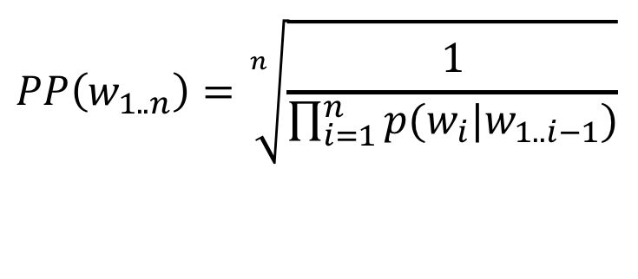
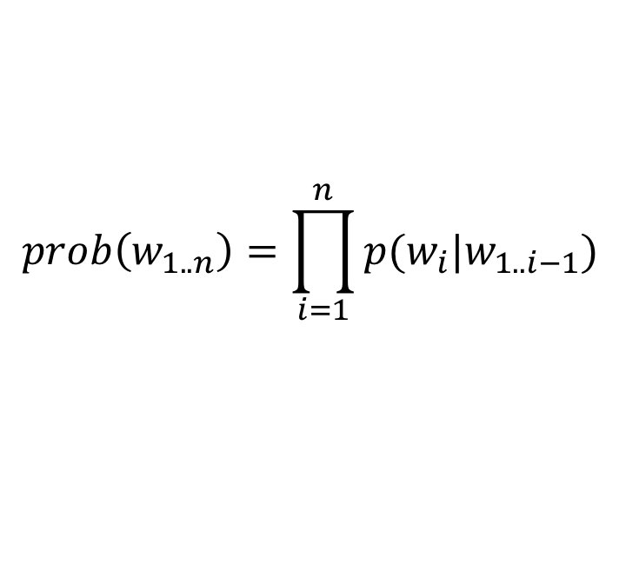
The solution: perplexity
$$prob\left(w_{1..n}\right)=\prod_{i=1}^{n}{p(w_{i}|w_{1..i−1})}$$
average the probabilities
geometric mean
$$PP\left(w_{1..n}\right)=\sqrt[n]{\frac{1}{\prod_{i=1}^{n}{p(w_{i}|w_{1..i−1})}}}$$

Slide 42
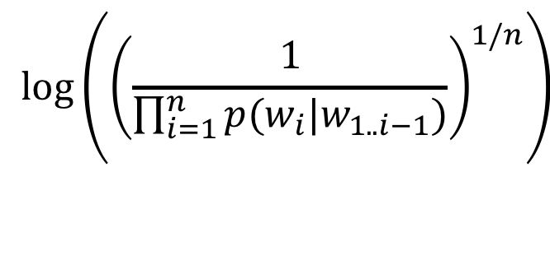
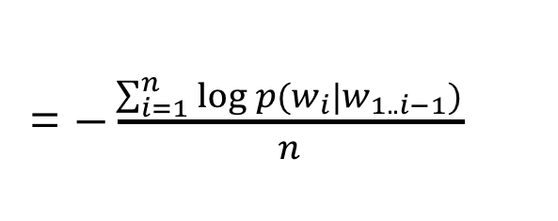
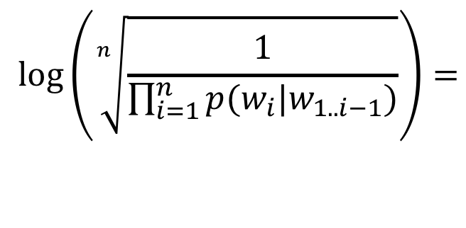
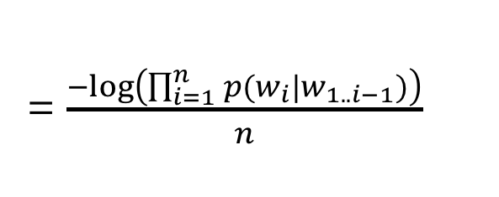
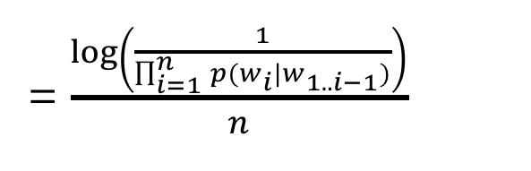
Calculating perplexity in practice
$$\log\left(\sqrt[n]{\frac{1}{\prod_{i=1}^{n}{p(w_{i}|w_{1..i−1})}}}\right)=$$
$$\log\left({\left(\frac{1}{\prod_{i=1}^{n}{p(w_{i}|w_{1..i−1})}}\right)}^{1/n}\right)$$
= $\frac{\log\left(\frac{1}{\prod_{i=1}^{n}{p(w_{i}|w_{1..i−1})}}\right)}{n}$
= $\frac{−log\left(\prod_{i=1}^{n}{p(w_{i}|w_{1..i−1})}\right)}{n}$
= $−\frac{\sum_{i=1}^{n}{log⁡p(w_{i}|w_{1..i−1})}}{n}$
What is this?

Slide 43
Calculating perplexity in practice
$$\log\left(\sqrt[n]{\frac{1}{\prod_{i=1}^{n}{p(w_{i}|w_{1..i−1})}}}\right)=$$
$$\log\left({\left(\frac{1}{\prod_{i=1}^{n}{p(w_{i}|w_{1..i−1})}}\right)}^{1/n}\right)$$
= $\frac{\log\left(\frac{1}{\prod_{i=1}^{n}{p(w_{i}|w_{1..i−1})}}\right)}{n}$
= $\frac{−log\left(\prod_{i=1}^{n}{p(w_{i}|w_{1..i−1})}\right)}{n}$
= $−\frac{\sum_{i=1}^{n}{log⁡p(w_{i}|w_{1..i−1})}}{n}$
Average logprob per word!

Slide 44
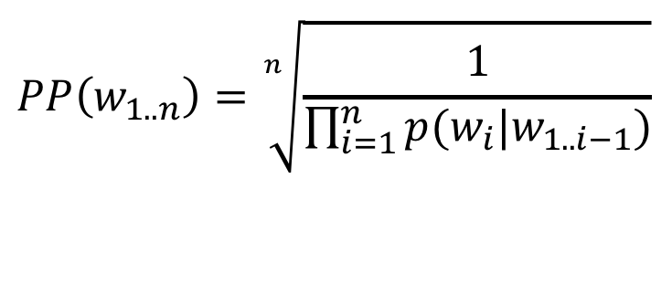
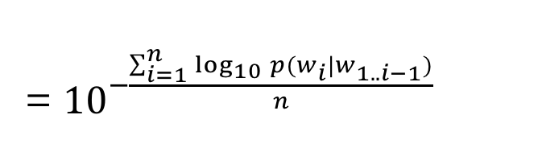
Calculating perplexity
$$PP\left(w_{1..n}\right)=\sqrt[n]{\frac{1}{\prod_{i=1}^{n}{p(w_{i}|w_{1..i−1})}}}$$
= ${10}^{−\frac{\sum_{i=1}^{n}{\log_{10}{p(w_{i}|w_{1..i−1})}}}{n}}$
This is often how it’s calculated (and how we’ll calculate it)
Avoid underflow from multiplying too many small probabilities together

Slide 45
Another view of perplexity
Weighted average branching factor
  number of possible next words that can follow a word or phrase
  measure of the complexity/uncertainty of text (as viewed from the language models perspective)

Slide 46
Smoothing
What if our test set contains the following sentence, but one of the trigrams never occurred in our training data?
P(I think today is a good day to be me) =
P(I | <start> <start>) x
P(think | <start> I) x
P(today| I think) x
If any of these has never been seen before, prob = 0!
P(is| think today) x
P(a| today is) x
P(good| is a) x
…

Slide 47
A better approach
p(z | x y) = ?
Suppose our training data includes
… x y a ..
… x y d …
… x y d …
but never: xyz
We would conclude
p(a | x y) = 1/3?
p(d | x y) = 2/3?
p(z | x y) = 0/3?
Is this ok?
Intuitively, how should we fix these?

Slide 48
Smoothing the estimates
Basic idea:
p(a | x y) = 1/3? reduce
p(d | x y) = 2/3? reduce
p(z | x y) = 0/3? increase
Discount the positive counts somewhat
Reallocate that probability to the zeroes
Remember, it needs to stay a probability distribution

Slide 49
Other situations
p(z | x y) = ?
Suppose our training data includes
… x y a … (100 times)
… x y d … (100 times)
… x y d … (100 times)
but never: x y z
Suppose our training data includes
  … x y a …
  … x y d …
  … x y d …
  … x y … (300 times)
  but never: x y z
Is this the same situation as before?

Slide 50
Smoothing the estimates
Should we conclude
p(a | xy) = 1/3? reduce
p(d | xy) = 2/3? reduce
p(z | xy) = 0/3? increase
Readjusting the estimate is particularly important if:
  the denominator is small …
    1/3 probably too high, 100/300 probably about right
  numerator is small …
    1/300 is probably too high, 100/300 probably about right
p(c|a b) = count(a b c)
count(a b)

Slide 51
Add-one (Laplacian) smoothing
xya | 1 | 1/3 | 2 | 2/29
xyb | 0 | 0/3 | 1 | 1/29
xyc | 0 | 0/3 | 1 | 1/29
xyd | 2 | 2/3 | 3 | 3/29
xye | 0 | 0/3 | 1 | 1/29
…
xyz | 0 | 0/3 | 1 | 1/29
Total xy | 3 | 3/3 | 29 | 29/29
Notes:
all possible bigrams that start with xy
in this case, we’re looking at lowercase letters, so 26 letters

Slide 52
Add-one (Laplacian) smoothing
300 observations instead of 3 – better data, less smoothing
xya | 100 | 100/300 | 101 | 101/326
xyb | 0 | 0/300 | 1 | 1/326
xyc | 0 | 0/300 | 1 | 1/326
xyd | 200 | 200/300 | 201 | 201/326
xye | 0 | 0/300 | 1 | 1/326
…
xyz | 0 | 0/300 | 1 | 1/326
Total xy | 300 | 300/300 | 326 | 326/326

Slide 53
Add-one (Laplacian) smoothing
What happens if we’re now considering a vocabulary of 20,000 words?
xya | 1 | 1/3 | 2 | 2/29
xyb | 0 | 0/3 | 1 | 1/29
xyc | 0 | 0/3 | 1 | 1/29
xyd | 2 | 2/3 | 3 | 3/29
xye | 0 | 0/3 | 1 | 1/29
…
xyz | 0 | 0/3 | 1 | 1/29
Total xy | 3 | 3/3 | 29 | 29/29

Slide 54
Add-one (Laplacian) smoothing
20,000 words, not 26 letters
see the abacus | 1 | 1/3 | 2 | 2/20003
see the abbot | 0 | 0/3 | 1 | 1/20003
see the abduct | 0 | 0/3 | 1 | 1/20003
see the above | 2 | 2/3 | 3 | 3/20003
see the Abram | 0 | 0/3 | 1 | 1/20003
…
see the zygote | 0 | 0/3 | 1 | 1/20003
Total | 3 | 3/3 | 20003 | 20003/20003
Any problem with this?

Slide 55
Add-one (Laplacian) smoothing
An “unseen event” is a 0-count event
The probability of an unseen event is 19998/20003
  add one smoothing thinks it is very likely to see a novel event
The problem with add-one smoothing is it gives too much probability mass to unseen events
see the abacus | 1 | 1/3 | 2 | 2/20003
see the abbot | 0 | 0/3 | 1 | 1/20003
see the abduct | 0 | 0/3 | 1 | 1/20003
see the above | 2 | 2/3 | 3 | 3/20003
see the Abram | 0 | 0/3 | 1 | 1/20003
…
see the zygote | 0 | 0/3 | 1 | 1/20003
Total | 3 | 3/3 | 20003 | 20003/20003

Slide 56
The general smoothing problem
modification
probability
see the abacus | 1 | 1/3 | ? | ?
see the abbot | 0 | 0/3 | ? | ?
see the abduct | 0 | 0/3 | ? | ?
see the above | 2 | 2/3 | ? | ?
see the Abram | 0 | 0/3 | ? | ?
… |  |  | ? | ?
see the zygote | 0 | 0/3 | ? | ?
Total | 3 | 3/3 | ? | ?

Slide 57
Add-lambda smoothing
A large dictionary makes novel events too probable.
Instead of adding 1 to all counts, add λ = 0.01?
  This gives much less probability to novel events
see the abacus | 1 | 1/3 | 1.01 | 1.01/203
see the abbot | 0 | 0/3 | 0.01 | 0.01/203
see the abduct | 0 | 0/3 | 0.01 | 0.01/203
see the above | 2 | 2/3 | 2.01 | 2.01/203
see the Abram | 0 | 0/3 | 0.01 | 0.01/203
… |  |  | 0.01 | 0.01/203
see the zygote | 0 | 0/3 | 0.01 | 0.01/203
Total | 3 | 3/3 | 203

