Slide 1
Naïve bayes
David Kauchak
CS159 Spring 2019

Slide 2
Admin
Assignment 7 out soon (due next Friday at 5pm)
Quiz #3 next Monday
- Text similarity -> this week (though, light on ML)
Final project

Slide 3
Final project
Your project should relate to something involving NLP
Your project must include a solid experimental evaluation
Your project should be in a pair or group of three. If you’d like to do it solo or in a group of four, please come talk to me.

Slide 4
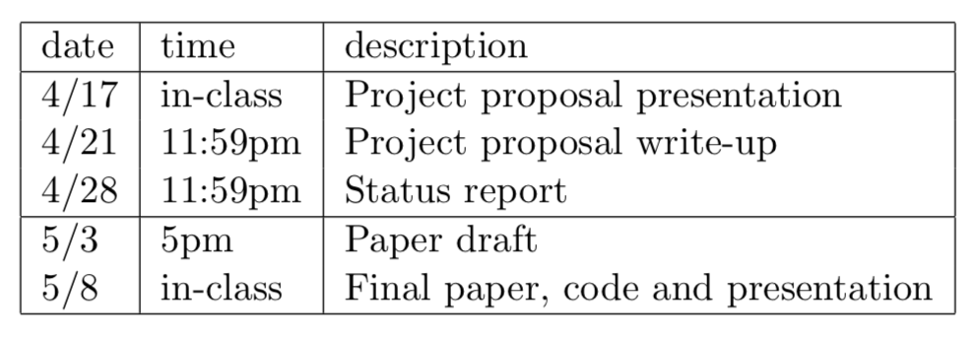
Final project
Read the final project handout ASAP!
Start forming groups and thinking about what you want to do

Slide 5
Final project ideas
pick a text classification task
  evaluate different machine learning methods
  implement a machine learning method
  analyze different feature categories
n-gram language modeling
  implement and compare other smoothing techniques
  implement alternative models
parsing
  lexicalized PCFG (with smoothing)
  n-best list generation
  parse output reranking
  implement another parsing approach and compare
  parsing non-traditional domains (e.g. twitter)
EM
  try and implement IBM model 2
  word-level translation models

Slide 6
Final project application areas
spelling correction
part of speech tagger
text chunker
dialogue generation
pronoun resolution
compare word similarity measures (more than the ones we looked at)
word sense disambiguation
machine translation
information retrieval
information extraction
question answering
summarization
speech recognition

Slide 7
Probabilistic Modeling
Model the data with a probabilistic model
specifically, learn p(features, label)
p(features, label) tells us how likely these features and this example are
train
probabilistic model
training data

Slide 8
Basic steps for probabilistic modeling
Probabilistic models
Step 1: pick a model
Step 2: figure out how to estimate the probabilities for the model
Step 3 (optional): deal with overfitting
Which model do we use, i.e. how do we calculate p(feature, label)?
How do train the model, i.e. how to we we estimate the probabilities for the model?
How do we deal with overfitting?

Slide 9
Naïve Bayes assumption
What does this assume?

Slide 10
Naïve Bayes assumption
Assumes feature i is independent of the the other features given the label

Slide 11
Naïve Bayes model
naïve Bayes assumption
p(x_{i}|y) is the probability of a particular feature value given the label
How do we model this?
for binary features (e.g., “banana” occurs in the text)
for discrete features (e.g., “banana” occurs x_{i} times)
for real valued features (e.g, the text contains x_{i} proportion of verbs)

Slide 12
p(x|y)
Binary features (aka, Bernoulli Naïve Bayes) :
biased coin toss!
Notes:
- for discrete, we could simply do a much larger table, but often that doesn’t capture everything we want

Slide 13
Basic steps for probabilistic modeling
Probabilistic models
Step 1: pick a model
Step 2: figure out how to estimate the probabilities for the model
Step 3 (optional): deal with overfitting
Which model do we use, i.e. how do we calculate p(feature, label)?
How do train the model, i.e. how to we we estimate the probabilities for the model?
How do we deal with overfitting?

Slide 14
Obtaining probabilities
train
probabilistic model
training data
…
(m = number of features)

Slide 15
MLE estimation for Bernoulli NB
train
probabilistic model
training data
What are the MLE estimates for these?

Slide 16
Maximum likelihood estimates
number of examples with label
total number of examples
number of examples with the label with feature
number of examples with label
What does training a NB model then involve?
How difficult is this to calculate?
Notes:
just involves iterating over the data and aggregating these counts!

Slide 17
Text classification
Unigram features:
w_{j}, whether or not word w_{j} occurs
in the text
What are these counts for text classification with unigram features?
Notes:
just involves iterating over the data and aggregating these counts!

Slide 18
text classification
number of texts with label
total number of texts
number of texts with the label with word w_{j}
number of texts with label
Notes:
just involves iterating over the data and aggregating these counts!

Slide 19
Naïve Bayes classification
NB Model
p(features, label)
yellow, curved, no leaf, 6oz, banana
0.004
Given an unlabeled example:
yellow, curved, no leaf, 6oz
predict the label
How do we use a probabilistic model for classification/prediction?

Slide 20
NB classification
probabilistic model:
p(features, label1)
yellow, curved, no leaf, 6oz, banana
pick largest
yellow, curved, no leaf, 6oz, apple
label =

Slide 21
NB classification
probabilistic model:
p(features, label1)
yellow, curved, no leaf, 6oz, banana
pick largest
yellow, curved, no leaf, 6oz, apple
Notice that each label has it’s own separate set of parameters, i.e. p(x_{j}|y)

Slide 22
Bernoulli NB for text classification
probabilistic model:
p(features, label1)
(1, 1, 1, 0, 0, 1, 0, 0, …)
pick largest
w₁
w₂
w₄
w₈
w₇
w₆
w₃
w₅
How good is this model for text classification?

Slide 23
Bernoulli NB for text classification
(1, 1, 1, 0, 0, 1, 0, 0, …)
w₁
w₂
w₄
w₆
w₇
w₈
w₃
w₅
pick largest
For text classification, what is this computation? Does it make sense?
Notes:
- Concern:

Slide 24
Bernoulli NB for text classification
(1, 1, 1, 0, 0, 1, 0, 0, …)
w₁
w₂
w₄
w₆
w₇
w₈
w₃
w₅
pick largest
Each word that occurs, contributes p(w_{j}|y)
Each word that does NOT occur, contributes 1-p(w_{j}|y)
Notes:
- Concern:

Slide 25

Generative Story
To classify with a model, we’re given an example and we obtain the probability
We can also ask how a given model would generate an example
This is the “generative story” for a model
Looking at the generative story can help understand the model
We also can use generative stories to help develop a model
Notes:
- although we don’t generally “generate” a document from a model, it’s often useful to look at the generative story of a model (i.e. how the model says a document was generate) to help us understand why the model assigns certain probabilities

Slide 26
Bernoulli NB generative story
What is the generative story for the NB model?

Slide 27
Bernoulli NB generative story
Pick a label according to p(y)
  roll a biased, num_labels-sided die
For each feature:
  Flip a biased coin:
    if heads, include the feature
    if tails, don’t include the feature
What does this mean for text classification, assuming unigram features?

Slide 28
Bernoulli NB generative story
Pick a label according to p(y)
  roll a biased, num_labels-sided die
For each word in your vocabulary:
  Flip a biased coin:
    if heads, include the word in the text
    if tails, don’t include the word

Slide 29
Bernoulli NB
Pros/cons?

Slide 30
Bernoulli NB
Pros
  Easy to implement
  Fast!
  Can be done on large data sets
Cons
  Naïve Bayes assumption is generally not true
  Performance isn’t as good as other models
  For text classification (and other sparse feature domains) the p(x_{i}=0|y) can be problematic

Slide 31
Another generative story
Randomly draw words from a “bag of words” until document length is reached
w₁
w₃
w₂
w₁
w₁
w₁
w₃

Slide 32
Draw words from a fixed distribution
Selected:
w₁
w₃
w₂
w₁
w₁
w₁
w₃

Slide 33
Draw words from a fixed distribution
Selected:
w₁
Put a copy of w₁ back
w₁
w₃
sampling with replacement
w₂
w₁
w₁
w₁
w₃

Slide 34
Draw words from a fixed distribution
Selected:
w₁
w₁
w₁
w₃
w₂
w₁
w₁
w₃

Slide 35
Draw words from a fixed distribution
Selected:
w₁
w₁
Put a copy of w₁ back
w₁
w₃
sampling with replacement
w₂
w₁
w₁
w₁
w₃

Slide 36
Draw words from a fixed distribution
Selected:
w₁
w₁
w₂
w₁
w₃
w₁
w₁
w₁
w₃

Slide 37
Draw words from a fixed distribution
Selected:
w₁
w₁
w₂
Put a copy of w₂ back
w₁
w₃
sampling with replacement
w₂
w₁
w₁
w₁
w₃

Slide 38
Draw words from a fixed distribution
Selected:
w₁
w₁
w₂
…
w₁
w₃
w₂
w₁
w₁
w₁
w₃

Slide 39
Draw words from a fixed distribution
Is this a NB model, i.e. does it assume each individual word occurrence is independent?
w₁
w₃
w₂
w₁
w₁
w₁
w₃

Slide 40
Draw words from a fixed distribution
Yes! Doesn’t matter what words were drawn previously, still the same probability of getting any particular word
w₁
w₃
w₂
w₁
w₁
w₁
w₃

Slide 41
Draw words from a fixed distribution
Does this model handle multiple word occurrences?
w₁
w₃
w₂
w₁
w₁
w₁
w₃

Slide 42
Draw words from a fixed distribution
Selected:
w₁
w₁
w₂
…
w₁
w₃
w₂
w₁
w₁
w₁
w₃

Slide 43
NB generative story
Bernoulli NB
Multinomial NB
Pick a label according to p(y)
  roll a biased, num_labels-sided die
For each word in your vocabulary:
  Flip a biased coin:
    if heads, include the word in the text
    if tails, don’t include the word
Pick a label according to p(y)
  roll a biased, num_labels-sided die
Keep drawing words from p(words|y) until text length has been reached.

Slide 44
Probabilities
Bernoulli NB
Multinomial NB
Pick a label according to p(y)
  roll a biased, num_labels-sided die
For each word in your vocabulary:
  Flip a biased coin:
    if heads, include the word in the text
    if tails, don’t include the word
Pick a label according to p(y)
  roll a biased, num_labels-sided die
Keep drawing words from p(words|y) until document length has been reached
?
(1, 1, 1, 0, 0, 1, 0, 0, …)
(4, 1, 2, 0, 0, 7, 0, 0, …)
w₁
w₂
w₄
w₈
w₇
w₆
w₁
w₂
w₄
w₈
w₃
w₅
w₇
w₆
w₃
w₅

Slide 45
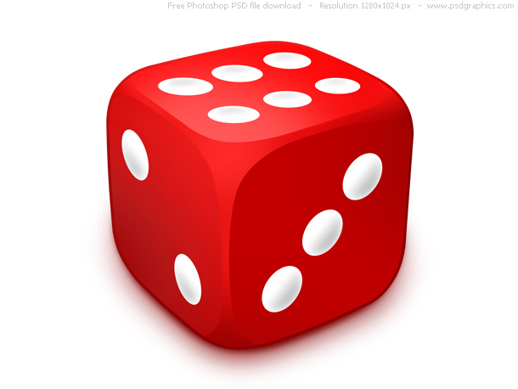
A digression: rolling dice
What’s the probability of getting a 3 for a single roll of this dice?
1/6

Slide 46
A digression: rolling dice
What is the probability distribution over possible single rolls?
1/6
1/6
1/6
1/6
1/6
1/6
1
2
3
4
5
6

Slide 47
A digression: rolling dice
What if I told you 1 was twice as likely as the others?
2/7
1/7
1/7
1/7
1/7
1/7
1
2
3
4
5
6

Slide 48
A digression: rolling dice
What if I rolled 400 times and got the following number?
1: 100
2: 50
3: 50
4: 100
5: 50
6: 50
1/4
1/8
1/8
1/4
1/8
1/8
1
2
3
4
5
6

Slide 49
A digression: rolling dice
What is the probability of rolling a 1 and a 5 (in any order)?
Two 1s and a 5 (in any order)?
Five 1s and two 5s (in any order)?
1/4
1/8
1/8
1/4
1/8
1/8
1
2
3
4
5
6

Slide 50
A digression: rolling dice
What it the probability of rolling a 1 and a 5 (in any order)?
Two 1s and a 5 (in any order)?
Five 1s and two 5s (in any order)?
(1/4 * 1/8) * 2 = 1/16
number of ways that can happen
(1,5 and 5,1)
prob. of those two rolls
((1/4)² * 1/8) * 3 = 3/128
((1/4)⁵ * (1/8)³) * 21 = 21/524,288 = 0.00004
General formula?
1/4
1/8
1/8
1/4
1/8
1/8
1
2
3
4
5
6

Slide 51
Multinomial distribution
Multinomial distribution: independent draws over m possible categories
If we have frequency counts x1, x2, …, xm over each of the categories, the probability is:
number of different ways to get those counts
probability of particular counts
θ₁
θ₂
θ₃
θ₄
θ₅
θ₆
…
1
2
3
4
5
6

Slide 52
Multinomial distribution
What are θ_{j}?
Are there any constraints on the values that they can take?
θ₁
θ₂
θ₃
θ₄
θ₅
θ₆
…
1
2
3
4
5
6

Slide 53
Multinomial distribution
θ_{j}: probability of rolling “j”
θ₁
θ₂
θ₃
θ₄
θ₅
θ₆
…
1
2
3
4
5
6

Slide 54
Back to words…
Why the digression?
Drawing words from a bag is the same as rolling a die!
number of sides = number of words in the vocabulary

Slide 55
Back to words…
Why the digression?
θ_{j} for class y

Slide 56
Basic steps for probabilistic modeling
Model each class as a multinomial:
Step 2: figure out how to estimate the probabilities for the model
How do we train the model, i.e. estimate θ_{j} for each class?

Slide 57
A digression: rolling dice
What if I rolled 400 times and got the following number?
1: 100
2: 50
3: 50
4: 100
5: 50
6: 50
1/4
1/8
1/8
1/4
1/8
1/8
1
2
3
4
5
6

Slide 58
Training a multinomial
label₁
label₂
1/4
1/8
1/8
1/4
1/8
1/8
1
2
3
4
5
6

Slide 59
Training a multinomial
label₁
For each label, y:
w1: 100 times
w2: 50 times
w3: 10 times
w4: …
number of times word w_{j} occurs in label y docs
total number of words in label y docs
1/4
1/8
1/8
1/4
1/8
1/8
1
2
3
4
5
6

Slide 60
Classifying with a multinomial
(10, 2, 6, 0, 0, 1, 0, 0, …)
w₁
w₂
w₄
w₆
w₇
w₈
w₃
w₅
Any way I can make this simpler?
pick largest

Slide 61
Classifying with a multinomial
(10, 2, 6, 0, 0, 1, 0, 0, …)
w₁
w₂
w₄
w₆
w₇
w₈
w₃
w₅
Is a constant!
pick largest

Slide 62
Multinomial finalized
Training:
  Calculate p(label)
  For each label, calculate θs
Classification:
  Get word counts
  For each label you had in training, calculate:
  and pick the largest

Slide 63
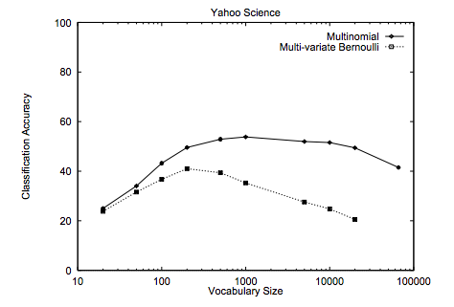
Multinomial vs. Bernoulli?
Handles word frequency
Given enough data, tends to performs better
http://www.cs.cmu.edu/~knigam/papers/multinomial-aaaiws98.pdf

Slide 64
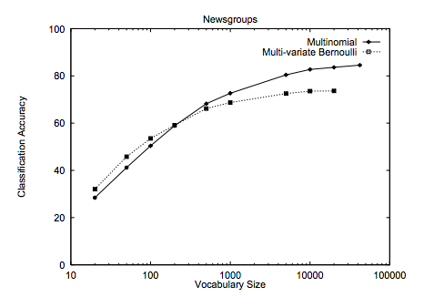
Multinomial vs. Bernoulli?
Handles word frequency
Given enough data, tends to performs better
http://www.cs.cmu.edu/~knigam/papers/multinomial-aaaiws98.pdf

Slide 65
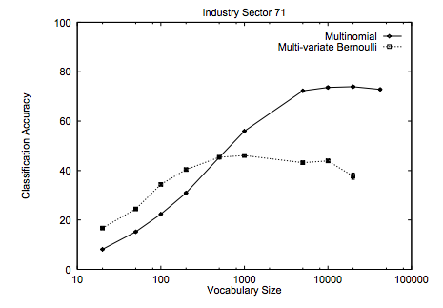
Multinomial vs. Bernoulli?
Handles word frequency
Given enough data, tends to performs better
http://www.cs.cmu.edu/~knigam/papers/multinomial-aaaiws98.pdf

Slide 66
Maximum likelihood estimation
Intuitive
Sets the probabilities so as to maximize the probability of the training data
Problems?
  Overfitting!
  Amount of data
    particularly problematic for rare events
  Is our training data representative

Slide 67
Basic steps for probabilistic modeling
Probabilistic models
Step 1: pick a model
Step 2: figure out how to estimate the probabilities for the model
Step 3 (optional): deal with overfitting
Which model do we use, i.e. how do we calculate p(feature, label)?
How do train the model, i.e. how to we we estimate the probabilities for the model?
How do we deal with overfitting?

Slide 68
Unseen events
positive
banana: 2
training data
negative
banana: 0
What will θ_{banana} be for the negative class?

Slide 69
Unseen events
positive
banana: 2
training data
negative
banana: 0
What will θ_{banana} be for the negative class?
0!
Is this a problem?

Slide 70
Unseen events
positive
banana: 2
training data
negative
banana: 0
p(“I ate a bad banana”, negative) = ?

Slide 71
Unseen events
positive
banana: 2
training data
negative
banana: 0
p(“I ate a bad banana”, negative) = 0
p(“…. banana …”, negative) = 0
Solution?

Slide 72
Add lambda smoothing
training data
for each label, pretend like we’ve seen each feature/word occur in λ additional examples

Slide 73
Different than…
positive
banana: 0
training data
negative
banana: 0
How is this problem different?

Slide 74
Different than…
positive
banana: 0
training data
negative
banana: 0
p(“I ate a bad banana”, positive)
p(“I ate a bad”, positive)
p(“I ate a bad banana”, negative)
p(“I ate a bad”, negative)
Out of vocabulary. Many ways to solve… for our implementation, we’ll just ignore them.

