Slide 1
Word representations
David Kauchak
CS158 – Fall 2016

Slide 2
Admin
Quiz #2
Quartile1: 23.25 (78%)
Median: 26 (87%)
Quartile3: 28 (93%)
Average: 24.8 (83%)
Assignments 3 and 5a graded (4b back soon)
Assignment 5

Slide 3
Decision boundaries
The decision boundaries are places in the features space where the classification of a point/example changes
label 1
label 2
label 3

Slide 4
A complicated decision boundary
label 1
label 2
label 3
For those curious, this is the decision boundary for k-nearest neighbors

Slide 5
What does the decision boundary look like?
1
Input x₁
1
-1
Output = x₁ xor x₂
T=0.5
-1
1
1
T=0.5
Input x₂
x₁ | x₂ | x₁ xor x₂
0 | 0 | 0
0 | 1 | 1
1 | 0 | 1
1 | 1 | 0
T=0.5

Slide 6
What does the decision boundary look like?
1
Input x₁
1
-1
Output = x₁ xor x₂
T=0.5
-1
1
1
T=0.5
Input x₂
x₁ | x₂ | x₁ xor x₂
0 | 0 | 0
0 | 1 | 1
1 | 0 | 1
1 | 1 | 0
T=0.5
What does this perceptron’s decision boundary look like?

Slide 7
NN decision boundary
Input x₁
-1
x₂
1
Input x₂
x₁
T=0.5
What does this perceptron’s decision boundary look like?

Slide 8
NN decision boundary
Input x₁
-1
x₂
1
Input x₂
x₁
T=0.5
$$−x_{1}+x_{2}=0.5$$
$$x_{2}=x_{1}+0.5$$

Slide 9
NN decision boundary
Input x₁
-1
x₂
1
Input x₂
x₁
T=0.5
Which side is positive (1) and which is negative (0)?

Slide 10
NN decision boundary
Input x₁
-1
x₂
1
Input x₂
x₁
T=0.5
x₁ wants to be very small (or negative) and x₂ large and positive

Slide 11
NN decision boundary
Input x₁
-1
x₂
(-1,1)
1
Input x₂
x₁
T=0.5
Another way to view the boundary is as the line perpendicular to the weight vector
(without the threshold)

Slide 12
NN decision boundary
Input x₁
-1
x₂
(-1,1)
1
Input x₂
x₁
T=0.5
How does the threshold affect this line?
(without the threshold)

Slide 13
NN decision boundary
Input x₁
-1
x₂
(-1,1)
1
Input x₂
x₁
T=0.5
Let x₂ = 0, then:
(without the threshold)

Slide 14
NN decision boundary
Input x₁
-1
x₂
1
Input x₂
x₁
T=0.5

Slide 15
What does the decision boundary look like?
1
Input x₁
1
-1
Output = x₁ xor x₂
b=0.5
-1
1
1
b=0.5
Input x₂
x₁ | x₂ | x₁ xor x₂
0 | 0 | 0
0 | 1 | 1
1 | 0 | 1
1 | 1 | 0
b=0.5
What does this perceptron’s decision boundary look like?

Slide 16
NN decision boundary
1
Input x₁
x₂
b=-0.5
-1
Input x₂
x₁
Let x₂ = 0, then:
(1,-1)
(without the bias)

Slide 17
NN decision boundary
1
Input x₁
x₂
b=-0.5
-1
Input x₂
x₁

Slide 18
What does the decision boundary look like?
1
Input x₁
1
-1
Output = x₁ xor x₂
T=0.5
-1
1
1
T=0.5
Input x₂
x₁ | x₂ | x₁ xor x₂
0 | 0 | 0
0 | 1 | 1
1 | 0 | 1
1 | 1 | 0
T=0.5
What operation does this perceptron perform on the result?

Slide 19
Fill in the truth table
1
1
T=0.5
out1 | out2
0 | 0 | ?
0 | 1 | ?
1 | 0 | ?
1 | 1 | ?

Slide 20
OR
1
1
T=0.5
out1 | out2
0 | 0 | 0
0 | 1 | 1
1 | 0 | 1
1 | 1 | 1

Slide 21
What does the decision boundary look like?
1
Input x₁
1
-1
Output = x₁ xor x₂
T=0.5
-1
1
1
T=0.5
Input x₂
x₁ | x₂ | x₁ xor x₂
0 | 0 | 0
0 | 1 | 1
1 | 0 | 1
1 | 1 | 0
T=0.5

Slide 22
1
Input x₁
1
-1
Output = x₁ xor x₂
x₂
T=0.5
-1
1
1
T=0.5
Input x₂
x₁
T=0.5

Slide 23
1
Input x₁
1
-1
Output = x₁ xor x₂
x₂
T=0.5
-1
1
1
T=0.5
Input x₂
x₁
T=0.5
x₁ | x₂ | x₁ xor x₂
0 | 0 | 0
0 | 1 | 1
1 | 0 | 1
1 | 1 | 0

Slide 24
What does the decision boundary look like?
Input x₁
Output = x₁ xor x₂
Input x₂
linear splits of the feature space
combination of these linear spaces

Slide 25
This decision boundary?
?
Input x₁
?
?
Output
T=?
?
?
?
T=?
Input x₂
T=?

Slide 26
This decision boundary?
1
Input x₁
-1
-1
Output
T=0.5
-1
1
-1
T=-0.5
Input x₂
T=0.5

Slide 27
This decision boundary?
1
Input x₁
-1
-1
Output
T=0.5
-1
1
-1
T=-0.5
Input x₂
T=0.5

Slide 28
-1
-1
T=-0.5
out1 | out2
0 | 0 | ?
0 | 1 | ?
1 | 0 | ?
1 | 1 | ?

Slide 29
NOR
-1
-1
T=-0.5
out1 | out2
0 | 0 | 1
0 | 1 | 0
1 | 0 | 0
1 | 1 | 0

Slide 30
What does the decision boundary look like?
Input x₁
Output = x₁ xor x₂
Input x₂
combination of these linear spaces
linear splits of the feature space

Slide 31
Three hidden nodes

Slide 32
NN decision boundaries
‘Or, in colloquial terms “two-layer networks can approximate any function.”’

Slide 33
NN decision boundaries
More hidden nodes = more complexity
Adding more layers adds even more complexity (and much more quickly)
Good rule of thumb:
number of examples
number of 2-layer hidden nodes ≤
number of dimensions

Slide 34
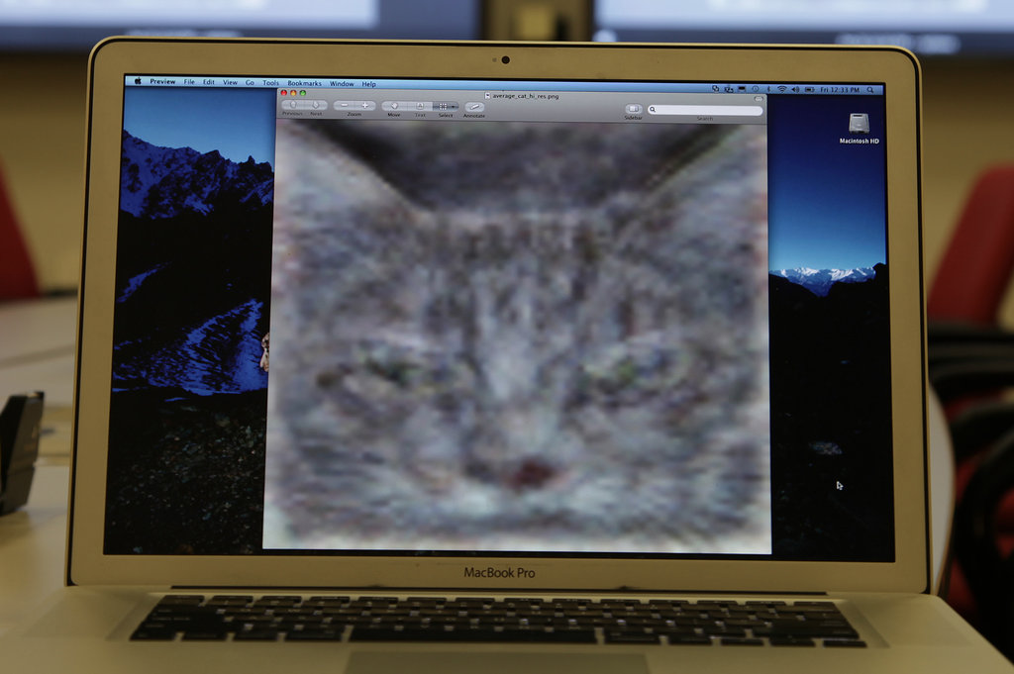
Trained a NN with 1B connections on 10M snapshots from youtube on 16,000 processors

Slide 35
http://www.nytimes.com/2012/06/26/technology/in-a-big-network-of-computers-evidence-of-machine-learning.html

Slide 36
Deep learning
Deep learning is a branch of machine learning based on a set of algorithms that attempt to model high level abstractions in data by using a deep graph with multiple processing layers, composed of multiple linear and non-linear transformations.
Deep learning is part of a broader family of machine learning methods based on learning representations of data.

Slide 37
Deep learning
Key: learning better features that abstract from the “raw” data
Using learned feature representations based on large amounts of data, generally unsupervised
Using classifiers with multiple layers of learning

Slide 38
Deep learning
More abstract representation
Train multiple layers of features/abstractions from data.
Try to discover representation that makes decisions easy.
Low-level
Features
Mid-level
Features
High-level
Features
Classifier
“Cat”?
Deep Learning: train layers of features so that classifier works well.
Slide adapted from: Adam Coates

Slide 39
Deep learning for neural networks
Traditional NN models: 1-2 hidden layers
Deep learning NN models: 3+ hidden layers
…

Slide 40
Challenges
What makes “deep learning” hard for NNs?
…

Slide 41
Challenges
What makes “deep learning” hard for NNs?
w₅
w₄
w₆
…
~w * error
Modified errors tend to get diluted as they get combined with many layers of weight corrections

Slide 42
Deep learning
Growing field
Driven by:
Increase in data availability
Increase in computational power
Parallelizability of many of the algorithms
Involves more than just neural networks (though, they’re a very popular model)

Slide 43
word2vec
How many people have heard of it?
What is it?

Slide 44
Word representations generalized
Project words into a multi-dimensional “meaning” space
word
[x₁, x₂, …, x_{d}]
What is our projection for assignment 5?

Slide 45
Word representations generalized
Project words into a multi-dimensional “meaning” space
word
[w₁, w₂, …, w_{d}]
Each dimension is the co-occurrence of word with w_{i}

Slide 46
Word representations
Project words into a multi-dimensional “meaning” space
word
[x₁, x₂, …, x_{d}]
red
[r₁, r₂, …, r_{d}]
[y₁, y₂, …, y_{d}]
crimson
[c₁, c₂, …, c_{d}]
[r₁, r₂, …, r_{d}]
[c₁, c₂, …, c_{d}]
yellow
[y₁, y₂, …, y_{d}]

Slide 47
Word representations
Project words into a multi-dimensional “meaning” space
word
[x₁, x₂, …, x_{d}]
The idea of word representations is not new:
Co-occurrence matrices
Latent Semantic Analysis (LSA)
New idea: learn word representation using a task-driven approach

Slide 48
A prediction problem
I like to eat bananas with cream cheese
Given a context of words
Predict what words are likely to occur in that context

Slide 49
A prediction problem
Given text, can generate lots of positive examples:
I like to eat bananas with cream cheese
input
prediction
___ like to eat
I ___ to eat bananas
I like ___ eat bananas with
I like to ___ bananas with cream
…
I
like
to
eat
…

Slide 50
A prediction problem
Use data like this to learn a distribution:
words before
words after

Slide 51
A prediction problem
Any problems with using only positive examples?
input
prediction
___ like to eat
I ___ to eat bananas
I like ___ eat bananas with
I like to ___ bananas with cream
…
I
like
to
eat
…

Slide 52
A prediction problem
Want to learn a distribution over all words
input
prediction
___ like to eat
I ___ to eat bananas
I like ___ eat bananas with
I like to ___ bananas with cream
…
I
like
to
eat
…

Slide 53
A prediction problem
Negative examples?
I like to eat bananas with cream cheese
input
prediction
___ like to eat
I ___ to eat bananas
I like ___ eat bananas with
I like to ___ bananas with cream
…
I
like
to
eat
…

Slide 54
A prediction problem
Any other word that didn’t occur in that context
I like to eat bananas with cream cheese
input
prediction (negative)
___ like to eat
I ___ to eat bananas
I like ___ eat bananas with
I like to ___ bananas with cream
…
car
snoopy
run
sloth
…
Notes:
In practice, because we end up using one-hot encoding, every word other word in the vocabulary will count as a negative example.

Slide 55
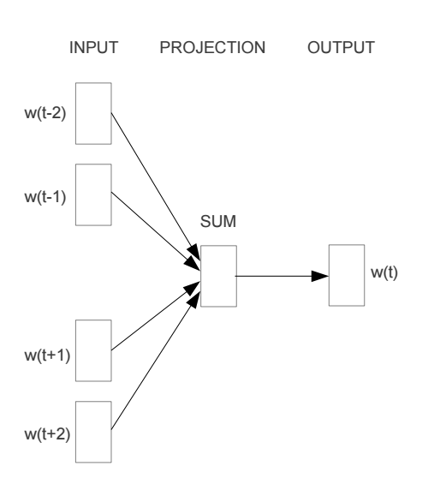
Train a neural network on this problem
https://arxiv.org/pdf/1301.3781v3.pdf

Slide 56
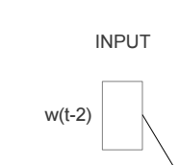
Encoding words
How can we input a “word” into a network?

Slide 57
“One-hot” encoding
For a vocabulary of V words, have V input nodes
All inputs are 0 except the for the one corresponding to the word
a
apple
…
V nodes
banana
…
zebra

Slide 58
“One-hot” encoding
For a vocabulary of V words, have V input nodes
All inputs are 0 except the for the one corresponding to the word
0
a
0
apple
banana
…
1
banana
…
0
zebra

Slide 59
“One-hot” encoding
For a vocabulary of V words, have V input nodes
All inputs are 0 except the for the one corresponding to the word
0
a
1
apple
apple
…
0
banana
…
0
zebra

Slide 60
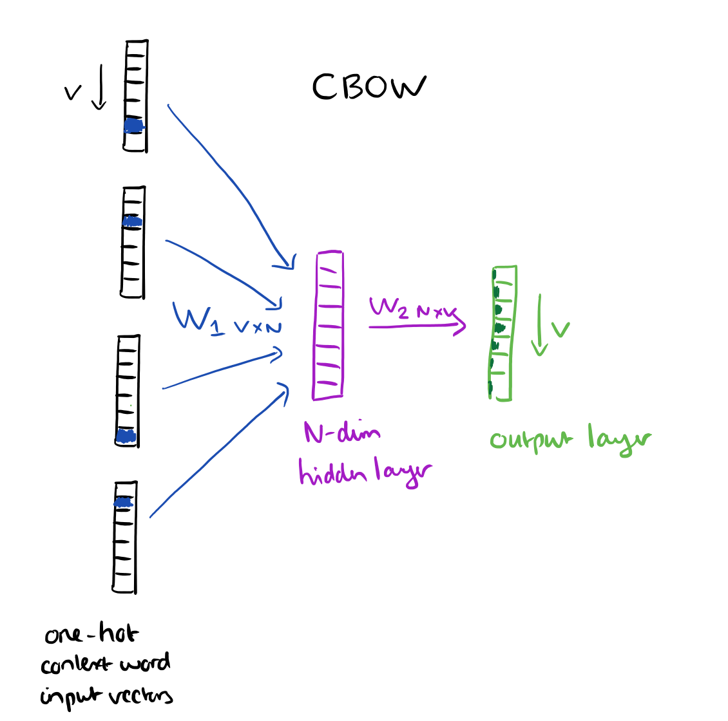
N = 100 to 1000
https://blog.acolyer.org/2016/04/21/the-amazing-power-of-word-vectors/

Slide 61
Another view
…
…
…
N hidden nodes
V input nodes
V output nodes

Slide 62
Training: backpropagation
___ like to eat
I ___ to eat bananas
I like ___ eat bananas with
I like to ___ bananas with cream
…
I
like
to
eat
…
…
…
…
N hidden nodes
V input nodes
V output nodes

Slide 63
Training: backpropagation
eat
I like to ___ bananas with cream
0
0
…
1
0
…
1
0
…
1
0
…
0
0
…
1
0
…
eat
I
…
like
…
…
to
N hidden nodes
V input nodes
V output nodes
Notes:
We want to predict 1 for the correct (positive) word and 0 for all other words

Slide 64
Training: backpropagation
___ like to eat
I ___ to eat bananas
I like ___ eat bananas with
I like to ___ bananas with cream
…
I
like
to
eat
…

Slide 65
Word representation
VxN weights
The weights for each word provide an N dimensional mapping of the word
Words that predict similarly should have similar weights
…
…
…
N hidden nodes
V input nodes
V output nodes

Slide 66
Results
vector(word1) – vector(word2) = vector(word3) - X
word1 is to word2 as word3 is to X

Slide 67
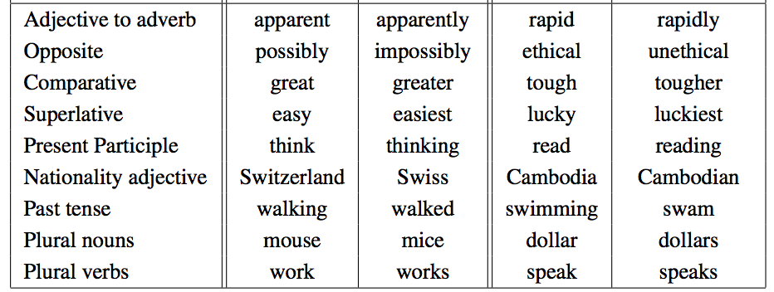
Results
vector(word1) – vector(word2) = vector(word3) - X
word1 is to word2 as word3 is to X

Slide 68
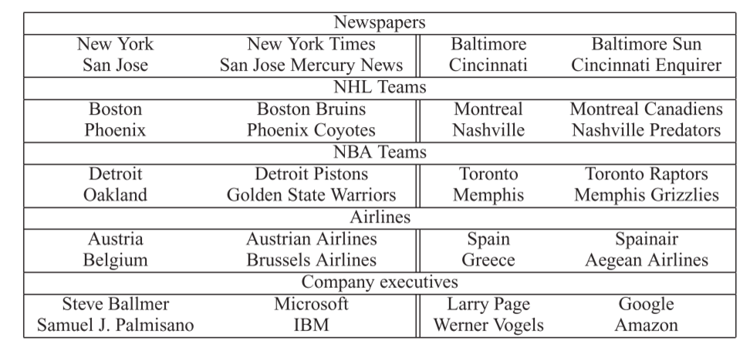
Results
vector(word1) – vector(word2) = vector(word3) - X
word1 is to word2 as word3 is to X

Slide 69
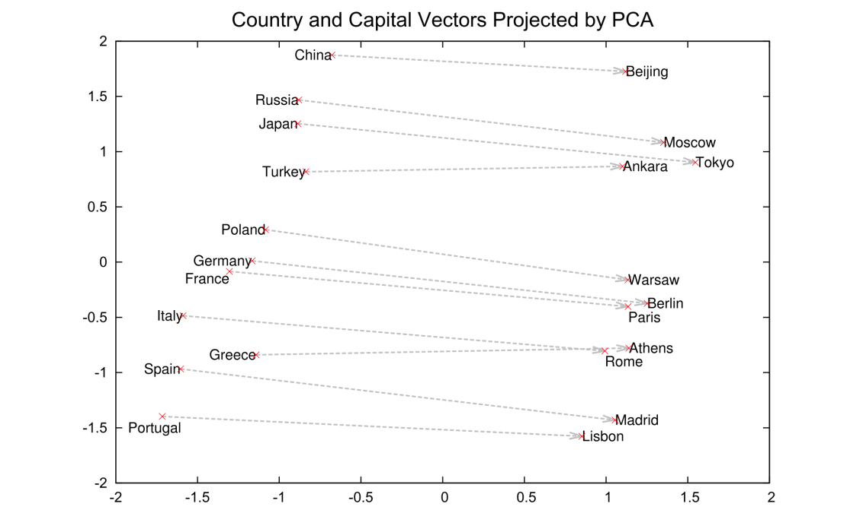
Results
2-Dimensional projection of the N-dimensional space

Slide 70
Visualized
https://projector.tensorflow.org/

Slide 71
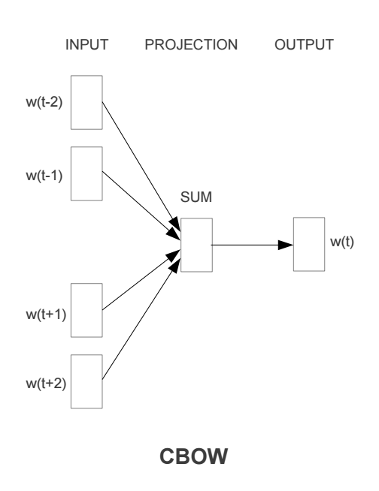
Continuous Bag Of Words

Slide 72
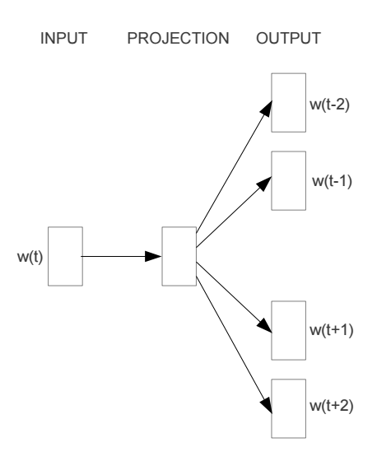
Other models: skip-gram

Slide 73
word2vec
A model for learning word representations from large amounts of data
Has become a popular pre-processing step for learning a more robust feature representation
Models like word2vec have also been incorporated into other learning approaches (e.g. translation tasks)

Slide 74
word2vec resources
https://blog.acolyer.org/2016/04/21/the-amazing-power-of-word-vectors/
https://code.google.com/archive/p/word2vec/
https://deeplearning4j.org/word2vec
https://arxiv.org/pdf/1301.3781v3.pdf

