Slide 1
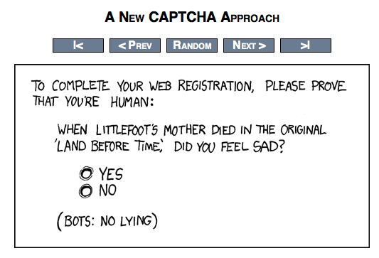

Slide 2
Natural Language Processing
CS159 – Fall 2019
David Kauchak

Slide 3
Adding the course?

Slide 4
Administrivia
http://www.cs.pomona.edu/classes/cs159/
  Office hours, schedule, assigned readings, assignments
  Everything will be posted there
Read the “administrivia” handout!
  ~7 assignments (in a variety of languages)
  4 quizzes
  final project for the last 3-4 weeks
    teams of 2-3 people
  class participation
  Readings
Academic Honesty Collaboration

Slide 5
Administrivia
Assignment 0 posted already
  Shouldn’t take too long
  Due Friday by 5pm
Assignment 1 posted soon
  Won’t cover all material until next Monday
  Due Monday 2/4

Slide 6
Videos before class

Slide 7
What to expect…
This course will be challenging for many of you
  assignments will be non-trivial
  content can be challenging
But it is a fun field!
We’ll cover
  basic linguistics
  probability
  the common problems
  many techniques and algorithms
  common machine learning techniques
  some recent advances in neural networks for language processing
  NLP applications

Slide 8
Requirements and goals
Requirements
  Competent programmer
    Some assignments in Java, but I will allow/encourage other languages after the first few assignments
  Comfortable with mathematical thinking
    We’ll use a fair amount of probability, which I will review
    Other basic concepts, like logs, summation, etc.
  Data structures
    trees, hashtables, etc.
Goals
  Learn the problems and techniques of NLP
  Build real NLP tools
  Understand what the current research problems are in the field

Slide 9
What is NLP?
Natural language processing (NLP) is a field of computer science and linguistics concerned with the interactions between computers and human (natural) languages.
- Wikipedia

Slide 10
What is NLP?
The goal of this new field is to get computers to perform useful tasks involving human language…
- The book

Slide 11

Key: Natural text
“A growing number of businesses are making Facebook an indispensible part of hanging out their shingles. Small businesses are using …”
Natural text is written by people, generally for people
Why do we even care about natural text in computer science?

Slide 12
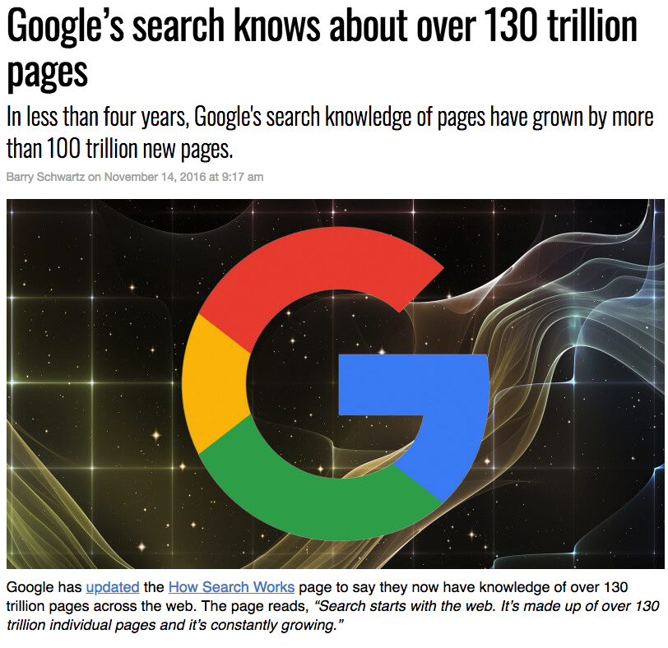
Why do we need computers for dealing with natural text?
https://searchengineland.com/googles-search-indexes-hits-130-trillion-pages-documents-263378
Notes:
besides being a complex problem, there’s a lot of data! (which is a good thing and a bad thing)
some people may say… outsource it (India, the Philippines, etc.). And there are frameworks, like mechanical Turk
world population: ~7M
let’s say you had a simple task to perform on each web page that only took 10 seconds to do. If every single person in the world worked on this non-stop, they would have to work for 20 days straight.
what if it’s a task like translating the page or finding information that requires specialization?

Slide 13
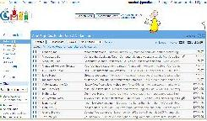


Web is just the start…
e-mail
~500 million tweets a day
~200-300 billion e-mails a day
Blogs:
~200 million different blogs
corporate
databases
Facebook
Notes:
- web pages are just the beginning…

Slide 14
Why is NLP hard?
Iraqi Head Seeks Arms
Juvenile Court to Try Shooting Defendant
Stolen Painting Found by Tree
Kids Make Nutritious Snacks
Local HS Dropouts Cut in Half
Obesity Study Looks for Larger Test Group
British Left Waffles on Falkland Islands
Red Tape Holds Up New Bridges
Hospitals Are Sued by 7 Foot Doctors
Notes:
Iraqi Head (

Slide 15
Why is NLP hard?
User: Where is Escape Room playing in the Claremont Area?
System: Escape Room is playing at the Edwards in La Verne.
User: When is it playing there?
System: It’s playing at 2pm, 5pm and 8pm
User: I’d like 1 adult and 2 children for the first show. How much would that cost?

Slide 16
Why is NLP hard?
Natural language:
  is highly ambiguous at many different levels
  is complex and contains subtle use of context to convey meaning
  is probabilistic?
  involves reasoning about the world
  is highly social
  is a key part in how people interact
However, some NLP problems can be surprisingly easy

Slide 17
Different levels of NLP
pragmatics/discourse: how does the context affect the interpretation?
semantics: what does it mean?
syntax: phrases, how do words interact
words: morphology, classes of words

Slide 18
NLP problems and applications
What are some places where you have seen NLP used?
What are NLP problems?

Slide 19
NLP problems and applications
Lots of problems of varying difficulty
Easier
  Word segmentation: where are the words?
I would’ve liked Dr. Dave to finish early. But he didn’t.

Slide 20


NLP problems and applications
Lots of problems of varying difficulty
Easier
  Word segmentation: where are the words?

Slide 21
NLP problems and applications
Lots of problems of varying difficulty
Easier
  Speech segmentation
  Sentence splitting (aka sentence breaking, sentence boundary disambiguation)
  Language identification
I would’ve liked Dr. Dave to finish early. But he didn’t.
Soy un maestro con queso.

Slide 22

NLP problems and applications
Easier continued
  truecasing
  spell checking
  OCR
i would’ve liked dr. dave to finish early. but he didn’t.
Identifying mispellings is challenging especially in the dessert.

Slide 23


NLP problems and applications
Moderately difficult
  morphological analysis/stemming
  speech recognition
  text classification
smarter
smarter
smartly
smartest
smart
smart
☺
☹
SPAM
sentiment analysis

Slide 24
NLP problems and applications
Moderately difficult continued
  text segmentation: break up text by topics
  part of speech tagging (and inducing word classes)
  parsing
S
VP
NP
NP
PP
PRP
V
N
IN
N
I eat sushi with tuna

Slide 25

NLP problems and applications
Moderately difficult continued
  word sense disambiguation
  grammar correction
  speech synthesis
As he walked along the side of the stream, he spotted some money by the bank. The money had gotten muddy from being so close to the water.

Slide 26
NLP problems and applications
Hard (many of these contain many smaller problems)
  Machine translation
美国关岛国际机场及其办公室均接获一名自称沙地阿拉伯富商拉登等发出的电子邮件，威胁将会向机场等公众地方发动生化袭击後，关岛经保持高度戒备。
The U.S. island of Guam is maintaining a high state of alert after the Guam airport and its offices both received an e-mail from someone calling himself the Saudi Arabian Osama bin Laden and threatening a biological/chemical attack against public places such as the airport .

Slide 27

NLP problems and applications
Information extraction
IBM hired Fred Smith as president.

Slide 28
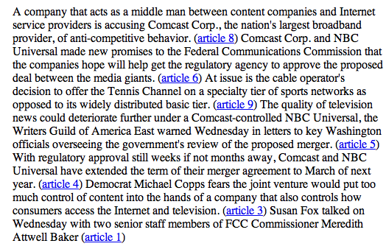
NLP problems and applications
Summarization

Slide 29
NLP problems and applications
Natural language understanding
  Text => semantic representation (e.g. logic, probabilistic relationships)
Information retrieval and question answering
"How many programmers in the child care department make over $50,000?”
“Who was the fourteenth president?”
“How did he die?”

Slide 30
NLP problems and applications
Text simplification
Alfonso Perez Munoz, usually referred to as Alfonso, is a former Spanish footballer, in the striker position.
Alfonso Perez is a former Spanish football player.

Slide 31
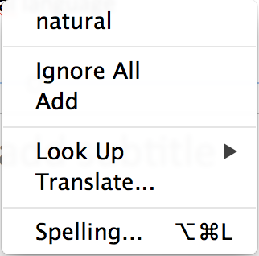

Where are we now?
Many of the “easy” and “medium” problems have reasonable solutions
  spell checkers
  sentence splitters
  word segmenters/tokenizers

Slide 32
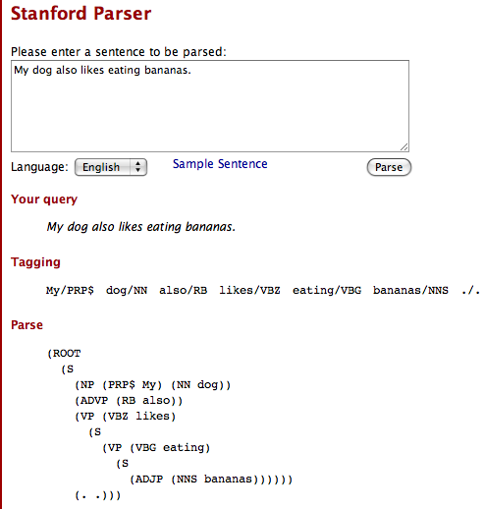
Where are we now?
Parsing
  Stanford Parser (http://nlp.stanford.edu:8080/parser/)

Slide 33
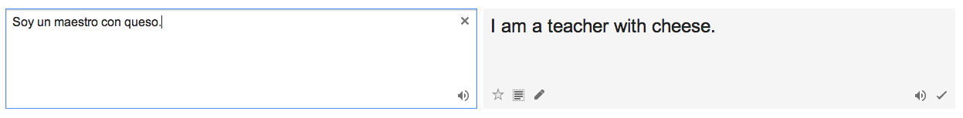
Where are we now?
Machine translation
How is it?

Slide 34
Where are we now?
Machine translation
  Getting better every year
  enough to get the jist of most content, but still no where near a human translation
  better for some types of text
http://translate.google.com
Many commercial versions…
  systran
  language weaver

Slide 35
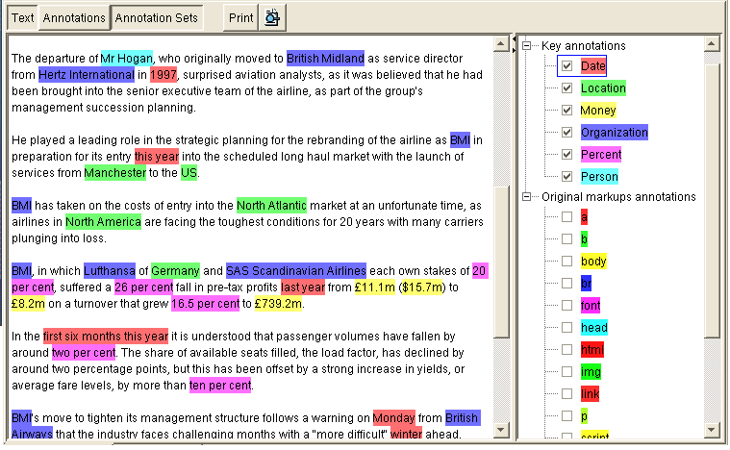
Where are we now?
Information extraction
  Structured documents (very good!)
    www.dealtime.com
    www.google.com/shopping
  AKT technologies
  Lots of these
    FlipDog
    WhizBang! Labs
    …
    work fairly well

Slide 36
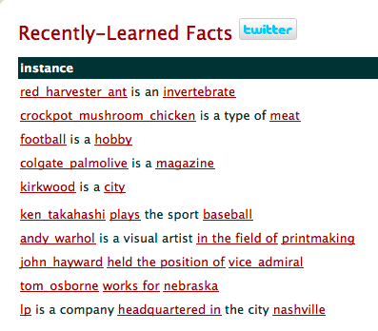
Where are we now?
CMU’s NELL (Never Ending Language Learner)
http://rtw.ml.cmu.edu/rtw/

Slide 37

Where are we now?
Why do people do this?

Slide 38
Where are we now?
Information retrieval/query answering
How are search engines?
What are/aren’t the good at?
How do they work?

Slide 39
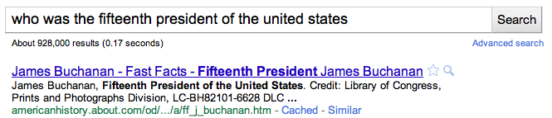
Where are we now?
Information retrieval/query answering
  search engines:
    pretty good for some things
    does mostly pattern matching and ranking
      no deep understanding
      still requires user to “find” the answer

Slide 40
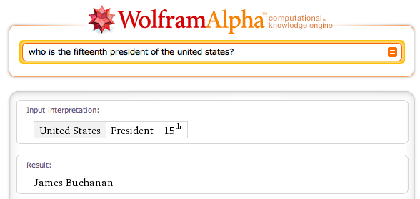
Where are we now?
Question answering
  wolfram alpha

Slide 41
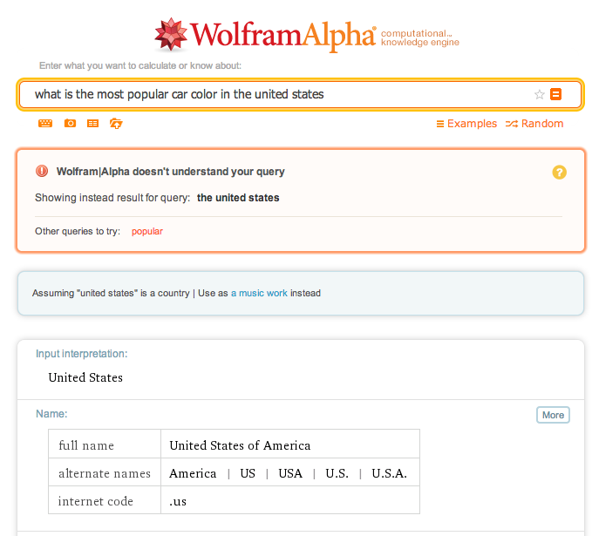
Where are we now?
Question answering: wolfram alpha

Slide 42

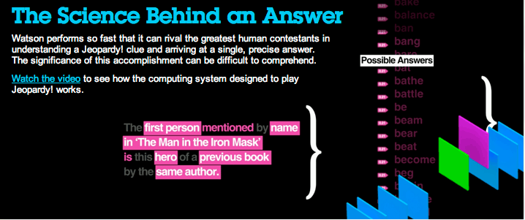
Question answering

Slide 43
Where are we now?
Question answering
  Many others systems
    TREC question answering competition
    language computer corp
    answerbus
    …

Slide 44
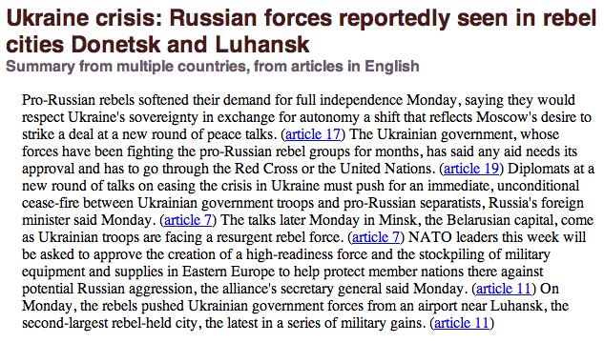
Where are we now?
Summarization
  NewsBlaster (Columbia)http://newsblaster.cs.columbia.edu/

Slide 45
Where are we now?
Voice recognition
  pretty good, particularly with speaker training
    Apple OS/Siri
    Android/Google
    Alexa, Google Assistant, etc…
    IBM ViaVoice
    Dragon Naturally Speaking
Speech generation
  The systems can generate the words, but getting the subtle nuances right is still tricky
    Apple OS
    http://translate.google.com

Slide 46
Other problems
Many problems untackled/undiscovered
“That’s What She Said: Double Entendre Identiﬁcation”
  ACL 2011
  http://www.aclweb.org/anthology/P11-2016.pdf

