Slide 1
Encryption
David Kauchak
CS52 – Spring 2016

Slide 2
Admin
Assignment 6

Slide 3
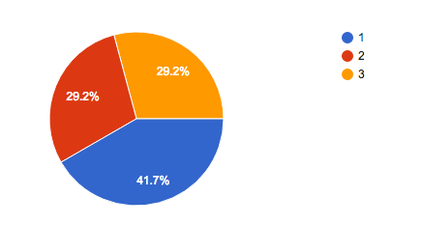
Survey: respondents
24 total respondents

Slide 4
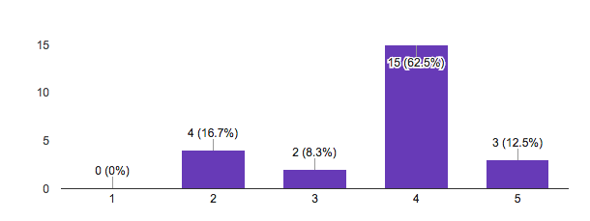
Survey: “How is the class going?”

Slide 5
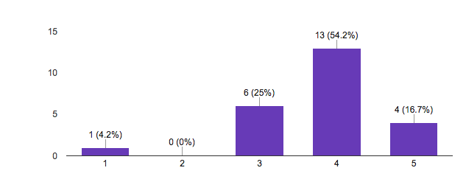
Survey: “How is the difficulty of the class?”

Slide 6
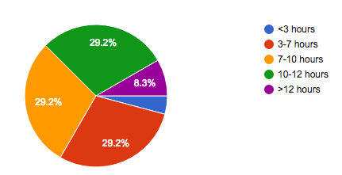
Survey: time spent per week

Slide 7
Survey: comments
It's rewarding to get the right answers after putting in lots of effort
Making my code work after hours of coding!!
The feeling of relief/ success of turning in assignments

Slide 8
Survey: comments
More opportunities for collaboration or at least a less pessimistic attitude towards discussing assignments with classmates.

Slide 9
Survey: comments
Practice questions for every test so we can have a good idea of what to expect on the tests.

Slide 10
Survey: comments
Having a CS 52 mixer would allow students and mentors to interact in a more social environment creating a stronger Pomona CS community. Although CS snack and the weekly lunch with Prof. Kauchak are good events, those are very defined and formal events to perform informal actions like getting to know someone else better. A mixer with all the sections would also allow non-Pomona students to meet new students. Libations optional.

Slide 11
Survey: comments
Haskell>SML and what I mean by it's just going ok is that I think we could learn more

Slide 12
Survey: comments
Releasing homework solutions after we complete them.

Slide 13
Survey: comments
I have honestly enjoyed the midterms

Slide 14
Encryption
What is it and why do we need it?

Slide 15



Encryption
I like bananas

Slide 16
Encryption
I like bananas

Slide 17

Encryption: a bad attempt
I like bananas

Slide 18

Encryption: the basic idea
I like bananas
I like bananas
encrypt message
decrypt message
send encrypted message

Slide 19
Encryption: a better approach
the hawk sleeps at midnight

Slide 20
Encryption uses
Where have you seen encryption used?

Slide 21


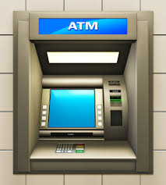
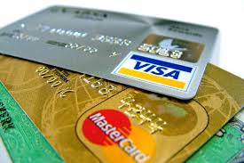
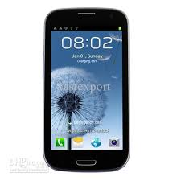
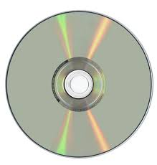
Encryption uses

Slide 22
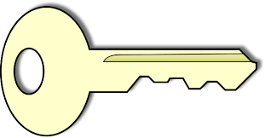
Private key encryption
I like bananas
I like bananas
encrypt message
decrypt message
send encrypted message

Slide 23

Private key encryption
Any problems with this?

Slide 24
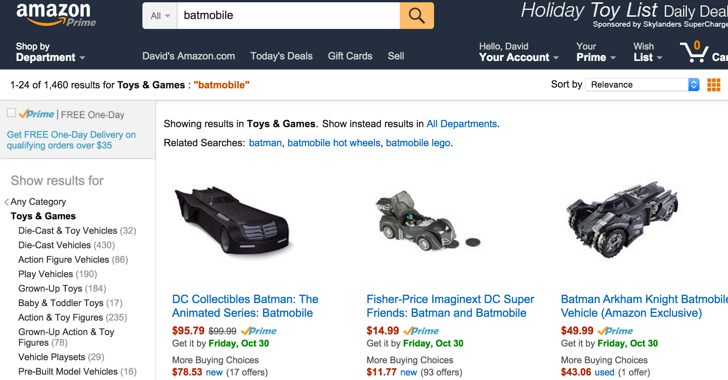
Private key encryption

Slide 25
Private key encryption
?

Slide 26


Public key encryption
private key
public key
Two keys, one you make publicly available and one you keep to yourself

Slide 27

Public key encryption
Share your public key with everyone

Slide 28
Public key encryption
I like bananas
I like bananas
encrypt message
decrypt message
send encrypted message

Slide 29
Public key encryption
I like bananas
Only the person with the private key can decrypt!
decrypt message

Slide 30

Modular arithmetic
Normal arithmetic:
a = b
a is equal to b or a-b = 0
Modular arithmetic:
a b (mod n)
a-b = n*k for some integer k or
a = b + n*k for some integer k or
a % n = b % n (where % is the mod operator)
Notes:
note that (mod n) is notation NOT the mod operator

Slide 31
Modular arithmetic
Which of these statements are true?
12
5 (mod 7)
52
92 (mod 10)
17
12 (mod 6)
a-b = n*k for some integer k or
a = b + n*k for some integer k or
a % n = b % n (where % is the mod operator)
65
33 (mod 32)

Slide 32
Modular arithmetic
Which of these statements are true?
12-5 = 7 = 1*7
12 % 7 = 5 = 5 % 7
12
5 (mod 7)
92-52 = 40 = 4*10
92 % 10 = 2 = 52 % 20
52
92 (mod 10)
17-12 = 5
17 % 6 = 5
12 % 6 = 0
17
12 (mod 6)
65-33 = 32 = 1*32
65 % 32 = 1 = 33 % 32
65
33 (mod 32)

Slide 33
Modular arithmetic properties
If:
a
b (mod n)
then:
a mod n = b mod n
“mod”/remainder operator
congruence (mod n)

Slide 34
Modular arithmetic properties
If:
a
b (mod n)
then:
a mod n = b mod n
More importantly:
(a+b) mod n = ((a mod n) + (b mod n)) mod n
and
(a*b) mod n = ((a mod n) * (b mod n)) mod n
What do these say?

Slide 35
Modular arithmetic
Why talk about modular arithmetic and congruence? How is it useful? Why might it be better than normal arithmetic?
We can limit the size of the numbers we’re dealing with to be at most n (if it gets larger than n at any point, we can always just take the result mod n)
The mod operator can be thought of as mapping a number in the range 0 … n-1

Slide 36
GCD
What does GCD stand for?

Slide 37
Greatest Common Divisor
gcd(a, b) is the largest positive integer that divides both numbers without a remainder
gcd(25, 15) = ?

Slide 38
Greatest Common Divisor
gcd(a, b) is the largest positive integer that divides both numbers without a remainder
gcd(25, 15) = 5
25
15
25
5
1
15
5
3
1
Divisors:

Slide 39
Greatest Common Divisor
gcd(a, b) is the largest positive integer that divides both numbers without a remainder
gcd(100, 52) = ?

Slide 40
Greatest Common Divisor
gcd(a, b) is the largest positive integer that divides both numbers without a remainder
gcd(100, 52) = 4
100
52
100
50
25
20
10
5
4
2
1
52
13
4
2
1
Divisors:

Slide 41
Greatest Common Divisor
gcd(a, b) is the largest positive integer that divides both numbers without a remainder
gcd(14, 63) = ?
gcd(7, 56) = ?
gcd(23, 5) = ?
gcd(100, 9) = ?
gcd(111, 17) = ?

Slide 42
Greatest Common Divisor
gcd(a, b) is the largest positive integer that divides both numbers without a remainder
gcd(14, 63) = 7
gcd(7, 56) = 7
gcd(23, 5) = 1
gcd(100, 9) = 1
gcd(111, 17) = 1
Any observations?

Slide 43
Greatest Common Divisor
When the gcd = 1, the two numbers share no factors/divisors in common
If gcd(a,b) = 1 then a and b are relatively prime
This a weaker condition than primality, since any two prime numbers are also relatively prime, but not vice versa

Slide 44
Greatest Common Divisor
A useful property:
If two numbers, a and b, are relatively prime (i.e. gcd(a,b) = 1), then there exists a c such that
a*c mod b = 1

Slide 45
RSA public key encryption
Have you heard of it?
What does it stand for?

Slide 46
RSA public key encryption
RSA is one of the most popular public key encryption algorithms in use
RSA = Ron Rivest, Adi Shamir and Leonard Adleman

Slide 47
RSA public key encryption
Choose a bit-length k
    Security increases with the value of k, though so does computation
Choose two primes p and q which can be represented with at most k bits
Let n = pq and ϕ(n) = (p-1)(q-1)
    ϕ() is called Euler’s totient function
Find d such that 0 < d < n and gcd(d,ϕ(n)) = 1
Find e such that de mod ϕ(n) = 1
    Remember, we know one exists!

Slide 48
RSA public key encryption
p: prime number
q: prime number
n = pq
ϕ(n) = (p-1)(q-1)
d: 0 < d < n and gcd(d,ϕ(n)) = 1
e: de mod ϕ(n) = 1
Given this setup, you can prove that given a number m:
(m^{e})^{d} = m^{ed} = m (mod n)
What does this do for us, though?

Slide 49
RSA public key encryption
p: prime number
q: prime number
n = pq
ϕ(n) = (p-1)(q-1)
d: 0 < d < n and gcd(d,ϕ(n)) = 1
e: de mod ϕ(n) = 1
Given this setup, you can prove that given a number m:
m
message
What does this do for us, though?

Slide 50
RSA public key encryption
p: prime number
q: prime number
n = pq
ϕ(n) = (p-1)(q-1)
d: 0 < d < n and gcd(d,ϕ(n)) = 1
e: de mod ϕ(n) = 1
Given this setup, you can prove that given a number m:
(m^{e})
encrypted message
What does this do for us, though?

Slide 51
RSA public key encryption
p: prime number
q: prime number
n = pq
ϕ(n) = (p-1)(q-1)
d: 0 < d < n and gcd(d,ϕ(n)) = 1
e: de mod ϕ(n) = 1
Given this setup, you can prove that given a number m:
(m^{e})^{d} = m^{ed} = m (mod n)
decrypted message
What does this do for us, though?

Slide 52
RSA public key encryption
p: prime number
q: prime number
n = pq
ϕ(n) = (p-1)(q-1)
d: 0 < d < n and gcd(d,ϕ(n)) = 1
e: de mod ϕ(n) = 1
private key
public key
(d, n)
(e, n)

Slide 53
RSA encryption/decryption
private key
public key
(d, n)
(e, n)
You have a number m that you want to send encrypted
encrypt(m) = m^{e} mod n
(uses the public key)
How does this encrypt the message?

Slide 54
RSA encryption/decryption
private key
public key
(d, n)
(e, n)
You have a number m that you want to send encrypted
encrypt(m) = m^{e} mod n
(uses the public key)
Maps m onto some number in the range 0 to n-1
If you vary e, it will map to a different number
Therefore, unless you know d, it’s hard to know what the original m was after the transformation

Slide 55
RSA encryption/decryption
private key
public key
(d, n)
(e, n)
You have a number m that you want to send encrypted
encrypt(m) = m^{e} mod n
(uses the public key)
decrypt(z) = z^{d} mod n
(uses the private key)
Does this work?

Slide 56
RSA encryption/decryption
encrypt(m) = m^{e} mod n
decrypt(z) = z^{d} mod n
decrypt(z) =
decrypt(m^{e} mod n)
z is some encrypted message
= (m^{e} mod n)^{d} mod n
definition of decrypt
= (m^{e})^{d} mod n
modular arithmetic
= m mod n
(m^{e})^{d} = m^{ed} = m (mod n)
Did we get the original message?

Slide 57
RSA encryption/decryption
encrypt(m) = m^{e} mod n
decrypt(z) = z^{d} mod n
decrypt(z) =
decrypt(m^{e} mod n)
z is some encrypted message
= (m^{e} mod n)^{d} mod n
definition of decrypt
= (m^{e})^{d} mod n
modular arithmetic
= m mod n
(m^{e})^{d} = m^{ed} = m (mod n)
If 0 ≤ m < n, yes!

Slide 58
RSA encryption: an example
p: prime number
q: prime number
n = pq
ϕ(n) = (p-1)(q-1)
d: 0 < d < n and gcd(d,ϕ(n)) = 1
e: de mod ϕ(n) = 1
p = 3
q = 13
n = ?
ϕ(n) = ?
d = ?
e = ?

Slide 59
RSA encryption: an example
p: prime number
q: prime number
n = pq
ϕ(n) = (p-1)(q-1)
d: 0 < d < n and gcd(d,ϕ(n)) = 1
e: de mod ϕ(n) = 1
p = 3
q = 13
n = ?

Slide 60
RSA encryption: an example
p: prime number
q: prime number
n = pq
ϕ(n) = (p-1)(q-1)
d: 0 < d < n and gcd(d,ϕ(n)) = 1
e: de mod ϕ(n) = 1
p = 3
q = 13
n = 3*13 = 39

Slide 61
RSA encryption: an example
p: prime number
q: prime number
n = pq
ϕ(n) = (p-1)(q-1)
d: 0 < d < n and gcd(d,ϕ(n)) = 1
e: de mod ϕ(n) = 1
p = 3
q = 13
n = 39
ϕ(n) = ?

Slide 62
RSA encryption: an example
p: prime number
q: prime number
n = pq
ϕ(n) = (p-1)(q-1)
d: 0 < d < n and gcd(d,ϕ(n)) = 1
e: de mod ϕ(n) = 1
p = 3
q = 13
n = 39
ϕ(n) = 2*12 = 24

Slide 63
RSA encryption: an example
p: prime number
q: prime number
n = pq
ϕ(n) = (p-1)(q-1)
d: 0 < d < n and gcd(d,ϕ(n)) = 1
e: de mod ϕ(n) = 1
p = 3
q = 13
n = 39
ϕ(n) = 24
d = ?
e = ?

Slide 64
RSA encryption: an example
p: prime number
q: prime number
n = pq
ϕ(n) = (p-1)(q-1)
d: 0 < d < n and gcd(d,ϕ(n)) = 1
e: de mod ϕ(n) = 1
p = 3
q = 13
n = 39
ϕ(n) = 24
d = 5
e = 5

Slide 65
RSA encryption: an example
p: prime number
q: prime number
n = pq
ϕ(n) = (p-1)(q-1)
d: 0 < d < n and gcd(d,ϕ(n)) = 1
e: de mod ϕ(n) = 1
p = 3
q = 13
n = 39
ϕ(n) = 24
d = 5
e = 29

Slide 66
RSA encryption: an example
encrypt(m) = m^{e} mod n
n = 39
d = 5
e = 29
decrypt(z) = z^{d} mod n
encrypt(10) = ?

Slide 67
RSA encryption: an example
encrypt(m) = m^{e} mod n
n = 39
d = 5
e = 29
decrypt(z) = z^{d} mod n
encrypt(10) = 10²⁹ mod 39 = 4

Slide 68
RSA encryption: an example
encrypt(m) = m^{e} mod n
n = 39
d = 5
e = 29
decrypt(z) = z^{d} mod n
encrypt(10) = 10²⁹ mod 39 = 4
decrypt(4) = ?

Slide 69
RSA encryption: an example
encrypt(m) = m^{e} mod n
n = 39
d = 5
e = 29
decrypt(z) = z^{d} mod n
encrypt(10) = 10²⁹ mod 39 = 4
decrypt(4) = 4⁵ mod 39 = 10

Slide 70
RSA encryption: an example
encrypt(m) = m^{e} mod n
n = 39
d = 5
e = 5
decrypt(z) = z^{d} mod n
encrypt(2) = ?

Slide 71
RSA encryption: an example
encrypt(m) = m^{e} mod n
n = 39
d = 5
e = 5
decrypt(z) = z^{d} mod n
encrypt(2) = 2⁵ mod 39 = 32 mod 39 = 32
decrypt(32) = ?

Slide 72
RSA encryption: an example
encrypt(m) = m^{e} mod n
n = 39
d = 5
e = 5
decrypt(z) = z^{d} mod n
encrypt(2) = 2⁵ mod 39 = 32 mod 39 = 32
decrypt(32) = 32⁵ mod 39 = 2

Slide 73
RSA encryption in practice
For RSA to work: 0 ≤ m < n
What if our message isn’t a number?
What if our message is a number that’s larger than n?

Slide 74
RSA encryption in practice
For RSA to work: 0 ≤ m < n
What if our message isn’t a number?
  We can always convert the message into a number (remember everything is stored in binary already somewhere!)
What if our message is a number that’s larger than n?
  Break it into n sized chunks and encrypt/decrypt those chunks

Slide 75
RSA encryption in practice
encrypt(“I like bananas”) =
0101100101011100 …
encode as a binary string (i.e. number)
4, 15, 6, 2, 22, …
break into multiple < n size numbers
17, 1, 43, 15, 12, …
encrypt each number

Slide 76
RSA encryption in practice
decrypt((17, 1, 43, 15, 12, …)) =
4, 15, 6, 2, 22, …
decrypt each number
0101100101011100 …
put back together
“I like bananas”
turn back into a string (or whatever the original message was)
Often encrypt and decrypt just assume sequences of bits and the interpretation is done outside

