Slide 1
binary
David Kauchak
CS 52 – Spring 2017

Slide 2
Admin
Assignment 5

Slide 3
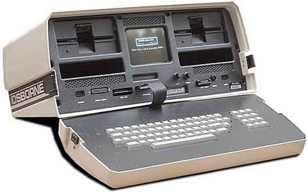
Diving into your computer

Slide 4
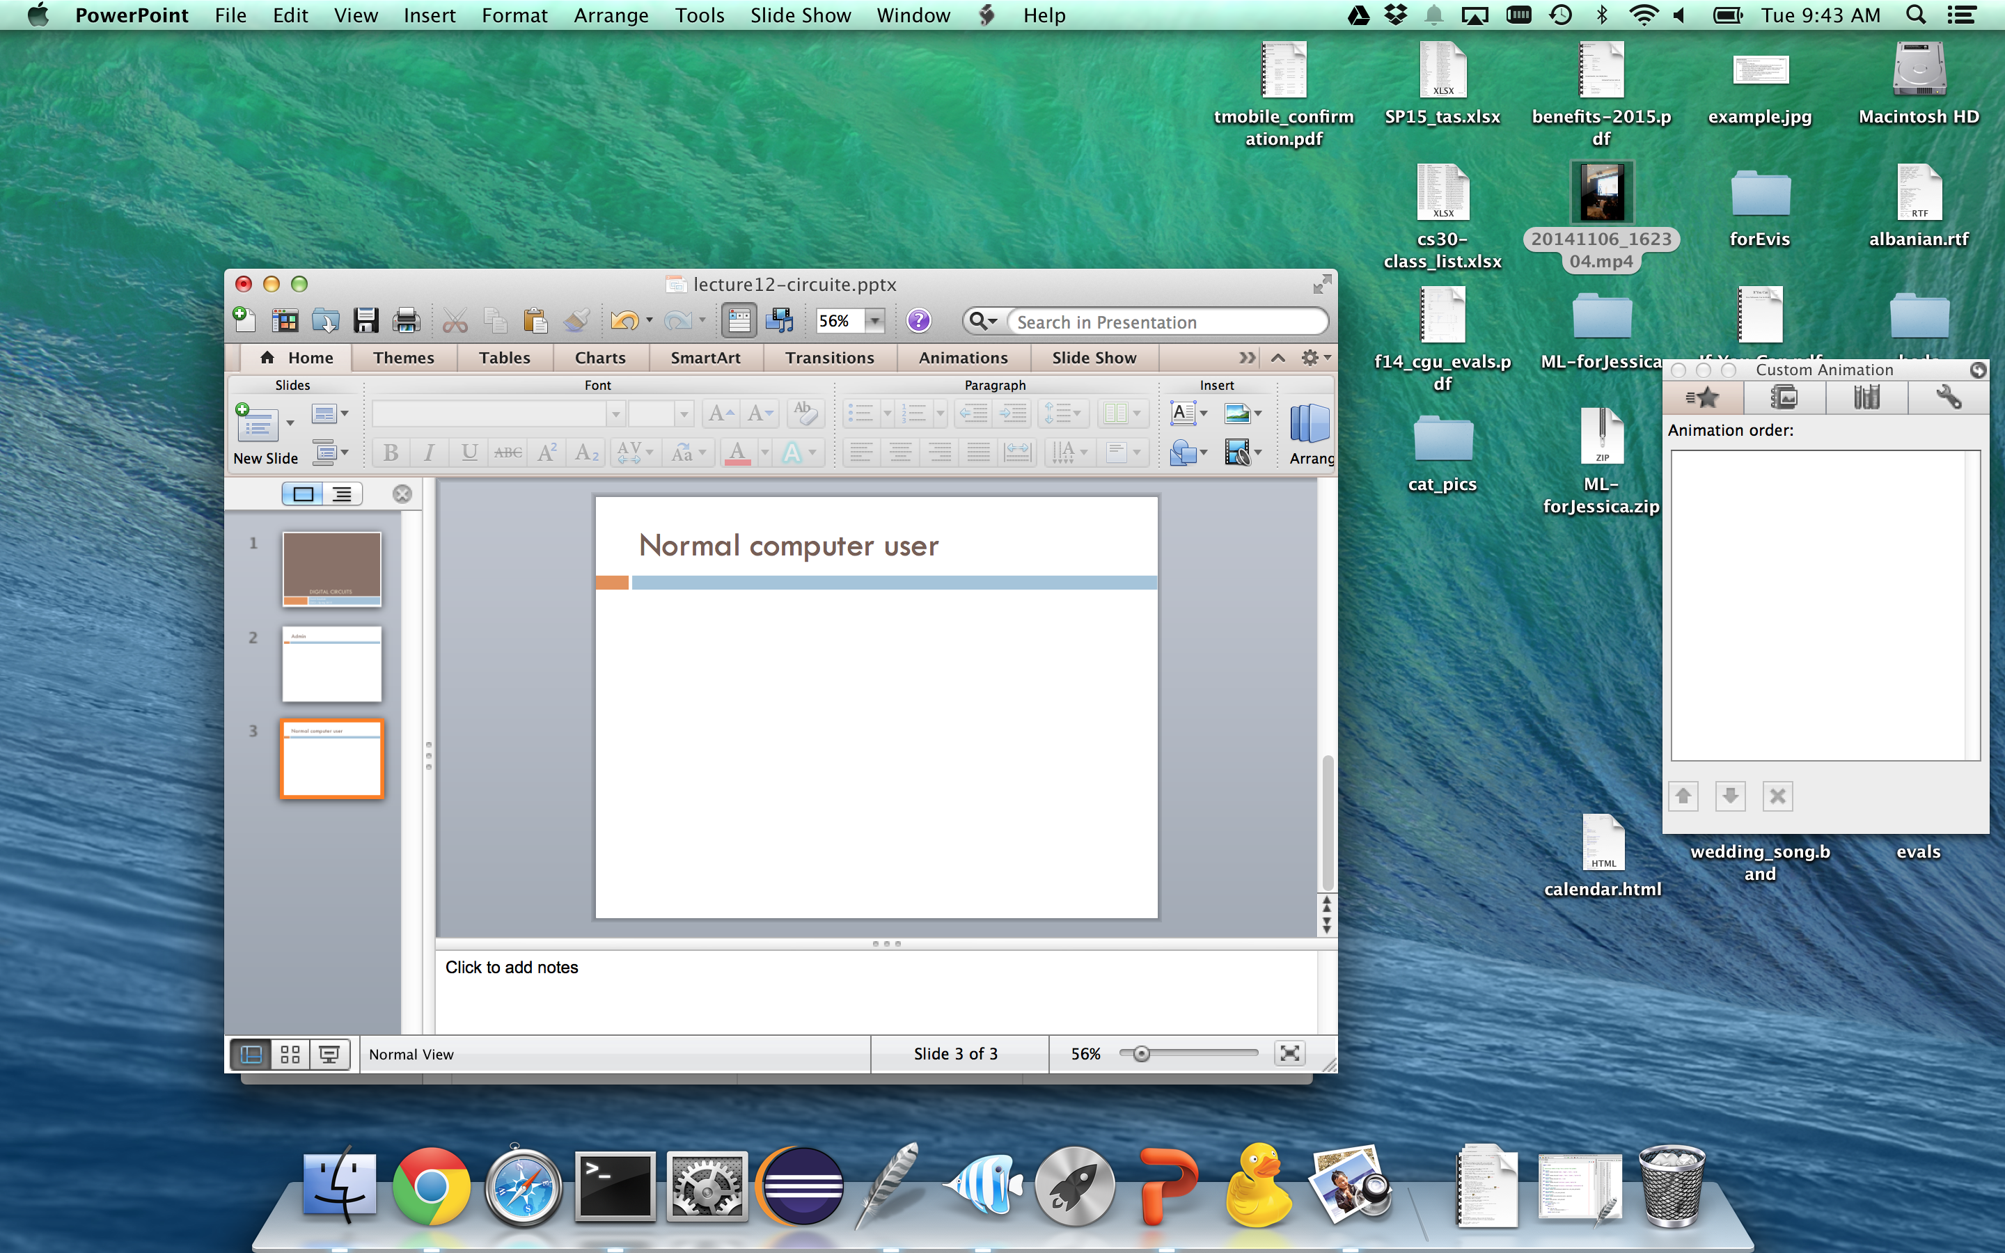
Normal computer user

Slide 5
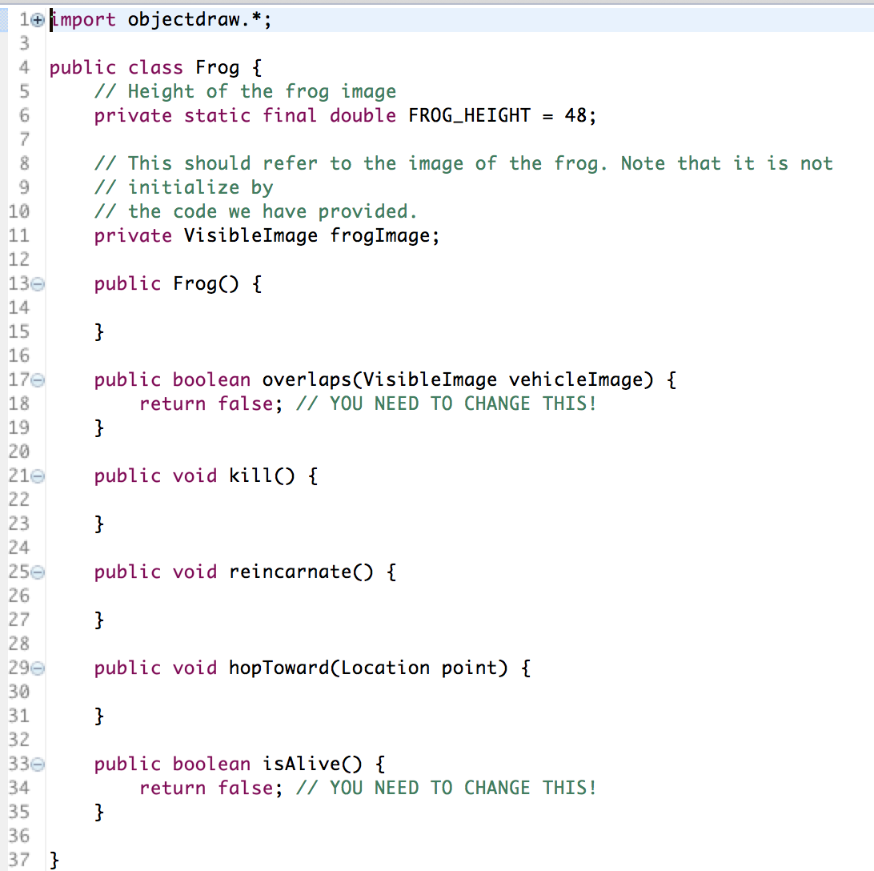
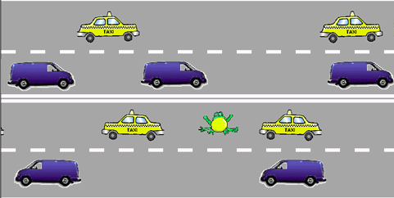
After intro CS

Slide 6
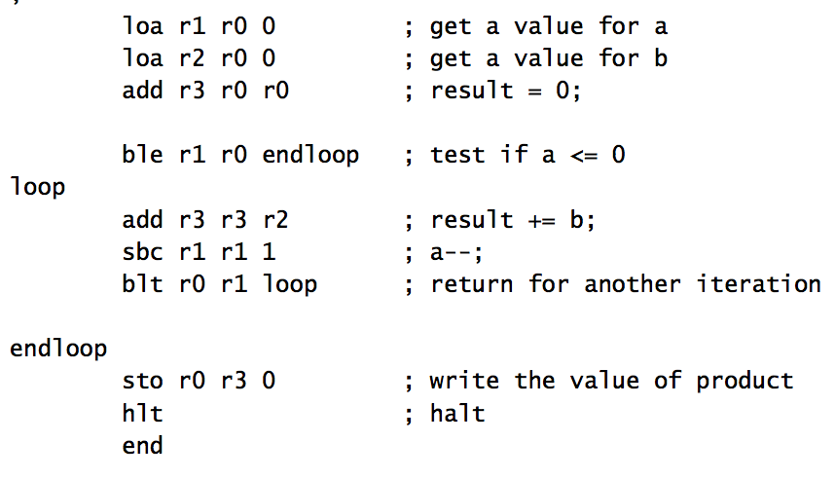
After 5 weeks of cs52

Slide 7
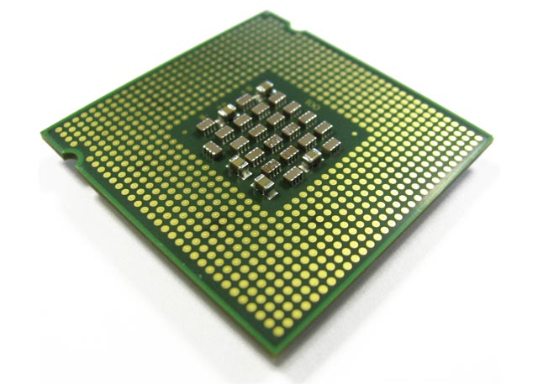
What now?

Slide 8
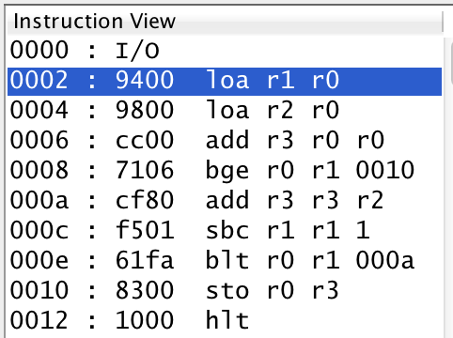
One last note on CS52
memory address
binary representation of code
instructions (assembly code)
How do we get this?

Slide 9
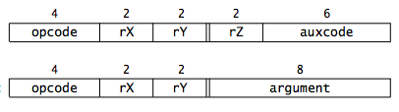
Encoding assembly instructions
1001 0100 0000 0000
1001 1000 0000 0000
1100 1100 0000 0000
opcode
rx
ry
rz

Slide 10
Binary numbers revisited
What number does 1001 represent in binary?
Depends!
Is it a signed number or unsigned?
If signed, what convention are we using?

Slide 11
Twos complement
For a number with n digits the high order bit represents -2^{n-1}
unsigned
2³
2²
2¹
2⁰
signed
(twos complement)
-2³
2²
2¹
2⁰

Slide 12
Twos complement
What number is it?
1
0
0
1
unsigned
9
2³
2²
2¹
2⁰
1
0
0
1
signed
(twos complement)
-7
-2³
2²
2¹
2⁰

Slide 13
Twos complement
What number is it?
1
1
1
1
unsigned
15
2³
2²
2¹
2⁰
1
1
1
1
signed
(twos complement)
-1
-2³
2²
2¹
2⁰

Slide 14
Twos complement
What number is it?
1
1
0
0
unsigned
12
2³
2²
2¹
2⁰
1
1
0
0
signed
(twos complement)
-4
-2³
2²
2¹
2⁰

Slide 15
Twos complement
How many numbers can we represent with each approach using 4 bits?
16 (2⁴) numbers, 0000, 0001, …., 1111
Doesn’t matter the representation!
unsigned
2³
2²
2¹
2⁰
signed
(twos complement)
-2³
2²
2¹
2⁰

Slide 16
Twos complement
How many numbers can we represent with each approach using 32 bits?
2³² ≈ 4 billion numbers
unsigned
2³
2²
2¹
2⁰
signed
(twos complement)
-2³
2²
2¹
2⁰

Slide 17
Twos complement
What is the range of numbers that we can represent for each approach with 4 bits?
unsigned: 0, 1, … 15
signed: -8, -7, …, 7
unsigned
2³
2²
2¹
2⁰
signed
(twos complement)
-2³
2²
2¹
2⁰

Slide 18
binary representation | unsigned
0000 | 0
0001 | 1
0010 | ?
0011
0100
0101
0110
0111
1000
1001
1010
1011
1100
1101
1110
1111

Slide 19
binary representation | unsigned | twos complement
0000 | 0 | ?
0001 | 1
0010 | 2
0011 | 3
0100 | 4
0101 | 5
0110 | 6
0111 | 7
1000 | 8
1001 | 9
1010 | 10
1011 | 11
1100 | 12
1101 | 13
1110 | 14
1111 | 15

Slide 20
binary representation | unsigned | twos complement
0000 | 0 | 0
0001 | 1 | 1
0010 | 2 | 2
0011 | 3 | 3
0100 | 4 | 4
0101 | 5 | 5
0110 | 6 | 6
0111 | 7 | 7
1000 | 8 | ?
1001 | 9
1010 | 10
1011 | 11
1100 | 12
1101 | 13
1110 | 14
1111 | 15

Slide 21
binary representation | unsigned | twos complement
0000 | 0 | 0
0001 | 1 | 1
0010 | 2 | 2
0011 | 3 | 3
0100 | 4 | 4
0101 | 5 | 5
0110 | 6 | 6
0111 | 7 | 7
1000 | 8 | -8
1001 | 9 | ?
1010 | 10
1011 | 11
1100 | 12
1101 | 13
1110 | 14
1111 | 15

Slide 22
binary representation | unsigned | twos complement
0000 | 0 | 0
0001 | 1 | 1
0010 | 2 | 2
0011 | 3 | 3
0100 | 4 | 4
0101 | 5 | 5
0110 | 6 | 6
0111 | 7 | 7
1000 | 8 | -8
1001 | 9 | -7
1010 | 10 | -6
1011 | 11 | -5
1100 | 12 | -4
1101 | 13 | -3
1110 | 14 | -2
1111 | 15 | -1

Slide 23
binary representation | unsigned | twos complement
0000 | 0 | 0
0001 | 1 | 1
0010 | 2 | 2
0011 | 3 | 3
0100 | 4 | 4
0101 | 5 | 5
0110 | 6 | 6
0111 | 7 | 7
1000 | 8 | -8
1001 | 9 | -7
1010 | 10 | -6
1011 | 11 | -5
1100 | 12 | -4
1101 | 13 | -3
1110 | 14 | -2
1111 | 15 | -1
How can you tell if a number is negative?

Slide 24
binary representation | unsigned | twos complement
0000 | 0 | 0
0001 | 1 | 1
0010 | 2 | 2
0011 | 3 | 3
0100 | 4 | 4
0101 | 5 | 5
0110 | 6 | 6
0111 | 7 | 7
1000 | 8 | -8
1001 | 9 | -7
1010 | 10 | -6
1011 | 11 | -5
1100 | 12 | -4
1101 | 13 | -3
1110 | 14 | -2
1111 | 15 | -1
High order bit!

Slide 25
A two’s complement trick
You can also calculate the value of a negative number represented as twos complement as follows:
  Flip all of the bits (0 → 1 and 1→ 0)
  Add 1
  The resulting number is the magnitude of the original negative number
flip the bits
add 1
1101
0010
0011
-3

Slide 26
A two’s complement trick
You can also calculate the value of a negative number represented as twos complement as follows:
  Flip all of the bits (0 → 1 and 1→ 0)
  Add 1
  The resulting number is the magnitude of the original negative number
flip the bits
add 1
1110
0001
0010
-2

Slide 27
Shifting
Shifting shifts the binary representation of the number right or left

Slide 28
Shifting
Shifting shifts the binary representation of the number right or left
37 >> 2
?
number to be shifted
number of positions to shift
right shift

Slide 29
Shifting
Shifting shifts the binary representation of the number right or left
37 >> 2
37
100101
1001
9
shift right two positions
(discard bits shifting off)
number in binary
decimal form

Slide 30
Shifting
Shifting shifts the binary representation of the number right or left
37 >> 3
?

Slide 31
Shifting
Shifting shifts the binary representation of the number right or left
37 >> 3
37
100101
100
4
shift right three positions
(discard bits shifting off)
number in binary
decimal form

Slide 32
Shifting with fixed bit representations
In real computers, we generally have a fixed number of bits we use to represent a number (e.g. 8-bits, 16-bits, 32-bits)

Slide 33
Shifting 8-bit numbers
Shifting shifts the binary representation of the number right or left
37 >> 2
What is 37 as an 8-bit binary number?
37
00100101
pad with 0s
number in binary

Slide 34
Shifting 8-bit numbers
Shifting shifts the binary representation of the number right or left
37 >> 2
How do we fill in the leftmost bits?
37
00100101
shift right two positions
(discard bits shifting off)
number in binary

Slide 35
Shifting 8-bit numbers
Shifting shifts the binary representation of the number right or left
37 >> 2
How do we fill in the leftmost bits?
37
00100101
00001001
shift right two positions
(discard bits shifting off)
number in binary

Slide 36
Shifting 8-bit numbers
Shifting shifts the binary representation of the number right or left
37 >> 2
37
00100101
00001001
9
shift right two positions
(discard away bits shifting off)
number in binary
decimal form

Slide 37
Shifting 8-bit numbers
Shifting shifts the binary representation of the number right or left
15 << 2
?

Slide 38
Shifting 8-bit numbers
Shifting shifts the binary representation of the number right or left
15 << 2
15
?
number in binary

Slide 39
Shifting 8-bit numbers
Shifting shifts the binary representation of the number right or left
15 << 2
15
00001111
number in binary

Slide 40
Shifting 8-bit numbers
Shifting shifts the binary representation of the number right or left
15 << 2
15
00001111
?
shift left two positions
(discard bits shifting off)
number in binary

Slide 41
Shifting 8-bit numbers
Shifting shifts the binary representation of the number right or left
15 << 2
15
00001111
001111??
shift left two positions
(discard bits shifting off)
number in binary

Slide 42
Shifting 8-bit numbers
Shifting shifts the binary representation of the number right or left
15 << 2
15
00001111
00111100
shift left two positions
(discard bits shifting off)
number in binary

Slide 43
Shifting 8-bit numbers
Shifting shifts the binary representation of the number right or left
15 << 2
15
00001111
00111100
60
shift left two positions
(discard bits shifting off)
number in binary
decimal form

Slide 44
Shifting mathematically
What does left shifting by one position do mathematically?
0
A
B
C
2³
2²
2¹
2⁰

Slide 45
Shifting mathematically
What does left shifting by one position do mathematically?
0
A
B
C
2³
2²
2¹
2⁰
A
B
C
0
2³
2²
2¹
2⁰

Slide 46
Shifting mathematically
What does left shifting by one position do mathematically?
0
A
B
C
2³
2²
2¹
2⁰
A
B
C
0
2³
2²
2¹
2⁰

Slide 47
Shifting mathematically
What does left shifting by one position do mathematically?
0
A
B
C
2³
2²
2¹
2⁰
Doubles the number!
A
B
C
0
2³
2²
2¹
2⁰

Slide 48
Shifting mathematically
What does left shifting by n positions do mathematically?
Multiply by 2^{n} (double n times)

Slide 49
Shifting mathematically
What does right shifting by one position do mathematically?
0
A
B
C
2³
2²
2¹
2⁰

Slide 50
Shifting mathematically
What does right shifting by one position do mathematically?
0
A
B
C
2³
2²
2¹
2⁰
0
0
A
B
2³
2²
2¹
2⁰

Slide 51
Shifting mathematically
What does right shifting by one position do mathematically?
0
A
B
C
2³
2²
2¹
2⁰
0
0
A
B
2³
2²
2¹
2⁰

Slide 52
Shifting mathematically
What does right shifting by one position do mathematically?
0
A
B
C
2³
2²
2¹
2⁰
Integer divide by 2
0
0
A
B
2³
2²
2¹
2⁰

Slide 53
Shifting mathematically
What does right shifting by n positions do mathematically?
Integer division by 2^{n} (halve n times)

Slide 54
Shifting 4-bit numbers
Shifting shifts the binary representation of the number right or left
-4 >> 1
?

Slide 55
Shifting 4-bit numbers
Shifting shifts the binary representation of the number right or left
-4 >> 1
What is -4 as a 4-bit binary number?
-4
1100
number in binary

Slide 56
Shifting 4-bit numbers
Shifting shifts the binary representation of the number right or left
-4 >> 1
How do we fill in the leftmost bit?
-4
1100
?110
shift right one position
(discard bits shifting off)
number in binary

Slide 57
Shifting 4-bit numbers
Two types of right shifts:
logical shift: always shift in 0s
arithmetic shift: shift in the same as the high-order bit
-4
1100
?110
shift right one position
(discard bits shifting off)
number in binary

Slide 58
Shifting 4-bit numbers
Two types of right shifts:
logical shift: always shift in 0s
arithmetic shift: shift in the same as the high-order bit
-4
1100
?110
shift right one position
(discard bits shifting off)
number in binary

Slide 59
Shifting 4-bit numbers
Two types of right shifts:
logical shift: always shift in 0s
arithmetic shift: shift in the same as the high-order bit
-4
1100
1110
shift right one position
(discard bits shifting off)
number in binary

Slide 60
Shifting 4-bit numbers
Two types of right shifts:
logical shift: always shift in 0s
arithmetic shift: shift in the same as the high-order bit
-4 >> 1
-4
1100
1110
?
shift right one position
(discard bits shifting off)
number in binary
decimal form

Slide 61
Shifting 4-bit numbers
Two types of right shifts:
logical shift: always shift in 0s
arithmetic shift: shift in the same as the high-order bit
-4 >> 1
-4
1100
1110
-2
shift right one position
(discard bits shifting off)
number in binary
decimal form

Slide 62
Shifting 4-bit numbers
Shifting shifts the binary representation of the number right or left
-4 >> 2
?

Slide 63
Shifting 4-bit numbers
Two types of right shifts:
logical shift: always shift in 0s
arithmetic shift: shift in the same as the high-order bit
-4 >> 2
-4
1100
1111
-1
shift right two positions
(discard bits shifting off)
number in binary
decimal form

Slide 64
Arithmetic shifting mathematically
What does right arithmetic shifting by n positions do mathematically for signed numbers?
Integer division by 2^{n} (halve n times)
Same thing!!

Slide 65
Shifting 4-bit numbers
Two types of right shifts:
logical shift: always shift in 0s
arithmetic shift: shift in the same as the high-order bit
-4
1100
?110
shift right one position
(discard bits shifting off)
number in binary

Slide 66
Shifting 4-bit numbers
Two types of right shifts:
logical shift: always shift in 0s
arithmetic shift: shift in the same as the high-order bit
-4
1100
0110
shift right one position
(discard bits shifting off)
number in binary

Slide 67
Shifting 4-bit numbers
Two types of right shifts:
logical shift: always shift in 0s
arithmetic shift: shift in the same as the high-order bit
-4 >>> 1
-4
1100
0110
?
shift right one position
(discard bits shifting off)
number in binary
decimal form

Slide 68
Shifting 4-bit numbers
Two types of right shifts:
logical shift: always shift in 0s
arithmetic shift: shift in the same as the high-order bit
-4 >>> 1
-4
1100
0110
6
shift right one position
(discard bits shifting off)
number in binary
decimal form

Slide 69
Left shifts
Two types of left shifts?
logical shift: always shift in 0s
arithmetic shift: ?
arithmetic
-3 << 1
?
logical
-3 <<< 1
?

Slide 70
Left shifts
Two types of left shifts?
logical shift: always shift in 0s
arithmetic shift: ?
arithmetic
-3 << 1
1101
101?
(double the number)
logical
-3 <<< 1
1101
1010

Slide 71
Left shifts
Two types of left shifts?
logical shift: always shift in 0s
arithmetic shift: ?
arithmetic
-3 << 1
1101
1010
(double the number)
logical
-3 <<< 1
1101
1010
Only one type of left shift

Slide 72
Shifting summarized
Arithmetic shift:
  Right shift n
    shift n bits to the right
    discard right n bits
    left n bits match high-order bits of original number
    Effect: Integer division by 2^{n} (halve n times)
  Left shift
    shift n bits to the left
    discard left n bits
    right n bits are 0s
    Effect: multiply by 2^{n} (double n times)
Logical shift right:
  left n bits are 0s (no mathematical guarantees for negative numbers)

Slide 73
Adding numbers base 10
Add: 456 and 735

Slide 74
Adding numbers base 10
456
735
+
?

Slide 75
Adding numbers base 10
1 0 1
456
735
+
1191

Slide 76
Adding numbers base 5
Add: 223₅ and 414₅

Slide 77
Adding numbers base 5
223₅
414₅
+
?

Slide 78
Adding numbers base 5
1 0 1
223₅
414₅
+
1142₅

Slide 79
Adding numbers base 5
1 0 1
223₅
414₅
63₁₀
+
109₁₀
1142₅
172₁₀

Slide 80
Adding numbers base 2
Add: 0001₂ and 0101₂

Slide 81
Adding numbers base 2
0001₂
0101₂
+
?

Slide 82
Adding numbers base 2
0
0
1
0001₂
0101₂
+
0110₂

Slide 83
Adding numbers base 2
0
0
1
0001₂
0101₂
1₁₀
+
5₁₀
0110₂
6₁₀

Slide 84
Addition with 4-bit twos complement numbers
0001₂
0101₂
+
?

Slide 85
Addition with 4-bit twos complement numbers
0
0
1
0001₂
0101₂
+
0110₂

Slide 86
Addition with 4-bit twos complement numbers
0110
0101
+
?
(Note: I’m going to stop writing the base 2 ☺)

Slide 87
Addition with 4-bit twos complement numbers
1
0110
0101
+
1011?

Slide 88
Addition with 4-bit twos complement numbers
1
0110
0101
6
+
5
1011?
-5? (11 unsigned)
Overflow! We cannot represent this number (it’s too large)

Slide 89
Addition with 4-bit twos complement numbers
0110
1101
+
?

Slide 90
Addition with 4-bit twos complement numbers
1
1
0110
1101
+
0011

Slide 91
Addition with 4-bit twos complement numbers
1
1
0110
1101
6
ignore the last carry
+
-3
0011
3

Slide 92
Subtraction
Ideas?

Slide 93
Subtraction
Negate the 2nd number (flip the bits and add 1)
Add them!

Slide 94
Midterm
Average: 28 (77%)
Q1: 24.9 (70%)
Median: 28.5 (81%)
Q3: 32 (91%)

