Slide 1
CS41B machine
David Kauchak
CS 52 – Spring 2016

Slide 2
Admin
Midterm Thursday
  Review question sessions tonight and Wednesday
Assignment 3?
Assignment 4 out soon
  Due Monday 2/29

Slide 3
Examples from this lecture
http://www.cs.pomona.edu/~dkauchak/classes/cs52/examples/cs41b/

Slide 4
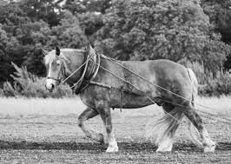
CS41B machine
CPU
instruction counter
(location in memory of the next
instruction in memory)
processor
ic
r0
holds the value 0 (read only)
r1
general purpose
read/write
r2
registers
r3

Slide 5
CS41B code
Four main types of operations
math
branch/conditionals
memory
control the machine (e.g. stop it)

Slide 6
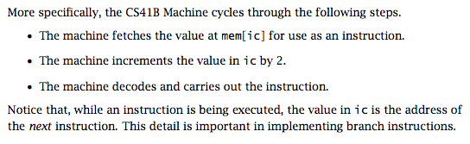
CS41B execution

Slide 7
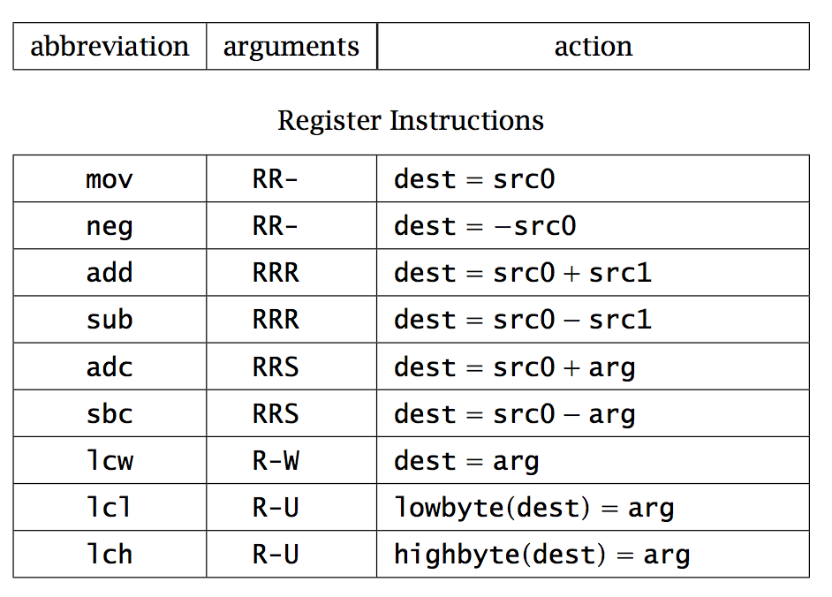

Slide 8
operation name
(always three characters)

Slide 9
operation arguments
R = register (e.g. r0)
S = signed number (byte)

Slide 10
operation function
dest = first register
src0 = second register
src1 = third register
arg = number/argument

Slide 11
adc r1 r0 8
neg r2 r1
sub r2 r1 r2
What number is in r2?

Slide 12
adc r1 r0 8
neg r2 r1
sub r2 r1 r2
r1 = 8
r2 = -8, r1 = 8
r2 = 16

Slide 13
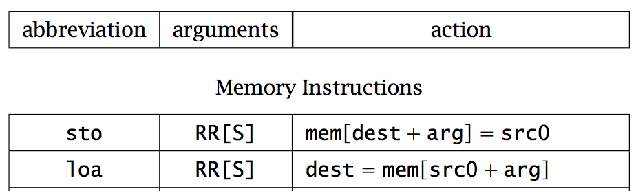
sto = save data in register TO memory
loa = put data FROM memory into a register
Special cases:
saving TO (sto) address 0 prints
reading from (loa) address 0 gets input from user

Slide 14
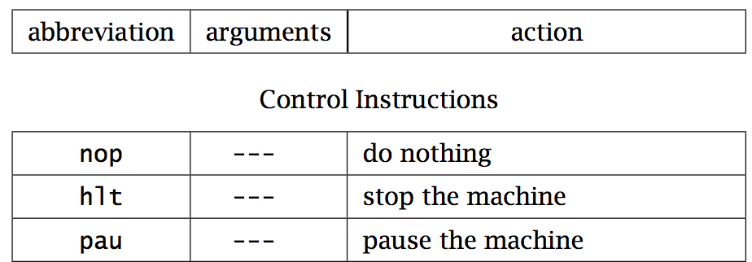

Slide 15
Basic structure of CS41B program
; great comments at the top!
;
instruction1 ; comment
instruction2 ; comment
...
hlt
end
whitespace before operations/instructions

Slide 16
Running the CS41B machine
Look at subtract.a41
load two numbers from the user
subtract
print the result

Slide 17
CS41B simulater
Different windows
  Memory (left)
  Instruction execution (right)
  Registers
  I/O and running program

Slide 18
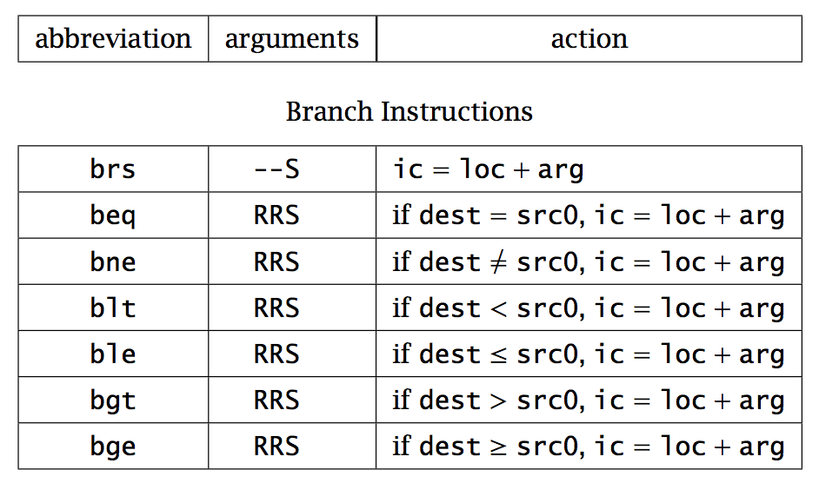
What do these operations do?

Slide 19
Modify ic, the instruction counter…
which changes the flow of the program!

Slide 20
beq r3 r0 done
What does this do?

Slide 21
beq r3 r0 done
If r3 = 0, branch to the label “done”
if not (else) ic is incremented as normal to the next instruction

Slide 22
ble r2 r3 done
What does this do?

Slide 23
ble r2 r3 done
If r2 <= r3, branch to the label done

Slide 24
Conditionals
Loops
Change the order that instructions are executed

Slide 25
Basic structure of CS41B program
; great comments at the top!
;
instruction1 ; comment
instruction2 ; comment
...
label1
instruction ; comment
instruction ; comment
label2
...
hlt
end
- whitespace before operations/instructions
- labels go here

Slide 26
More CS41B examples
Look at max_simple.a41
Get two values from the user
Compare them
Use a branch to distinguish between the two cases
  Goal is to get largest value in r3
print largest value

Slide 27
What does this code do?
bge r3 r0 elif
sbc r2 r0 1
brs endif
elif
beq r3 r0 else
adc r2 r0 1
brs endif
else
add r2 r0 r0
endif
sto r0 r2
hlt
end

Slide 28
What does this code do?
bge r3 r0 elif
sbc r2 r0 1
brs endif
elif
beq r3 r0 else
adc r2 r0 1
brs endif
else
add r2 r0 r0
endif
sto r0 r2
hlt
end
if( r3 < 0 ){
r2 = -1
}else if( r3 != 0 ){
r2 = 1
}else{
r2 = 0
}

Slide 29
What does this code do?
bge r3 r0 elif ; if r3 >= 0 go to elif
sbc r2 r0 1 ; r3 < 0: r2 = -1
brs endif ; jump to end of if/elif/else
elif
beq r3 r0 else ; if r3 = 0 go to else
adc r2 r0 1 ; r3 > 0: r2 = 1
brs endif ; jump to end of if/elif/else
else
add r2 r0 r0 ; r3 = 0: r2 = 0
endif
sto r0 r2 ; print out r2
hlt
end

Slide 30
Your turn ☺
Write some code that prints out abs(r3)

Slide 31
abs
Look at abs.a41

Slide 32
Memory layout
0
Code
Heap
Where dynamically allocated program data is stored
Where program/function execution information is stored, parameters, and local variables
Stack

Slide 33
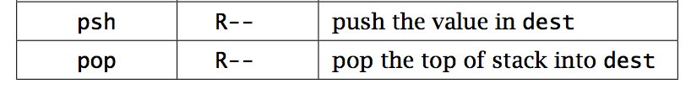
Stacks
Two operations
  push: add a value in the register to the top of the stack
  pop: remove a value from the top of the stack and put it in the register

Slide 34
Stack frame
Key unit for keeping track of a function call
return address (where to go when we’re done executing)
parameters
local variables

Slide 35
CS41B function call conventions
r1 is reserved for the stack pointer
r2 contains the return address
r3 contains the first parameter
additional parameters go on the stack (more on this)
the result should go in r3

Slide 36
Structure of a single parameter function
fname
psh r2 ; save return address on stack
... ; do work using r3 as argument
; put result in r3
pop r2 ; restore return address from stack
jmp r2 ; return to caller
conventions:
argument is in r3
r1 is off-limits since it’s used for the stack pointer
return value goes in r3

Slide 37
Our first function call
loa r3 r0 ; get variable
lcw r2 increment ; call increment
cal r2 r2
sto r0 r3 ; write result,
hlt ; and halt
increment
psh r2 ; save the return address on the stack
adc r3 r3 1 ; add 1 to the input parameter
pop r2 ; get the return address from stack
jmp r2 ; go back to where we were called from

Slide 38
Our first function call
loa r3 r0
lcw r2 increment
cal r2 r2
sto r0 r3
hlt
increment
psh r2
adc r3 r3 1
pop r2
jmp r2
r2
r3
sp (r1)
Stack

Slide 39
Our first function call
loa r3 r0
lcw r2 increment
cal r2 r2
sto r0 r3
hlt
increment
psh r2
adc r3 r3 1
pop r2
jmp r2
r2
r3
sp (r1)
Stack

Slide 40
Our first function call
loa r3 r0
lcw r2 increment
cal r2 r2
sto r0 r3
hlt
increment
psh r2
adc r3 r3 1
pop r2
jmp r2
r2
r3 | 10
sp (r1)
Stack

Slide 41
Our first function call
loa r3 r0
lcw r2 increment
cal r2 r2
sto r0 r3
hlt
increment
psh r2
adc r3 r3 1
pop r2
jmp r2
r2
r3 | 10
sp (r1)
Stack

Slide 42
Our first function call
loa r3 r0
lcw r2 increment
cal r2 r2
sto r0 r3
hlt
increment
psh r2
adc r3 r3 1
pop r2
jmp r2
r2 | increment
r3 | 10
sp (r1)
Stack

Slide 43
Our first function call
loa r3 r0
lcw r2 increment
cal r2 r2
sto r0 r3
hlt
increment
psh r2
adc r3 r3 1
pop r2
jmp r2
r2 | increment
r3 | 10
Go to instruction address in r2 (2nd r2)
Save current instruction address in r2
sp (r1)
Stack

Slide 44
Our first function call
loa r3 r0
lcw r2 increment
cal r2 r2
sto r0 r3
hlt
increment
psh r2
adc r3 r3 1
pop r2
jmp r2
r2 | loc: sto
r3 | 10
Go to instruction address in r2 (2nd r2)
Save current instruction address in r2
sp (r1)
Stack

Slide 45
Our first function call
loa r3 r0
lcw r2 increment
cal r2 r2
sto r0 r3
hlt
increment
psh r2
adc r3 r3 1
pop r2
jmp r2
r2 | loc: sto
r3 | 10
sp (r1)
Stack

Slide 46
Our first function call
loa r3 r0
lcw r2 increment
cal r2 r2
sto r0 r3
hlt
increment
psh r2
adc r3 r3 1
pop r2
jmp r2
r2 | loc: sto
r3 | 10
sp (r1)
loc: sto
Stack

Slide 47
Our first function call
loa r3 r0
lcw r2 increment
cal r2 r2
sto r0 r3
hlt
increment
psh r2
adc r3 r3 1
pop r2
jmp r2
r2 | loc: sto
r3 | 10
sp (r1)
loc: sto
Stack

Slide 48
Our first function call
loa r3 r0
lcw r2 increment
cal r2 r2
sto r0 r3
hlt
increment
psh r2
adc r3 r3 1
pop r2
jmp r2
r2 | loc: sto
r3 | 11
sp (r1)
loc: sto
Stack

Slide 49
Our first function call
loa r3 r0
lcw r2 increment
cal r2 r2
sto r0 r3
hlt
increment
psh r2
adc r3 r3 1
pop r2
jmp r2
r2 | loc: sto
r3 | 11
sp (r1)
loc: sto
Stack

Slide 50
Our first function call
loa r3 r0
lcw r2 increment
cal r2 r2
sto r0 r3
hlt
increment
psh r2
adc r3 r3 1
pop r2
jmp r2
r2 | loc: sto
r3 | 11
sp (r1)
Stack

Slide 51
Our first function call
loa r3 r0
lcw r2 increment
cal r2 r2
sto r0 r3
hlt
increment
psh r2
adc r3 r3 1
pop r2
jmp r2
r2 | loc: sto
r3 | 11
sp (r1)
Stack

Slide 52
Our first function call
loa r3 r0
lcw r2 increment
cal r2 r2
sto r0 r3
hlt
increment
psh r2
adc r3 r3 1
pop r2
jmp r2
r2 | loc: sto
r3 | 11
sp (r1)
Stack

Slide 53
Our first function call
loa r3 r0
lcw r2 increment
cal r2 r2
sto r0 r3
hlt
increment
psh r2
adc r3 r3 1
pop r2
jmp r2
r2 | loc: sto
r3 | 11
11 ☺
sp (r1)
Stack

Slide 54
Our first function call
loa r3 r0
lcw r2 increment
cal r2 r2
sto r0 r3
hlt
increment
psh r2
adc r3 r3 1
pop r2
jmp r2
r2 | loc: sto
r3 | 11
sp (r1)
Stack

Slide 55

To the simulator!

Slide 56
Examples from this lecture
http://www.cs.pomona.edu/~dkauchak/classes/cs52/examples/cs41b/

