Slide 1
Encryption: practical details
David Kauchak
CS52 – Spring 2016

Slide 2
Admin
Assignment 6
Midterm next Thursday
Covers everything from 2/16 – 3/24 + some minor SML
Will not have to write any assembly
2 pages of notes
Review sessions next week (TBA)

Slide 3
Encryption
What is it and why do we need it?

Slide 4
Encryption
I like bananas

Slide 5
Encryption
I like bananas

Slide 6
Encryption: a bad attempt
I like bananas

Slide 7
Encryption: the basic idea
I like bananas
I like bananas
encrypt message
decrypt message
send encrypted message

Slide 8
Encryption: a better approach
the hawk sleeps at midnight

Slide 9
Encryption uses
Where have you seen encryption used?

Slide 10
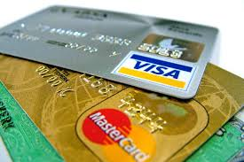
Encryption uses

Slide 11
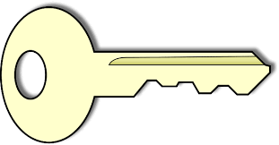
Private key encryption
I like bananas
I like bananas
encrypt message
decrypt message
send encrypted message

Slide 12
Private key encryption
Any problems with this?

Slide 13
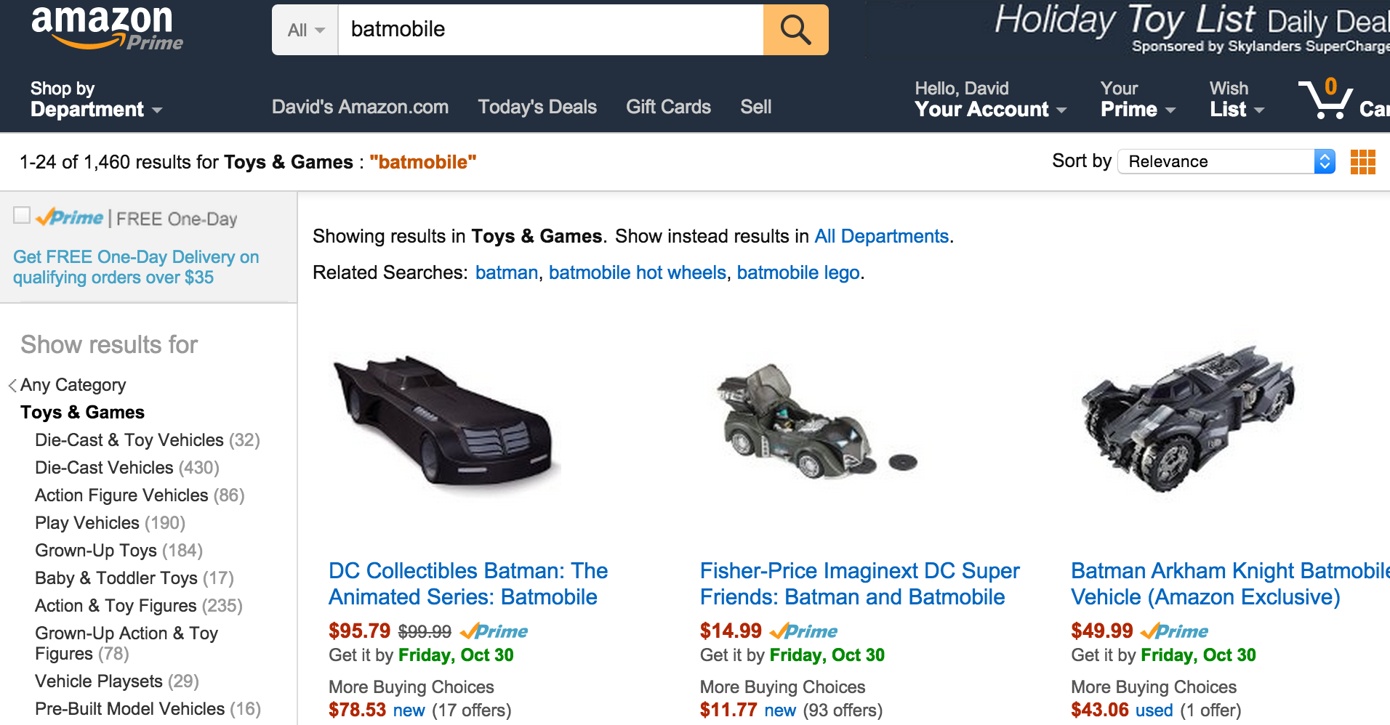
Private key encryption

Slide 14
Private key encryption
?

Slide 15
Public key encryption
private key
public key
Two keys, one you make publicly available and one you keep to yourself

Slide 16
Public key encryption
Share your public key with everyone

Slide 17
Public key encryption
I like bananas
I like bananas
encrypt message
decrypt message
send encrypted message

Slide 18
Public key encryption
I like bananas
Only the person with the private key can decrypt!
decrypt message

Slide 19
Modular arithmetic
Normal arithmetic:
a = b
a is equal to b or a-b = 0
Modular arithmetic:
a b (mod n)
a-b = n*k for some integer k or
a = b + n*k for some integer k or
a % n = b % n (where % is the mod operator)
Notes:
note that (mod n) is notation NOT the mod operator

Slide 20
Modular arithmetic
Which of these statements are true?
12
5 (mod 7)
52
92 (mod 10)
17
12 (mod 6)
a-b = n*k for some integer k or
a = b + n*k for some integer k or
a % n = b % n (where % is the mod operator)
65
33 (mod 32)

Slide 21
Modular arithmetic
Which of these statements are true?
12-5 = 7 = 1*7
12 % 7 = 5 = 5 % 7
12
5 (mod 7)
92-52 = 40 = 4*10
92 % 10 = 2 = 52 % 20
52
92 (mod 10)
17-12 = 5
17 % 6 = 5
12 % 6 = 0
17
12 (mod 6)
65-33 = 32 = 1*32
65 % 32 = 1 = 33 % 32
65
33 (mod 32)

Slide 22
Modular arithmetic properties
If:
a
b (mod n)
then:
a mod n = b mod n
“mod”/remainder operator
congruence (mod n)

Slide 23
Modular arithmetic properties
If:
a
b (mod n)
then:
a mod n = b mod n
More importantly:
(a+b) mod n = ((a mod n) + (b mod n)) mod n
and
(a*b) mod n = ((a mod n) * (b mod n)) mod n
What do these say?

Slide 24
Modular arithmetic
Why talk about modular arithmetic and congruence? How is it useful? Why might it be better than normal arithmetic?
We can limit the size of the numbers we’re dealing with to be at most n (if it gets larger than n at any point, we can always just take the result mod n)
The mod operator can be thought of as mapping a number in the range 0 … number-1

Slide 25
GCD
What does GCD stand for?

Slide 26
Greatest Common Divisor
gcd(a, b) is the largest positive integer that divides both numbers without a remainder
gcd(25, 15) = ?

Slide 27
Greatest Common Divisor
gcd(a, b) is the largest positive integer that divides both numbers without a remainder
gcd(25, 15) = 5
25
15
25
5
1
15
5
3
1
Divisors:

Slide 28
Greatest Common Divisor
gcd(a, b) is the largest positive integer that divides both numbers without a remainder
gcd(100, 52) = ?

Slide 29
Greatest Common Divisor
gcd(a, b) is the largest positive integer that divides both numbers without a remainder
gcd(100, 52) = 4
100
52
100
50
25
20
10
5
4
2
1
52
13
4
2
1
Divisors:

Slide 30
Greatest Common Divisor
gcd(a, b) is the largest positive integer that divides both numbers without a remainder
gcd(14, 63) = ?
gcd(7, 56) = ?
gcd(23, 5) = ?
gcd(100, 9) = ?
gcd(111, 17) = ?

Slide 31
Greatest Common Divisor
gcd(a, b) is the largest positive integer that divides both numbers without a remainder
gcd(14, 63) = 7
gcd(7, 56) = 7
gcd(23, 5) = 1
gcd(100, 9) = 1
gcd(111, 17) = 1
Any observations?

Slide 32
Greatest Common Divisor
When the gcd = 1, the two numbers share no factors/divisors in common
If gcd(a,b) = 1 then a is relatively prime to b
This a weaker condition than primality, since any two prime numbers are also relatively prime, but not vice versa

Slide 33
Greatest Common Divisor
A useful property:
If two numbers, a and b, are relatively prime (i.e. gcd(a,b) = 1), then there exists a c such that
a*c mod b = 1

Slide 34
RSA public key encryption
Have you heard of it?
What does it stand for?

Slide 35
RSA public key encryption
RSA is one of the most popular public key encryption algorithms in use
RSA = Ron Rivest, Adi Shamir and Leonard Adleman

Slide 36
RSA public key encryption
Choose a bit-length k
Security increase with the value of k, though so does computation
Choose two primes p and q which can be represented with at most k bits
Let n = pq and ϕ(n) = (p-1)(q-1)
ϕ() is called Euler’s totient function
Find d such that 0 < d < n and gcd(d,ϕ(n)) = 1
Find e such that de mod ϕ(n) = 1
Remember, we know one exists!

Slide 37
RSA public key encryption
p: prime number
q: prime number
n = pq
ϕ(n) = (p-1)(q-1)
d: 0 < d < n and gcd(d,ϕ(n)) = 1
e: de mod ϕ(n) = 1
Given this setup, you can prove that given a number m:
(m^{e})^{d} = m^{ed} = m (mod n)
What does this do for us, though?

Slide 38
RSA public key encryption
p: prime number
q: prime number
n = pq
ϕ(n) = (p-1)(q-1)
d: 0 < d < n and gcd(d,ϕ(n)) = 1
e: de mod ϕ(n) = 1
private key
public key
(d, n)
(e, n)

Slide 39
RSA encryption/decryption
private key
public key
(d, n)
(e, n)
You have a number m that you want to send encrypted
encrypt(m) = m^{e} mod n
(uses the public key)
How does this encrypt the message?

Slide 40
RSA encryption/decryption
private key
public key
(d, n)
(e, n)
You have a number m that you want to send encrypted
encrypt(m) = m^{e} mod n
(uses the public key)
Maps m onto some number in the range 0 to n-1
If you vary e, it will map to a different number
Therefore, unless you know d, it’s hard to know what the original m was after the transformation

Slide 41
RSA encryption/decryption
private key
public key
(d, n)
(e, n)
You have a number m that you want to send encrypted
encrypt(m) = m^{e} mod n
(uses the public key)
decrypt(z) = z^{d} mod n
(uses the private key)
Does this work?

Slide 42
RSA encryption/decryption
encrypt(m) = m^{e} mod n
decrypt(z) = z^{d} mod n
decrypt(z) =
decrypt(m^{e} mod n)
z is some encrypted message
= (m^{e} mod n)^{d} mod n
definition of decrypt
= (m^{e})^{d} mod n
modular arithmetic
= m mod n
(m^{e})^{d} = m^{ed} = m (mod n)
Did we get the original message?

Slide 43
RSA encryption/decryption
encrypt(m) = m^{e} mod n
decrypt(z) = z^{d} mod n
decrypt(z) =
decrypt(m^{e} mod n)
z is some encrypted message
= (m^{e} mod n)^{d} mod n
definition of decrypt
= (m^{e})^{d} mod n
modular arithmetic
= m mod n
(m^{e})^{d} = m^{ed} = m (mod n)
If 0 ≤ m < n, yes!

Slide 44
RSA encryption: an example
p: prime number
q: prime number
n = pq
ϕ(n) = (p-1)(q-1)
d: 0 < d < n and gcd(d,ϕ(n)) = 1
e: de mod ϕ(n) = 1
p = 3
q = 13
n = ?
ϕ(n) = ?
d = ?
e = ?

Slide 45
RSA encryption: an example
p: prime number
q: prime number
n = pq
ϕ(n) = (p-1)(q-1)
d: 0 < d < n and gcd(d,ϕ(n)) = 1
e: de mod ϕ(n) = 1
p = 3
q = 13
n = ?

Slide 46
RSA encryption: an example
p: prime number
q: prime number
n = pq
ϕ(n) = (p-1)(q-1)
d: 0 < d < n and gcd(d,ϕ(n)) = 1
e: de mod ϕ(n) = 1
p = 3
q = 13
n = 3*13 = 39

Slide 47
RSA encryption: an example
p: prime number
q: prime number
n = pq
ϕ(n) = (p-1)(q-1)
d: 0 < d < n and gcd(d,ϕ(n)) = 1
e: de mod ϕ(n) = 1
p = 3
q = 13
n = 39
ϕ(n) = ?

Slide 48
RSA encryption: an example
p: prime number
q: prime number
n = pq
ϕ(n) = (p-1)(q-1)
d: 0 < d < n and gcd(d,ϕ(n)) = 1
e: de mod ϕ(n) = 1
p = 3
q = 13
n = 39
ϕ(n) = 2*12 = 24

Slide 49
RSA encryption: an example
p: prime number
q: prime number
n = pq
ϕ(n) = (p-1)(q-1)
d: 0 < d < n and gcd(d,ϕ(n)) = 1
e: de mod ϕ(n) = 1
p = 3
q = 13
n = 39
ϕ(n) = 24
d = ?
e = ?

Slide 50
RSA encryption: an example
p: prime number
q: prime number
n = pq
ϕ(n) = (p-1)(q-1)
d: 0 < d < n and gcd(d,ϕ(n)) = 1
e: de mod ϕ(n) = 1
p = 3
q = 13
n = 39
ϕ(n) = 24
d = 5
e = 5

Slide 51
RSA encryption: an example
p: prime number
q: prime number
n = pq
ϕ(n) = (p-1)(q-1)
d: 0 < d < n and gcd(d,ϕ(n)) = 1
e: de mod ϕ(n) = 1
p = 3
q = 13
n = 39
ϕ(n) = 24
d = 5
e = 29

Slide 52
RSA encryption: an example
encrypt(m) = m^{e} mod n
n = 39
d = 5
e = 29
decrypt(z) = z^{d} mod n
encrypt(10) = ?

Slide 53
RSA encryption: an example
encrypt(m) = m^{e} mod n
n = 39
d = 5
e = 29
decrypt(z) = z^{d} mod n
encrypt(10) = 10²⁹ mod 39 = 4

Slide 54
RSA encryption: an example
encrypt(m) = m^{e} mod n
n = 39
d = 5
e = 29
decrypt(z) = z^{d} mod n
encrypt(10) = 10²⁹ mod 39 = 4
decrypt(4) = ?

Slide 55
RSA encryption: an example
encrypt(m) = m^{e} mod n
n = 39
d = 5
e = 29
decrypt(z) = z^{d} mod n
encrypt(10) = 10²⁹ mod 39 = 4
decrypt(4) = 4⁵ mod 39 = 10

Slide 56
RSA encryption: an example
encrypt(m) = m^{e} mod n
n = 39
d = 5
e = 5
decrypt(z) = z^{d} mod n
encrypt(2) = ?

Slide 57
RSA encryption: an example
encrypt(m) = m^{e} mod n
n = 39
d = 5
e = 5
decrypt(z) = z^{d} mod n
encrypt(2) = 2⁵ mod 39 = 32 mod 39 = 32
decrypt(32) = ?

Slide 58
RSA encryption: an example
encrypt(m) = m^{e} mod n
n = 39
d = 5
e = 5
decrypt(z) = z^{d} mod n
encrypt(2) = 2⁵ mod 39 = 32 mod 39 = 32
decrypt(32) = 32⁵ mod 39 = 2

Slide 59
RSA encryption in practice
For RSA to work: 0 ≤ m < n
What if our message isn’t a number?
What if our message is a number that’s larger than n?

Slide 60
RSA encryption in practice
For RSA to work: 0 ≤ m < n
What if our message isn’t a number?
We can always convert the message into a number (remember everything is stored in binary already somewhere!)
What if our message is a number that’s larger than n?
Break it into n sized chunks and encrypt/decrypt those chunks

Slide 61
RSA encryption in practice
encrypt(“I like bananas”) =
0101100101011100 …
encode as a binary string (i.e. number)
4, 15, 6, 2, 22, …
break into multiple < n size numbers
17, 1, 43, 15, 12, …
encrypt each number

Slide 62
RSA encryption in practice
decrypt((17, 1, 43, 15, 12, …)) =
4, 15, 6, 2, 22, …
decrypt each number
0101100101011100 …
put back together
“I like bananas”
turn back into a string (or whatever the original message was)
Often encrypt and decrypt just assume sequences of bits and the interpretation is done outside

