Slide 1
List induction
David Kauchak
CS52 – Spring 2016

Slide 2
Admin
Assignment 5
Assignment 6

Slide 3
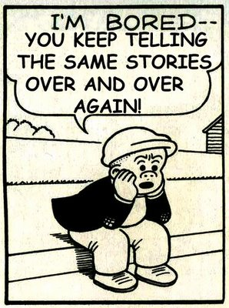
Today
http://lavonhardison.com/tag/repetition/
Notes:
- Day 3 of induction. Hopefully after today’s examples you start to see the repetition and are able to apply induction as a tool in many scenarios.

Slide 4
List induction
State what you’re trying to prove!
State and prove the base case (often empty list)
Assume it’s true for sublists – inductive hypothesis
Show that it holds for the full list

Slide 5
List fact
^{len (map f lst) = len lst}
What does this say?
Does it make sense?

Slide 6
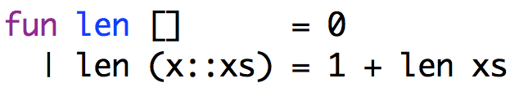
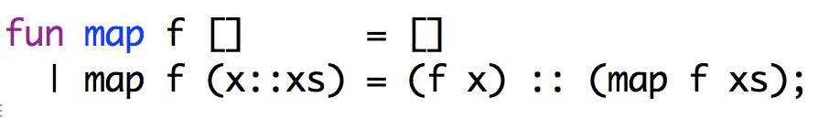
List induction
Facts
^{Prove:} ^{len (map f lst) = len lst}
State what you’re trying to prove!
State and prove the base case (often empty list)
Assume it’s true for sublists – inductive hypothesis
Show that it holds for the full list

Slide 7
Base case:
Want to prove:
lst = []
len (map f []) = len []
Proof?
^{Prove:} ^{len (map f lst) = len lst}
Facts

Slide 8
Base case:
Want to prove:
lst = []
len (map f []) = len []
len (map f []) = len ([])
definition of map
= len []
definition of ( )
^{Prove:} ^{len (map f lst) = len lst}

Slide 9
Inductive hypothesis:
Want to prove:
len (map f xs) = len xs
len (map f (x::xs)) = len (x::xs)
Proof?
^{Prove:} ^{len (map f lst) = len lst}

Slide 10
Inductive hypothesis:
Want to prove:
len (map f xs) = len xs
len (map f (x::xs)) = len (x::xs)
len (map f (x::xs)) =
len ((f x) :: (map f xs))
definition of map
= 1 + len (map f xs)
definition of len
= 1 + len xs
inductive hypothesis
= len (x::xs)
definition of len
Done!

Slide 11
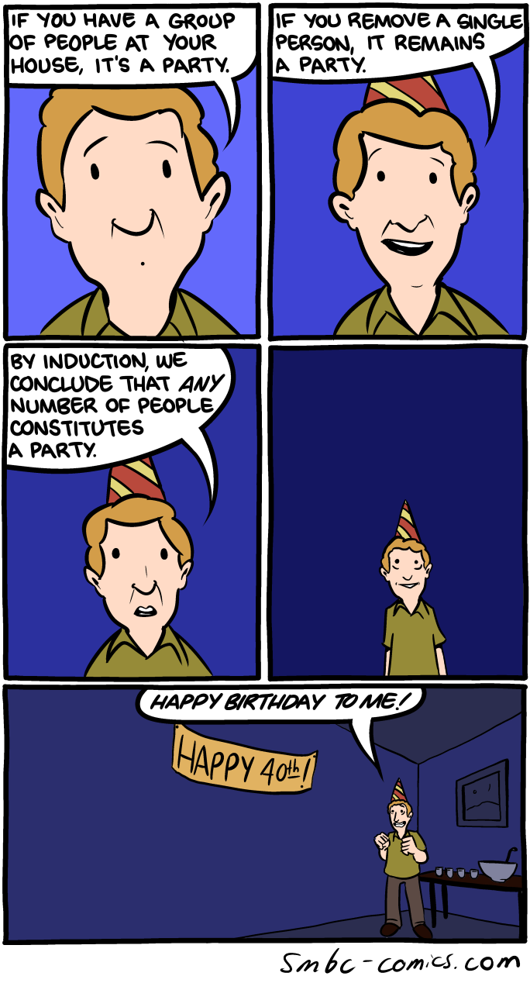

Slide 12
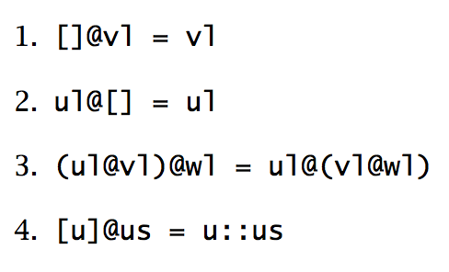
Some list “facts”
What do they say?

Slide 13
Another list fact
len (xlst @ ylst) = len xlst + len ylst
What does this say?
Does it make sense?

Slide 14
use induction on xlst
^{Prove:} len (xlst @ ylst) = len xlst + len ylst
State what you’re trying to prove!
State and prove the base case (often empty list)
Assume it’s true for smaller lists – inductive hypothesis
Show that it holds for the current list

Slide 15
Base case:
Want to prove:
xlst = []
len ([] @ ylst) = len [] + len ylst
Proof?
^{Prove:} len (xlst @ ylst) = len xlst + len ylst

Slide 16
Base case:
Want to prove:
xlst = []
len ([] @ ylst) = len [] + len ylst
len ([] @ ylst) = … = len [] + len ylist
start with left hand side
show a set of justified steps that derive the right hand size
^{Prove:} len (xlst @ ylst) = len xlst + len ylst

Slide 17
Base case:
Want to prove:
xlst = []
len ([] @ ylst) = len [] + len ylst
len ([] @ ylst) =
len ylst
fact 1
= 0 + len ylst
math
= len [] + len ylst
definition of len
^{Prove:} len (xlst @ ylst) = len xlst + len ylst

Slide 18
Inductive hypothesis:
Want to prove:
len (xs @ ylst) = len xs + len ylst
len ((x::xs) @ ylst) = len (x::xs) + len ylst
^{Prove:} len (xlst @ ylst) = len xlst + len ylst
^{Prove:} len (xlst @ ylst) = len xlst + len ylst

Slide 19


Want to prove:
len ((x::xs) @ ylst) = len (x::xs) + len ylst
len ((x::xs) @ ylst) =
= len (x::xs) + len ylst
len (xs @ ylst) = len xs + len ylst

Slide 20

Want to prove:
len ((x::xs) @ ylst) = len (x::xs) + len ylst
len ((x::xs) @ ylst) =
= len (x::xs) + len ylst
len (xs @ ylst) = len xs + len ylst

Slide 21
Want to prove:
len ((x::xs) @ ylst) = len (x::xs) + len ylst
?
len ((x::xs) @ ylst) =
= len (x::xs) + len ylst
len (xs @ ylst) = len xs + len ylst

Slide 22
Inductive hypothesis:
Want to prove:
len (xs @ ylst) = len xs + len ylst
len ((x::xs) @ ylst) = len (x::xs) + len ylst
len ((x::xs) @ ylst) =
len ( ([x]@xs) @ ylst )
fact 4
= len ( [x] @ (xs @ ylst) )
fact 3
= len ( x :: (xs @ ylst) )
fact 4
= 1 + len (xs @ ylst)
definition of len
= 1 + len xs + len ylst
inductive hypothesis
= len (x::xs) + len ylst
definition of len

Slide 23
Blast from the past
What does the anonymous function do?

Slide 24
Blast from the past
Takes a value, x, and creates a tuple with u as the first element and x as the second

Slide 25
Blast from the past
What does the map part of this function do?

Slide 26
Blast from the past
For each element in vl, creates a tuple (pair) with u as the first element and an element of vl as the second

Slide 27
Blast from the past
What is the type signature?
What does this function do?

Slide 28
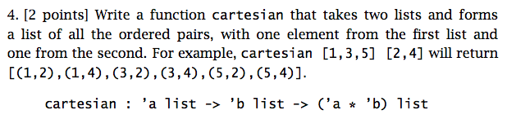
Blast from the past

Slide 29

Blast from the past
Name the actor and movie

Slide 30

Blast from the past

Slide 31
A property of cart
len(cart ul vl) = (len ul) * (len vl)
What does this say?
Does it make sense?

Slide 32
A property of cart
Prove: len(cart ul vl) = (len ul) * (len vl)
Proof by induction. Which variable, ul or vl?

Slide 33
Base case:
Want to prove:
ulst = []
len (cart [] vl) = (len []) * (len vl)
Proof?
Prove: len(cart ul vl) = (len ul) * (len vl)

Slide 34
Base case:
Want to prove:
ulst = []
len (cart [] vl) = (len []) * (len vl)
len (cart [] vl) =
len []
definition of cart
= 0
definition of len
= 0 * (len vl)
math
= (len []) * (len vl)
definition of len
Prove: len(cart ul vl) = (len ul) * (len vl)

Slide 35
Inductive hypothesis:
Want to prove:
len (cart us vl) = (len us) * (len vl)
len (cart (u::us) vl) = (len (u::us)) * (len vl)
Prove: len(cart ul vl) = (len ul) * (len vl)
Prove: len(cart ul vl) = (len ul) * (len vl)

Slide 36
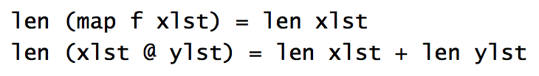
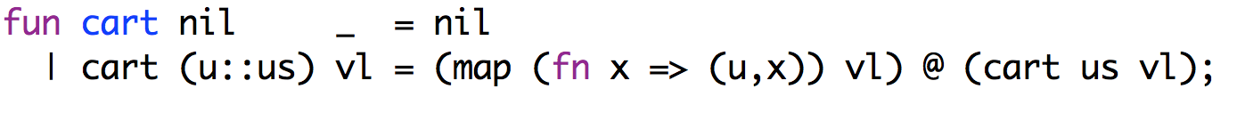
Want to prove:
len (cart (u::us) vl) = (len (u::us)) * (len vl)
?
len (cart (u::us) vl) =
= (len (u::us)) * (len vl)
IH: len (cart us vl) = (len us) * (len vl)

Slide 37
Want to prove:
len (cart (u::us) vl) = (len (u::us)) * (len vl)
definition of cart
len (cart (u::us) vl) =
len (map (fn x => (u,x)) vl) @ (cart us vl))
= len (map (fn x => (u,x)) vl)) + len (cart us vl)
“@” fact
= len (vl) + len(cart us vl)
“map” fact
= len (vl) + (len us) * (len vl)
inductive hypothesis
= (1 + (len us)) * (len vl)
math
= (len (u::us)) * (len vl)
definition of len
IH: len (cart us vl) = (len us) * (len vl)

Slide 38
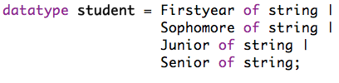

Quick refresher: datatypes

Slide 39
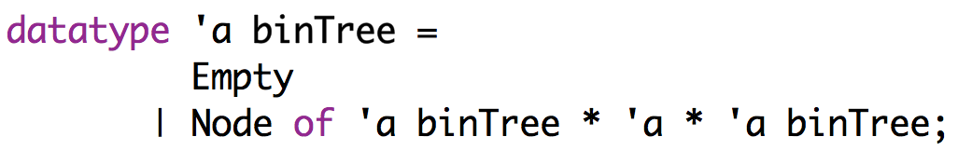
Recursive datatype
Defines a type variable for use in the datatype constructors
Still just defines a new type called “binTree”

Slide 40
Recursive datatype
What is this?

Slide 41
Recursive datatype
Binary Tree!
‘a
A binary tree is a recursive data structure where each node in the tree consists of a value and then two other binary trees.
‘a binTree
‘a binTree

Slide 42
Recursive datatype
Node(Empty, 1, Empty);
What does this look like?

Slide 43
Recursive datatype
Node(Empty, 1, Empty);
1
Empty
Empty

Slide 44
Recursive datatype
Node(Node(Empty, 3, Node(Empty, 4, Empty)), 5, Node(Empty, 9, Empty));
What does this look like?

Slide 45
Recursive datatype
Node(Node(Empty, 3, Node(Empty, 4, Empty)), 5, Node(Empty, 9, Empty));
5
3
9
4
Empty
Empty
Empty
Empty
Empty

Slide 46
Recursive datatype
Node(Node(Empty, “apple”, Node(Empty, “banana”, Empty)),
“carrot”,
Node(Empty, “rhubarb”, Empty));
What does this look like?

Slide 47
Recursive datatype
Node(Node(Empty, “apple”, Node(Empty, “banana”, Empty)),
“carrot”, Node(Empty, “rhubarb”, Empty));
carrot
apple
rhubarb
Empty
banana
Empty
Empty
Empty
Empty

Slide 48
Facts about binary trees
Counting elements in a tree N( ):
N(Empty) =
How many Nodes (i.e. values) are in an empty binary tree?

Slide 49
Facts about binary trees
Counting elements in a tree N( ):
N(Empty) = 0

Slide 50
Facts about binary trees
Counting elements in a tree N( ):
N(Empty) = 0
N(Node(u, elt, v)) =
How many Nodes (i.e. values) are in a non-empty binary tree (stated recursively)?

Slide 51
Facts about binary trees
Counting elements in a tree N( ):
N(Empty) = 0
N(Node(u, elt, v)) = 1 + N(u) + N(v)
One element stored in this node plus the nodes in the left tree and the nodes in the right tree

Slide 52
Leaves
A “leaf” is a Node at the bottom of the tree, i.e. Node(Empty, elt, Empty)
Node(Node(Empty, 3, Node(Empty, 4, Empty)), 5, Node(Empty, 9, Empty));
5
3
9
4
Empty
Empty
Empty
Empty
Empty
Which are the leaves?

Slide 53
Leaves
A “leaf” is a Node at the bottom of the tree, i.e. Node(Empty, elt, Empty)
Node(Node(Empty, 3, Node(Empty, 4, Empty)), 5, Node(Empty, 9, Empty));
5
3
9
4
Empty
Empty
Empty
Empty
Empty

Slide 54
Facts about binary trees
Counting leaves in a tree L( ):
L(Empty) =
L((Empty, elt, Empty) =
L(Node(u, elt, v) =
?

Slide 55
Facts about binary trees
Counting leaves in a tree L( ) :
L(Empty) = 0
L((Empty, elt, Empty) = 1
L(Node(u, elt, v) = L(u) + L(v)

Slide 56
Facts about binary trees
Counting Emptys in a tree E( ):
E(Empty) =
E(Node(u, elt, v) =
?

Slide 57
Facts about binary trees
Counting Emptys in a tree E( ):
E(Empty) = 1
E(Node(u, elt, v) = E(u) + E(v)

Slide 58
Notation summarized
N( ): number of elements/values in the tree
L( ): number of leaves in the tree
E( ): number of Empty nodes in the tree

Slide 59
Tree induction
State what you’re trying to prove!
State and prove the base case(s)
(often Empty and/or Leaf)
Assume it’s true for smaller subtrees – inductive hypothesis
Show that it holds for the full tree

Slide 60
N(t) = E(t) - 1
What is this saying in English?
N(Empty) = 0
N(Node(u, elt, v)) = 1 + N(u) + N(v)
N: number of nodes
L: number of leaves
E: number of Emptys
L(Empty) = 0
L((Empty, elt, Empty) = 1
L(Node(u, elt, v) = L(u) + L(v)
E(Empty) = 1
E(Node(u, elt, v) = E(u) + E(v)

Slide 61
N(t) = E(t) - 1
Number of nodes/values is equal to the number of Emptys minus one
5
Sanity check: is it right here?
3
9
4
Empty
Empty
Empty
Empty
Empty
N(Empty) = 0
N(Node(u, elt, v)) = 1 + N(u) + N(v)
N: number of nodes
L: number of leaves
E: number of Emptys
L(Empty) = 0
L((Empty, elt, Empty) = 1
L(Node(u, elt, v) = L(u) + L(v)
E(Empty) = 1
E(Node(u, elt, v) = E(u) + E(v)

Slide 62
N(t) = E(t) - 1
Number of nodes/values is equal to the number of Emptys minus one
5
4 nodes = 5 Emptys - 1
3
9
4
Empty
Empty
Empty
Empty
Empty
N(Empty) = 0
N(Node(u, elt, v)) = 1 + N(u) + N(v)
N: number of nodes
L: number of leaves
E: number of Emptys
L(Empty) = 0
L((Empty, elt, Empty) = 1
L(Node(u, elt, v) = L(u) + L(v)
E(Empty) = 1
E(Node(u, elt, v) = E(u) + E(v)

Slide 63
Base case:
Want to prove:
t = Empty
N(Empty) = E(Empty) - 1
Proof?
Prove: N(t) = E(t) - 1
N(Empty) = 0
N(Node(u, elt, v)) = 1 + N(u) + N(v)
N: number of nodes
L: number of leaves
E: number of Emptys
L(Empty) = 0
L((Empty, elt, Empty) = 1
L(Node(u, elt, v) = L(u) + L(v)
E(Empty) = 1
E(Node(u, elt, v) = E(u) + E(v)

Slide 64
Base case:
Want to prove:
t = Empty
N(Empty) = E(Empty) - 1
N(Empty) = 0
“N” fact
E(Empty)-1 = 1 - 1
= 0
“E” fact
math
Prove: N(t) = E(t) - 1
N(Empty) = 0
N(Node(u, elt, v)) = 1 + N(u) + N(v)
N: number of nodes
L: number of leaves
E: number of Emptys
L(Empty) = 0
L((Empty, elt, Empty) = 1
L(Node(u, elt, v) = L(u) + L(v)
E(Empty) = 1
E(Node(u, elt, v) = E(u) + E(v)

Slide 65
Inductive hypotheses:
Want to prove:
N(u) = E(u) - 1
N(v) = E(v) - 1
(Relation holds for any subtree)
N(Node(u, elt, v)) = E(Node(u, elt, v)) - 1
Prove: N(t) = E(t) - 1
N(Empty) = 0
N(Node(u, elt, v)) = 1 + N(u) + N(v)
N: number of nodes
L: number of leaves
E: number of Emptys
L(Empty) = 0
L((Empty, elt, Empty) = 1
L(Node(u, elt, v) = L(u) + L(v)
E(Empty) = 1
E(Node(u, elt, v) = E(u) + E(v)

Slide 66
Want to prove:
N(Node(u, elt, v)) = E(Node(u, elt, v)) - 1
?
N(Node(u, elt, v)) =
= E(Node(u, elt, v)) - 1
N(u) = E(u) - 1
N(v) = E(v) - 1
N: number of nodes
L: number of leaves
E: number of Emptys
N(Empty) = 0
N(Node(u, elt, v)) = 1 + N(u) + N(v)
L(Empty) = 0
L((Empty, elt, Empty) = 1
L(Node(u, elt, v) = L(u) + L(v)
E(Empty) = 1
E(Node(u, elt, v) = E(u) + E(v)

Slide 67
Want to prove:
N(Node(u, elt, v)) = E(Node(u, elt, v)) - 1
N(Node(u, elt, v)) =
1 + N(u) + N(v)
“N” fact
= 1 + E(u) - 1 + E(v) - 1
inductive hypothesis
= E(u) + E(v) - 1
math
= E(Node(u, elt, v)) - 1
“E” fact
N(u) = E(u) - 1
N(v) = E(v) - 1
N: number of nodes
L: number of leaves
E: number of Emptys
N(Empty) = 0
N(Node(u, elt, v)) = 1 + N(u) + N(v)
L(Empty) = 0
L((Empty, elt, Empty) = 1
L(Node(u, elt, v) = L(u) + L(v)
E(Empty) = 1
E(Node(u, elt, v) = E(u) + E(v)

Slide 68
Other interesting tree facts
N(t) = E(t) - 1
N: number of nodes
L: number of leaves
E: number of Emptys
N(Empty) = 0
N(Node(u, elt, v)) = 1 + N(u) + N(v)
L(Empty) = 0
L((Empty, elt, Empty) = 1
L(Node(u, elt, v) = L(u) + L(v)
E(Empty) = 1
E(Node(u, elt, v) = E(u) + E(v)

Slide 69
Summary of induction proofs
Numbers:
Recurrence relations:
Code equivalence:
fibrec(n) = fibiter(n)
Induction on lists:
len (map f xlst) = len xlst
len (xlst @ ylst) = len xlst + len ylst
len(cart ul vl) = (len ul) * (len vl)
Induction on trees:
N(t) = E(t) - 1

Slide 70

Be careful!

Slide 71
Outline for a “good” proof by induction
1. Prove: what_to_prove
2. Base case: the_base_case(s)
a. state what you’re trying to prove
b. show a step by step proof
with each step clearly justified
3. Assume: the_inductive_hypothesis
4. Show: what_you’re_trying_to_prove
step by step proof from left hand side deriving the right
hand side with each step clearly justified

