Slide 1
Big-o
David Kauchak
CS52 – Spring 2016

Slide 2
Admin
Assignment 4 graded
Assignment 5
Academic honesty

Slide 3
member
What is it’s type signature?
What does it do?

Slide 4
member
‘a -> ‘a list -> bool
Determines if the first argument is in the second argument

Slide 5
member
How fast is it?
For a list with k elements in it, how many calls are made to member?
Depends on the input!

Slide 6
member
For a list with k elements in it, how many calls are made to member in the worst case?
Worst case is when the item doesn’t exist in the list
k+1 times:
each element will be examined one time (2nd pattern)
plus one time for the empty list

Slide 7
member
How will the run-time grow as the list size increases?
Linearly:
for each element we add to the list, we’ll have to make one more recursive call
doubling the size of the list would roughly double the run-time

Slide 8
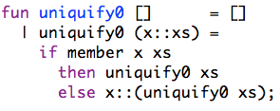
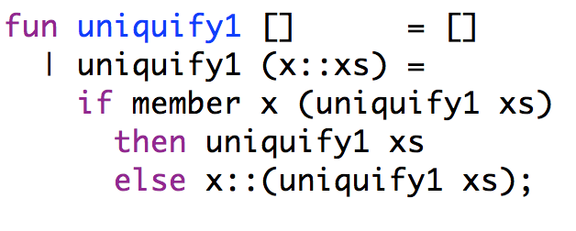
Uniquify
Type signature?
What do they do?
Which is faster?
How much faster?

Slide 9
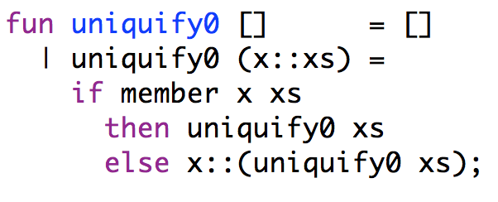
uniquify0
How many calls to member are made for a list of size k, including calls made in uniquify0 as well as recursive calls made in member?
Depends on the values!

Slide 10
uniquify0
Worst case, how many calls to member are made for a list of size k, including calls made in uniquify0 as well as recursive calls made in member?

Slide 11
uniquify0
How many calls are made if the list is empty?
0

Slide 12
uniquify0
Recursive case:
Let count₀(i) be the number of calls that uniquify0 makes to member for a list of size i.
Can you define the number of calls for a list of size k (count₀(k))? Hint: the definition will be recursive?

Slide 13
uniquify0
Recursive case:
Let count₀(i) be the number of calls that uniquify0 makes to member for a list of size i.
worst case number of calls for 1 call to member of size k
number of calls for uniquify0 on a list of size k-1

Slide 14
Recurrence relation
How many calls is this?
Notes:
- we’ll just approximate k+1 as k since it doesn’t really matter in the grand scheme of things

Slide 15
Recurrence relation

Slide 16
Recurrence relation
calls to member
Can you prove this?

Slide 17
Proof by induction
State what you’re trying to prove!
State and prove the base case
  What is the smallest possible case you need to consider?
  Should be fairly easy to prove
Assume it’s true for k (or k-1). Write out specifically what this assumption is (called the inductive hypothesis).
Prove that it then holds for k+1 (or k)
  State what you’re trying to prove (should be a variation on step 1)
  Prove it. You will need to use inductive hypothesis.

Slide 18
Proof by induction!
1.
2.
base case?

Slide 19
Proof by induction!
1.
2.
k = 0
from definition of count₀
by math

Slide 20
1.
3. assume:
inductive hypothesis

Slide 21
1.
3. assume:
inductive hypothesis

Slide 22
1.
3. assume:
inductive hypothesis
4. prove:
by definition of count₀
inductive hypothesis
math (k = 2k/2, multiply (k-1)k)

Slide 23
Proof by induction!
3. assume:
inductive hypothesis
4. prove:
more math (subtraction)
more math (factor out k)
Done!

Slide 24
uniquify1
What is the recurrence relation for calls to member for uniquify1? Write a recursive function called count₁ that gives the number of calls to member for a list of size k.

Slide 25
uniquify1

Slide 26
How many calls is that?
I claim:
Can you prove it?

Slide 27
Prove it!
State what you’re trying to prove!
State and prove the base case
Assume it’s true for k (or k-1) (and state the inductive hypothesis!)
Show that it holds for k+1 (or k)
1.

Slide 28
Proof by induction!
1.
2.
Base case:

Slide 29
Proof by induction!
1.
2.
Base case: k = 0
from definition of count₁

Slide 30
Proof by induction!
1.
2.
Base case: k = 0
from definition of count₁
by math

Slide 31
Proof by induction!
1.
3. assume:
inductive hypothesis

Slide 32
Proof by induction!
3. assume:
inductive hypothesis
4. prove:
by definition of count₁
inductive hypothesis
math (multiply through by 2)
Done!
math

Slide 33
Does it matter?
vs.

Slide 34
Does it matter?
k
0
1
2
3
4
…
10
…
100
?

Slide 35
Does it matter?
k
0
1
2
3
4
…
10
…
100
0
?
0

Slide 36
Does it matter?
k
0
1
2
3
4
…
10
…
100
0
1
?
0
1

Slide 37
Does it matter?
k
0
1
2
3
4
…
10
…
100
0
1
3
?
0
1
4

Slide 38
Does it matter?
k
0
1
2
3
4
…
10
…
100
0
1
3
6
15
…
?
0
1
4
11
57
…

Slide 39
Does it matter?
k
0
1
2
3
4
…
10
…
100
0
1
3
6
15
…
55
…
?
0
1
4
11
57
…
2036
…

Slide 40
Does it matter?
k
0
1
2
3
4
…
10
…
100
0
1
3
6
15
…
55
…
5050
0
1
4
11
57
…
2036
…
2.5 x 10³⁰

Slide 41
Maybe it’s not that bad
2.5 x 10³⁰ calls to member for a list of size 100
Roughly how long will that take?

Slide 42
Maybe it’s not that bad
2.5 x 10³⁰ calls to member for a list of size 100
Assume 10⁹ calls per second
~3 x 10⁷ seconds per year
~3 x 10¹⁷ calls per year
~10¹³ years to finish!
Just to be clear: 10,000,000,000,000 years

Slide 43
In practice
On my laptop, starts to slow down with lists of length 22 or so

Slide 44
Undo
What’s the problem?
Can we fix it?

Slide 45
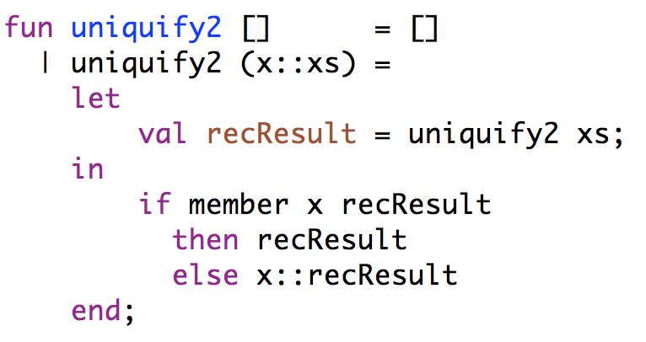
Undo

Slide 46
Which is faster?

Slide 47
Big O: Upper bound
O(g(n)) is the set of functions:

Slide 48
Big O: Upper bound
O(g(n)) is the set of functions:
We can bound the function f(n) above by some constant factor of g(n): constant factors don’t matter!

Slide 49
Big O: Upper bound
O(g(n)) is the set of functions:
We can bound the function f(n) above by some constant factor of g(n): constant factors don’t matter!
For some increasing range: we’re interested in long-term growth

Slide 50
Visually
f(n)

Slide 51
Visually: upper bound
f(n)
n₀

Slide 52
Big-O
member is O(n) – linear
  n+1 is O(n)
uniquify0 is O(n²) – quadratic
  n(n+1)/2 = n²/2 + n/2 is O(n²)
uniquify1 is O(2^{n}) – exponential
  2^{n+1}-n-2 is O(2^{n})
uniquify2 is O(n²) – quadratic

Slide 53
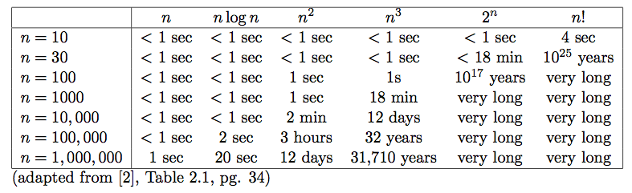
Runtime examples

Slide 54
Some examples
O(1) – constant. Fixed amount of work, regardless of the input size
  add two 32 bit numbers
  determine if a number is even or odd
  sum the first 20 elements of an array
  delete an element from a doubly linked list
O(log n) – logarithmic. At each iteration, discards some portion of the input (i.e. half)
  binary search

Slide 55
Some examples
O(n) – linear. Do a constant amount of work on each element of the input
  find an item in an array (unsorted) or linked list
  determine the largest element in an array
O(n log n) log-linear. Divide and conquer algorithms with a linear amount of work to recombine
  Sort a list of number with MergeSort
  FFT

Slide 56
Some examples
O(n²) – quadratic. Double nested loops that iterate over the data
  Insertion sort
O(2^{n}) – exponential
  Enumerate all possible subsets
  Traveling salesman using dynamic programming
O(n!)
  Enumerate all permutations
  determinant of a matrix with expansion by minors

Slide 57
STOPPED HERE
This is as far as I made it in lecture. There are two additional examples of proofs by induction that I won’t cover, but I’ll leave them in the notes in case you want to see more examples.

Slide 58
An aside
My favorite thing in python!

Slide 59
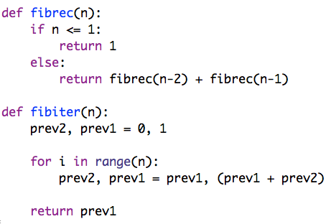
What do these functions do?

Slide 60
Runtime
Which is faster?
What is the big-O runtime of each function in terms of n, i.e. how does the runtime grow w.r.t. n?

Slide 61
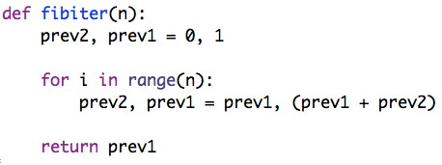
Runtime
O(n) – linear
Informal justification:
The for loop does n iterations and does just a constant amount of work for each iteration. An increase in n will see a corresponding increase in the number of iterations.

Slide 62
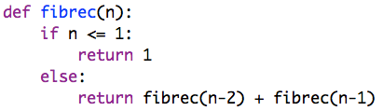
Runtime
Guess?

Slide 63
Runtime
Guess: O(2^{n}) – for each call, makes two recursive calls
What is the recurrence relation?

Slide 64
Runtime
Guess: O(2^{n}) – for each call, makes two recursive calls
Slightly different than the recurrence relation for uniquify1.

Slide 65
Proof
We want to prove that f(n) is O(2^{n})
Show that f(n) ≤ 2^{n}-1
Why is this sufficient?

Slide 66
Proof
We want to prove that f(n) is O(2^{n})
Show that f(n) ≤ 2^{n}-1
f(n) ≤ 2^{n}-1≤ 2^{n} (c = 1, for all n ≥ 0)

Slide 67
Proof
We want to prove that f(n) is O(2^{n})
Show that f(n) ≤ 2^{n}-1
How do we prove this?
Induction!

Slide 68
Proof by induction
1. Prove: f(n) ≤ 2^{n}-1
2. Base case:
n = 1
by definition of f(n)
by math

Slide 69
Proof by induction
1. Prove: f(n) ≤ 2^{n}-1
3. Inductive hypothesis:
Assume:
4. Prove:
n+1:

Slide 70
Proof by induction
Assume:
Prove:
definition of f(n)
inductive hypothesis
What do we do with ?

Slide 71
Proof by induction
1. Prove: f(n) ≤ 2^{n}-1
3. Inductive hypothesis:
Assume:
strong induction
4. Prove:
n+1:

Slide 72
Proof by induction
Assume:
Prove:
definition of f(n)
inductive hypotheses
math
2^{n-1}< 2^{n}
more math
Done!

Slide 73
Proving exponential runtime
We proved that f(n) is O(2^{n})
Is this sufficient to prove that f(n) takes an exponential amount of time?
No. This is only an upper bound!
Most of the time, this is what we’re worried about, talking about bounding the running time of our algorithm, i.e. no worse than.

Slide 74
Proving exponential runtime
We proved that f(n) is O(2^{n})
How would we prove that f(n) is exponential, i.e. always takes exponential time?
f(n) ≥ c2^{n}, for some c
Using induction, can prove f(n) ≥ ½ 2^{n/2}

Slide 75
Proving correctness
Can you prove that these two functions give the same result, i.e. that fibrec(n) = fibiter(n)?

Slide 76
Prove it!
fibrec(n) = fibiter(n)
State what you’re trying to prove!
State and prove the base case(s)
Assume it’s true for all values ≤ k
Show that it holds for k+1

Slide 77
Base cases
fibrec(n) = fibiter(n)
n = 0 and n = 1
?

Slide 78
Base cases
fibrec(n) = fibiter(n)
n = 0 and n = 1
?
n = 0: 1
n = 1: 1

Slide 79
Base cases
fibrec(n) = fibiter(n)
n = 0 and n = 1
n = 0: 1
n = 1: 1
Loop doesn’t execute at all
prev1 = 1 and is returned
n = 0: 1

Slide 80
Base cases
fibrec(n) = fibiter(n)
n = 0 and n = 1
n = 0: 1
n = 1: 1
Loop executes once
prev1 = 1 + 0 = 1
n = 1: 1

Slide 81
Inductive hypotheses
fibrec(n) = fibiter(n)
Assume:
fibrec(n-1) = fibiter(n-1)
fibrec(n-2) = fibiter(n-2)
Prove:
fibrec(n) = fibiter(n)

Slide 82
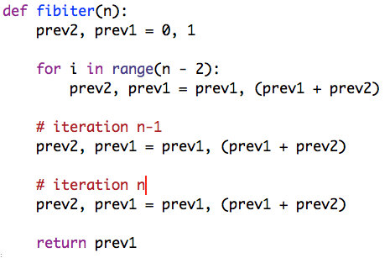
Assume: fibiter(n-2) = fibrec(n-2)
fibiter(n-1) = fibrec(n-1)
Prove: fibiter(n) = fibrec(n)
Definition of for loops

Slide 83
Assume: fibiter(n-2) = fibrec(n-2)
fibiter(n-1) = fibrec(n-1)
Prove: fibiter(n) = fibrec(n)
What is prev1 after this?

Slide 84
Assume: fibiter(n-2) = fibrec(n-2)
fibiter(n-1) = fibrec(n-1)
Prove: fibiter(n) = fibrec(n)
prev1 = fibiter(n-2)
by inductive hypothesis:
prev1 = fibrec(n-2)

Slide 85
Assume: fibiter(n-2) = fibrec(n-2)
fibiter(n-1) = fibrec(n-1)
Prove: fibiter(n) = fibrec(n)
What is prev2 after this?
prev1 = fibrec(n-2)
assignment
prev2 = fibrec(n-2)

Slide 86
Assume: fibiter(n-2) = fibrec(n-2)
fibiter(n-1) = fibrec(n-1)
Prove: fibiter(n) = fibrec(n)
What is prev1 after this?
prev1 = fibrec(n-2)
by inductive hypothesis
prev1 = fibrec(n-1)
prev2 = fibrec(n-2)

Slide 87
Assume: fibiter(n-2) = fibrec(n-2)
fibiter(n-1) = fibrec(n-1)
Prove: fibiter(n) = fibrec(n)
What is prev1 after this?
prev1 = fibrec(n-2)
prev2 = fibrec(n-2)
prev1 = fibrec(n-1)

Slide 88
Assume: fibiter(n-2) = fibrec(n-2)
fibiter(n-1) = fibrec(n-1)
Prove: fibiter(n) = fibrec(n)
prev1 = fibrec(n-2)
prev2 = fibrec(n-2)
prev1 = fibrec(n-1)
Done!

