Slide 1
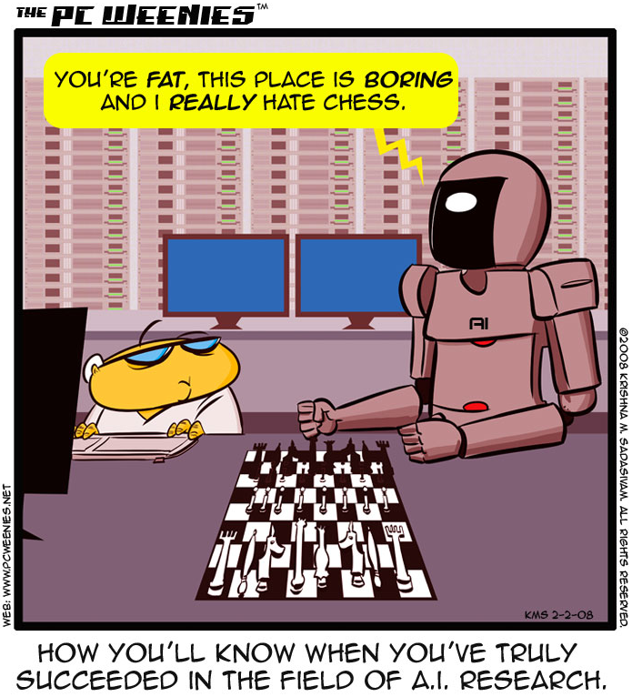
http://www.bbspot.com/comics/PC-Weenies/2008/02/3248.php

Slide 2
Intro to AI
CS30
David Kauchak
Spring 2016
Adapted from notes from:
Sara Owsley Sood

Slide 3
AI is a huge field
What is AI (artificial intelligence)…

Slide 4
AI is a huge field
What is AI…
One definition:
“Building programs that enable computers to do what humans can do.”
For example:
read, walk around, drive, play games, solve problems, learn, have conversations…

Slide 5
How do we measure success?
“Building programs that enable computers to do what humans can do.”
there are many interpretations of this goal…
human vs. rational
Think like a human Cognitive Modeling | Think rationally Logic-based Systems
Act like a human Turing Test | Act rationally Rational Agents
thinking
vs.
acting

Slide 6
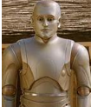

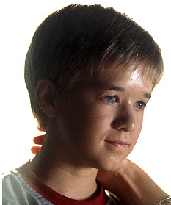
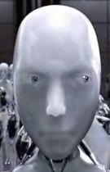

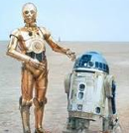

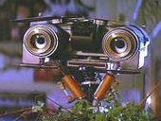
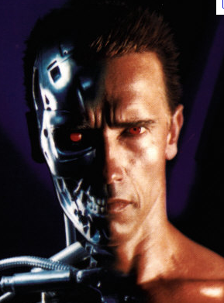
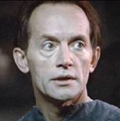
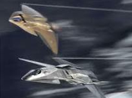
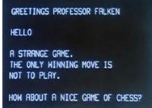
How is AI viewed in popular media?

Slide 7

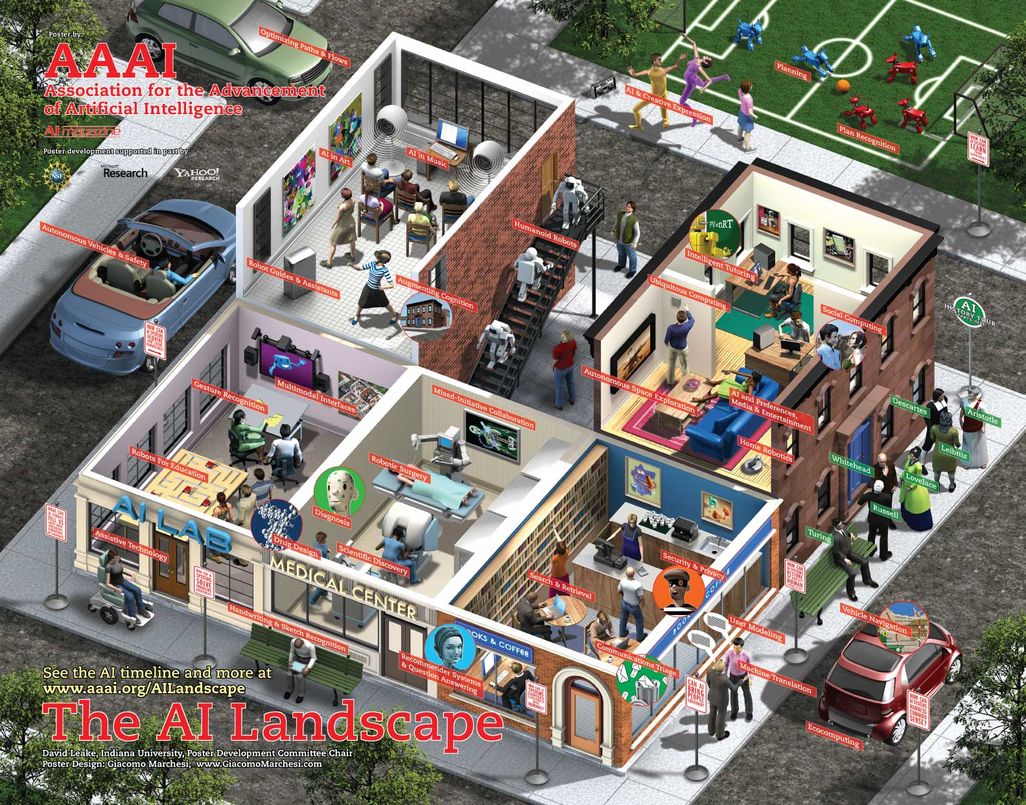
What challenges are there?

Slide 8
What challenges are there?
Perception
  perceive the environment via sensors
Computer vision (perception via images/video)
  process visual information
  object identification, face recognition, motion tracking
Natural language processing and generation
  speech recognition, language understanding
  language translation, speech generation, summarization

Slide 9
What challenges are there?
Knowledge representation
  encode known information
  water is wet, the sun is hot, Dave is a person, …
Learning
  learn from environment
  What type of feedback? (supervised vs. unsupervised vs. reinforcement vs …)
Reasoning/problem solving
  achieve goals, solve problems
  planning
  How do you make an omelet? I’m carrying an umbrella and it’s raining… will I get wet?
Robotics
  How can computers interact with the physical world?

Slide 10
What can we currently do?

Slide 11
What can we currently do?
Understand spoken language?
  speech recognition is really good, if:
    restricted vocabulary
    specific speaker with training
  Gotten quite good in the last few years and shows up in lots of places:
    Mac has built-in dictation software
    Siri is pretty good (though there’s more than speech recognition going on there)
    Google allows you to search via voice command
  What does the spoken language actually mean (language understanding)?
    much harder problem!
    many advances in NLP in small things, but still far away from a general solution

Slide 12

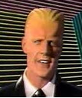
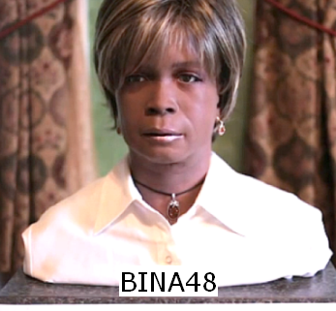
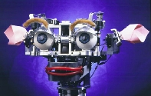
What can we currently do?
Speak?
  Understandable, but you wouldn’t confuse it for a person
  Can do accents, intonations, etc.
  Better with restricted vocabulary
  Loquendo
    http://www.nuance.com/for-business/by-solution/customer-service-solutions/solutions-services/inbound-solutions/loquendo-small-business-bundle/tts-demo/english/index.htm
    Dealing with facial expression is challenging
Kismet (MIT)

Slide 13
What can we currently do?
Drive a car?

Slide 14
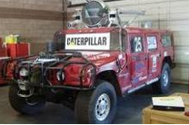
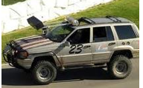
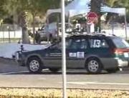
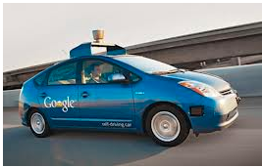
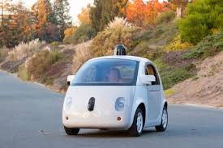
What can we currently do?
Drive a car?
  Freeway driving is relatively straightforward
  Off-road a bit harder
    see DARPA grand challenges (2004, 2005)
  And urban driving is even trickier
    See DARPA urban challenge (2007)
    Google’s autonomous vehicle
Hint: there’s a connection here

Slide 15
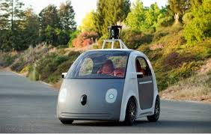
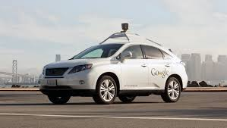
What can we currently do?
Drive a car?
https://www.google.com/selfdrivingcar/

Slide 16

What can we currently do?
Identify emotion?
  This is hard!
  Some success in text
    movie reviews
    blogs
    twitter
    dealing with sarcasm is hard
  Some success with faces
    strongly biased by training data
    works best when exaggerated

Slide 17
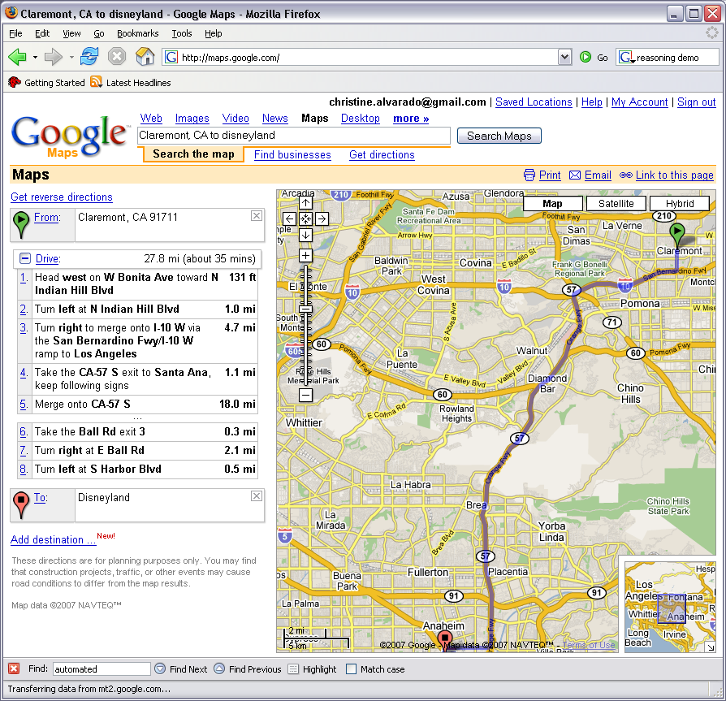
What can we currently do?
Reasoning?
  Success on small sub-problems
  General purpose reasoning is harder
    Wolfram Alpha
    OpenCyc

Slide 18
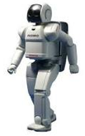
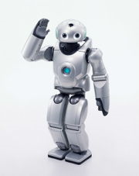
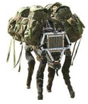
What can we currently do?
Walk?
  Robots have had a variety of locomotion methods
  Walking with legs, is challenging
    Differing terrains, stairs, running, ramps, etc.
    Recently, a number of successes
      Honda’s Asimo
        http://www.youtube.com/watch?v=W1czBcnX1Ww
      Sony QRIO
        http://www.youtube.com/watch?v=9vwZ5FQEUFg
      Boston Dynamic’s Big Dog
        http://www.youtube.com/watch?v=W1czBcnX1Ww

Slide 19
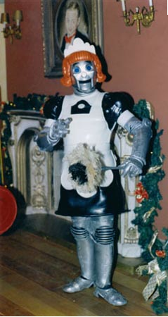
When will I have my robot helper?
What can we currently do?

Slide 20
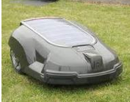
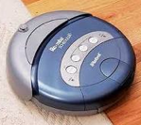
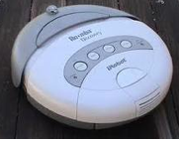
What can we currently do?

Slide 21
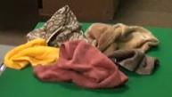
What can we currently do?
Fold a pile of towels?
UC Berkeley towel folding robot:
http://www.youtube.com/watch?v=gy5g33S0Gzo

Slide 22
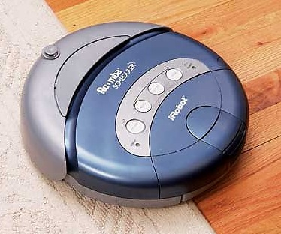
How do we make a computer "smart?"
Computer,
clean the house!
Um… OK…??
This one's got no chance…
Notes:
Assume that we want this vacuum to clean this house
To us - if someone told us to use a vacuum to clean a house, the sequence of events that should follow are pretty clear
We’d walk into the house, figure out what rooms needed to be vacuumed and start vacuuming
We’d methodically go through the room, not vacuuming over places we’ve already been, until we cover the whole room, then move to the next room

Slide 23
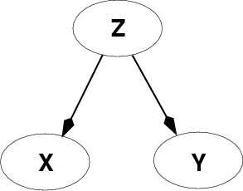
Fundamental problem of AI
Reasoning with knowledge
and uncertainty
Search
Many different ways of making an agent intelligent
Learning
Reasoning with
Utility

