Slide 1
Adversarial Search
CS30
David Kauchak
Spring 2015
Some material borrowed from :
Sara Owsley Sood and others

Slide 2
Admin
Assignment 10 out soon
  May work in groups of up to 4 people
  Due Sunday 4/26 (though, don’t wait until the weekend to finish!)

Slide 3
A quick review of search
Problem solving via search:
To define the state space, define three things:
  is_goal
  next_states
  starting state
Uninformed search vs. informed search
  what’s the difference?
  what are the techniques we’ve seen?
  pluses and minuses?

Slide 4
Why should we study games?
Clear success criteria
Important historically for AI
Fun ☺
Good application of search
  hard problems (chess 35¹⁰⁰ states in search space, 10⁴⁰ legal states)
Some real-world problems fit this model
  game theory (economics)
  multi-agent problems

Slide 5
Types of games
What are some of the games you’ve played?

Slide 6
Types of games: game properties
single-player vs. 2-player vs. multiplayer
Fully observable (perfect information) vs. partially observable
Discrete vs. continuous
real-time vs. turn-based
deterministic vs. non-deterministic (chance)

Slide 7

Strategic thinking = intelligence
?
For reasons previously stated, two-player games have been a focus of AI since its inception…
Begs the question: Is strategic thinking the same as intelligence?

Slide 8
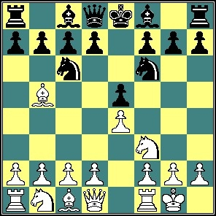
Strategic thinking = intelligence
?
Humans and computers have different relative strengths in these games:
humans
computers
?
?

Slide 9
Strategic thinking = intelligence
?
Humans and computers have different relative strengths in these games:
humans
computers
good at evaluating the strength of a board for a player
good at looking ahead in the game to find winning combinations of moves

Slide 10
Strategic thinking = intelligence
?
How could you figure out how humans approach playing chess?
humans
good at evaluating the strength of a board for a player

Slide 11
How humans play games…
An experiment (by deGroot) was performed in which chess positions were shown to novice and expert players…
- experts could reconstruct these perfectly
- novice players did far worse…

Slide 12
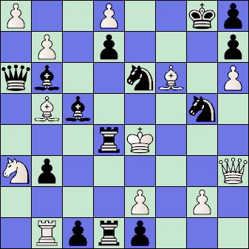
How humans play games…
An experiment (by deGroot) was performed in which chess positions were shown to novice and expert players…
- experts could reconstruct these perfectly
- novice players did far worse…
Random chess positions (not legal
ones) were then shown to the two
groups
- experts and novices did just as
badly at reconstructing them!

Slide 13
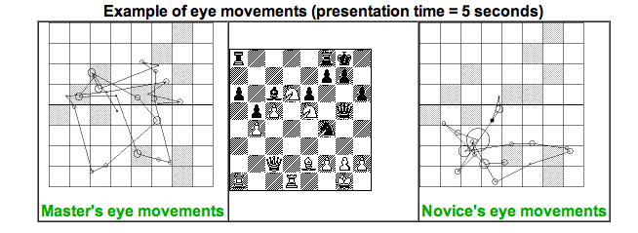
People are still working on this problem…
http://people.brunel.ac.uk/~hsstffg/frg-research/chess_expertise/

Slide 14
Tic Tac Toe as search
If we want to write a program to play tic tac toe, what question are we trying to answer?
Given a state (i.e. board configuration), what move should we make!

Slide 15
Tic Tac Toe as search
X

Slide 16
Tic Tac Toe as search
X
X
O
O
O
X
O
X
X
X
O
X
O
O
X
O
X

Slide 17
Tic Tac Toe as search
How can we pose this as a search problem?

Slide 18
Tic Tac Toe as search
X
X
…
X

Slide 19
Tic Tac Toe as search
X
X
O
X
O
X
…
O
…

Slide 20
Tic Tac Toe as search
Eventually, we’ll get to a leaf
X
X
O
X
X
O
X
X
O
X
O
O
X
X
O
…
O
X
O
X
O
X
O
O
X
X
O
WIN
TIE
LOSE
How does this help us?
Try and make moves that move us towards a win, i.e. where there are leaves with a WIN.

Slide 21
Tic Tac Toe
X’s turn
x
x
…
x
O’s turn
x
o
x
o
x
…
X’s turn
o
…
…
…
Problem: we don’t know what O will do

Slide 22
I’m X, what will ‘O’ do?
X
X
O
O
X
O
X
O’s turn
X
X
O
X
X
O
O
X
O
O
X
O
X
O
X
O

Slide 23
Minimizing risk
The computer doesn’t know what move O (the opponent) will make
It can assume, though, that it will try and make the best move possible
Even if O actually makes a different move, we’re no worse off. Why?
X
X
O
O
X
O
X
X
X
O
X
X
O
O
X
O
O
X
O
X
O
X
O

Slide 24
Optimal Strategy
An Optimal Strategy is one that is at least as good as any other, no matter what the opponent does
  If there's a way to force the win, it will
  Will only lose if there's no other option

Slide 25
Defining a scoring function
X
X
O
X
X
O
X
X
O
X
O
O
X
X
O
…
O
X
O
X
O
X
O
O
X
X
O
WIN
TIE
LOSE
+1
0
-1
Idea:
define a function that gives us a “score” for how good each state is for us
higher scores mean better for us

Slide 26
Defining a scoring function
X
X
O
Our (X) turn
O
O
X
O
X
What should be the score of this state?
+1: we can get to a win

Slide 27
Defining a scoring function
X
X
O
Opponent’s (O) turn
O
X
O
X
What should be the score of this state?
-1: we can get to a win

Slide 28
Defining a scoring function
X
X
O
O
X
O
-1
Opponent’s (O) turn
X
X
X
O
X
X
O
O
X
O
O
X
O
X
O
X
O
+1
-1

Slide 29
Defining a scoring function
X
O
Our (X) turn
O
X
What should be the score of this state?

Slide 30
Defining a scoring function
X
O
Our (X) turn
O
X
X
O
O turn
O
What’s the score of this state?
X
X
X
O
O
X
O
X
O
X
O
X turn
+1
O
+1
O
O
+1
O
+1
O
O
X
O
X
X
X
X
X
X
X
X
O
O
X
O
X
O
X
O
O
O
O
X
O
X
O
O
+1
+1
+1
+1
X
X
O
X
X
X
X
X
X
X
X

Slide 31
Defining a scoring function
X
O
Our (X) turn
+1
O
What’s the score of this state?
X
X
O
O turn
+1
O
X
X
X
O
O
X
O
X
O
X
O
X turn
+1
O
+1
O
O
+1
O
+1
O
O
X
O
X
X
X
X
X
X
X
X
O
O
X
O
X
O
X
O
O
O
O
X
O
X
O
O
+1
+1
+1
+1
X
X
O
X
X
X
X
X
X
X
X

Slide 32
Defining a scoring function
X
Our (X) turn
O
What should be the score of this state?
0: If we play perfectly and so does O, the best we can do is a tie (could do better if O makes a mistake)

Slide 33
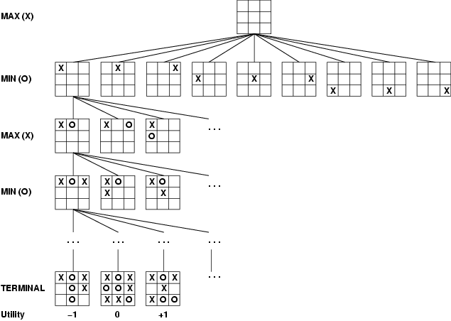
How can X play optimally?

Slide 34
How can X play optimally?
When it’s my turn, pick the highest scoring state
When it’s the opponent’s turn, assume the lowest scoring state (from my perspective)
If we can reach the end games, we can percolate these answers all the way back up

Slide 35
How can X play optimally?
Start from the leaves and propagate the score up:
  if X’s turn, pick the move that maximizes the utility
  if O’s turn, pick the move that minimizes the utility
Is this optimal?

Slide 36
Minimax Algorithm: An Optimal Strategy
minimax(state) =
- if state is a terminal state
Utility(state)
- if MY turn
return the maximum of minimax(...)
on all next states of state
- if OPPONENTS turn
return the minimum of minimax(…)
on all next states of state
Uses recursion to compute the “value” of each state
Proceeds to the leaves, then the values are “backed up” through the tree as the recursion unwinds
What type of search is this?
What does this assume about how MIN will play? What if this isn’t true?
Note: We can't always search all the way down to the bottom of the tree…

Slide 37
Baby Nim
MAX
MIN
Take 1 or 2 at each turn
Goal: take the last match
MAX
What move should I take?
MIN
MAX

Slide 38
Baby Nim
MAX
5
MAX
1
2
MIN
4
3
MIN
2
1
2
1
Take 1 or 2 at each turn
Goal: take the last match
MAX
3
2
2
1
MAX
MAX wins
1
2
1
2
1
2
1
MIN
MIN
2
1
1
W
1
W
W
W
= 1.0
1
2
1
1
1
MAX
1
W
W
W
W
W
= -1.0
MAX
1
MIN wins/
MAX loses
W

Slide 39
Baby Nim
MAX
5
MAX
1
2
MIN
4
3
MIN
2
1
2
1
Take 1 or 2 at each turn
Goal: take the last match
MAX
3
2
2
1
MAX
MAX wins
1
2
1
2
1
2
1
MIN
MIN
2
1
1
W
1
W
W
W
= 1.0
1.0
1.0
1.0
1
1
1
2
1
?
MAX
1
W
W
W
W
W
= -1.0
MAX
-1.0
-1.0
-1.0
-1.0
1
MIN wins/
MAX loses
W
1.0

Slide 40
Baby Nim
MAX
5
MAX
1
2
MIN
4
3
MIN
2
1
2
1
Take 1 or 2 at each turn
Goal: take the last match
MAX
3
2
2
1
MAX
MAX wins
1
2
1
2
1
2
1
?
MIN
MIN
2
1
1
W
1
W
W
W
= 1.0
1.0
1.0
1.0
1
1
1
2
1
MAX
1
W
W
W
W
W
= -1.0
MAX
1.0
-1.0
-1.0
-1.0
-1.0
1
MIN wins/
MAX loses
W
1.0

Slide 41
Baby Nim
MAX
5
MAX
1
2
MIN
4
3
MIN
2
1
2
1
Take 1 or 2 at each turn
Goal: take the last match
MAX
3
2
2
1
MAX
MAX wins
1
2
1
2
1
2
1
?
MIN
MIN
2
1
1
W
1
W
W
W
= 1.0
-1.0
1.0
1.0
1.0
1
1
1
2
1
MAX
1
W
W
W
W
W
= -1.0
MAX
1.0
-1.0
-1.0
-1.0
-1.0
1
MIN wins/
MAX loses
W
1.0

Slide 42
Baby Nim
MAX
5
MAX
1
2
MIN
4
3
MIN
2
1
2
1
Take 1 or 2 at each turn
Goal: take the last match
?
2
1
MAX
3
2
MAX
MAX wins
1
2
1
2
1
2
1
MIN
MIN
2
1
1
W
1
W
W
W
= 1.0
-1.0
-1.0
1.0
1.0
1.0
1
1
1
2
1
MAX
1
W
W
W
W
W
= -1.0
MAX
1.0
-1.0
-1.0
-1.0
-1.0
1
MIN wins/
MAX loses
W
1.0

Slide 43
Baby Nim
MAX
5
MAX
1
2
MIN
4
3
MIN
2
1
2
1
Take 1 or 2 at each turn
Goal: take the last match
MAX
3
2
2
1
MAX
-1.0
MAX wins
1
2
1
2
1
2
1
?
MIN
MIN
2
1
1
W
1
W
W
W
= 1.0
-1.0
-1.0
1.0
1.0
1.0
1
1
1
2
1
MAX
1
W
W
W
W
W
= -1.0
MAX
1.0
-1.0
-1.0
-1.0
-1.0
1
MIN wins/
MAX loses
W
1.0

Slide 44
Baby Nim
MAX
5
MAX
1
2
MIN
4
3
MIN
2
1
2
1
Take 1 or 2 at each turn
Goal: take the last match
?
2
1
MAX
3
2
MAX
-1.0
MAX wins
1
2
1
2
1
2
1
MIN
MIN
2
1
1
W
1
W
W
-1.0
-1.0
-1.0
1.0
1.0
W
= 1.0
1
1.0
2
1
1
1
MAX
1
W
W
W
W
W
= -1.0
MAX
1.0
-1.0
-1.0
-1.0
-1.0
1
MIN wins/
MAX loses
W
1.0

Slide 45
Baby Nim
MAX
5
MAX
1
2
?
MIN
4
3
MIN
2
1
2
1
Take 1 or 2 at each turn
Goal: take the last match
MAX
3
2
2
1
MAX
-1.0
1.0
MAX wins
1
2
1
2
1
2
1
MIN
MIN
2
1
1
W
1
W
W
-1.0
-1.0
-1.0
1.0
1.0
W
= 1.0
1
1.0
2
1
1
1
MAX
1
W
W
W
W
W
= -1.0
MAX
1.0
-1.0
-1.0
-1.0
-1.0
1
MIN wins/
MAX loses
W
1.0

Slide 46
Baby Nim
MAX
5
MAX
1
2
MIN
4
3
MIN
-1.0
2
1
2
1
Take 1 or 2 at each turn
Goal: take the last match
MAX
3
2
2
1
MAX
1.0
-1.0
MAX wins
1
2
1
2
1
2
1
?
MIN
MIN
2
1
1
W
1
W
W
-1.0
-1.0
-1.0
1.0
1.0
W
= 1.0
1
1.0
2
1
1
1
MAX
1
W
W
W
W
W
= -1.0
MAX
1.0
-1.0
-1.0
-1.0
-1.0
1
MIN wins/
MAX loses
W
1.0

Slide 47
Baby Nim
MAX
5
MAX
1
2
MIN
4
3
MIN
-1.0
2
1
2
1
Take 1 or 2 at each turn
Goal: take the last match
?
MAX
3
2
2
1
MAX
1.0
-1.0
MAX wins
1
2
1
2
1
2
1
?
MIN
MIN
2
1
1
W
1
W
W
-1.0
-1.0
-1.0
-1.0
1.0
1.0
W
= 1.0
1
1.0
2
1
1
1
MAX
1
W
W
W
W
W
= -1.0
MAX
1.0
-1.0
-1.0
-1.0
-1.0
1
MIN wins/
MAX loses
W
1.0

Slide 48
Baby Nim
MAX
5
MAX
1
2
MIN
4
3
MIN
-1.0
2
1
2
1
Take 1 or 2 at each turn
Goal: take the last match
?
MAX
3
2
2
1
MAX
1.0
1.0
-1.0
MAX wins
1
2
1
2
1
2
1
MIN
MIN
2
1
1
W
1
W
W
-1.0
-1.0
-1.0
-1.0
1.0
1.0
W
= 1.0
1
1.0
2
1
1
1
MAX
1
W
W
W
W
W
= -1.0
MAX
1.0
-1.0
-1.0
-1.0
-1.0
1
MIN wins/
MAX loses
W
1.0

Slide 49
Baby Nim
MAX
5
MAX
1
2
?
MIN
4
3
MIN
-1.0
2
1
2
1
Take 1 or 2 at each turn
Goal: take the last match
MAX
3
2
2
1
MAX
1.0
1.0
1.0
-1.0
MAX wins
1
2
1
2
1
2
1
MIN
MIN
2
1
1
W
1
W
W
-1.0
-1.0
-1.0
-1.0
1.0
1.0
W
= 1.0
1
1.0
2
1
1
1
MAX
1
W
W
W
W
W
= -1.0
MAX
1.0
-1.0
-1.0
-1.0
-1.0
1
MIN wins/
MAX loses
W
1.0

Slide 50
Baby Nim
5
Which move?
MAX
MAX
1
2
MIN
4
3
MIN
-1.0
2
1
1.0
2
1
Take 1 or 2 at each turn
Goal: take the last match
MAX
3
2
2
1
MAX
1.0
1.0
1.0
-1.0
MAX wins
1
2
1
2
1
2
1
MIN
MIN
2
1
1
W
1
W
W
-1.0
-1.0
-1.0
-1.0
1.0
1.0
W
= 1.0
1
1.0
2
1
1
1
MAX
1
W
W
W
W
W
= -1.0
MAX
1.0
-1.0
-1.0
-1.0
-1.0
1
MIN wins/
MAX loses
W
1.0

Slide 51
Baby Nim
could still win, but not optimal!!!
MAX
5
MAX
1
2
MIN
4
3
MIN
-1.0
2
1
1.0
2
1
Take 1 or 2 at each turn
Goal: take the last match
MAX
3
2
2
1
MAX
1.0
1.0
1.0
-1.0
MAX wins
1
2
1
2
1
2
1
MIN
MIN
2
1
1
W
1
W
W
-1.0
-1.0
-1.0
-1.0
1.0
1.0
W
= 1.0
1
1.0
2
1
1
1
MAX
1
W
W
W
W
W
= -1.0
MAX
1.0
-1.0
-1.0
-1.0
-1.0
1
MIN wins/
MAX loses
W
1.0

Slide 52
Minimax example 2
MAX
A1
A2
A3
MIN
A11
A12
A13
A21
A22
A23
A31
A32
A33
3
12
8
2
4
6
14
5
2
Which move should be made: A₁, A₂ or A₃?

Slide 53
Minimax example 2
MAX
A1
A2
A3
MIN
3
2
2
A11
A12
A13
A21
A22
A23
A31
A32
A33
3
12
8
2
4
6
2
5
14

Slide 54

Properties of minimax
Minimax is optimal!
Are we done?
Yes (if tree is finite)
Yes (against an optimal opponent)
O(bm)
O(bm) (depth-first exploration)

Slide 55
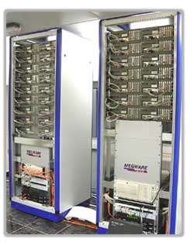
Games State Space Sizes
On average, there are ~35 possible moves that a chess player can make from any board configuration…
0 Ply
1 Ply
18 Ply!!
2 Ply
Branching Factor Estimates
for different two-player games
Tic-tac-toe 4
Connect Four 7
Checkers 10
Othello 30
Chess 35
Go 300
Hydra at home in the United Arab Emirates…

Slide 56
Games State Space Sizes
On average, there are ~35 possible moves that a chess player can make from any board configuration…
0 Ply
1 Ply
2 Ply
Branching Factor Estimates
for different two-player games
Tic-tac-toe 4
Connect Four 7
Checkers 10
Othello 30
Chess 35
Go 300
Boundaries for qualitatively different games…

Slide 57
Games State Space Sizes
On average, there are ~35 possible moves that a chess player can make from any board configuration…
0 Ply
1 Ply
2 Ply
Branching Factor Estimates
for different two-player games
Can search entire space
Tic-tac-toe 4
Connect Four 7
Checkers 10
Othello 30
Chess 35
Go 300
“solved” games
CHINOOK (2007)
computer-dominated
Can’t ☹
human-dominated
What do we do?

Slide 58
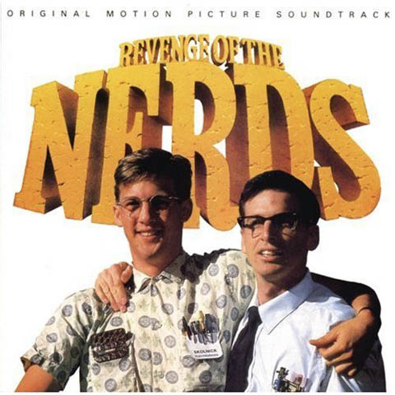
Alpha-Beta pruning

Slide 59
Games State Space Sizes
Pruning helps get a bit deeper
For many games, still can’t search the entire tree
Now what?
0 Ply
1 Ply
2 Ply
Branching Factor Estimates
for different two-player games
Tic-tac-toe 4
Connect Four 7
Checkers 10
Othello 30
Chess 35
Go 300
computer-dominated

Slide 60
Games State Space Sizes
Pruning helps get a bit deeper
For many games, still can’t search the entire tree
Go as deep as you can:
estimate the score/quality of the state (called an evaluation function)
use that instead of the real score
0 Ply
1 Ply
2 Ply
Branching Factor Estimates
for different two-player games
Tic-tac-toe 4
Connect Four 7
Checkers 10
Othello 30
Chess 35
Go 300
computer-dominated

Slide 61
Tic Tac Toe evaluation functions
O
X
X
O
Ideas?

Slide 62
Example Tic Tac Toe EVAL
Tic Tac Toe
Assume MAX is using “X”
EVAL(state) =
if state is win for MAX:
+ ∞
if state is win for MIN:
- ∞
else:
  (number of rows, columns and diagonals available to MAX) - (number of rows, columns and diagonals available to MIN)
X
O
= 6 - 4 = 2
O
X
X
O
= 4 - 3 = 1

Slide 63
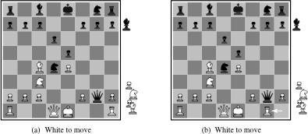
Chess evaluation functions
Ideas?

Slide 64
Chess EVAL
Assume each piece has the following values
  pawn = 1;
  knight = 3;
  bishop = 3;
  rook = 5;
  queen = 9;
EVAL(state) =
sum of the value of white pieces –
sum of the value of black pieces
= 31 - 36 = -5

Slide 65
Chess EVAL
Assume each piece has the following values
  pawn = 1;
  knight = 3;
  bishop = 3;
  rook = 5;
  queen = 9;
EVAL(state) =
sum of the value of white pieces –
sum of the value of black pieces
Any problems with this?

Slide 66
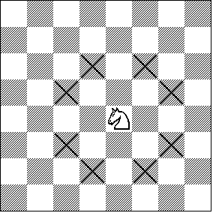
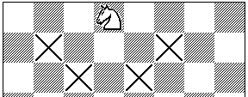
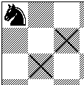
Chess EVAL
Ignores actual positions!
Actual heuristic functions are often
a weighted combination of features

Slide 67
Chess EVAL
number of pawns
number of attacked knights
1 if king has knighted, 0 otherwise
A feature can be any numerical information about the board
  as general as the number of pawns
  to specific board configurations
Deep Blue: 8000 features!

Slide 68
history/end-game tables
History
  keep track of the quality of moves from previous games
  use these instead of search
end-game tables
  do a reverse search of certain game configurations, for example all board configurations with king, rook and king
  tells you what to do in any configuration meeting this criterion
  if you ever see one of these during search, you lookup exactly what to do

Slide 69
end-game tables
Devastatingly good
Allows much deeper branching
  for example, if the end-game table encodes a 20-move finish and we can search up to 14
  can search up to depth 34
Stiller (1996) explored all end-games with 5 pieces
  one case check-mate required 262 moves!
Knoval (2006) explored all end-games with 6 pieces
  one case check-mate required 517 moves!
Traditional rules of chess require a capture or pawn move within 50 or it’s a stalemate

Slide 70
Opening moves
At the very beginning, we’re the farthest possible from any goal state
People are good with opening moves
Tons of books, etc. on opening moves
Most chess programs use a database of opening moves rather than search

