Slide 1
informed Search
David Kauchak
CS30 – Spring 2015

Slide 2
Admin
Assignment 8… how did it go?
Assignment 9
  Out later today
  Due Sunday at 11:59 pm
  Lab tomorrow is a work session. Make sure to read the handout and ideally start before then.
Office hours this week are posted on course web page

Slide 3
Schedule
Midterm next Tuesday (4/14)
  In-class
  Will focus on material since the second midterm up through today’s class
  Can use 2 pages of notes (like last time)
  I’ll post practice problems (as soon as I can ☺)
Review session: Monday, 5-6pm (location TBA)
No lab next week (4/15)
Pre-registration: We’ll talk about on Thursday

Slide 4
Other search problems
What problems have you seen that could be posed as search problems?
What is the state?
Start state
Goal state
State-space/transition between states

Slide 5
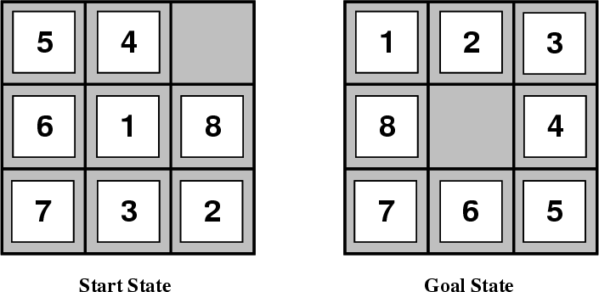
8-puzzle

Slide 6
8-puzzle
goal
state representation?
start state?
state-space/transitions?

Slide 7
8-puzzle
state:
  all 3 x 3 configurations of the tiles on the board
transitions between states:
  Move Blank Square Left, Right, Up or Down.
  This is a more efficient encoding than moving each of the 8 distinct tiles

Slide 8
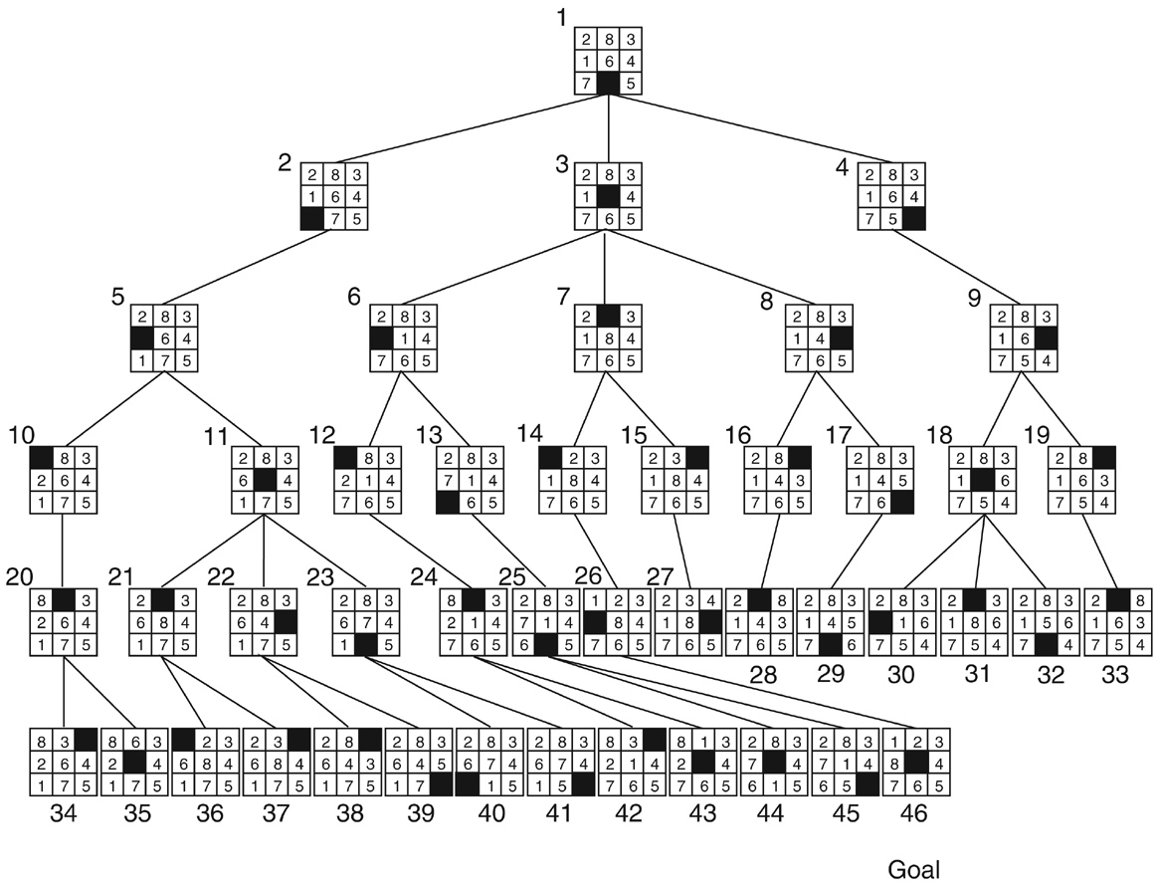

Slide 9
Cryptarithmetic
Find an assignment of digits (0, ..., 9) to letters so that a given arithmetic expression is true. examples:
SEND + MORE = MONEY
    FORTY Solution: 29786
    + TEN 850
    + TEN 850
    ----- -----
    SIXTY 31486
    F=2, O=9, R=7, etc.

Slide 10
Remove 5 Sticks
Given the following configuration of sticks, remove exactly 5 sticks in such a way that the remaining configuration forms exactly 3 squares.

Slide 11
Water Jug Problem
Given a full 5-gallon jug and a full 2-gallon jug, fill the 2-gallon jug with exactly one gallon of water.
5
2

Slide 12
Water Jug Problem
State = (x,y), where x is the number of gallons of water in the 5-gallon jug and y is # of gallons in the 2-gallon jug
Initial State = (5,2)
Goal State = (*,1), where * means any amount
Operator table
5
Name | Cond. | Transition | Effect
Empty5 | – | (x,y)→(0,y) | Empty 5-gal. jug
Empty2 | – | (x,y)→(x,0) | Empty 2-gal. jug
2to5 | x ≤ 3 | (x,2)→(x+2,0) | Pour 2-gal. into 5-gal.
5to2 | x ≥ 2 | (x,0)→(x-2,2) | Pour 5-gal. into 2-gal.
5to2part | y < 2 | (1,y)→(0,y+1) | Pour partial 5-gal. into 2-gal.
2

Slide 13
8-puzzle revisited
How hard is this problem?
1
3
8
4
7
6
5
2

Slide 14
8-puzzle revisited
The average depth of a solution for an 8-puzzle is 22 moves
An exhaustive search requires searching ~3²² = 3.1 x 10¹⁰ states
  BFS: 10 terabytes of memory
  DFS: 8 hours (assuming one million nodes/second)
Can we do better?
Is DFS and BFS intelligent?
1
3
8
4
7
6
5
2

Slide 15
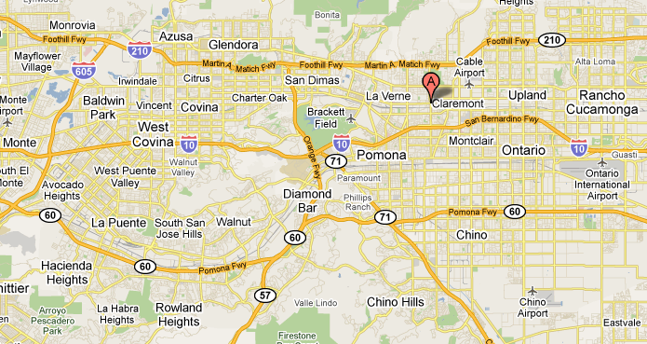
from: Claremont to:Rowland Heights
How do you think google maps does it?

Slide 16
from: Claremont to:Rowland Heights
What would the search algorithms do?

Slide 17
from: Claremont to:Rowland Heights
DFS

Slide 18
from: Claremont to:Rowland Heights
BFS

Slide 19
from: Claremont to: Rowland Heights
Ideas?

Slide 20
from: Claremont to: Rowland Heights
We’d like to bias search towards the actual solution

Slide 21
Informed search
Order to_visit based on some knowledge of the world that estimates how “good” a state is
  h(n) is called an evaluation function
Best-first search
  rank to_visit based on h(n)
  take the most desirable state in to_visit first
  different approaches depending on how we define h(n)

Slide 22
Heuristic
Merriam-Webster's Online Dictionary
  Heuristic (pron. \hyu-’ris-tik\): adj. [from Greek heuriskein to discover.] involving or serving as an aid to learning, discovery, or problem-solving by experimental and especially trial-and-error methods
The Free On-line Dictionary of Computing (2/19/13)
  heuristic 1. Of or relating to a usually speculative formulation serving as a guide in the investigation or solution of a problem: "The historian discovers the past by the judicious use of such a heuristic device as the 'ideal type'" (Karl J. Weintraub).

Slide 23
Heuristic function: h(n)
An estimate of how close the node is to a goal
Uses domain-specific knowledge!
Examples
  Map path finding?
    straight-line distance from the node to the goal (“as the crow flies”)
  8-puzzle?
    how many tiles are out of place
    sum of the “distances” of the out of place tiles
  Missionaries and cannibals?
    number of people on the starting bank

Slide 24
Two heuristics
2 | 8 | 3
1 | 6 | 4
 | 7 | 5
1 | 2 | 3
8 |  | 4
7 | 6 | 5
1 | 2 | 3
8 | 6 | 4
 | 7 | 5
Which state is better?
GOAL
6 | 2 | 3
8 |  | 4
7 | 1 | 5

Slide 25
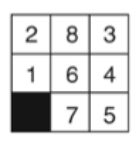

Two heuristics
How many tiles are out of place?

Slide 26
Two heuristics
5

Slide 27
Two heuristics
What is the “distance” of the tiles that are out of place?

Slide 28
Two heuristics
1
2
1
1
1
6

Slide 29
Two heuristics
Tiles out of place
Sum of distances for out of place tiles
2 | 8 | 3
1 | 6 | 4
 | 7 | 5
5
6
1 | 2 | 3
8 |  | 4
7 | 6 | 5
1 | 2 | 3
8 | 6 | 4
 | 7 | 5
?
GOAL
6 | 2 | 3
8 |  | 4
7 | 1 | 5

Slide 30
Two heuristics
Tiles out of place
Sum of distances for out of place tiles
2 | 8 | 3
1 | 6 | 4
 | 7 | 5
5
6
1 | 2 | 3
8 |  | 4
7 | 6 | 5
1 | 2 | 3
8 | 6 | 4
 | 7 | 5
2
2
GOAL
1
1
6 | 2 | 3
8 |  | 4
7 | 1 | 5
3
2
6
3

Slide 31
Two heuristics
Tiles out of place
Sum of distances for out of place tiles
2 | 8 | 3
1 | 6 | 4
 | 7 | 5
5
6
Which heuristic is better (if either)?
1 | 2 | 3
8 |  | 4
7 | 6 | 5
1 | 2 | 3
8 | 6 | 4
 | 7 | 5
2
3
GOAL
2
1
6 | 2 | 3
8 |  | 4
7 | 1 | 5
3
2
6
3

Slide 32
Two heuristics
Tiles out of place
Sum of distances for out of place tiles
2 | 8 | 3
1 | 6 | 4
 | 7 | 5
5
6
More closely approximates “real” number of steps remaining?
1 | 2 | 3
8 |  | 4
7 | 6 | 5
1 | 2 | 3
8 | 6 | 4
 | 7 | 5
2
3
GOAL
2
1
6 | 2 | 3
8 |  | 4
7 | 1 | 5
3
2
6
3

Slide 33
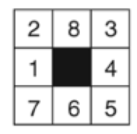
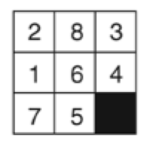
Two heuristics
Tiles out of place
Sum of distances for out of place tiles
5
6
1
2
3
4
1
1
2
5
6
1
1
1

Slide 34
2 | 8 | 3
1 | 6 | 4
7 |  | 5
Next states?

Slide 35
2 | 8 | 3
1 | 6 | 4
7 |  | 5
2 | 8 | 3
1 | 6 | 4
 | 7 | 5
2 | 8 | 3
1 |  | 4
7 | 6 | 5
2 | 8 | 3
1 | 6 | 4
7 | 5
Which would you do?

Slide 36
2 | 8 | 3
1 | 6 | 4
7 |  | 5
2 | 8 | 3
1 | 6 | 4
 | 7 | 5
2 | 8 | 3
1 |  | 4
7 | 6 | 5
2 | 8 | 3
1 | 6 | 4
7 | 5
Which would DFS choose
Completely depends on how next states are generated.
Not an “intelligent” decision!

Slide 37
1 | 2 | 3
8 |  | 4
7 | 6 | 5
2 | 8 | 3
1 | 6 | 4
7 |  | 5
GOAL
2 | 8 | 3
1 | 6 | 4
 | 7 | 5
2 | 8 | 3
1 |  | 4
7 | 6 | 5
2 | 8 | 3
1 | 6 | 4
7 | 5
Best first search: out of place tiles?

Slide 38
1 | 2 | 3
8 |  | 4
7 | 6 | 5
2 | 8 | 3
1 | 6 | 4
7 |  | 5
GOAL
2 | 8 | 3
1 | 6 | 4
 | 7 | 5
2 | 8 | 3
1 |  | 4
7 | 6 | 5
2 | 8 | 3
1 | 6 | 4
7 | 5
1
2
1
2
1
2
6
4
6
1
1
1
1
1
1
1
Best first search: distance of tiles?

Slide 39
1 | 2 | 3
8 |  | 4
7 | 6 | 5
2 | 8 | 3
1 | 6 | 4
7 |  | 5
GOAL
2 | 8 | 3
1 | 6 | 4
 | 7 | 5
2 | 8 | 3
1 |  | 4
7 | 6 | 5
2 | 8 | 3
1 | 6 | 4
7 | 5
Next states?

Slide 40
1 | 2 | 3
8 |  | 4
7 | 6 | 5
2 | 8 | 3
1 | 6 | 4
7 |  | 5
GOAL
2 | 8 | 3
1 | 6 | 4
 | 7 | 5
2 | 8 | 3
1 |  | 4
7 | 6 | 5
2 | 8 | 3
1 | 6 | 4
7 | 5
1
2
6
4
6
1
2 |  | 3
1 | 8 | 4
7 | 6 | 5
2 | 8 | 3
 | 1 | 4
7 | 6 | 5
2 | 8 | 3
1 | 6 | 4
7 |  | 5
2 | 8 | 3
1 | 4
7 | 6 | 5
3
5
5
5
Which next for best first search?

Slide 41
1 | 2 | 3
8 |  | 4
7 | 6 | 5
2 | 8 | 3
1 | 6 | 4
7 |  | 5
GOAL
2 | 8 | 3
1 | 6 | 4
 | 7 | 5
2 | 8 | 3
1 |  | 4
7 | 6 | 5
2 | 8 | 3
1 | 6 | 4
7 | 5
1
2
4
1
2 |  | 3
1 | 8 | 4
7 | 6 | 5
2 | 8 | 3
 | 1 | 4
7 | 6 | 5
2 | 8 | 3
1 | 6 | 4
7 |  | 5
2 | 8 | 3
1 | 4
7 | 6 | 5
3
5
5
5
 | 2 | 3
1 | 8 | 4
7 | 6 | 5
2 | 8 | 3
1 |  | 4
7 | 6 | 5
2 | 3
1 | 8 | 4
7 | 6 | 5
2
4
4

Slide 42
1 | 2 | 3
8 |  | 4
7 | 6 | 5
2 | 8 | 3
1 | 6 | 4
7 |  | 5
GOAL
2 | 8 | 3
1 | 6 | 4
 | 7 | 5
2 | 8 | 3
1 |  | 4
7 | 6 | 5
2 | 8 | 3
1 | 6 | 4
7 | 5
1
2
4
1
2 |  | 3
1 | 8 | 4
7 | 6 | 5
2 | 8 | 3
 | 1 | 4
7 | 6 | 5
2 | 8 | 3
1 | 6 | 4
7 |  | 5
2 | 8 | 3
1 | 4
7 | 6 | 5
3
5
5
5
 | 2 | 3
1 | 8 | 4
7 | 6 | 5
2 | 8 | 3
1 |  | 4
7 | 6 | 5
2 | 3
1 | 8 | 4
7 | 6 | 5
2
4
4
…

Slide 43
Informed search algorithms
Best first search is called an “informed” search algorithm
Why wouldn’t we always use an informed algorithm?
  Coming up with good heuristics can be hard for some problems
  There is computational overhead (both in calculating the heuristic and in keeping track of the next “best” state)

Slide 44
Informed search algorithms
Any other problems/concerns about best first search?

Slide 45
Informed search algorithms
Any other problems/concerns about best first search?
  Only as good as the heuristic function
START
GOAL
Best first search using distance as the crow flies as heuristic
What would the search do?

Slide 46
Informed search algorithms
Any other problems/concerns about best first search?
  Only as good as the heuristic function
START
GOAL
Best first search using distance as the crow flies as heuristic
What is the problem?

Slide 47
Informed search algorithms
Any other problems/concerns about best first search?
  Only as good as the heuristic function
START
GOAL
Best first search using distance as the crow flies as heuristic
Doesn’t take into account how far it’s come.
Best first search is a “greedy” algorithm

Slide 48
Informed search algorithms
Best first search is called an “informed” search algorithm
There are many other informed search algorithms:
  A* search (and variants)
  Theta*
  Beam search

Slide 49
Sudoku
 | 4 | 3 |  |  |  | 6 | 7
5 |  |  | 4 |  | 2 |  |  | 8
8 |  |  |  | 6 |  |  |  | 1
2 |  |  |  |  |  |  |  | 5
 | 5 |  |  |  |  |  | 4
 |  | 6 |  |  |  | 7
 |  |  | 5 |  | 1
 |  |  |  | 8
Fill in the grid with the numbers 1-9
  each row has 1-9 (without repetition)
  each column has 1-9 (without repetition)
  each quadrant has 1-9 (without repetition)

Slide 50
Sudoku
7 | 2 | 8 | 9 | 3 | 6 | 5 | 1 | 4
9 | 4 | 3 | 1 | 5 | 8 | 6 | 7 | 2
5 | 6 | 1 | 4 | 7 | 2 | 9 | 3 | 8
8 | 3 | 4 | 7 | 6 | 5 | 2 | 9 | 1
2 | 1 | 7 | 8 | 4 | 9 | 3 | 6 | 5
6 | 5 | 9 | 2 | 1 | 3 | 8 | 4 | 7
1 | 8 | 6 | 3 | 2 | 4 | 7 | 5 | 9
3 | 7 | 2 | 5 | 9 | 1 | 4 | 8 | 6
4 | 9 | 5 | 6 | 8 | 7 | 1 | 2 | 3
Fill in the grid with the numbers 1-9
  each row has 1-9 (without repetition)
  each column has 1-9 (without repetition)
  each quadrant has 1-9 (without repetition)

Slide 51
Sudoku
 | 4 | 3 |  |  |  | 6 | 7
5 |  |  | 4 |  | 2 |  |  | 8
8 |  |  |  | 6 |  |  |  | 1
2 |  |  |  |  |  |  |  | 5
 | 5 |  |  |  |  |  | 4
 |  | 6 |  |  |  | 7
 |  |  | 5 |  | 1
 |  |  |  | 8
How can we pose this as a search problem?
State
Start state
Goal state
State space/transitions
Fill in the grid with the numbers 1-9
  each row has 1-9 (without repetition)
  each column has 1-9 (without repetition)
  each quadrant has 1-9 (without repetition)

Slide 52
Sudoku
 | 4 | 3 |  |  |  | 6 | 7
5 |  |  | 4 |  | 2 |  |  | 8
8 |  |  |  | 6 |  |  |  | 1
2 |  |  |  |  |  |  |  | 5
 | 5 |  |  |  |  |  | 4
 |  | 6 |  |  |  | 7
 |  |  | 5 |  | 1
 |  |  |  | 8
How can we pose this as a search problem?
State: 9 x 9 grid with 1-9 or empty
Start state:
Goal state:
State space/transitions
Fill in the grid with the numbers 1-9
  each row has 1-9 (without repetition)
  each column has 1-9 (without repetition)
  each quadrant has 1-9 (without repetition)

Slide 53
Sudoku
 | 4 | 3 |  |  |  | 6 | 7
5 |  |  | 4 |  | 2 |  |  | 8
8 |  |  |  | 6 |  |  |  | 1
2 |  |  |  |  |  |  |  | 5
 | 5 |  |  |  |  |  | 4
 |  | 6 |  |  |  | 7
 |  |  | 5 |  | 1
 |  |  |  | 8
Generate next states:
pick an open entry
try all possible numbers that meet constraints
Fill in the grid with the numbers 1-9
  each row has 1-9 (without repetition)
  each column has 1-9 (without repetition)
  each quadrant has 1-9 (without repetition)

Slide 54
Sudoku
 | 4 | 3 |  |  |  | 6 | 7
5 |  |  | 4 |  | 2 |  |  | 8
8 |  |  |  | 6 |  |  |  | 1
2 |  |  |  |  |  |  |  | 5
 | 5 |  |  |  |  |  | 4
 |  | 6 |  |  |  | 7
 |  |  | 5 |  | 1
 |  |  |  | 8
Generate next states:
pick an open entry
try all possible numbers that meet constraints
How many next states?
What are they?
Fill in the grid with the numbers 1-9
  each row has 1-9 (without repetition)
  each column has 1-9 (without repetition)
  each quadrant has 1-9 (without repetition)

Slide 55
Sudoku
 | 4 | 3 |  |  |  | 6 | 7
5 |  |  | 4 |  | 2 |  |  | 8
8 |  |  |  | 6 |  |  |  | 1
2 |  |  |  |  |  |  |  | 5
 | 5 |  |  |  |  |  | 4
 |  | 6 |  |  |  | 7
 |  |  | 5 |  | 1
 |  |  |  | 8
Generate next states:
pick an open entry
try all possible numbers that meet constraints
1, 6, 7, 9
Fill in the grid with the numbers 1-9
  each row has 1-9 (without repetition)
  each column has 1-9 (without repetition)
  each quadrant has 1-9 (without repetition)

Slide 56
Sudoku
1
 | 4 | 3 |  |  |  | 6 | 7
5 |  |  | 4 |  | 2 |  |  | 8
8 |  |  |  | 6 |  |  |  | 1
2 |  |  |  |  |  |  |  | 5
 | 5 |  |  |  |  |  | 4
 |  | 6 |  |  |  | 7
 |  |  | 5 |  | 1
 |  |  |  | 8
Generate next states:
pick an open entry
try all possible numbers that meet constraints
1, 6, 7, 9
Fill in the grid with the numbers 1-9
  each row has 1-9 (without repetition)
  each column has 1-9 (without repetition)
  each quadrant has 1-9 (without repetition)

Slide 57
Sudoku
1
 | 4 | 3 |  |  |  | 6 | 7
5 |  |  | 4 |  | 2 |  |  | 8
8 |  |  |  | 6 |  |  |  | 1
2 |  |  |  |  |  |  |  | 5
 | 5 |  |  |  |  |  | 4
 |  | 6 |  |  |  | 7
 |  |  | 5 |  | 1
 |  |  |  | 8
Generate next states:
pick an open entry
try all possible numbers that meet constraints
How many next states?
What are they?
Fill in the grid with the numbers 1-9
  each row has 1-9 (without repetition)
  each column has 1-9 (without repetition)
  each quadrant has 1-9 (without repetition)

Slide 58
Sudoku
1
 | 4 | 3 |  |  |  | 6 | 7
5 |  |  | 4 |  | 2 |  |  | 8
8 |  |  |  | 6 |  |  |  | 1
2 |  |  |  |  |  |  |  | 5
 | 5 |  |  |  |  |  | 4
 |  | 6 |  |  |  | 7
 |  |  | 5 |  | 1
 |  |  |  | 8
Generate next states:
pick an open entry
try all possible numbers that meet constraints
2, 6, 7, 8, 9
Fill in the grid with the numbers 1-9
  each row has 1-9 (without repetition)
  each column has 1-9 (without repetition)
  each quadrant has 1-9 (without repetition)

Slide 59
Sudoku
1 | 2
 | 4 | 3 |  |  |  | 6 | 7
5 |  |  | 4 |  | 2 |  |  | 8
8 |  |  |  | 6 |  |  |  | 1
2 |  |  |  |  |  |  |  | 5
 | 5 |  |  |  |  |  | 4
 |  | 6 |  |  |  | 7
 |  |  | 5 |  | 1
 |  |  |  | 8
Generate next states:
pick an open entry
try all possible numbers that meet constraints
2, 6, 7, 8, 9
Fill in the grid with the numbers 1-9
  each row has 1-9 (without repetition)
  each column has 1-9 (without repetition)
  each quadrant has 1-9 (without repetition)

Slide 60
Sudoku
1 | 2
 | 4 | 3 |  |  |  | 6 | 7
5 |  |  | 4 |  | 2 |  |  | 8
8 |  |  |  | 6 |  |  |  | 1
2 |  |  |  |  |  |  |  | 5
 | 5 |  |  |  |  |  | 4
 |  | 6 |  |  |  | 7
 |  |  | 5 |  | 1
 |  |  |  | 8
Generate next states:
pick an open entry
try all possible numbers that meet constraints
What are the next states?
Fill in the grid with the numbers 1-9
  each row has 1-9 (without repetition)
  each column has 1-9 (without repetition)
  each quadrant has 1-9 (without repetition)

Slide 61
Sudoku
1 | 2
 | 4 | 3 |  |  |  | 6 | 7
5 |  |  | 4 |  | 2 |  |  | 8
8 |  |  |  | 6 |  |  |  | 1
2 |  |  |  |  |  |  |  | 5
 | 5 |  |  |  |  |  | 4
 |  | 6 |  |  |  | 7
 |  |  | 5 |  | 1
 |  |  |  | 8
Generate next states:
pick an open entry
try all possible numbers that meet constraints
7, 8, 9
Fill in the grid with the numbers 1-9
  each row has 1-9 (without repetition)
  each column has 1-9 (without repetition)
  each quadrant has 1-9 (without repetition)

Slide 62
Sudoku
1 | 2 | 7
 | 4 | 3 |  |  |  | 6 | 7
5 |  |  | 4 |  | 2 |  |  | 8
8 |  |  |  | 6 |  |  |  | 1
2 |  |  |  |  |  |  |  | 5
 | 5 |  |  |  |  |  | 4
 |  | 6 |  |  |  | 7
 |  |  | 5 |  | 1
 |  |  |  | 8
Generate next states:
pick an open entry
try all possible numbers that meet constraints
7, 8, 9
Fill in the grid with the numbers 1-9
  each row has 1-9 (without repetition)
  each column has 1-9 (without repetition)
  each quadrant has 1-9 (without repetition)

Slide 63
Sudoku
1 | 2 | 7
 | 4 | 3 |  |  |  | 6 | 7
5 |  |  | 4 |  | 2 |  |  | 8
8 |  |  |  | 6 |  |  |  | 1
2 |  |  |  |  |  |  |  | 5
 | 5 |  |  |  |  |  | 4
 |  | 6 |  |  |  | 7
 |  |  | 5 |  | 1
 |  |  |  | 8
Generate next states:
pick an open entry
try all possible numbers that meet constraints
7, 8, 9
Fill in the grid with the numbers 1-9
  each row has 1-9 (without repetition)
  each column has 1-9 (without repetition)
  each quadrant has 1-9 (without repetition)

Slide 64
Sudoku
1 | 2 | 7
9 | 4 | 3 |  |  |  | 6 | 7
5 |  |  | 4 |  | 2 |  |  | 8
8 |  |  |  | 6 |  |  |  | 1
2 |  |  |  |  |  |  |  | 5
 | 5 |  |  |  |  |  | 4
 |  | 6 |  |  |  | 7
 |  |  | 5 |  | 1
 |  |  |  | 8
Generate next states:
pick an open entry
try all possible numbers that meet constraints
Fill in the grid with the numbers 1-9
  each row has 1-9 (without repetition)
  each column has 1-9 (without repetition)
  each quadrant has 1-9 (without repetition)

Slide 65
Sudoku
1 | 2 | 7
9 | 4 | 3 |  |  |  | 6 | 7
5 |  |  | 4 |  | 2 |  |  | 8
8 |  |  |  | 6 |  |  |  | 1
2 |  |  |  |  |  |  |  | 5
 | 5 |  |  |  |  |  | 4
 |  | 6 |  |  |  | 7
 |  |  | 5 |  | 1
 |  |  |  | 8
Generate next states:
pick an open entry
try all possible numbers that meet constraints
Now what?
Try another branch, i.e. go back to a place where we had a decision and try a different one
Fill in the grid with the numbers 1-9
  each row has 1-9 (without repetition)
  each column has 1-9 (without repetition)
  each quadrant has 1-9 (without repetition)

Slide 66
Sudoku
1 | 2 | 8
 | 4 | 3 |  |  |  | 6 | 7
5 |  |  | 4 |  | 2 |  |  | 8
8 |  |  |  | 6 |  |  |  | 1
2 |  |  |  |  |  |  |  | 5
 | 5 |  |  |  |  |  | 4
 |  | 6 |  |  |  | 7
 |  |  | 5 |  | 1
 |  |  |  | 8
Generate next states:
pick an open entry
try all possible numbers that meet constraints
7, 8, 9
Fill in the grid with the numbers 1-9
  each row has 1-9 (without repetition)
  each column has 1-9 (without repetition)
  each quadrant has 1-9 (without repetition)

Slide 67
Best first Sudoku search
DFS and BFS will choose entries (and numbers within those entries) randomly
Is that how people do it?
How do you do it?
Heuristics for best first search?
Generate next states:
pick an open entry
try all possible numbers that meet constraints

Slide 68
Best first Sudoku search
DFS and BFS will choose entries (and numbers within those entries) randomly
Pick the entry that is MOST constrained
People often try and find entries where only one option exists and only fill it in that way (very little search)
Generate next states:
pick an open entry
try all possible numbers that meet constraints

Slide 69
Representing the Sudoku board
 | 4 | 3 |  |  |  | 6 | 7
5 |  |  | 4 |  | 2 |  |  | 8
8 |  |  |  | 6 |  |  |  | 1
2 |  |  |  |  |  |  |  | 5
 | 5 |  |  |  |  |  | 4
 |  | 6 |  |  |  | 7
 |  |  | 5 |  | 1
 |  |  |  | 8
[1, 6, 7, 9], [1, 2, 6, 7, 8, 9], [1, 2, 7, 8, 9],
[1, 9], 4, 3,
5, [1, 6, 7, 9], [1, 7, 9]
Which is the most constrained (of the ones above)?
Board is a matrix (list of lists)
Each entry is either:
  a number (if we’ve filled in the space already, either during search or as part of the starting state)
  a list of numbers that are valid to put in that entry if it hasn’t been filled in yet

Slide 70
Representing the Sudoku board
 | 4 | 3 |  |  |  | 6 | 7
5 |  |  | 4 |  | 2 |  |  | 8
8 |  |  |  | 6 |  |  |  | 1
2 |  |  |  |  |  |  |  | 5
 | 5 |  |  |  |  |  | 4
 |  | 6 |  |  |  | 7
 |  |  | 5 |  | 1
 |  |  |  | 8
[1, 6, 7, 9], [1, 2, 6, 7, 8, 9], [1, 2, 7, 8, 9],
[1, 9], 4, 3,
5, [1, 6, 7, 9], [1, 7, 9]
Which is the most constrained (of the ones above)?
Board is a matrix (list of lists)
Each entry is either:
  a number (if we’ve filled in the space already, either during search or as part of the starting state)
  a list of numbers that are valid to put in that entry if it hasn’t been filled in yet

