Slide 1
Search algorithms
David Kauchak
CS30 – Spring 2015

Slide 2
What order will BFS and DFS visit the states assuming states are added to to_visit left to right?
add the start state to to_visit
Repeat
take a state off the to_visit list
if it’s the goal state
we’re done!
if it’s not the goal state
Add all of the successive states to the to_visit list
1
2
3
4
5
6
7
8
9
Depth first search (DFS): to_visit is a stack
Breadth first search (BFS): to_visit is a queue

Slide 3
What order will BFS and DFS visit the states?
DFS:
1, 4, 3, 8, 7, 6, 9, 2, 5
1
2
3
4
Why not 1, 2, 5?
5
6
7
8
9
Depth first search (DFS): to_visit is a stack
Breadth first search (BFS): to_visit is a queue

Slide 4
What order will BFS and DFS visit the states?
DFS:
1, 4, 3, 8, 7, 6, 9, 2, 5
1
2
3
4
5
6
7
8
1
STACK
9
Depth first search (DFS): to_visit is a stack
Breadth first search (BFS): to_visit is a queue

Slide 5
What order will BFS and DFS visit the states?
DFS:
1, 4, 3, 8, 7, 6, 9, 2, 5
1
2
3
4
4
3
5
6
7
8
2
STACK
9
Depth first search (DFS): to_visit is a stack
Breadth first search (BFS): to_visit is a queue

Slide 6
What order will BFS and DFS visit the states?
DFS:
1, 4, 3, 8, 7, 6, 9, 2, 5
1
2
3
4
3
5
6
7
8
2
STACK
9
Depth first search (DFS): to_visit is a stack
Breadth first search (BFS): to_visit is a queue

Slide 7
What order will BFS and DFS visit the states?
DFS:
1, 4, 3, 8, 7, 6, 9, 5
1
BFS:
1, 2, 3, 4, 5
2
3
4
5
6
7
8
9
Depth first search (DFS): to_visit is a stack
Breadth first search (BFS): to_visit is a queue

Slide 8
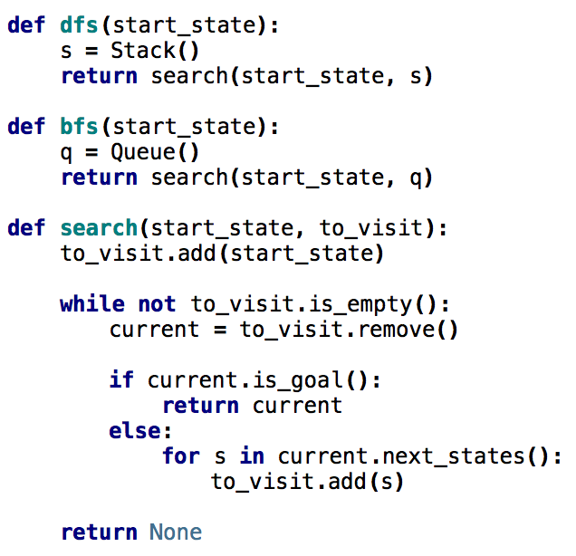
Search variants implemented
add the start state to to_visit
Repeat
take a state off the to_visit list
if it’s the goal state
we’re done!
if it’s not the goal state
Add all of the successive states to the to_visit list

Slide 9
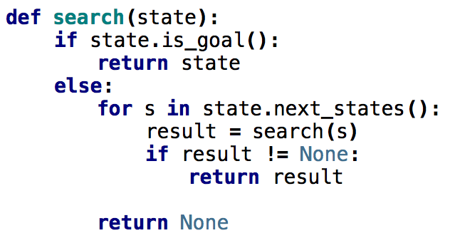
What order would this variant visit the states?
1
2
3
4
5
6
7
8
1, 2, 5
9

Slide 10
What order would this variant visit the states?
1
2
3
4
5
6
7
8
1, 2, 5, 3, 6, 9, 7, 8
9
What search algorithm is this?

Slide 11
What order would this variant visit the states?
1
2
3
4
5
6
7
8
1, 2, 5, 3, 6, 9, 7, 8
9
DFS!
Where’s the stack?

Slide 12
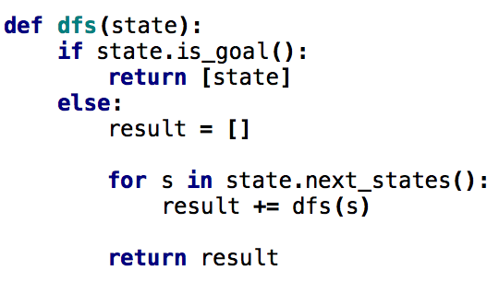
One last DFS variant
How is this different?

Slide 13
One last DFS variant
Returns ALL solutions found, not just one

Slide 14
Missionaries and Cannibals
Three missionaries and three cannibals wish to cross the river. They have a small boat that will carry up to two people. Everyone can navigate the boat. If at any time the Cannibals outnumber the Missionaries on either bank of the river, they will eat the Missionaries. Find the smallest number of crossings that will allow everyone to cross the river safely.
What is the “state” of this problem (it should capture all possible valid configurations)?

Slide 15
Missionaries and Cannibals
Three missionaries and three cannibals wish to cross the river. They have a small boat that will carry up to two people. Everyone can navigate the boat. If at any time the Cannibals outnumber the Missionaries on either bank of the river, they will eat the Missionaries. Find the smallest number of crossings that will allow everyone to cross the river safely.

Slide 16
Missionaries and Cannibals
Three missionaries and three cannibals wish to cross the river. They have a small boat that will carry up to two people. Everyone can navigate the boat. If at any time the Cannibals outnumber the Missionaries on either bank of the river, they will eat the Missionaries. Find the smallest number of crossings that will allow everyone to cross the river safely.
MMMCCC B
MMCC B MC
MC B MMCC
…

Slide 17
Searching for a solution
MMMCCC B ~~
What states can we get to from here?

Slide 18
Searching for a solution
MMMCCC B ~~
MMMC ~~ B CC
MMMCC ~~ B C
MMCC ~~ B MC
Next states?

Slide 19
Code!
http://www.cs.pomona.edu/~dkauchak/classes/cs30/examples/cannibals.txt

Slide 20
Talk about copy.deepcopy

Slide 21
Missionaries and Cannibals Solution
Near side Far side
0 Initial setup: MMMCCC B -
1 Two cannibals cross over: MMMC B CC
2 One comes back: MMMCC B C
3 Two cannibals go over again: MMM B CCC
4 One comes back: MMMC B CC
5 Two missionaries cross: MC B MMCC
6 A missionary & cannibal return: MMCC B MC
7 Two missionaries cross again: CC B MMMC
8 A cannibal returns: CCC B MMM
9 Two cannibals cross: C B MMMCC
10 One returns: CC B MMMC
11 And brings over the third: - B MMMCCC
How is this solution different than the n-queens problem?

Slide 22
Missionaries and Cannibals Solution
Near side Far side
0 Initial setup: MMMCCC B -
1 Two cannibals cross over: MMMC B CC
2 One comes back: MMMCC B C
3 Two cannibals go over again: MMM B CCC
4 One comes back: MMMC B CC
5 Two missionaries cross: MC B MMCC
6 A missionary & cannibal return: MMCC B MC
7 Two missionaries cross again: CC B MMMC
8 A cannibal returns: CCC B MMM
9 Two cannibals cross: C B MMMCC
10 One returns: CC B MMMC
11 And brings over the third: - B MMMCCC
Solution is not a state, but a sequence of actions (or a sequence of states)

Slide 23
One other problem
MMMCCC B ~~
MMMC ~~ B CC
MMMCC ~~ B C
MMCC ~~ B MC
MMMCCC B~~
MMMCC B~~ C
MMMCCC B~~
What would happen if we ran DFS here?

Slide 24
One other problem
MMMCCC B ~~
MMMC ~~ B CC
MMMCC ~~ B C
MMCC ~~ B MC
MMMCCC B~~
MMMCC B~~ C
MMMCCC B~~
If we always go left first, will continue forever!

Slide 25
One other problem
MMMCCC B ~~
MMMC ~~ B CC
MMMCC ~~ B C
MMCC ~~ B MC
MMMCCC B~~
MMMCC B~~ C
MMMCCC B~~
Does BFS have this problem?
No!

Slide 26
DFS vs. BFS
Why do we use DFS then, and not BFS?

Slide 27
DFS vs. BFS
1
Consider a search problem where each state has two states you can reach
Assume the goal state involves 20 actions, i.e. moving between ~20 states
2
3
4
5
6
7
…
How big can the queue get for BFS?

Slide 28
DFS vs. BFS
1
Consider a search problem where each state has two states you can reach
Assume the goal state involves 20 actions, i.e. moving between ~20 states
2
3
4
5
6
7
…
At any point, need to remember roughly a “row”

Slide 29
DFS vs. BFS
1
Consider a search problem where each state has two states you can reach
Assume the goal state involves 20 actions, i.e. moving between ~20 states
2
3
4
5
6
7
…
How big does this get?

Slide 30
DFS vs. BFS
1
Consider a search problem where each state has two states you can reach
Assume the goal state involves 20 actions, i.e. moving between ~20 states
2
3
4
5
6
7
…
Doubles every level we have to go deeper.
For 20 actions that is 2²⁰ = ~1 million states!

Slide 31
DFS vs. BFS
1
Consider a search problem where each state has two states you can reach
Assume the goal state involves 20 actions, i.e. moving between ~20 states
2
3
4
5
6
7
…
How many states would DFS keep on the stack?

Slide 32
DFS vs. BFS
1
Consider a search problem where each state has two states you can reach
Assume the goal state involves 20 actions, i.e. moving between ~20 states
2
3
4
5
6
7
…
Only one path through the tree, roughly 20 states

Slide 33
One other problem
MMMCCC B ~~
MMMC ~~ B CC
MMMCC ~~ B C
MMCC ~~ B MC
MMMCCC B~~
MMMCC B~~ C
MMMCCC B~~
If we always go left first, will continue forever!
Solution?

Slide 34
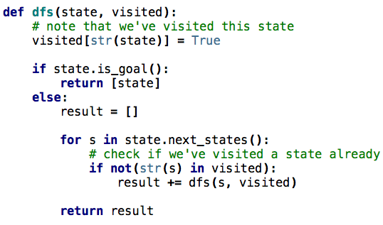
DFS avoiding repeats

